Slide 1
EE 451 Supervised Research Exposition (SRE) 3d Interactive Segmentation Guide: Prof. Amit Sethi

Slide 2
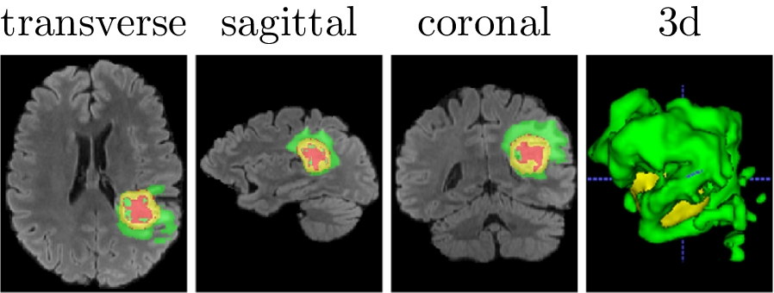
INTRODUCTION & CHALLENGES
Medical image segmentation is essential for diagnosis, surgical planning, AR-guided surgery, and treatment monitoring, but manual annotation remains slow, often 10–50 minutes per MRI series.
Radiology is highly resource-intensive; even partial automation for narrow segmentation tasks can save hospitals and patients millions of $$ annually.
Fully automatic systems cannot yet be trusted for clinically critical segmentation, so expert oversight is still necessary.
This motivates Interactive Segmentation, where the model performs most of the work and the user provides minimal corrective clicks-automatic AI + human corrections → reliable, clinically usable results.
This problem is not trivial to solve, a couple of challenges:
Sparse and costly annotations: Expert-labeled medical data is limited because annotations take a long time and require trained radiologists, leading to smaller, less diverse training datasets.
High clinical reliability requirement: Even small segmentation errors can affect diagnosis or treatment planning, so models must be extremely accurate and robust, much more than typical computer-vision tasks.
Low image quality & noise: MRI/CT scans often suffer from noise, motion artifacts, low contrast, and irregular shapes, which makes boundaries difficult for models to detect reliably.

Slide 3
Existing Research & Their Shortcomings

Slide 4
Classical interactive methods like Graph Cuts, Random Walker, and GeoS remain used but struggle with noisy scans, irregular shapes, and weak boundaries leading to slow workflows and limited accuracy. Deep learning has largely replaced them.
Modern deep learning models: Primarily encoder–decoder architectures achieve state-of-the-art performance across these segmentation tasks. These systems are powerful but fully automatic-We can’t have fully automatic systems in this application; they offer no mechanism for clinician intervention. For many clinical applications that requires expert validation or correction, purely automatic segmentation is insufficient.
Interactive deep learning systems attempt to combine model predictions with user feedback. Early systems used classical methods to refine automatic outputs, inheriting their limitations. Neural interactive systems accept images plus user masks, but training them is difficult because the input depends on previous outputs. Static Data Generation (SDG) builds user clicks before training, but does not reflect real sequential corrections and limits generalization.
Some other researchers have tried to build upon a memory which keeps all corrections between final image and first prediction. Existing works store all the interactions in the same mask, discarding the order of the interactions and hence the temporal information. We call such input structures Cumulative Interaction Memory (CIM).

Slide 5
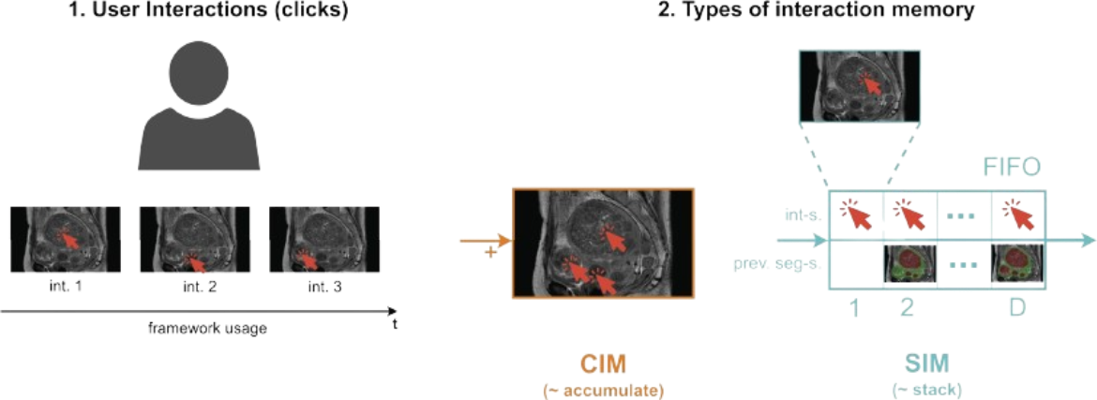
A Novel Idea by I. Mikhailov, B. Chauveau, N. Bourdel et al.
The researchers have proposed a new type of memory as opposed to CIM- they propose to use SIM (Sequential Interactive Memory)
SIM stores the ordered sequence of user clicks and corresponding segmentations, preserving interaction history. The network takes the image and SIM, produces a new segmentation, and then updates the SIM with the latest click and result for the next refinement.
Image source: https://www.sciencedirect.com/science/article/pii/S0169260724000348

Slide 6
SIM
How does the virtual user decide to place clicks (DDG Rules)
Every disconnected erroneous region is identified separately and are sorted on basis of size.
For each region, the virt. user can place up to max_clicks
Pick the center(centroid) of each region as click location
PSEUDO ALGO FOR PLACING CLICKS:
Set click probability p = 1
If p = 1: - Place initial click in each component
Else: - Place correction click in largest error region (per class) with probability p
“No click if random no generated is greater than p”
Update p ← p - 1/t
Skip a random class
Drop 80% of the simulated clicks
Create interaction mask M from clicks
Output: updated p and mask M
THESE CLICK MAPS along with initial predictions GO TO SIM
SIM tracks two things each round:
Click maps (user corrections)- 1 map/class
Class logits maps (model beliefs)- 1 map/class
Stacked over D rounds, they form the full model–user interaction history.
So, in total (1+1)*N*D=2DN maps, this is the size of SIM

Slide 7
U-Net–style encoder-decoder: Complete Model Pipeline
Encoder (Feature Extractor) – It receives only CT Scan + SIM stack.
The encoder is a ResNet34, modified to handle the increased input channels.
Normally, ResNet34 expects 3-channel RGB input.
This model replaces the first convolution (conv1) to accept (1 + 2*D*N) channels instead.
So the Encoder treats these as just channels and not intelligently as SIM, although data is of SIM.
Conv→ Pool→ Resnet_layer 1 → Layer 2→ Layer 3 → Layer 4
Feature maps from intermediate stages are saved as skip connections (used later in decoder)
Decoder (SIM-Guided Reconstruction) – It upsamples, fuses skip connections, and injects SIM
The decoder takes the deepest encoder feature and upsamples it stage-by-stage to recover spatial resolution.
At each stage, the upsampled feature is concatenated with the corresponding encoder skip feature, restoring lost anatomical detail.
The SIM memory (split into D states of shape (B, 2N, H, W)) is resized to match the current decoder stage resolution.

Slide 8
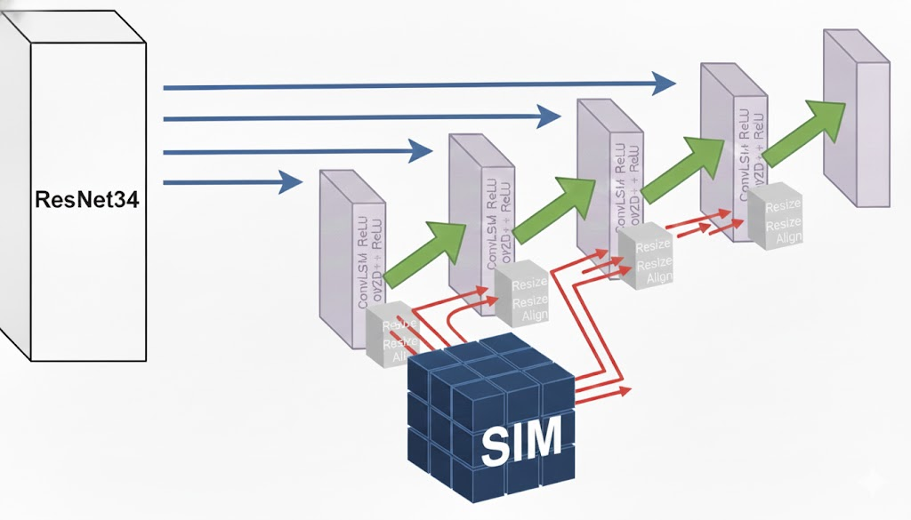
U-Net–style encoder-decoder: Complete Model Pipeline
Decoder contd…..
Each resized SIM state is passed through a 1×1 projection so its channel dimensions match the decoder feature map.
The projected SIM is added (residual fusion) to the visual feature map, injecting the user's interaction cues into the decoding process.
A ConvLSTM block iterates over all D SIM states, enabling sequential refinement and correction of segmentation errors.
After the final decoder stage, the output is upsampled to full resolution and passed through a 1×1 prediction head to produce the final segmentation map.
Image source: AI Generated

Slide 9
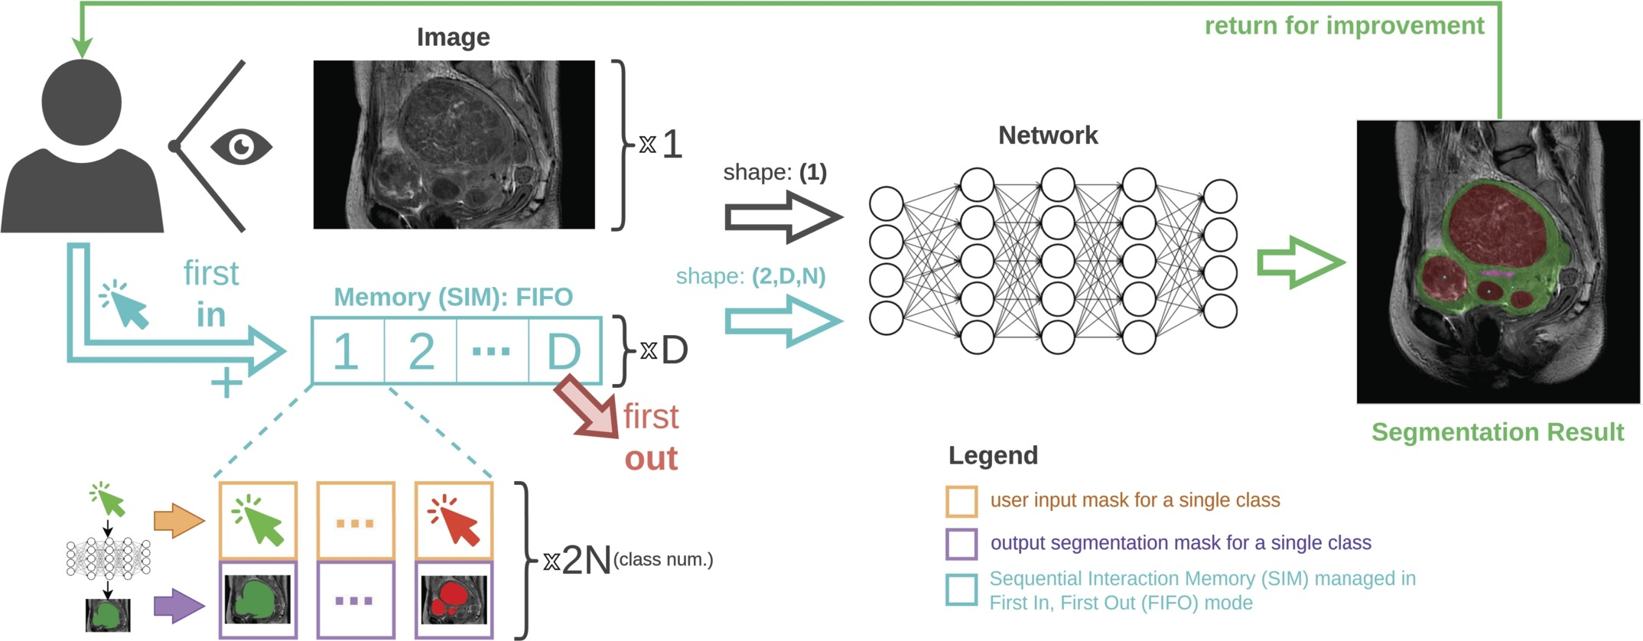
Complete Model Pipeline
Image source: https://www.sciencedirect.com/science/article/pii/S0169260724000348

Slide 10
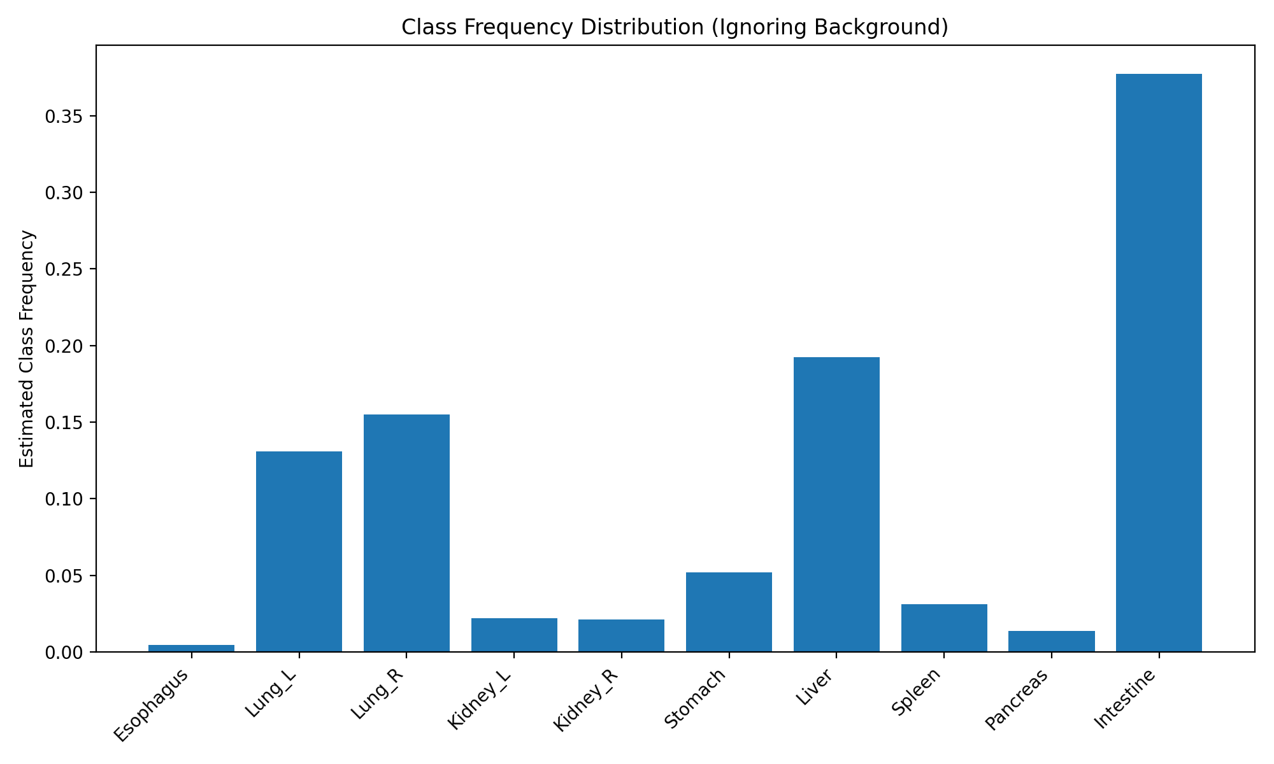
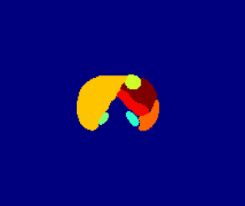
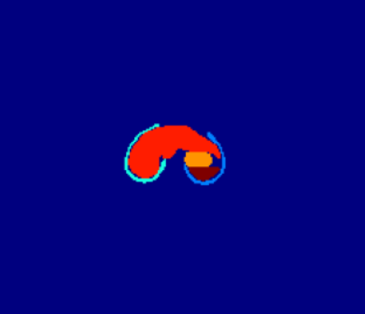
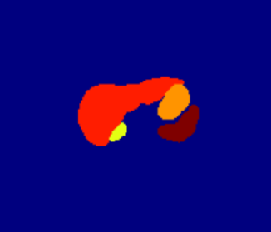
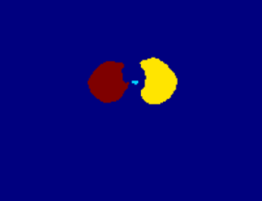
Dataset
The dataset used was obtained from Tata Memorial Hospital, and all CT scans were manually annotated by expert clinicians. For training, we used CT scans from 45 patients, where each scan contributed a variable number of slices (typically between 50 and 300). Total slices were 8064(train) + 896 (val) For testing, CT scans from 15 patients were used.
The background dominated the dataset and was penalized accordingly while computing loss
A Few Sample Annotated slices(Used in training)

Slide 11
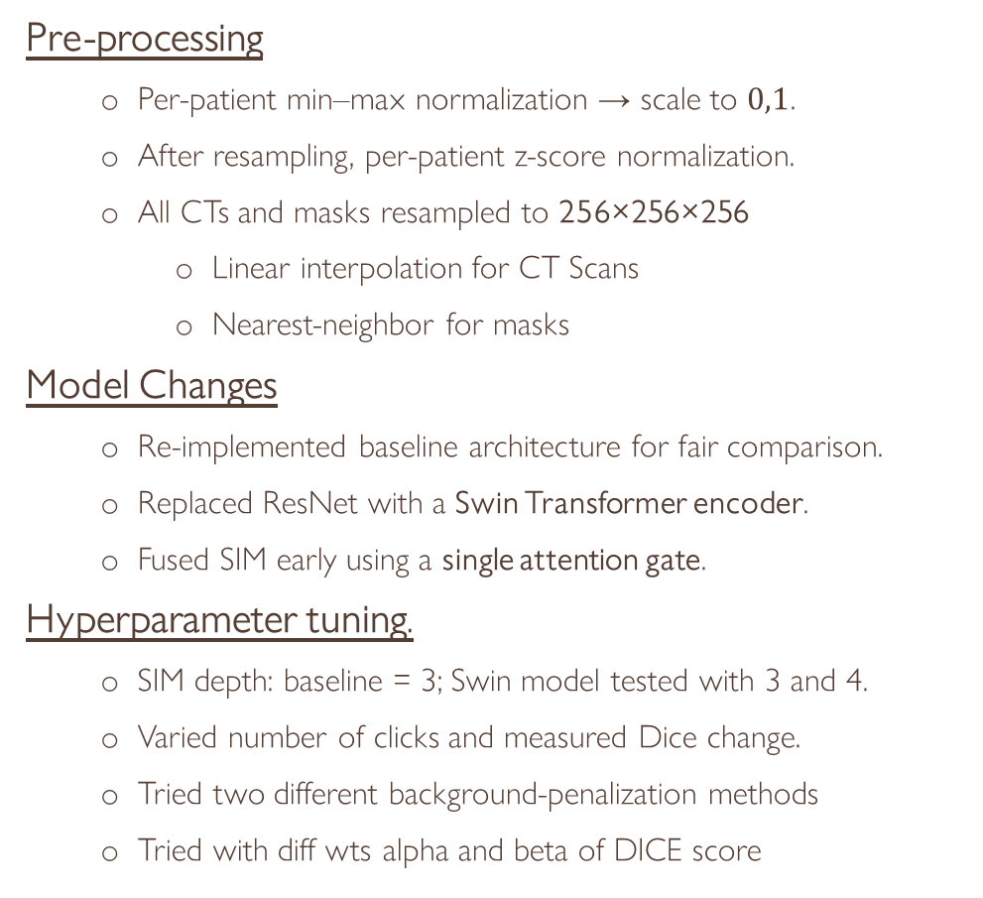
Methods & Experiments
Pre-processing
Per-patient min–max normalization → scale to $0,1$.
After resampling, per-patient z-score normalization.
All CTs and masks resampled to 256×256×256
Linear interpolation for CT Scans
Nearest-neighbor for masks
Model Changes
Re-implemented baseline architecture for fair comparison.
Replaced ResNet with a Swin Transformer encoder.
Fused SIM early using a single attention gate.
Hyperparameter tuning.
SIM depth: baseline = 3; Swin model tested with 3 and 4.
Varied number of clicks and measured Dice change.
Tried two different background-penalization methods
Tried with diff wts alpha and beta of DICE score
Loss functions
ResNet Baseline
Tested multiple losses: Dice only, Dice + CE, and Dice + Tversky (ComboLoss).
After experiments, Dice + Tversky gave the most stable gradients and best Dice performance.
Swin Transformer Model
Evaluated a wide range of losses including Dice, Dice+CE, Tversky, Dice+Tversky, and weighted CE variants
Also experimented with different α and β values in the Tversky formulation.
Dice + wtd CE gave the best overall results for the Swin-based architecture.

Slide 12
Architecture modifications made to use Swin Transformer
The ResNet34 encoder (based on 3×3 convolutions and limited local receptive fields) was replaced with a multi-stage Swin Transformer encoder, enabling hierarchical window-based self-attention and richer multi-scale feature representations with global context.
The Swin Transformer backbone was instantiated from TIMM’s pretrained model-swinv2_tiny_window8_256, allowing the network to leverage pretrained weights learned from large-scale image datasets, improving feature richness and accelerating convergence.
Early fusion of SIM with encoder:
SIM is first compressed with a 1×1 conv and concatenated with the encoder feature e1, then passed through an attention gate to generate a per-pixel weighting mask.
The gated SIM feature (gate * sim_feat) is added to e1, producing a corrected and SIM-enhanced encoder feature map used for the rest of the network (e1_fused​=e1+gate×sim_feat)
The ConvLSTM-guided decoder was retained to enable sequential refinement without SIM the states.
Swin’s hierarchical feature maps (channels: [96, 192, 384, 768]) were adapted to match the decoder and ConvLSTM bottleneck, ensuring smooth multi-resolution fusion.

Slide 13
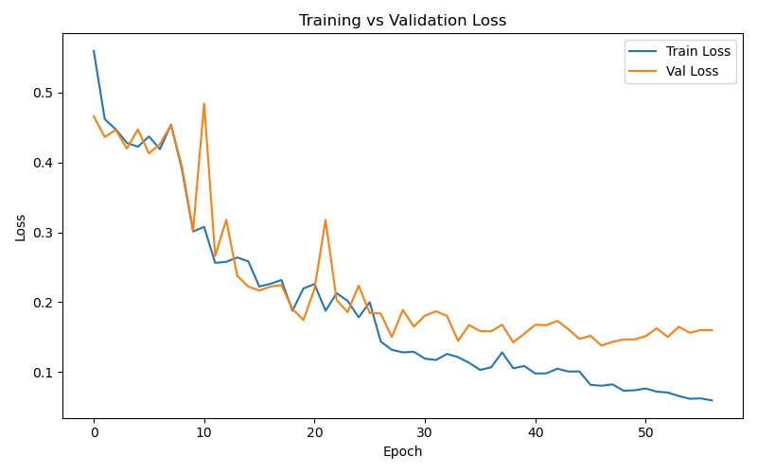
Training methods
Loss Function: Hybrid Dice + class-weighted CE(for Swin transformer model) and Dice+Tversky (for ResNet model), where weights are derived from inverse class frequencies to handle imbalance.
Optimization: AdamW optimizer with LR = 3e-4, weight decay = 1e-5, and ReduceLROnPlateau scheduler.
Interactive Supervision: Each training sample undergoes 3/4 rounds of DDG virtual user clicks, enabling the model to learn iterative refinement.
Data Split: Training/validation split = 90/10, batch size = 4, and early stopping with patience = 10 epochs.

Slide 14
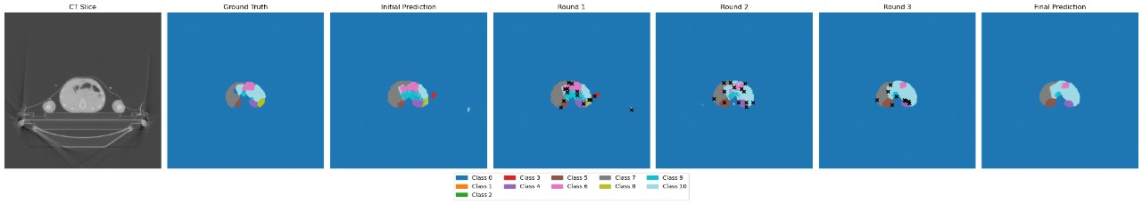
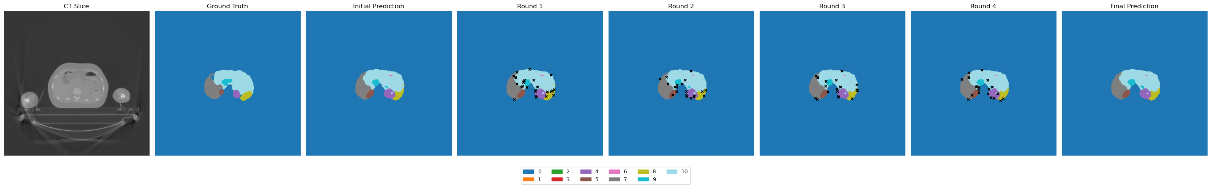
Results
This model has Encoder with ResNet
This model has Encoder with SwinTransformer

Slide 15
Results of some of the best models
Class | ResNet Model(Baseline) | Swin transformer Model With max_clicks = 3, depth=3 | Swin Transformer model with max_clicks=6, depth =3 | Swin Transformer model with max_clicks=6, depth =4
Background | 0.9980 | 0.9976 | 0.9985 | 0.9983
Esophagus | 0.4079 | 0.2135 | 0.4019 | 0.4009
Lung_L | 0.6572 | 0.7571 | 0.8602 | 0.8553
Lung_R | 0.7220 | 0.7794 | 0.8548 | 0.8535
Kidney_L | 0.4505 | 0.4469 | 0.5923 | 0.5888
Kidney_R | 0.3711 | 0.4834 | 0.5644 | 0.5620
Stomach | 0.2890 | 0.4575 | 0.4859 | 0.4856
Liver | 0.5526 | 0.7204 | 0.7625 | 0.7616
Spleen | 0.2603 | 0.5349 | 0.5898 | 0.5886
Pancreas | 0.2520 | 0.2819 | 0.3125 | 0.3120
Intestine | 0.4579 | 0.5659 | 0.6216 | 0.6103
Overall Avg | 0.4926 | 0.5671 | 0.6404 | 0.6370

Slide 16
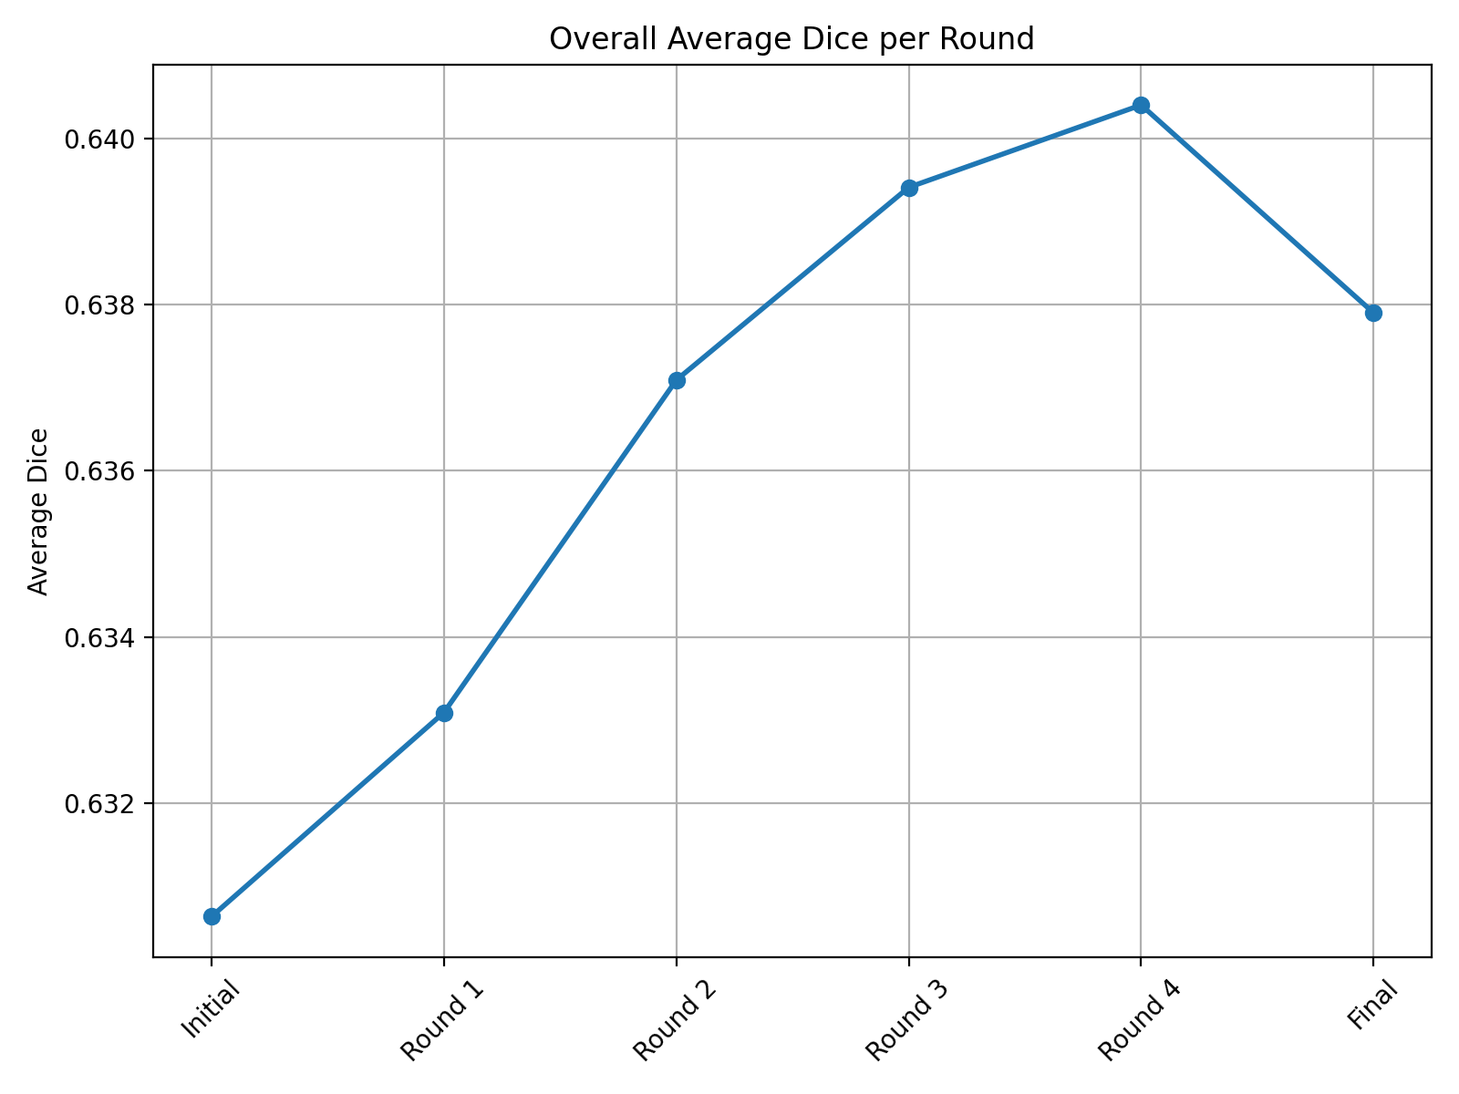
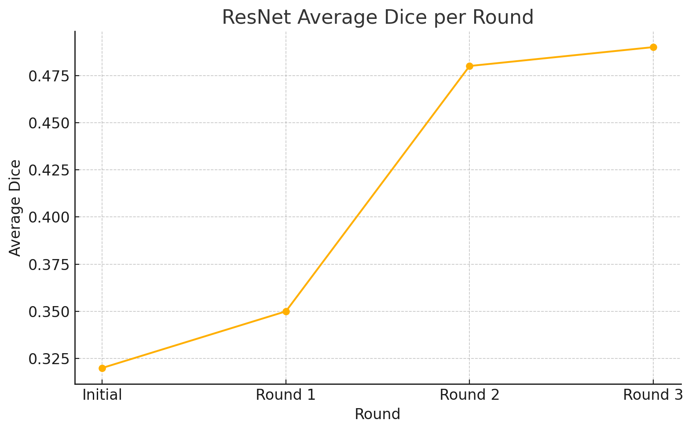
Observations
The Swin Transformer -based model produced strong initial predictions, noticeably better than those from the ResNet based model. As a result, the percentage improvement in accuracy for the Swin model was significantly lower.
Across the ‘D’ (3/4) rounds, the dice scores showed substantial improvement in the ResNet model, whereas the Swin model exhibited only limited gains.
(Swin model)

Slide 17
FUTURE SCOPE
Patient-consistent attention across slices: Instead of mixing slices from all patients during training, future systems can model attention across adjacent slices within the same patient. This would capture anatomical continuity and significantly improve organ boundary consistency.
Improved and balanced dataset: The current dataset is highly imbalanced, with several organs under-represented. A more balanced dataset or targeted data collection for smaller structures, would reduce bias and improve per-class Dice stability.
SAM2-inspired prompt fusion for SIM history: Future work could fuse SIM-Encoder click maps with probability maps to form richer prompt embeddings using temporal multi-head attention, inspired by SAM2. This would let the model leverage interaction history more effectively and produce sharper, more stable corrections.
Deformable attention in the decoder: Adding deformable attention to the decoder would allow spatially flexible feature aggregation. This can help the model focus on fine-grained, irregular structures and improve segmentation of small or complex organs.

Slide 18
thank you
Cherish Jain
22b3937
+91 8504082815
cherishjain01@gmail.com

