Slide 1
Special Project: Music Encoding with Watermarking
Conner Colligan

Slide 2
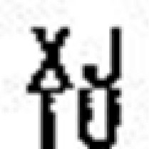
Goal
Watermark specified image into data values of music/audio WAV file.
Do so while not affecting overall quality of audio.
Be able to extract and identify image from file when necessary for proof of intellectual property.

Slide 3
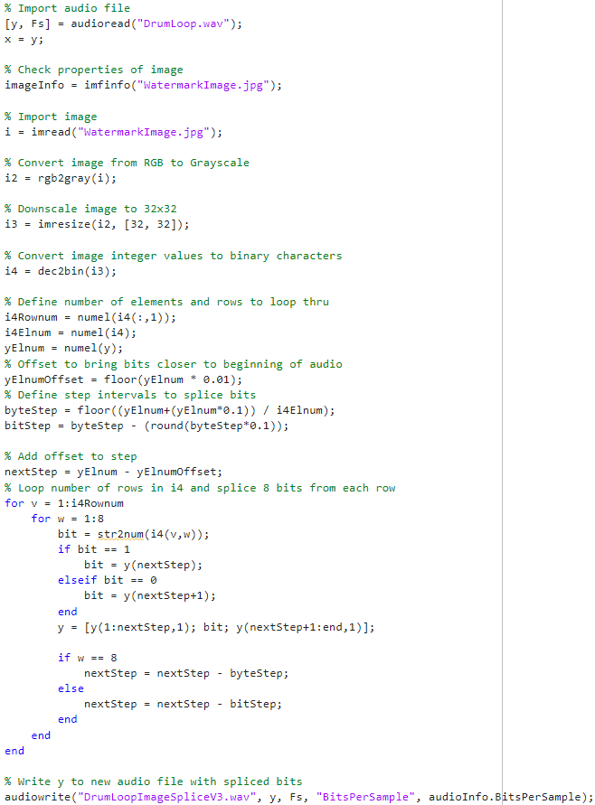
Encoding Process
Import audio file into 1 column matrix for data values to be manipulated.
Import and break down image into matrix of binary bits by grey scaling, resizing to 32x32, and converting raw color values to 8-bit long binary values.
Define variables based on image and audio size to determine number of steps between encoded values for even distribution.
Loop through audio data values to insert bits from image given step size.
Write modified matrix to newly encoded audio WAV file.

Slide 4
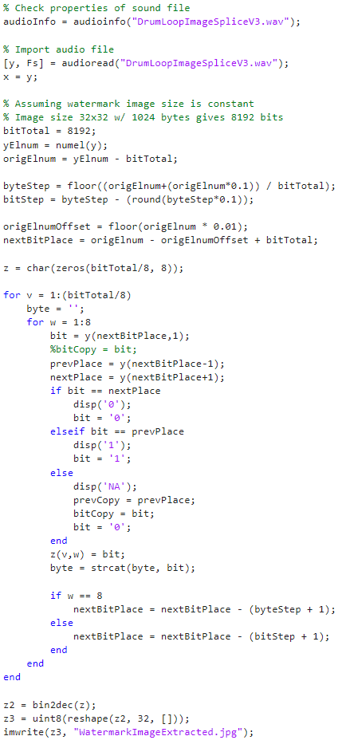
Decoding Process
Import encoded audio file into 1 column matrix for data values to be manipulated.
Define variables based on image (assuming 32x32) and audio size to determine number of steps between encoded values.
Loop through audio data values to identify bits based on encoding method and copy them to new matrix.
Convert values in new matrix from binary to integer color values.
Write modified matrix to reconstructed image of original watermark.

Slide 5
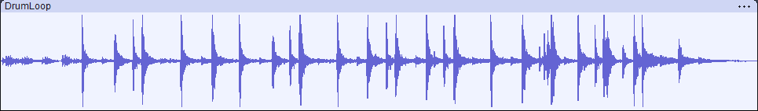

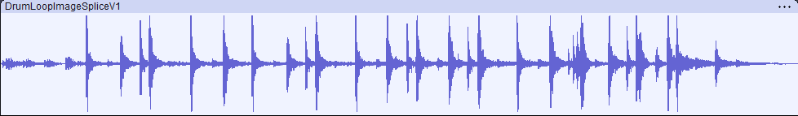
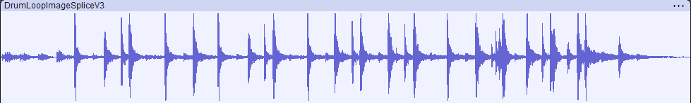
Results Comparison
Original Drum Audio:
Encoded Audio V1:
Encoded Audio V3:

Slide 6



Results Comparison
Original Watermark Image:
Extracted Image V1:
Extracted Image V3:

Slide 7


Next Steps
Working on method to detect bits in decoding process in the case that audio is edited and snipped, changing the total number of data values.
Will most likely require original watermark to compare pattern against and rebuild from encoded audio.
Plan to make bits detectable in ‘if’ checks through deviation percentage since values are very liable to change, especially through file compression.

