Slide 1
CE889 Assignment
Jiwei Chen
2401061

Slide 2
Assignment 1

Slide 3
Partition of data
Split:
Training Set: 80% of the data.
Testing Set: 20% of the data, randomly sampled by pandas.sample()
Min-Max Normalization:
Each column in the dataset is scaled to a range of [0, 1].
Formula: (x – min)/(max-min)
Normalization parameters (Min and Max): min_max.csv

Slide 4
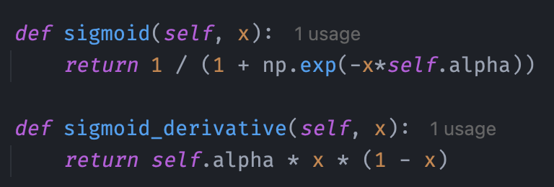
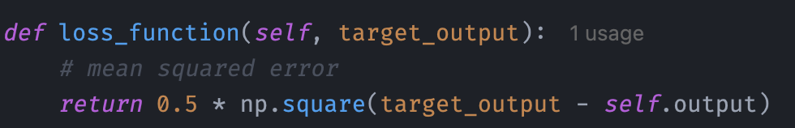
Architecture
Input: 2 --→ Hidden: 4 --→ Output: 2
Activation Function: Sigmoid ( alpha = 0.3 )
Loss Function: Mean Squared Error

Slide 5
Architecture
Weights update:
gradient = delta * self.sigmoid_derivative(self.output) delta_weights = learning_rate * gradient * self.input + momentum * previous_delta_weights
Neural Network:
self.input_layer_size = 2 self.hidden_layer = [Neuron(self.input_layer_size) for _ in range(4)] self.output_layer = [Neuron(len(self.hidden_layer)) for _ in range(2)]
Save model and early stop:
if total_loss < best_loss: best_loss = total_loss nn.save_weights('best_weights.csv') else: counter += 1 if counter > 20: break

Slide 6

RMSE
rmse = np.sqrt(np.mean((predicted_outputs - outputs_test) ** 2))
Training log:
…

Slide 7
Assignment 2

Slide 8
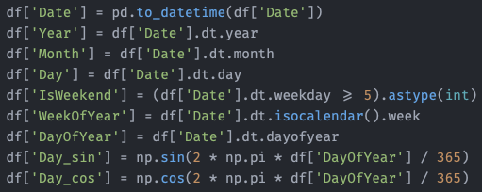
Data process
Combination
Combine store.csv with train.csv and test.csv
Date: Transform the Date column into multiple features
capture cyclic patterns

Slide 9
Data process
Features of competition:
Fills in missing values for (CompetitionOpenSinceYear, CompetitionOpenSinceMonth) with a 0, and CompetitionDistance with -1, representing no competition exist.
Derives a new feature, CompetitionOpenDurationMonths, representing the number of months the competition has been open up to the current date
Cleans up redundant columns (Year, Month) after calculating the required features.
PromoInterval:
Fills in missing values with an empty string.
Generates one-hot encoded columns (IsPromoJan, IsPromoFeb, etc.) for each month, indicating whether a promotion is active during that month.
Drops the original PromoInterval column after the transformation to avoid redundancy..

Slide 10
Data process
One-hot-encoding:
[Stateholiday] contain int and str, so use .astype(str) to converts all values to str.
Do one-hot-encoding columns=['Assortment', 'StoreType', 'StateHoliday', 'DayOfWeek']
Scaler:
By plotting the data, it was found to follow a standard distribution, so StandardScaler was chosen
columns_to_scale = [
'CompetitionDistance’,
'CompetitionOpenSinceMonth’,
‘CompetitionOpenSinceYear’,
'Promo2SinceWeek’,
'Promo2YearsActive’,
'Year', 'Month', 'Day','WeekOfYear']

Slide 11
Data process
Remove ‘Customer’, which doesn’s exist in test.csv
Set ‘Sales’ as output
Fill in all other missing value with 0.

Slide 12

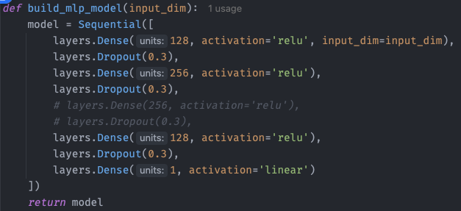
Building model
Optimizer:Adam - Adaptive Learning Rate
Epochs=100; Batch_size = 64

Slide 13
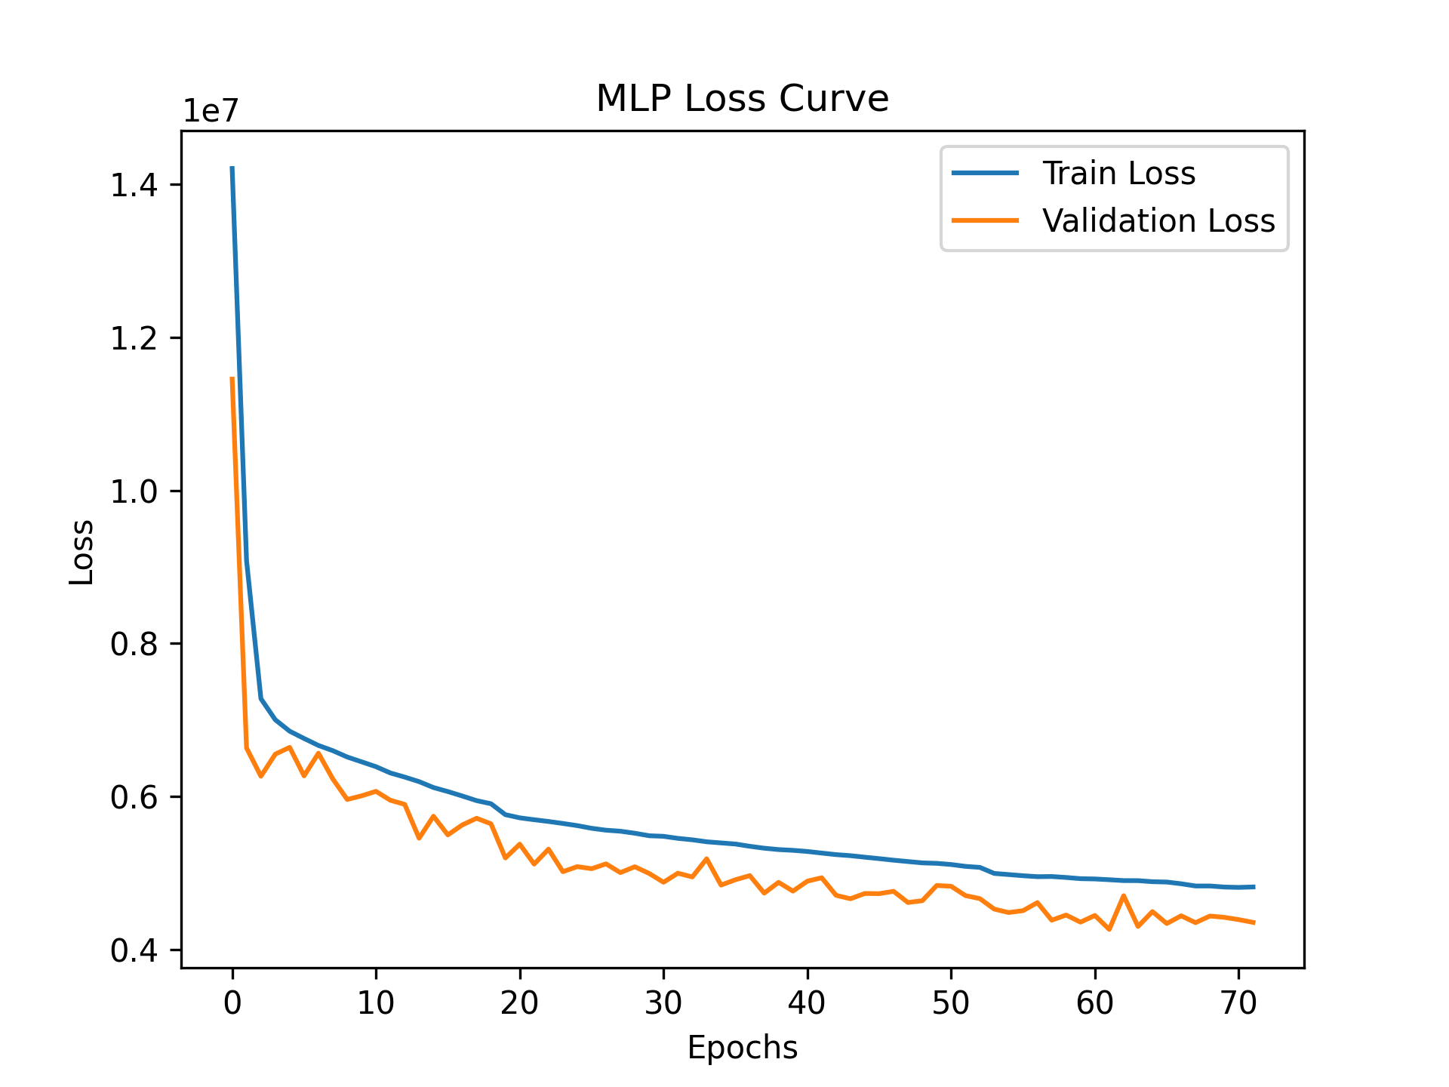
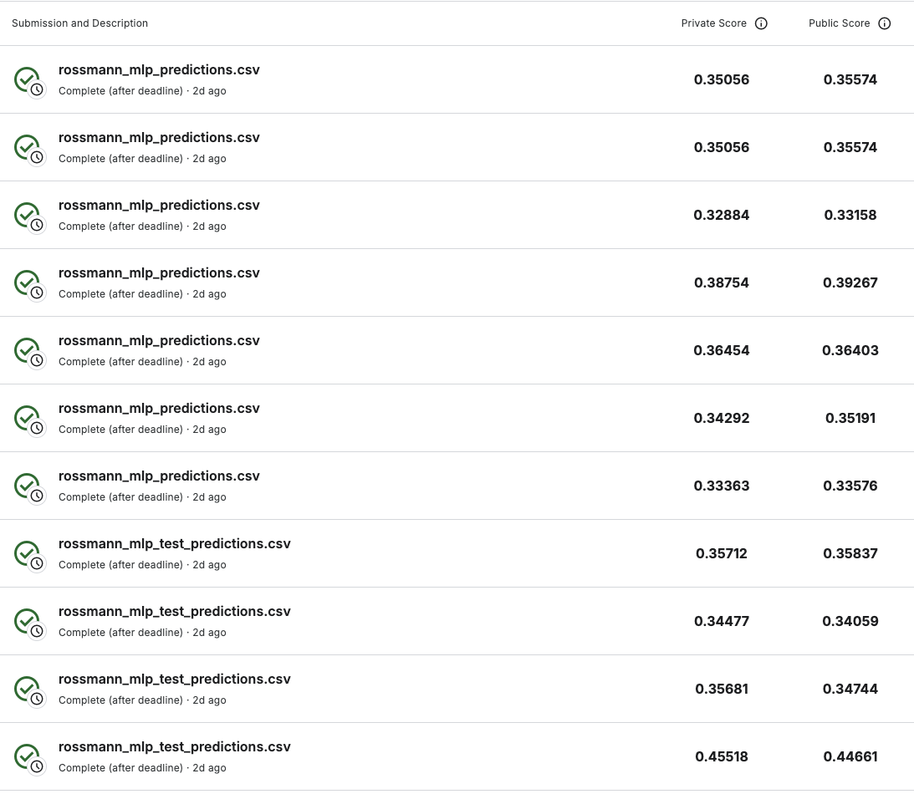
Performance

