Slide 1
CSCE569 Project
Chris Jenne

Slide 2
Goal: Paralyze the brute force and dictionary attack for cracking passwords.

Slide 3
Challenges:
Brute Force on passwords costs a lot and can take hours to crack a code that has a length of five.
Dictionary attack only works for individual words. Can’t break “thisword”.
Solution:
Run password through dictionary algorithm
If not found, paralyze brute force algorithm, and
Hope it works.

Slide 4
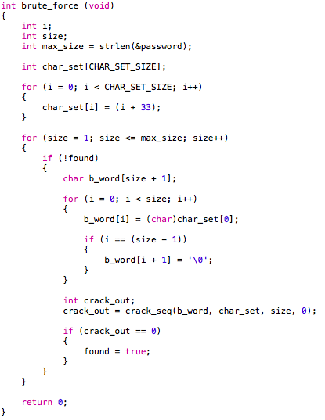
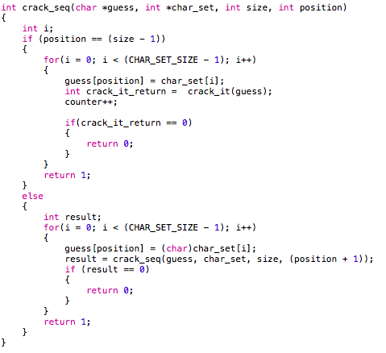
Algorithm for brute force
if guess = password,
it’ll return ‘0’

Slide 5
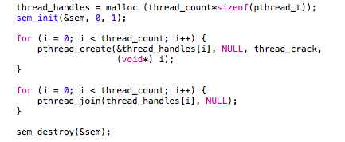
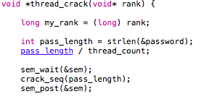
Parallelization
Pthreads
(semaphores)

Slide 6
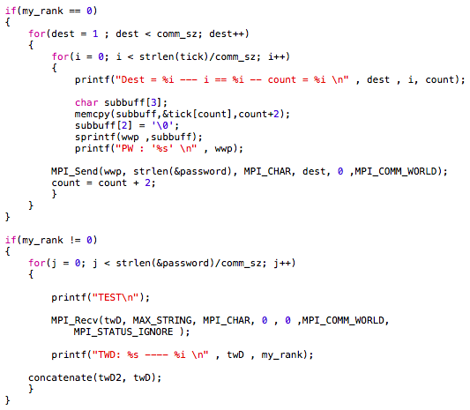
Parallelization
MPI

Slide 7
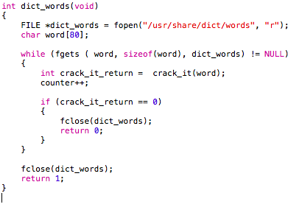
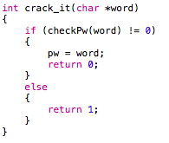
Algorithm for dictionary.

Slide 8


Findings
Pthreads - Program worked, but was not as well as MPI
MPI - Split up string into substrings of length 2 and concatenated the cracked string.

