Slide 1
Discussion of Adaptive increase in sample size when interim results are promising: A practical guide with examples by Cyrus Mehta and Stuart Pocock (Statistics in Medicine 2011)
Professor Chris Jennison
University of Bath
http://people.bath.ac.uk/mascj
Notes:
In his congress, we have heard about: ways of handling data, methods for analysing data, extracting the key information from big data.
I am
IN fact …

Slide 2
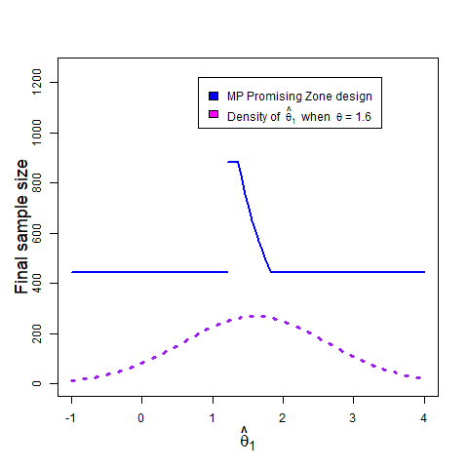
The Sample Size Re-estimation (SSR) approach
Start with an initial specification of
Type I error rate α
Power 1-β when treatment effect = δ₀
Hence, define a fixed sample or group sequential design.
But, at an interim analysis,
re-visit the power requirement
and, if appropriate, change
the study design.
An SSR rule

Slide 3
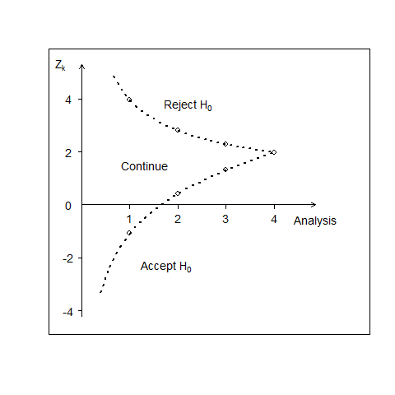
Group Sequential Tests (GSTs)
Fix
Type I error rate α
Power 1-β when treatment effect = δ
Set maximum sample size
Set number of interim analyses
Hence, define
A stopping boundary or
An error spending rule.
Stopping boundary for a GST

Slide 4
Sample Size Re-estimation (SSR) vs Group Sequential Tests (GSTs)
SSR Methods – “Start small and ask for more”
Start a trial with an initial target sample size.
Examine interim data: if appropriate, increase the sample size.
Use a combination test, say, to protect the type I error rate.
GSTs
Plan the trial with a maximum sample size and early stopping rule.
In both cases, the data determine the number of subjects observed.

Slide 5
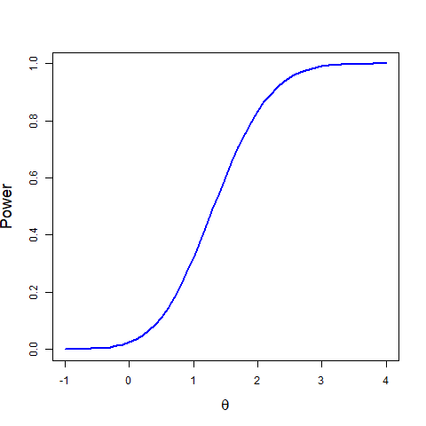
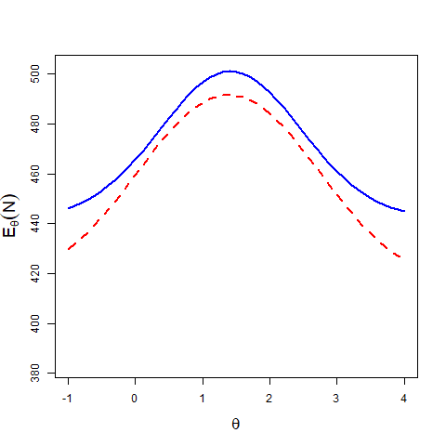
Comparing GST and SSR designs
In both types of design, the final sample size is determined by the observed data.
Once a design is fully specified, we can compute its:
Power as a function of treatment effect ϴ
E(Sample size) as a function of ϴ
Power curves Expected sample size functions
The two designs have almost identical power curves.
The red design has lower expected sample size for all Ө.

Slide 6
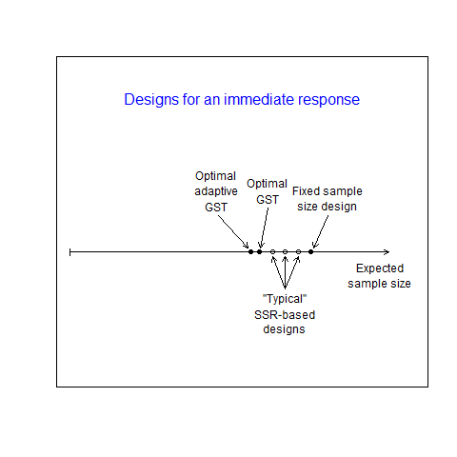
Comparing GST and SSR designs
CJ and Bruce Turnbull (2003, 2006, 2006) reported comparisons which showed traditional GSTs to have superior performance to a variety of SSR-based designs.
When the most efficient forms of each type of design are compared,
the SSR designs have a slight
advantage – but they may be
challenging to implement.
Efficiency of GSTs and SSR-based designs

Slide 7
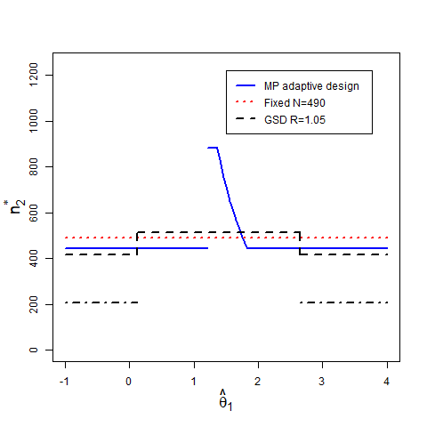
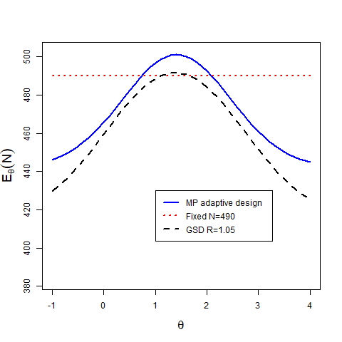
Mehta and Pocock (2011): Example 1
CJ and BWT (2015) assessed the Promising Zone design and found superior performance in
A 2-stage GST that is charged for but does not use “pipeline” data,
A fixed sample design.
Sample size rules Expected sample size functions.

Slide 8
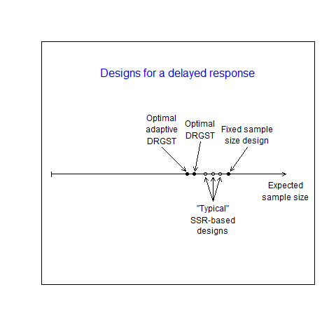
GST vs SSR when there is a delayed response
Lisa Hampson and CJ (2013)
defined efficient GSTs for studies with a delayed response (DRGSTs).
They reached similar conclusions about the relative efficient of
DRGSTs and SSR-based designs.
If the most efficient designs are compared, SSR designs have a
slight advantage – but may be
challenging to implement.
Efficiency of GSTs and SSR-based designs

Slide 9
Mehta and Pocock (2011): Example 1
CJ and BWT (2015) recommended modifications to improve performance of the Promising Zone design.
Use a combination test, not the Chen, DeMets & Lan construction
Apply a consistent “Rate of exchange” between sample size and conditional power
Have a lower maximum sample size

Slide 10
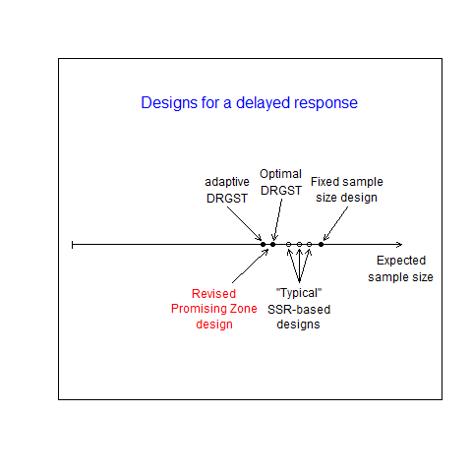
Recent developments in Promising Zone designs
Hsiao, Liu and Mehta (2019) published new versions of the Promising Zone design.
They treat JT’s design as the “gold standard”.
Now the Promising Zone design is efficient

Slide 11
References
Jennison and Turnbull (2003, Statistics in Medicine)
“Mid-course sample size modification in clinical trials based on the observed treatment effect.”
Jennison and Turnbull (2006, Biometrika)
“Adaptive and non-adaptive group sequential tests.”
Jennison and Turnbull (2006, Statistics in Medicine)
“Efficient group sequential designs when there are several effect sizes under consideration.”
Hampson and Jennison (2013, J. Royal Statistical Society, Series B)
“Group sequential tests for delayed responses.”
Jennison and Turnbull (2015, Statistics in Medicine)
“Adaptive sample size modification in clinical trials: Start small then ask for more?”
Hsiao, Liu and Mehta (2019, Biometrical Journal)
“Optimal promising zone designs.”

