Slide 1
Design and Analysis of Adaptive Clinical Trials: Addressing the Study Goals
Professor Chris Jennison
University of Bath
http://people.bath.ac.uk/mascj
18th Pharmaceutical IT and Data Congress
25 September 2020
Notes:
In his congress, we have heard about: ways of handling data, methods for analysing data, extracting the key information from big data.
I am
IN fact …

Slide 2
Decision making in clinical trials
What data should we collect?
How many subjects?
Which dose for each subject?
How to proceed after a Phase I or Phase II trial
Go / No go?
The dose to take forward?
The solution needs:
A model for the data
A well-formulated objective
– recognising the role of this study in the overall drug development process.

Slide 3
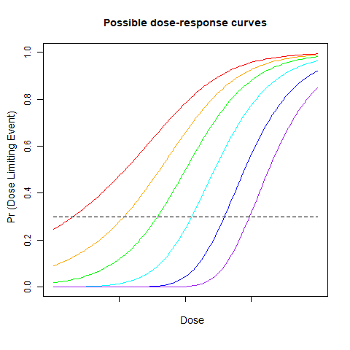
1. Phase I: “First in Human” trials
In a trial with healthy volunteers, we aim to:
Find the maximum safe dose;
Maintain safety of study participants.

Slide 4
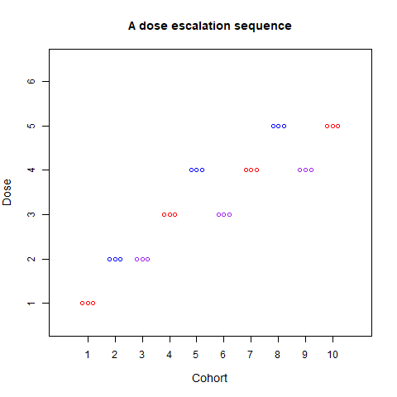
Design of a First in Human trial
Treat cohorts of 3 patients
Give cohort 1 the lowest dose
Increase the dose for each cohort if it is safe to do so
Select the dose for which Pr(Dose limiting event) is closest to 0.3.

Slide 5

Optimising the design: Bayes decision theory
Specify a model for the dose-response curve.
Elicit a prior distribution for the dose-response curve.
Define an objective function to be minimised, for example,
G = ${|p}^{∗}−0.3|$ + λ x (Number of observed dose limiting events)
where $p^{∗}$ denotes Pr(Dose limiting event) for the selected dose.
Choose doses for successive cohorts to minimise the average value of G.

Slide 6
Optimising by Dynamic Programming
There are many millions of possible sequences of dose assignments and outcomes.
Nevertheless, Lizzi Pitt, a University of Bath PhD student, has been able to compute the unique optimum design for a given statistical model and objective function G.
Additionally, modelling the data that arise in the Dynamic Programming algorithm allows rapid computation of an almost optimal trial design.

Slide 7
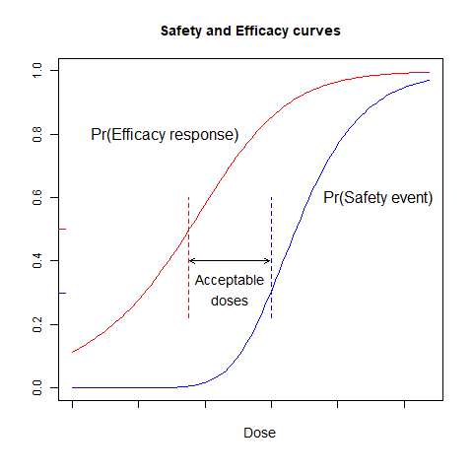
A Phase I trial with safety and efficacy endpoints
Suppose an acceptable dose should have
Pr(Efficacy response) > 0.5;
Pr(Safety event) < 0.3.
We wish to consider doses meeting these criteria in the subsequent Phase II trial.
Again, optimal trial
designs can be found.

Slide 8
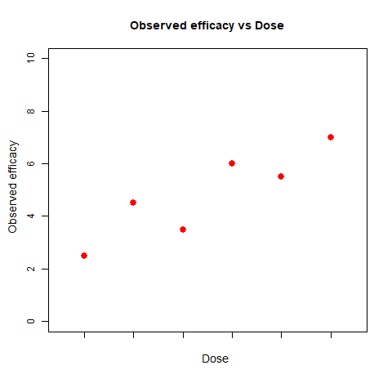
2. Dose selection after Phase II
After a Phase II trial is completed:
Is a Phase III trial worthwhile?
Which dose, or doses, should be tested vs control?
How large should the Phase III trial be?

Slide 9

Problem formulation
Ultimate goal
A positive Phase III trial and regulatory approval of the new drug.
Objective function to maximise
$C×I_{Success} −$Cost of Phase III trial
Where
$I_{Success}=$ 1, If Phase III trial
successful
0, Otherwise.
Statistical model
Efficacy vs Dose curve, e.g., an Emax model
Posterior distribution for model parameters, given Phase II data
Decision options
Phase III: Yes or no?
Which dose to test in Phase III
Sample size for Phase III trial

Slide 10
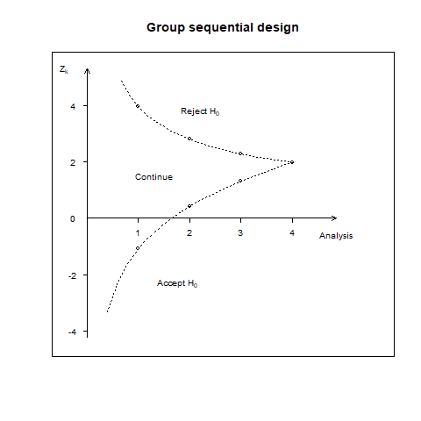
Optimising Phase II and Phase III trials
Robbie Peck, a University of Bath PhD student, has produced methods for joint optimisation of Phase II and Phase III trials.
In a group sequential Phase III trial:
Maximum sample size is set to give high power for
a small, but clinically relevant, treatment effect.
However, the trial will most likely stop early with
a smaller sample size when the treatment effect
is larger than this.

Slide 11
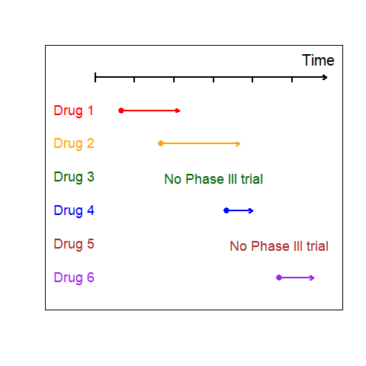
Portfolio management
A company must share finite resources between compounds, at different stages of development
Robbie Peck worked with Nitin Patel
(Cytel) and CJ (Univ of Bath) to
develop a model this process
and optimize its management
Dynamic Programming can
be used to solve complex
portfolio problems.

Slide 12
3. Phase III “enrichment” trials
A new treatment is expected to be particularly effective for patients exhibiting a certain biomarker.
Should we restrict the Phase III trial biomarker positive patients?
An “Enrichment trial” starts by recruiting from the full population.
The triaI “adapts” and focuses on biomarker positive patients if
interim data support this change.
Designing an adaptive enrichment trial
Adaptive trial design
Multiple hypothesis testing
Combination tests (to combine data from
before and after the interim analysis)
Gain function to maximise, proportional to:
The size of population in which the new treatment is proved to be effective
The average treatment effect in this population.

Slide 13
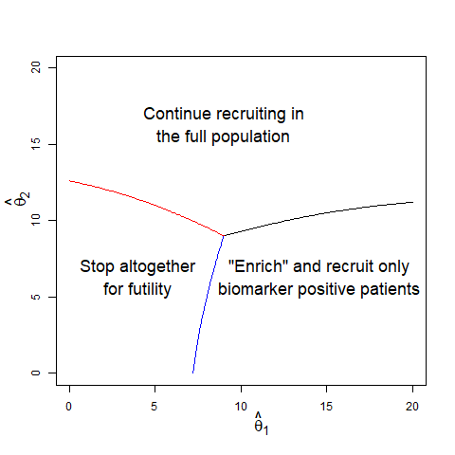

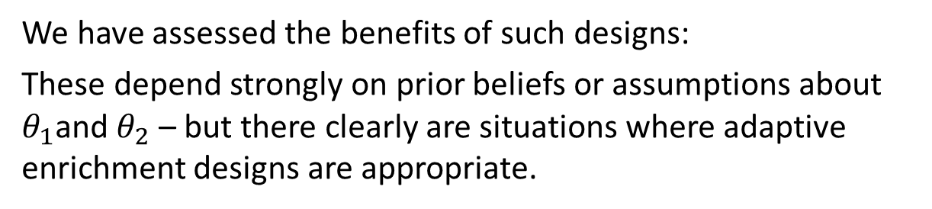
Optimising an enrichment design
The statistical model
Treatment effect (new vs control)
In biomarker positive patients: $θ_{1}$
In biomarker negative patients: $θ_{2}$
Prior distribution for $(θ_{1},θ_{2})$
The decision to enrich
is based on interim
estimates$({\hat{θ}}_{1}$,${\hat{θ}}_{2}$)
University of Bath PhD
student, Thomas Burnett, has derived Bayes optimal enrichment designs.
We have assessed the benefits of such designs:
These depend strongly on prior beliefs or assumptions about $θ_{1}$and $θ_{2}$ – but there clearly are situations where adaptive enrichment designs are appropriate.

Slide 14
Conclusions
Clinical trial data are expensive to obtain.
The duration of clinical trials has a major impact on the financial return to the developer of a new treatment.
Efficient trial designs can be created at all phases of development, given
A model for the trial in question;
A well-defined objective to optimise.

