Slide 1
Association of Clinical Research Professionals Academy of Pharmaceutical Physicians and Investigators
Global Headquarters
500 Montgomery St
Alexandria, VA 22314
USA
India Office
Bilcare Research Academy 1002, Sai Capital, Senapati Bapat Road, Pune-411 016, India
European Office
Goswell House
134 Peascod Street
Windsor, UK

Slide 2
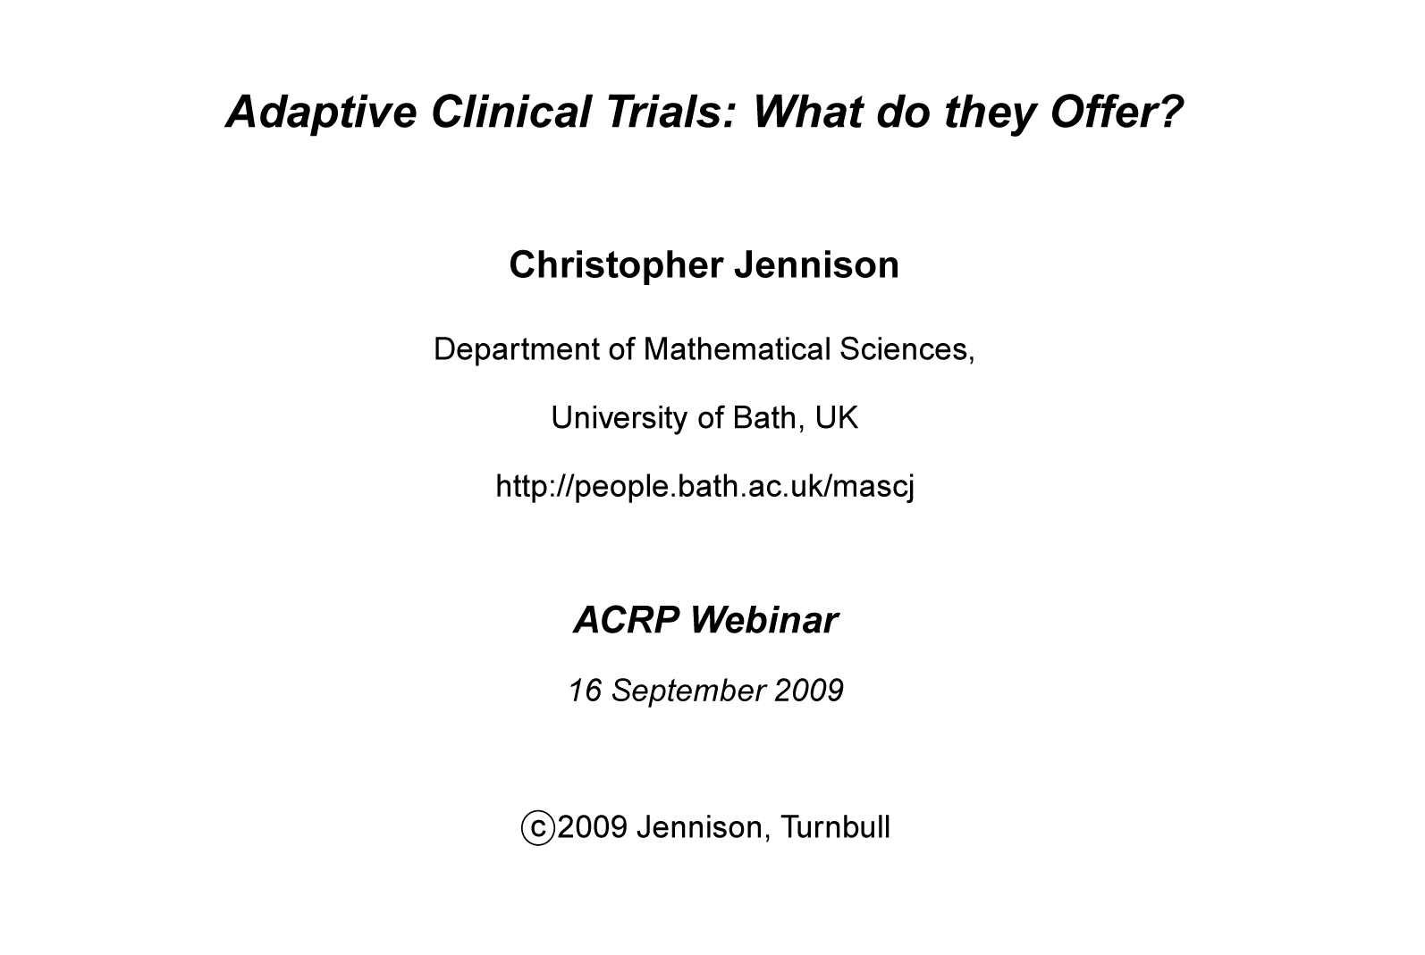
Adaptive Clinical Trials: What do they Offer?

Slide 3
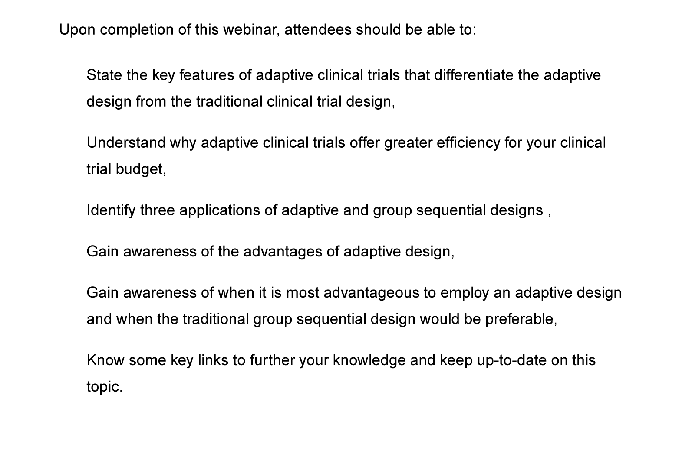
Objectives for the training
3
Notes:
3

Slide 4
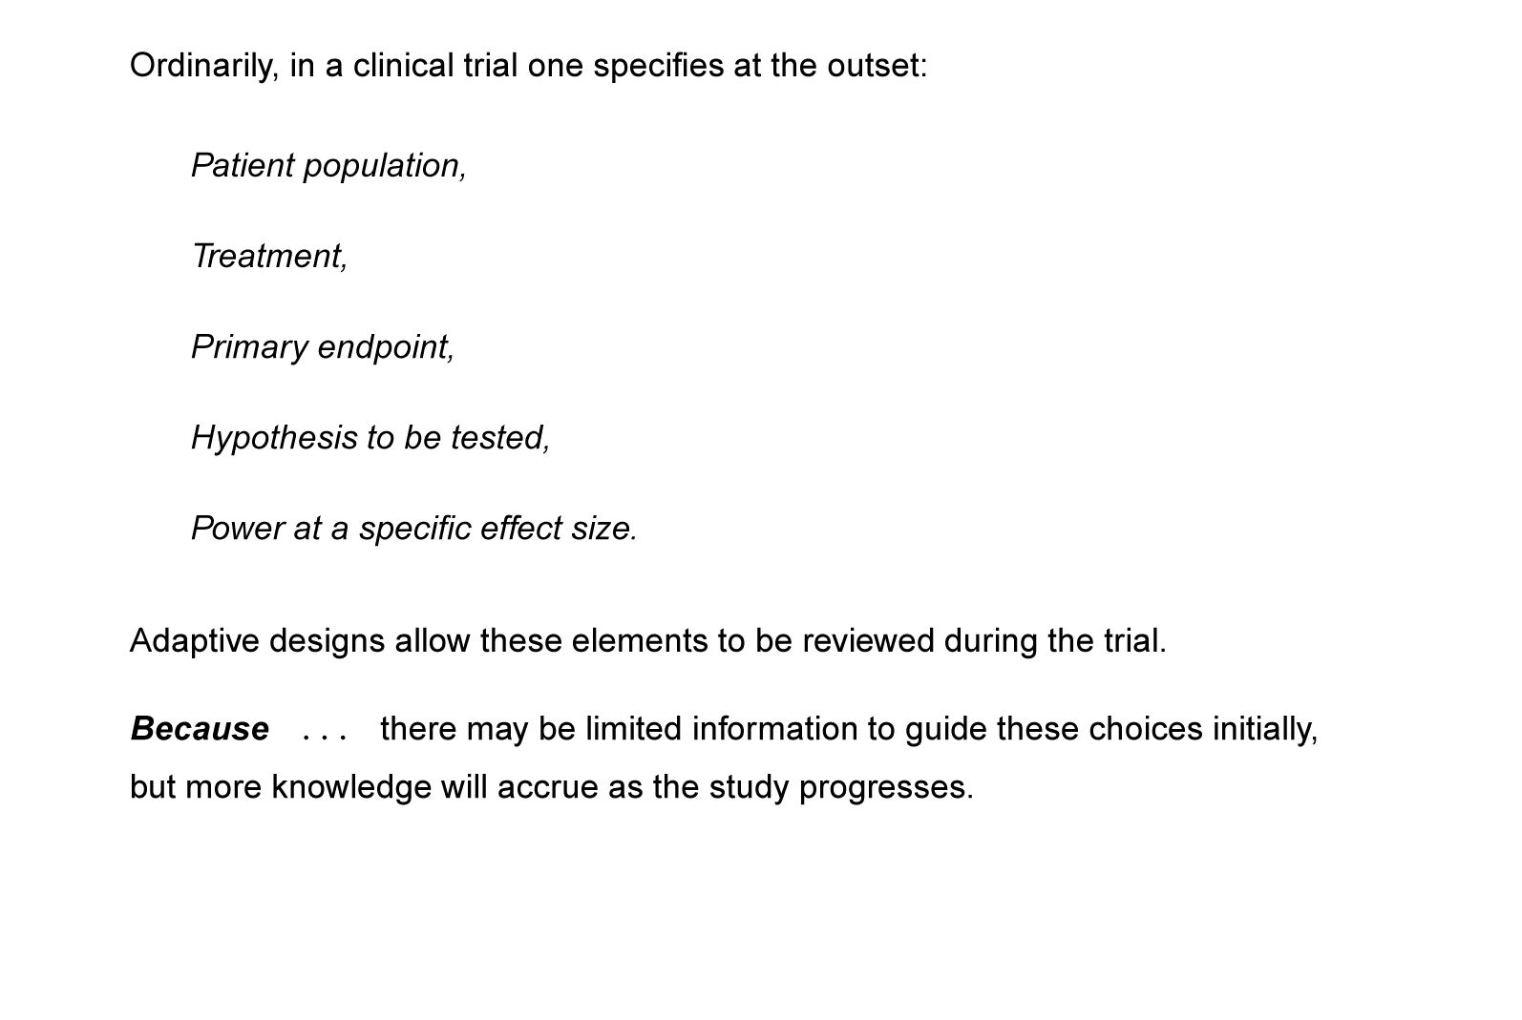
The role of adaptive methods
4
Notes:
4

Slide 5
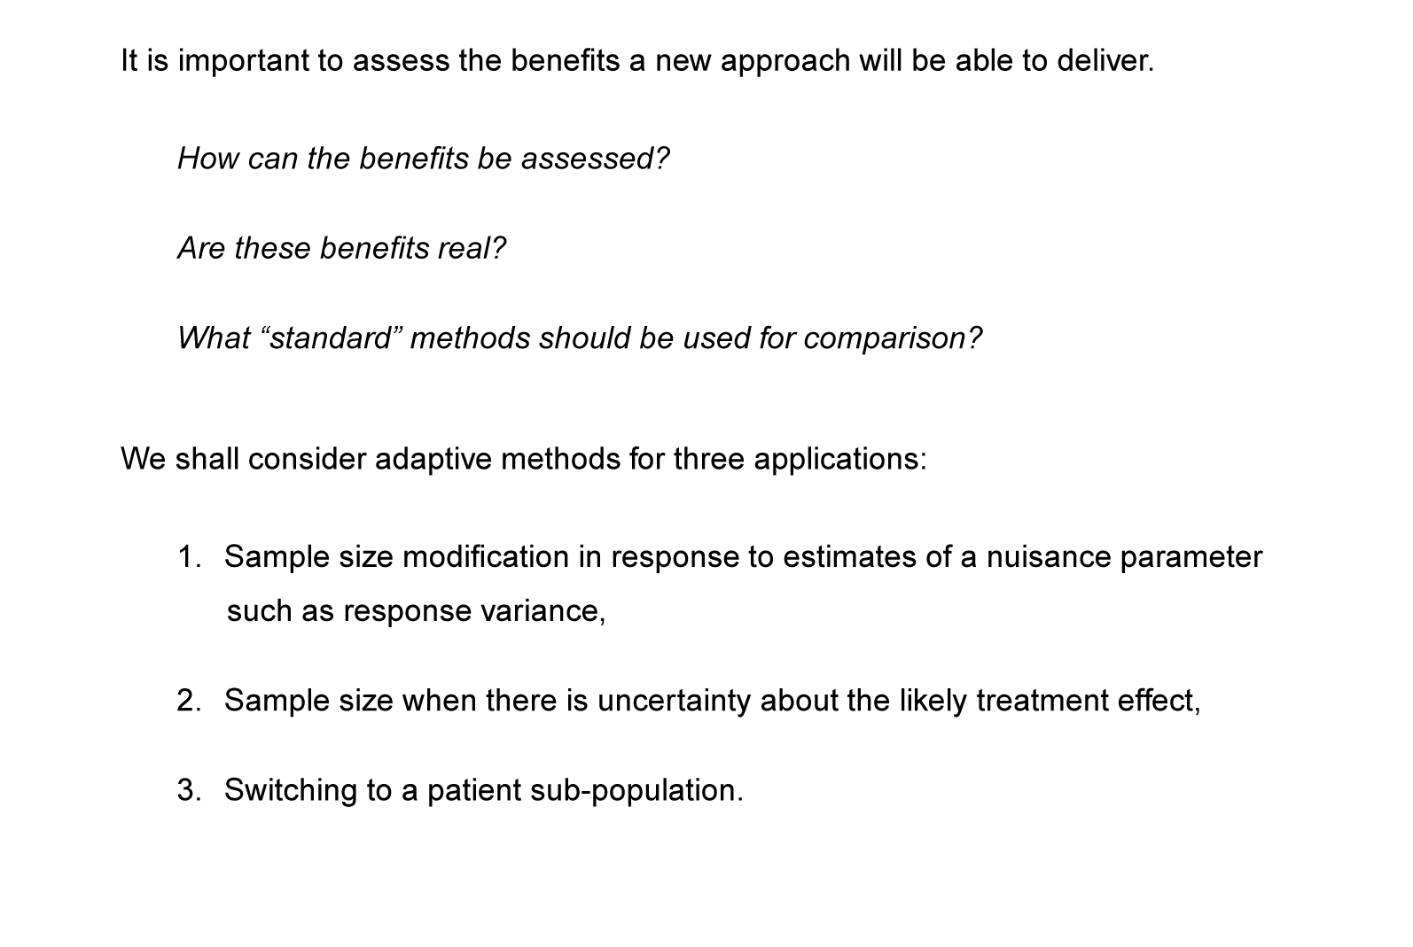
Critical appraisal of adaptive designs
5
Notes:
5

Slide 6
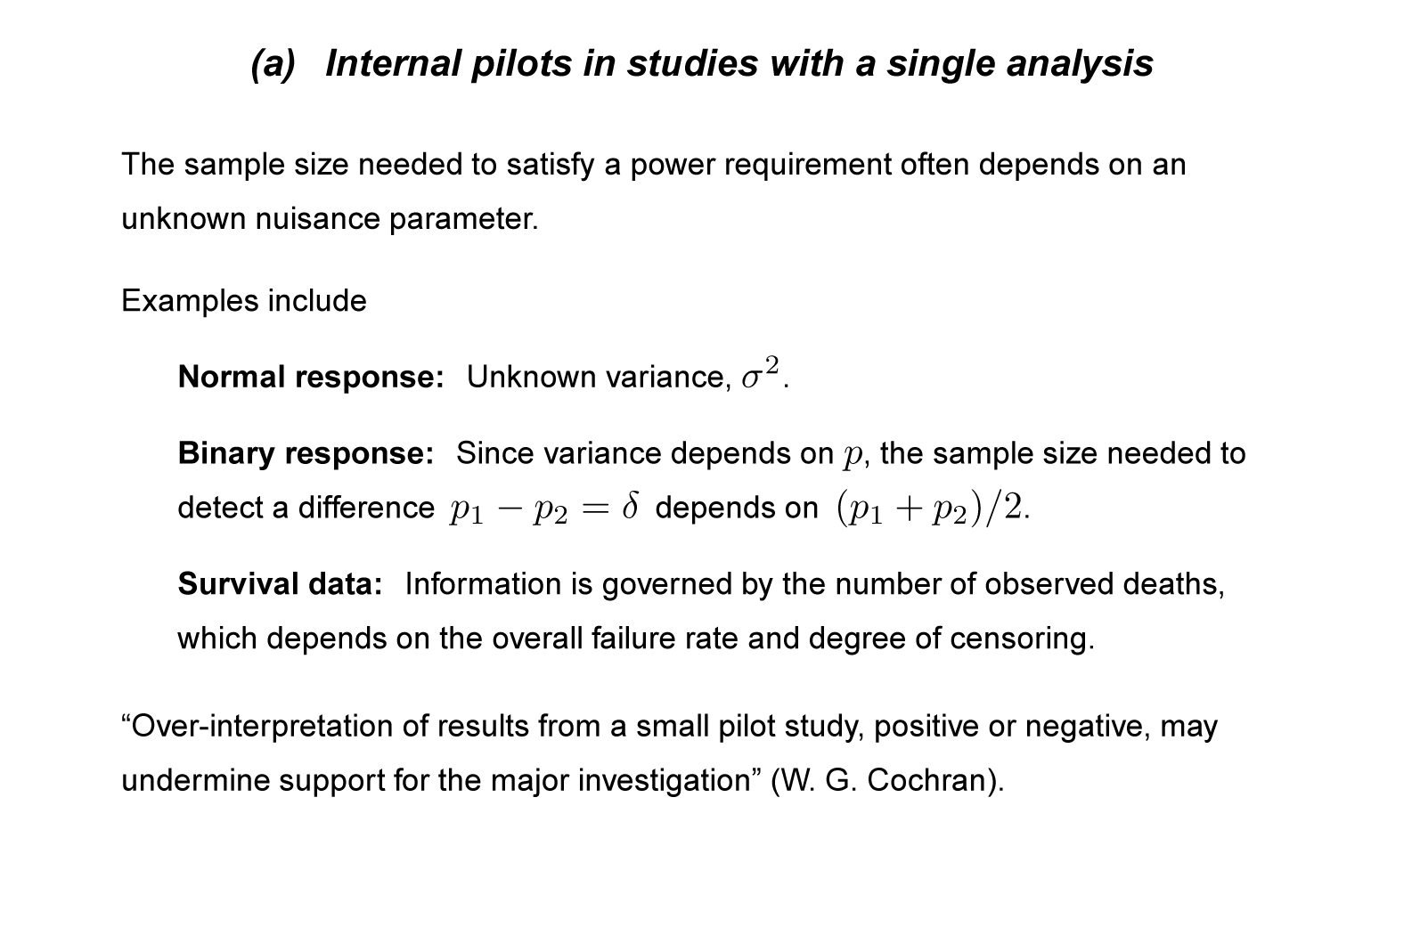
Sample size modification for a nuisance parameter
6
Notes:
6

Slide 7
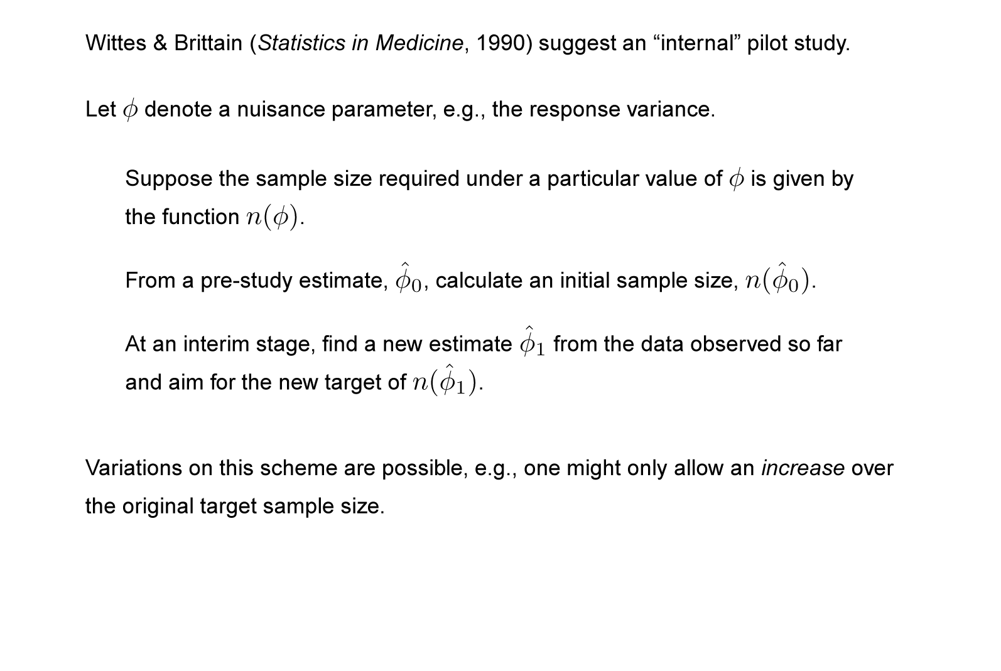
Internal pilots: Wittes & Brittain
7
Notes:
7

Slide 8
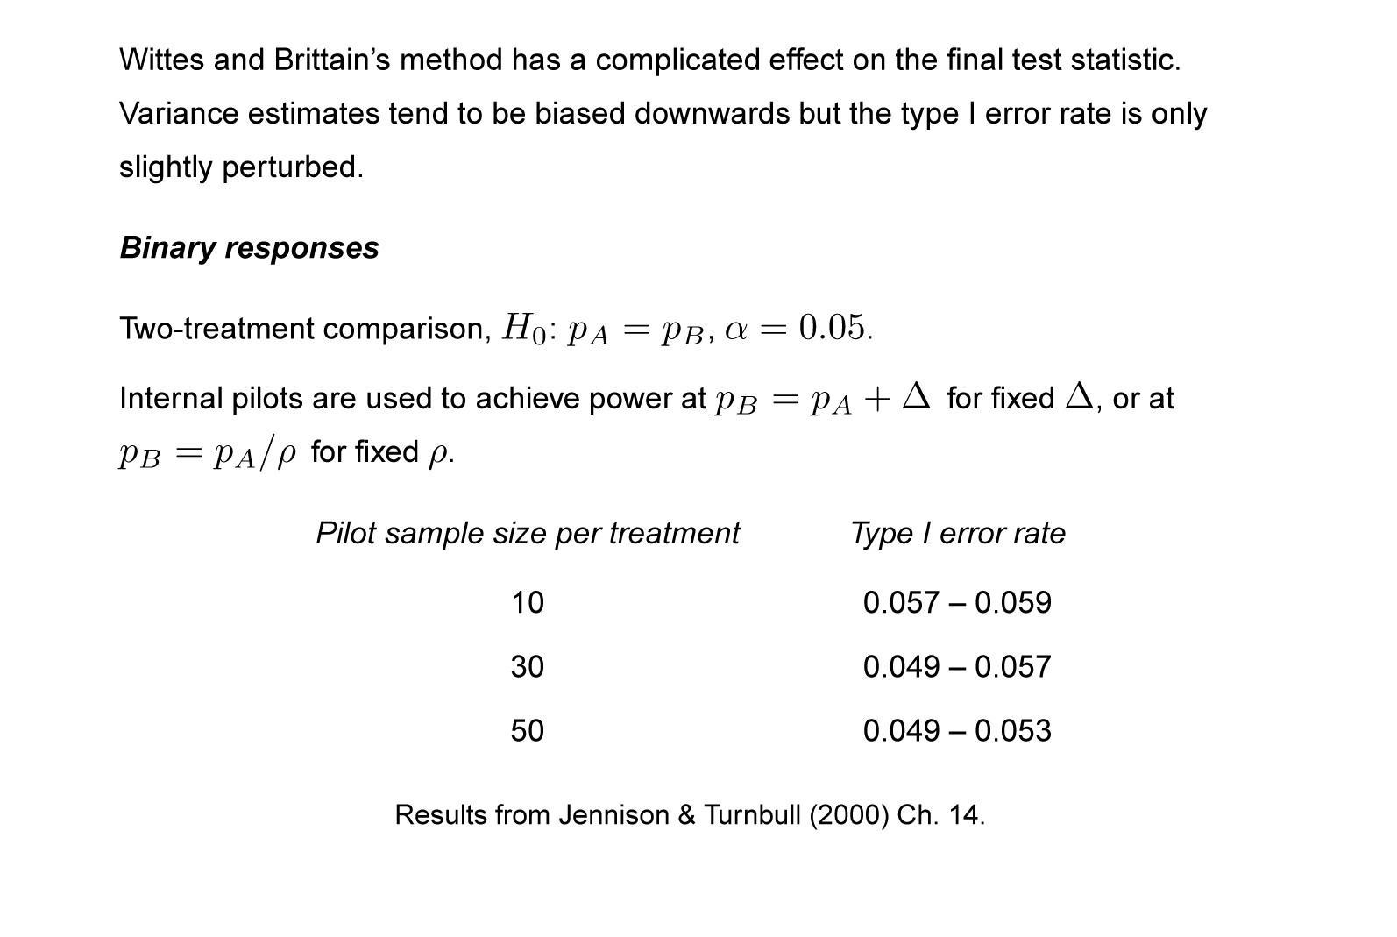
Internal pilots: Properties
8
Notes:
8

Slide 9
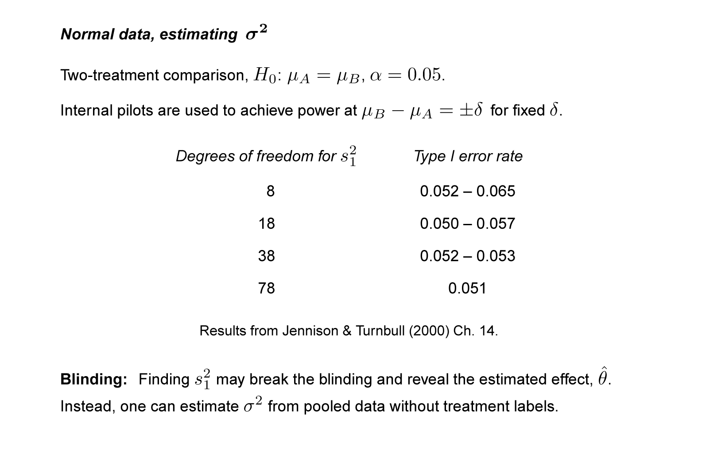
Internal pilots: Properties
9
Notes:
9

Slide 10
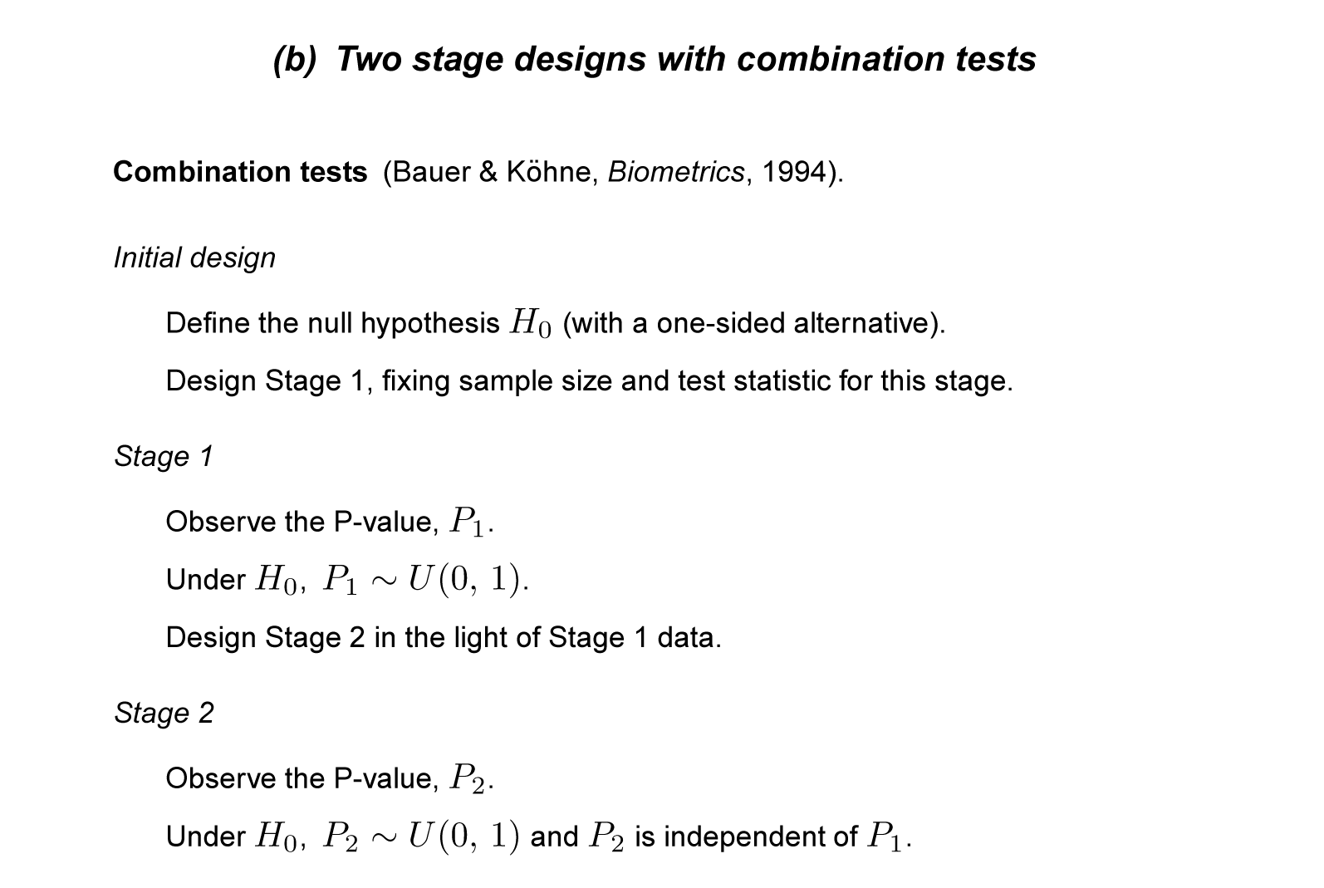
Sample size modification for a nuisance parameter
10
Notes:
10

Slide 11
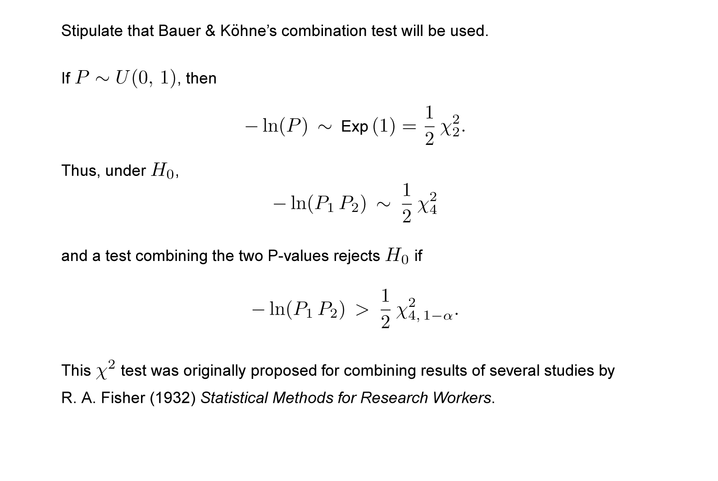
Combination tests: The inverse chi squared test
11
Notes:
11

Slide 12
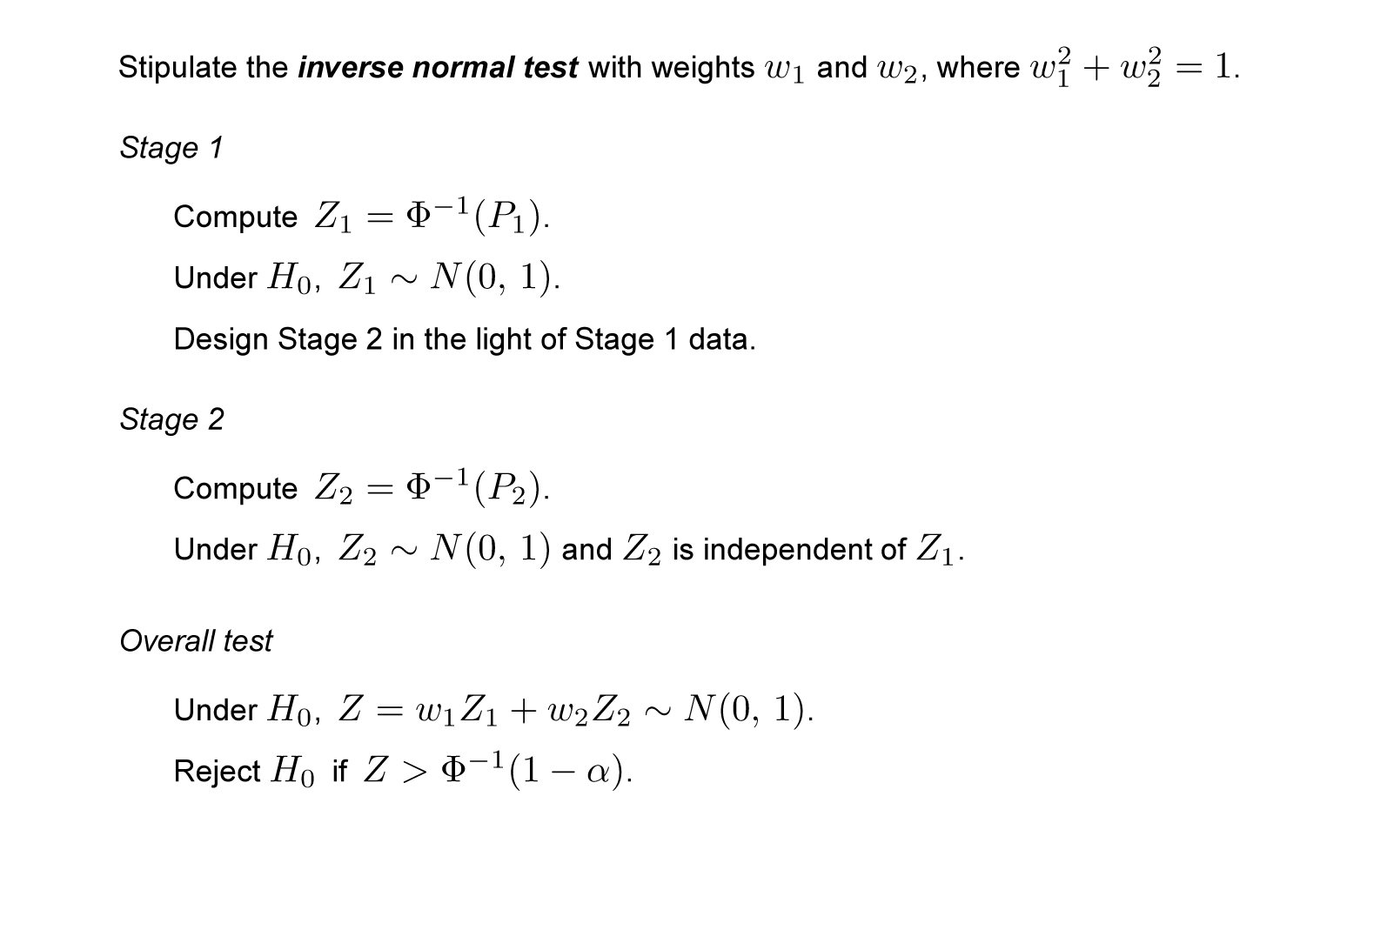
Combination tests: The inverse normal test
12
Notes:
12

Slide 13
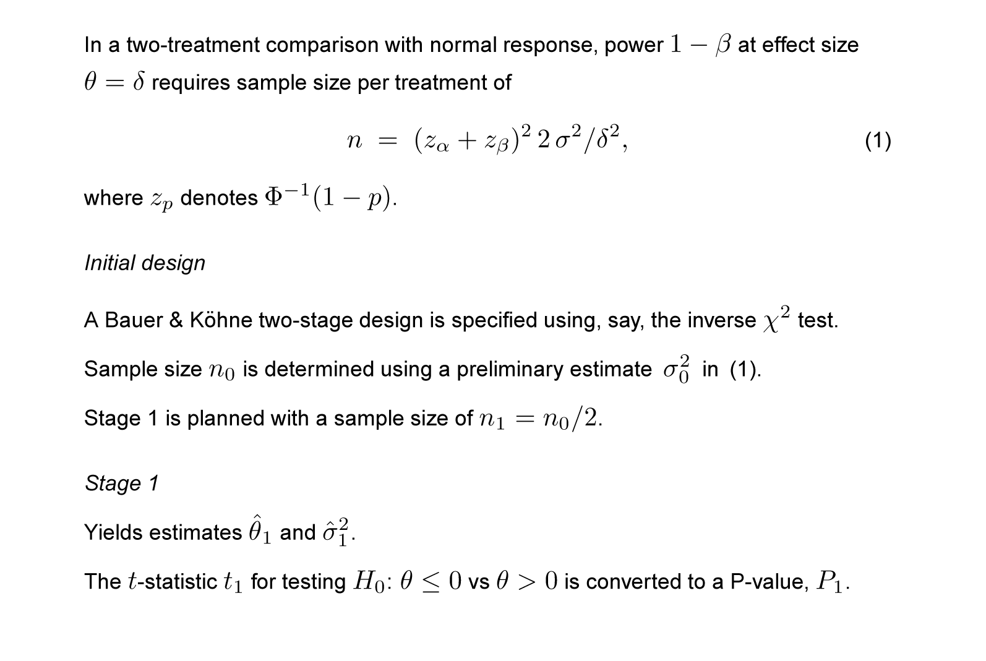
Sample size re-estimation using a combination test
13
Notes:
13

Slide 14
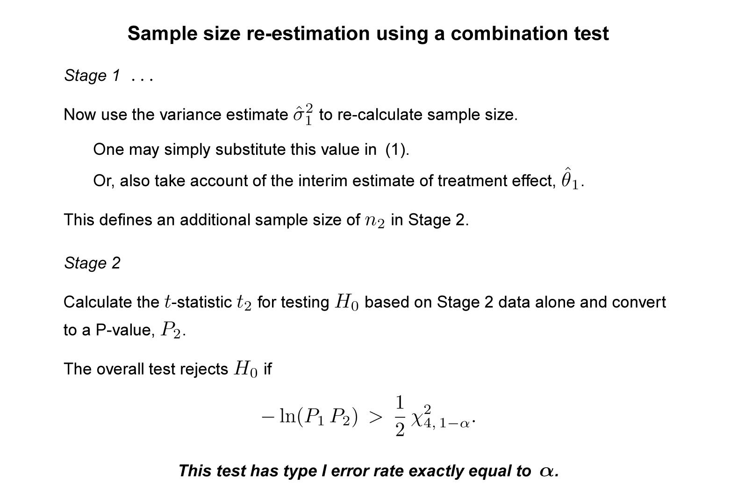
Sample size re-estimation using a combination test
14
Notes:
14

Slide 15
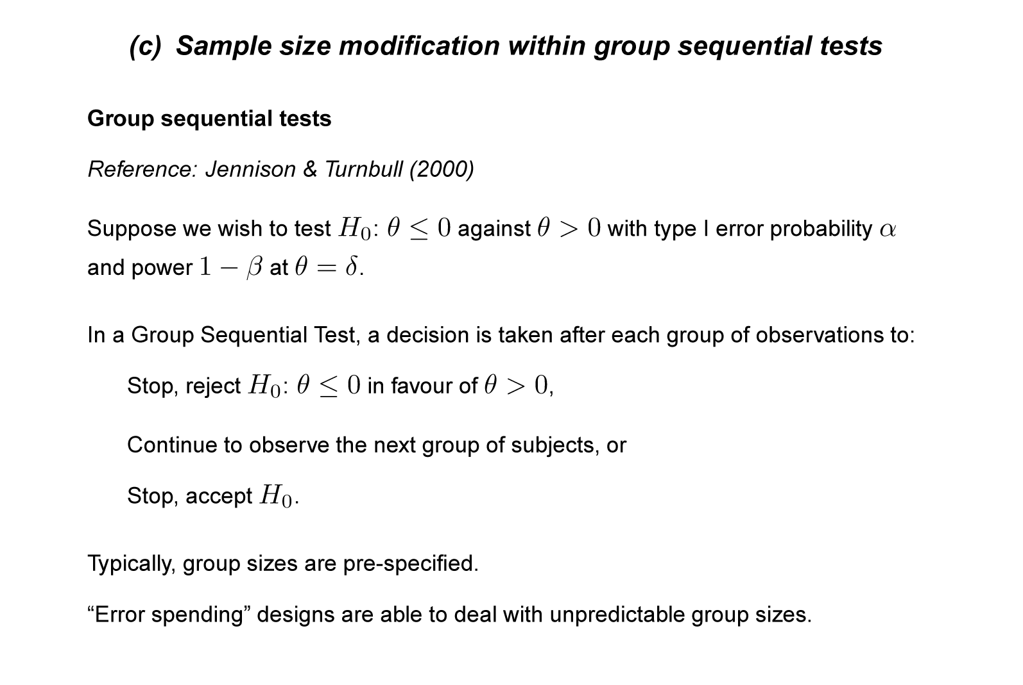
Sample size modification for a nuisance parameter
15
Notes:
15

Slide 16
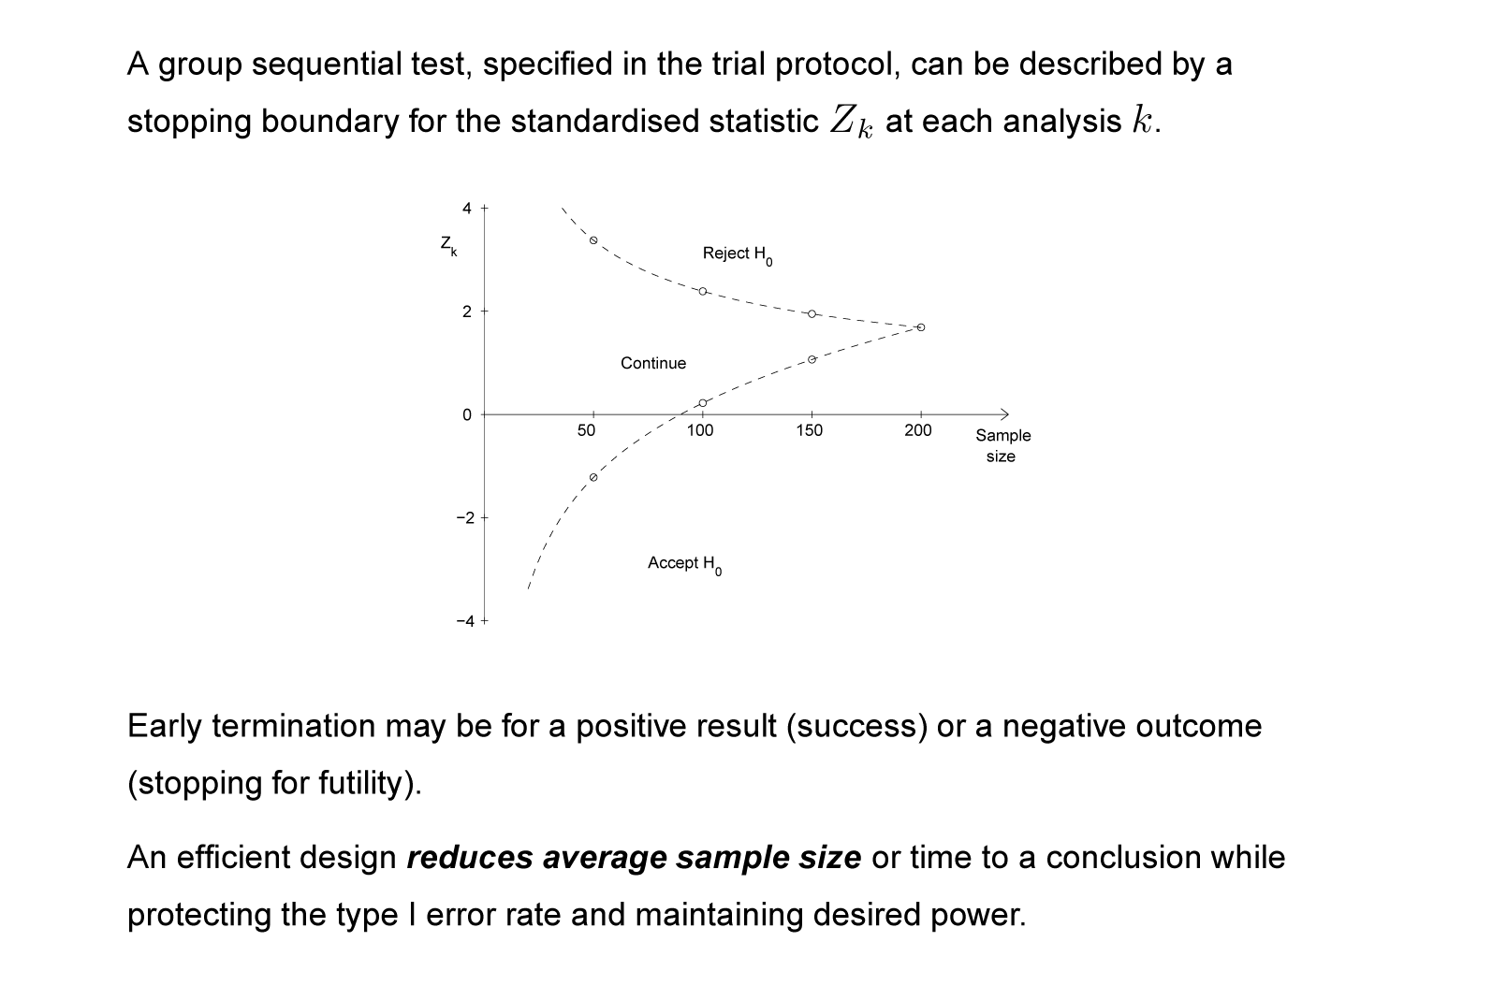
Group sequential tests
16
Notes:
16

Slide 17
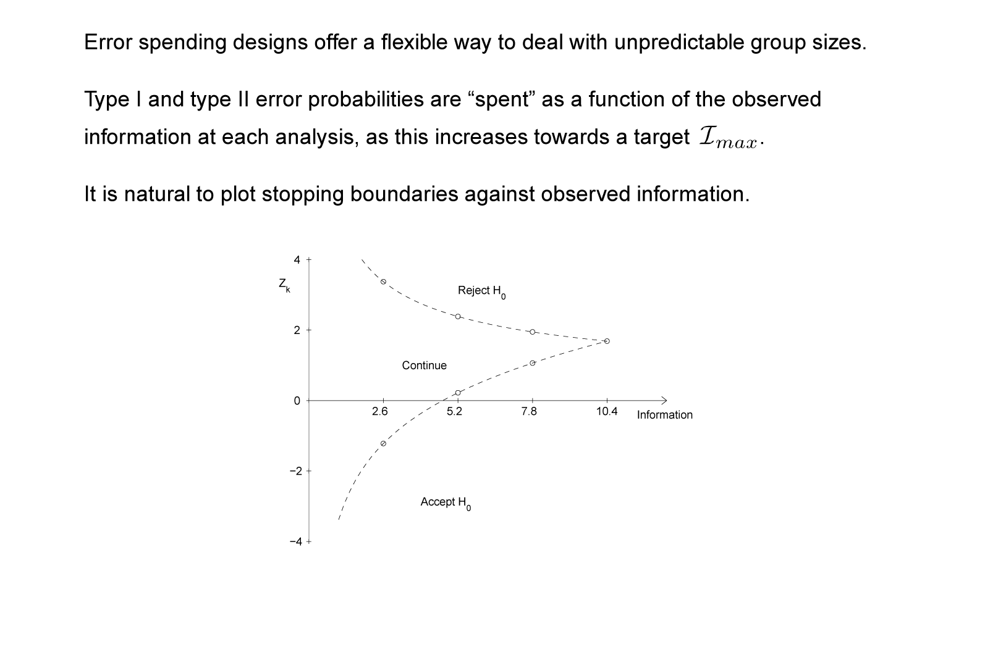
Error spending group sequential tests
17
Notes:
17

Slide 18
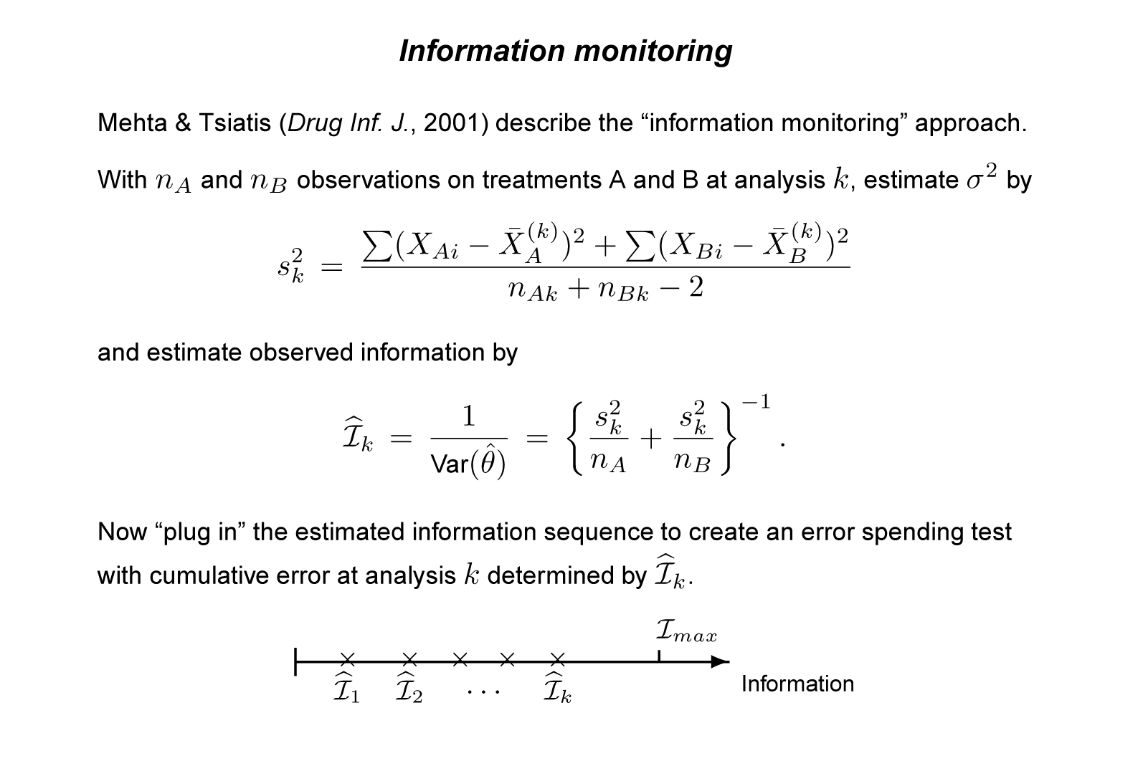
Sample size modification for a nuisance parameter
18
Notes:
18

Slide 19
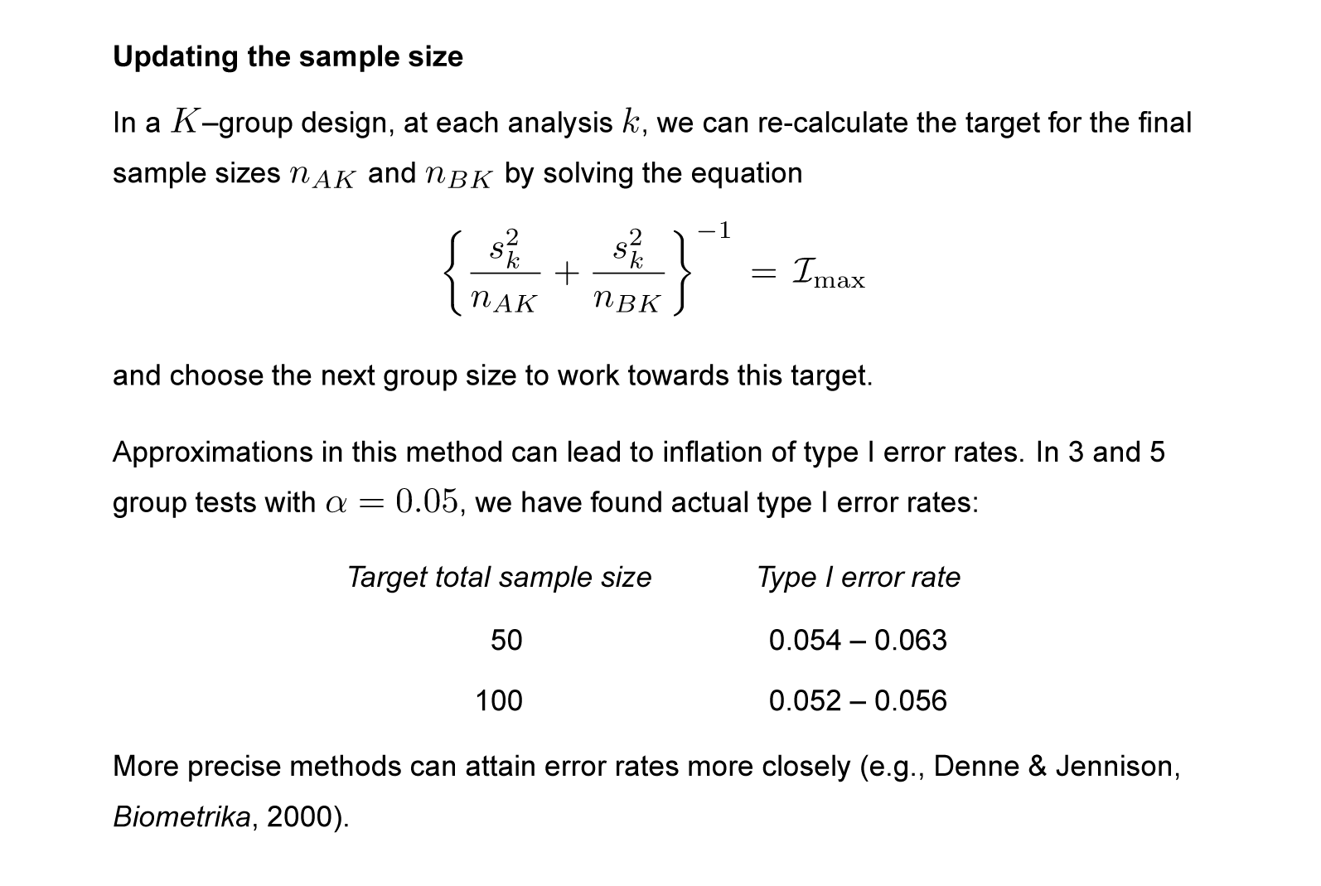
Information monitoring
19
Notes:
19

Slide 20
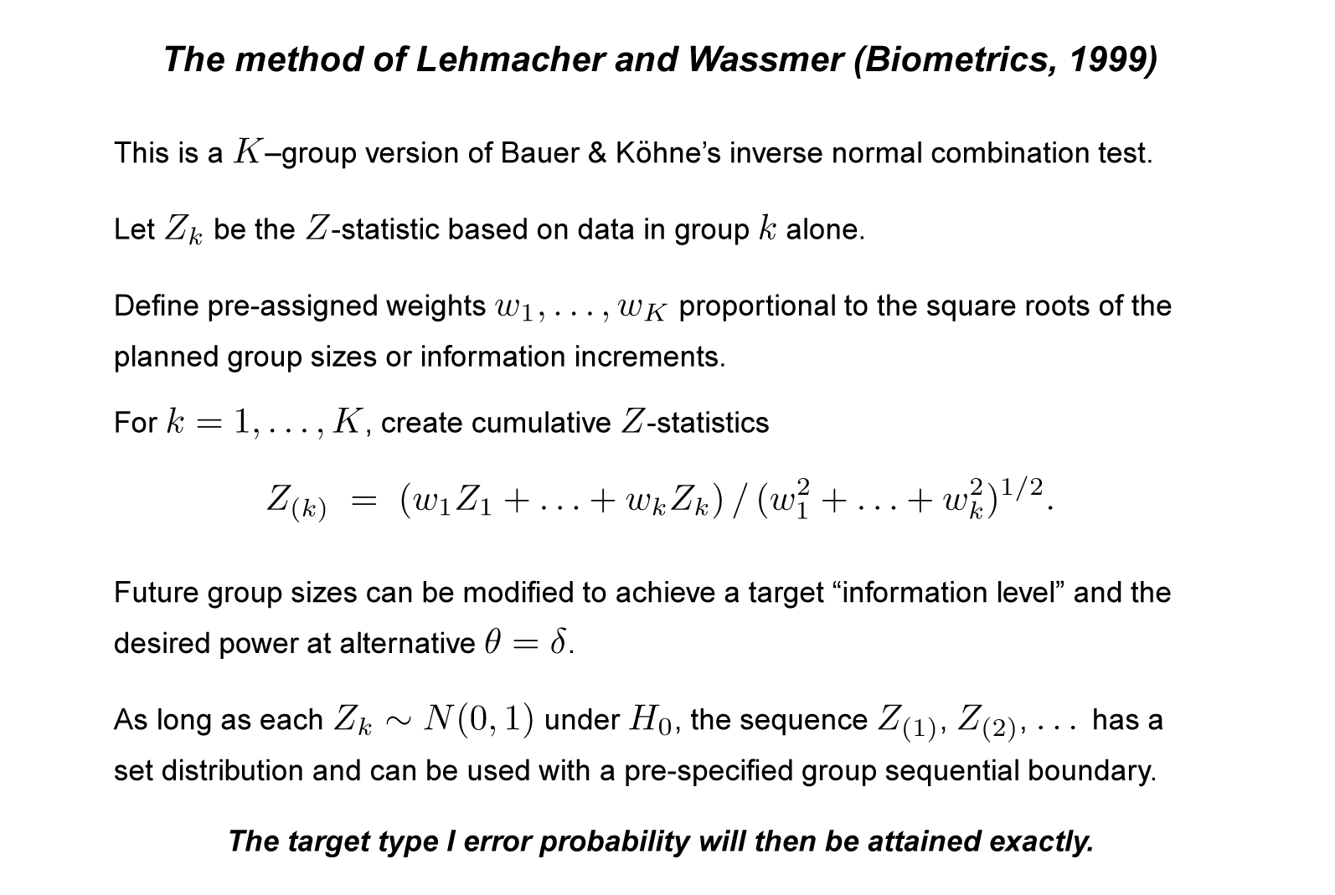
Sample size modification for a nuisance parameter
20
Notes:
20

Slide 21
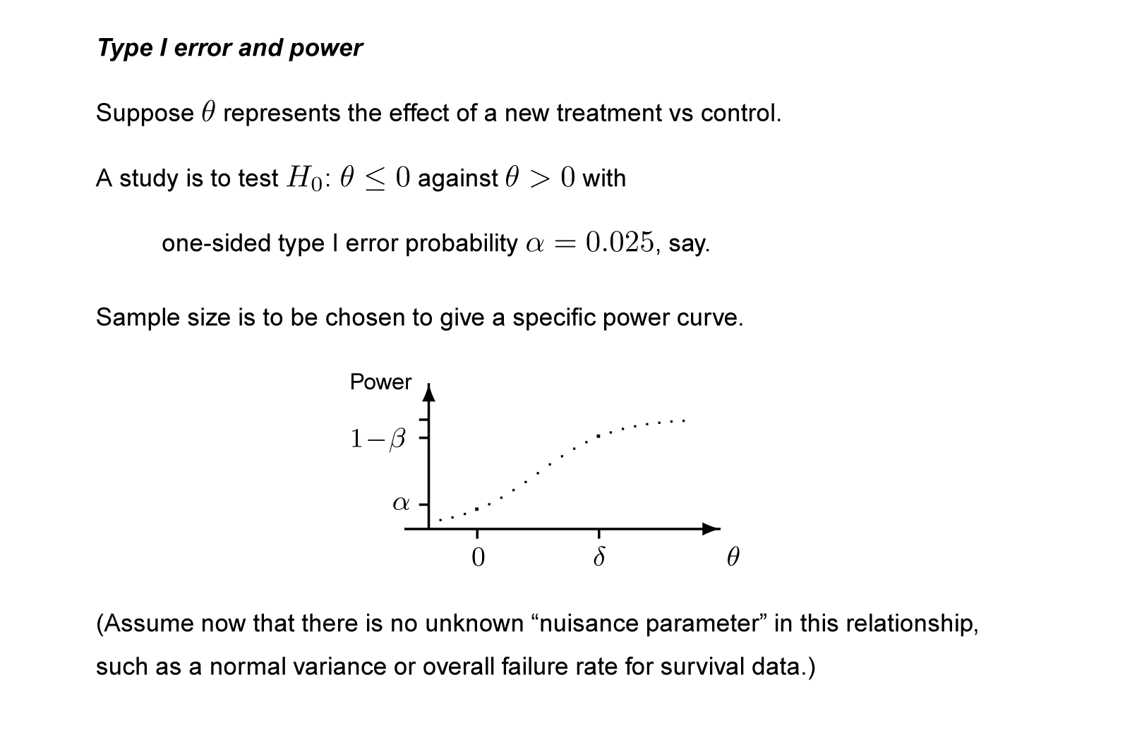
2. Sample size modification to increase power
21
Notes:
21

Slide 22
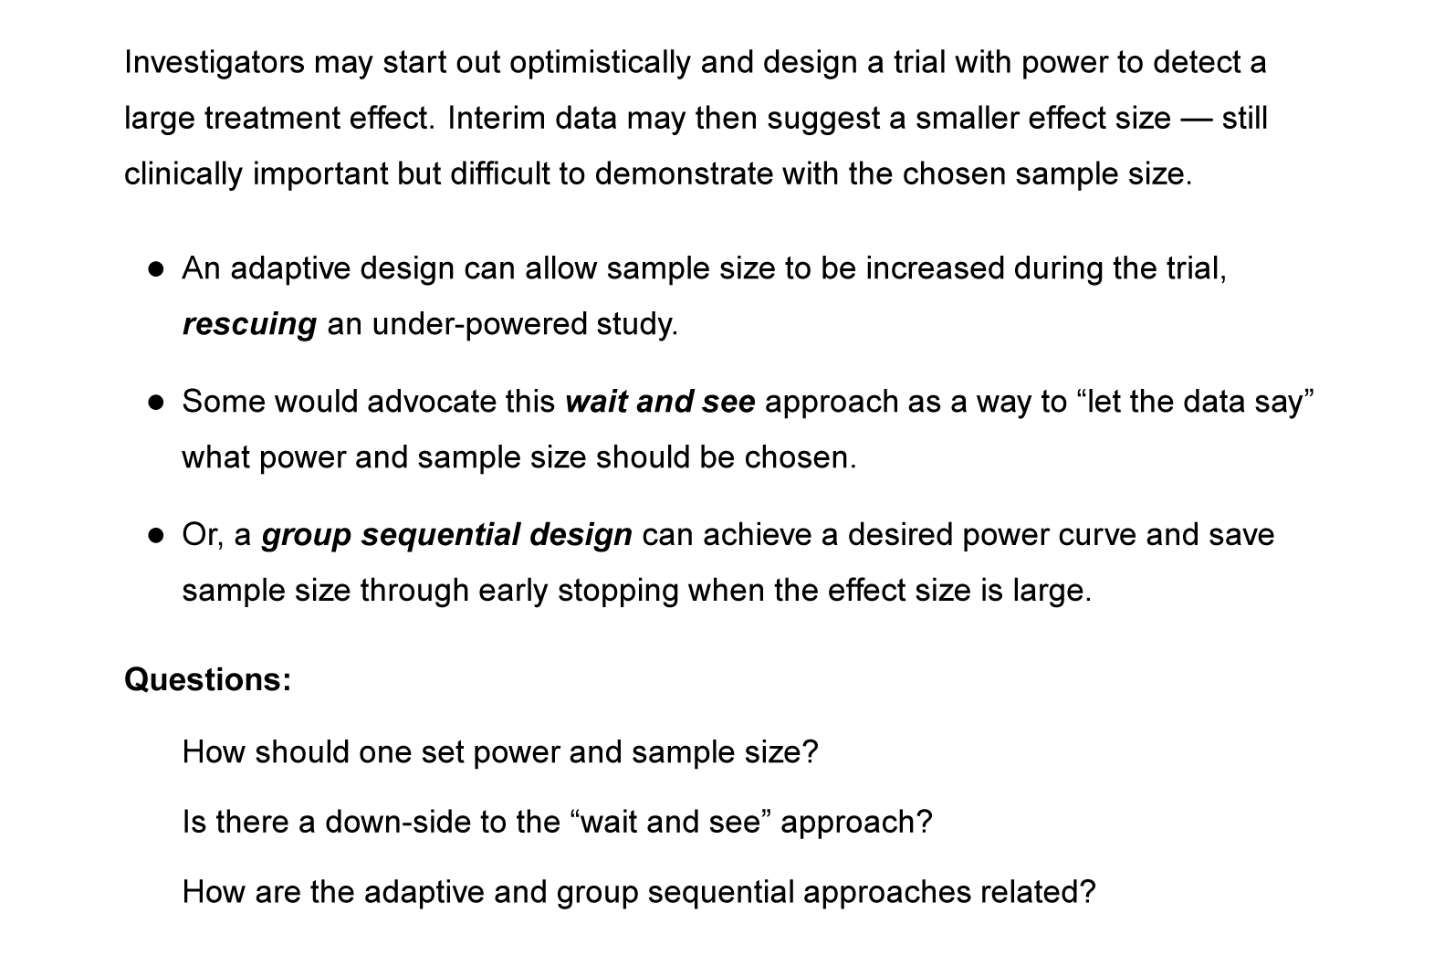
Sample size modification to increase power
22
Notes:
22

Slide 23
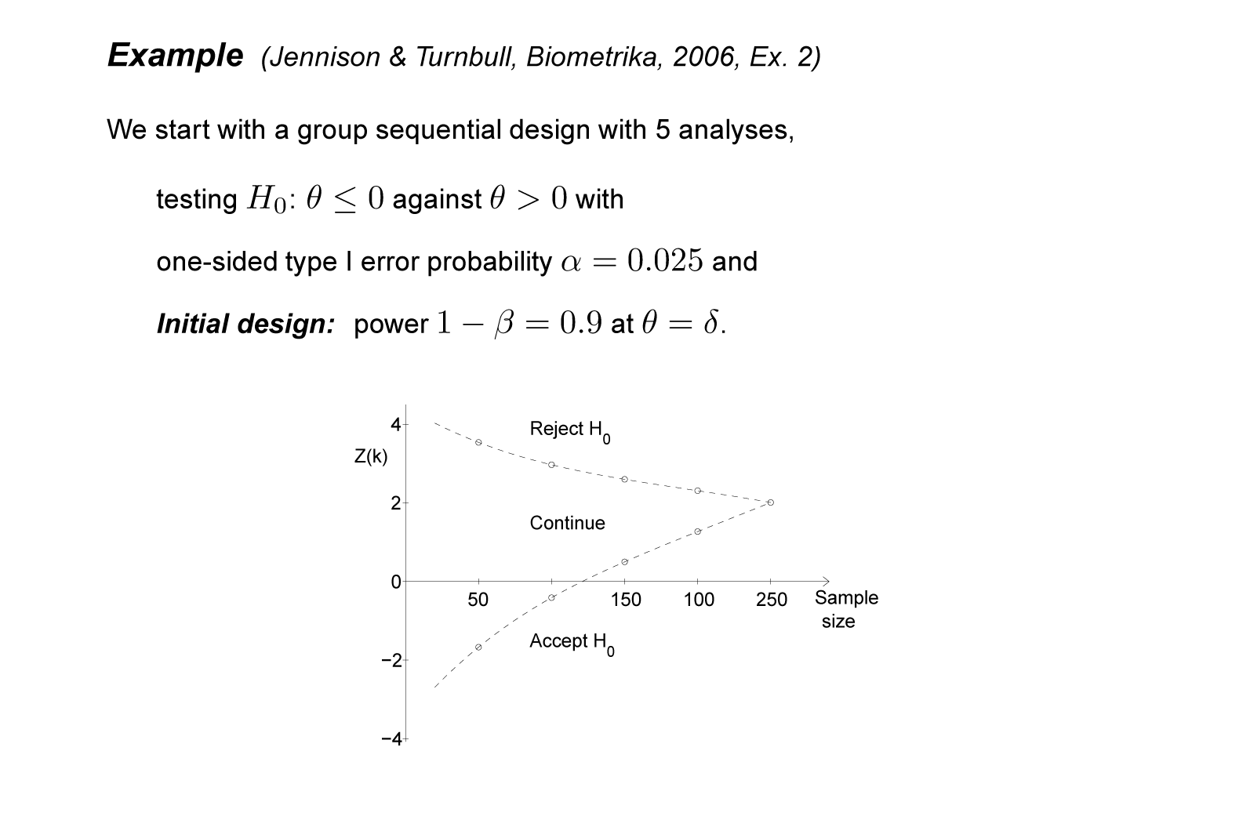
Sample size modification to increase power
23
Notes:
23

Slide 24
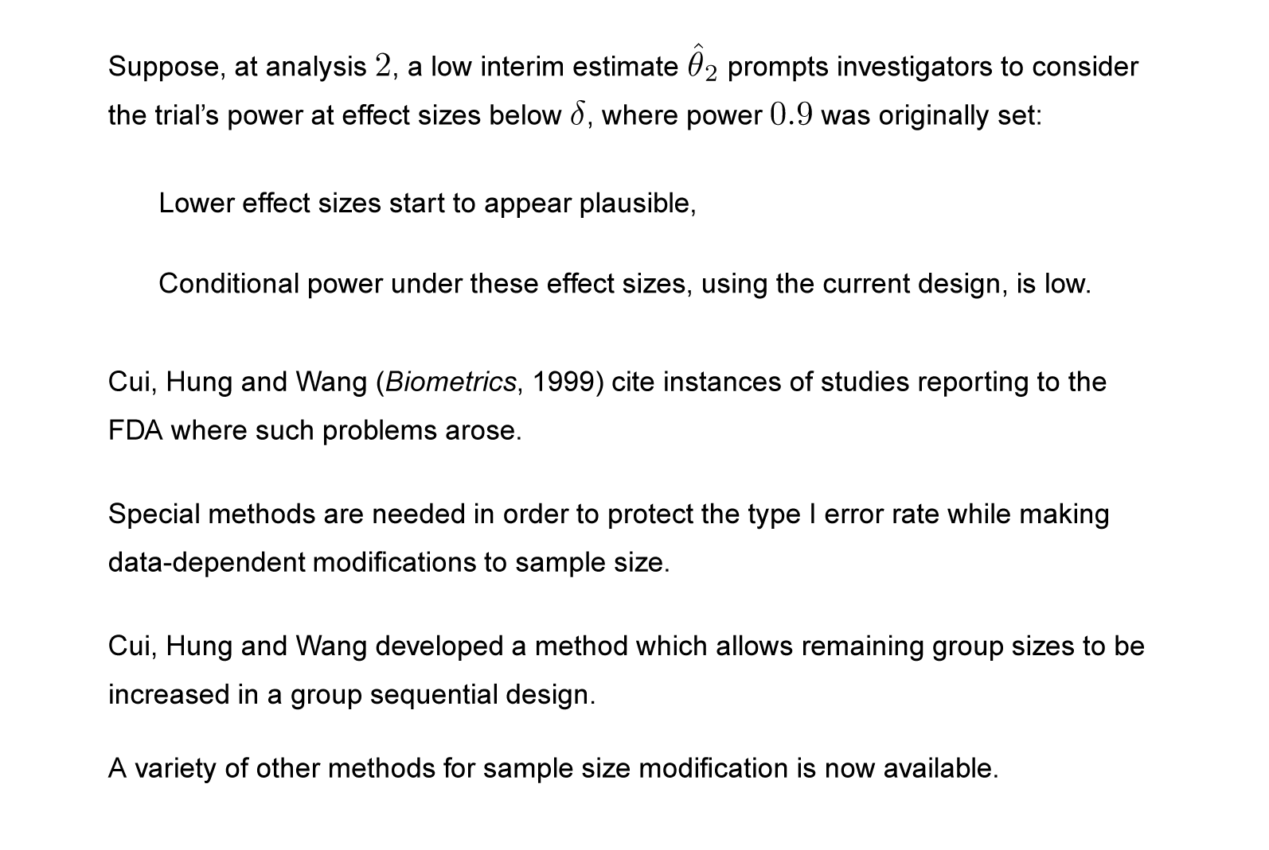
Sample size modification to increase power
24
Notes:
24

Slide 25
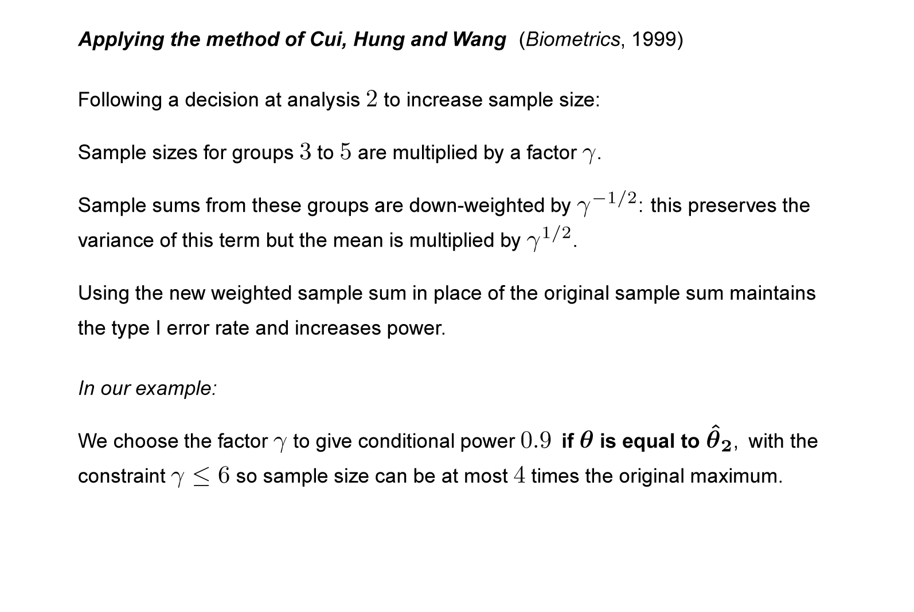
Sample size modification to increase power
25
Notes:
25

Slide 26
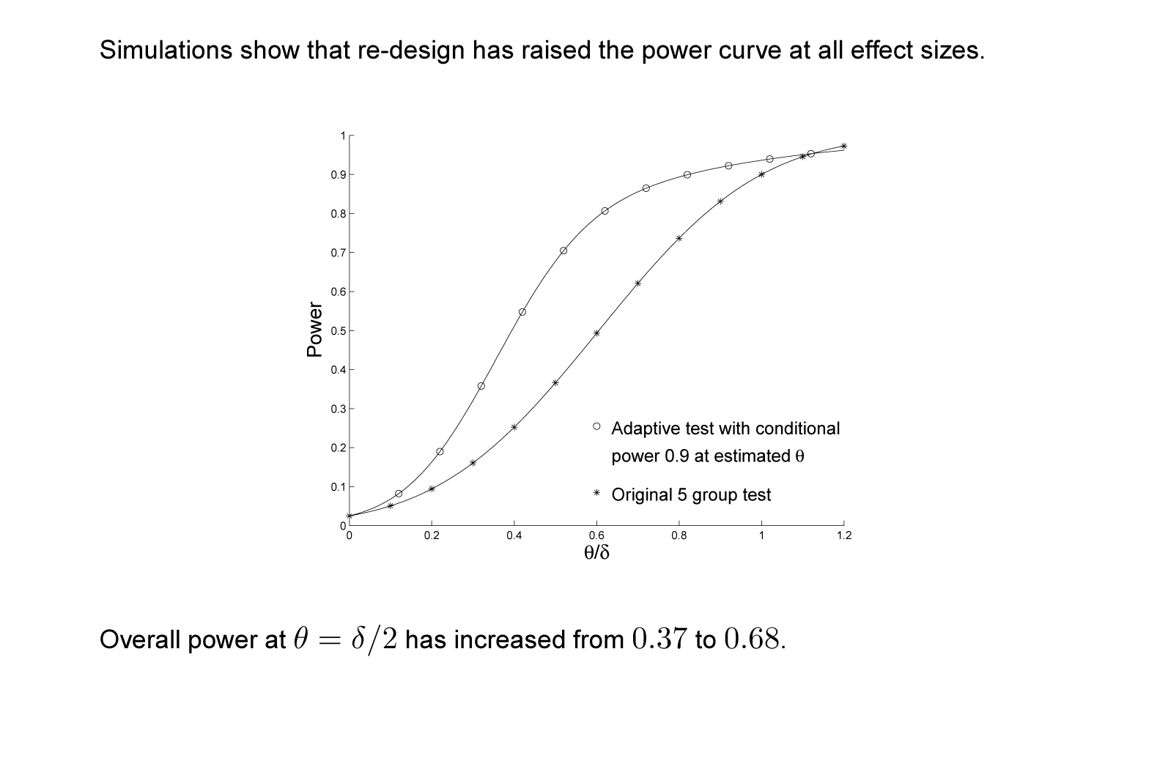
Sample size modification to increase power
26
Notes:
26

Slide 27
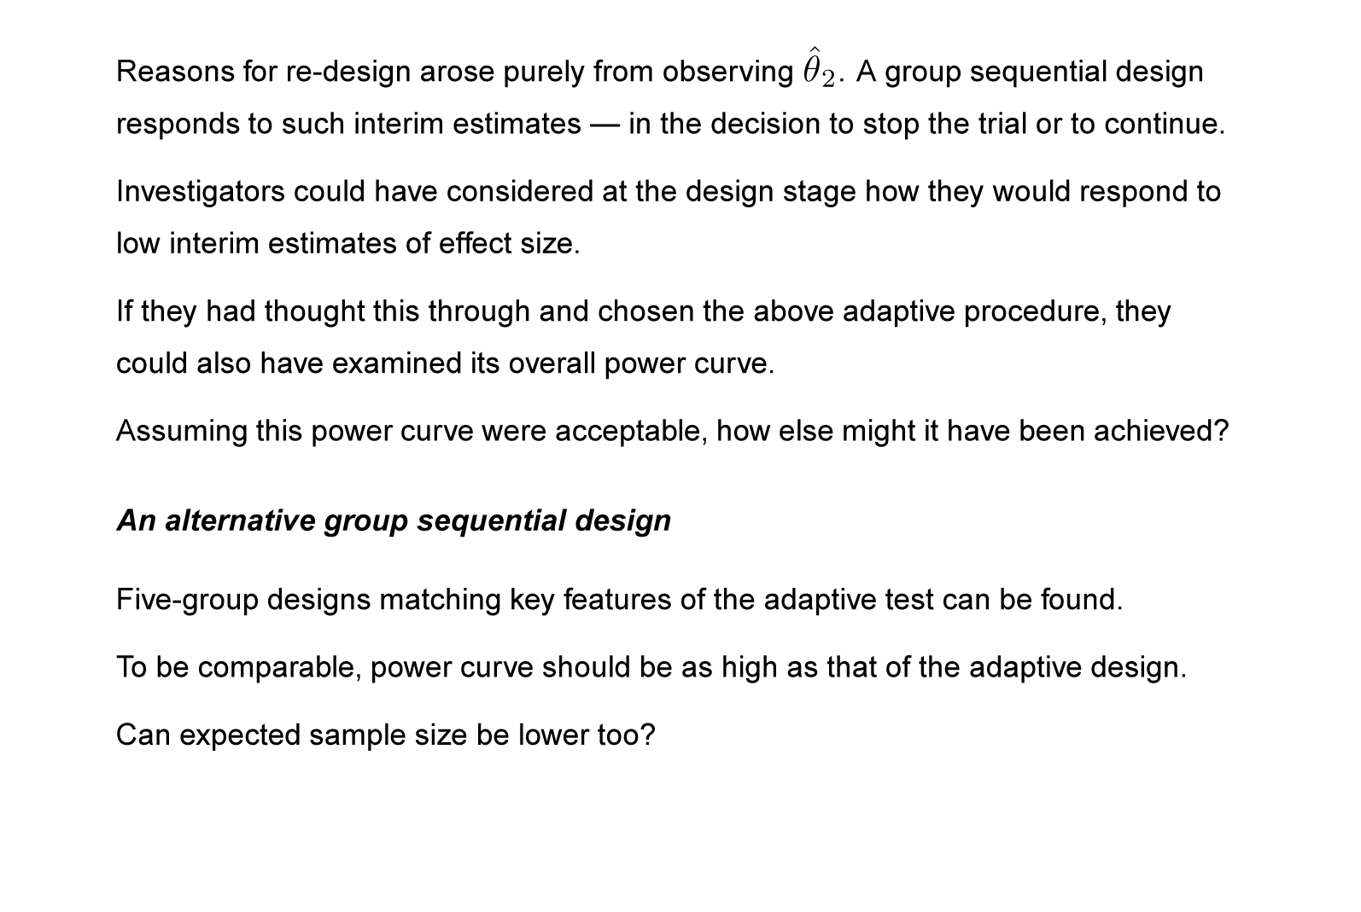
Sample size modification to increase power
27
Notes:
27

Slide 28
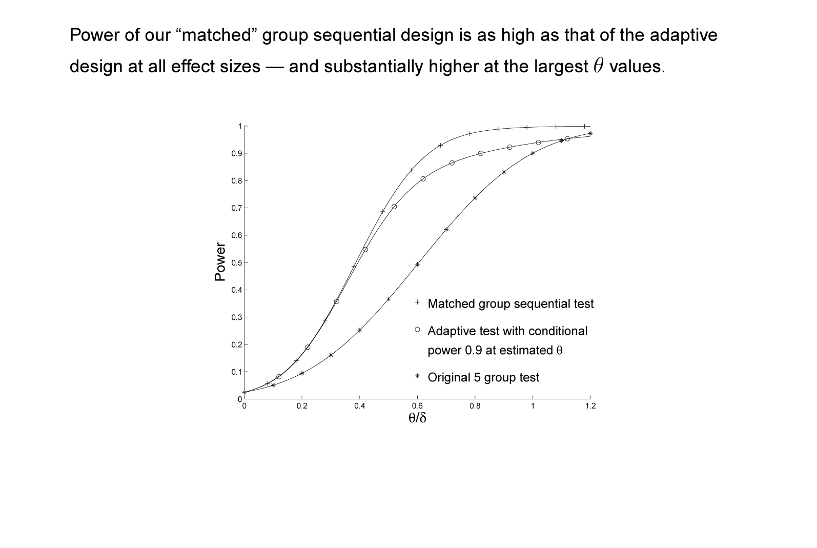
Sample size modification to increase power
28
Notes:
28

Slide 29
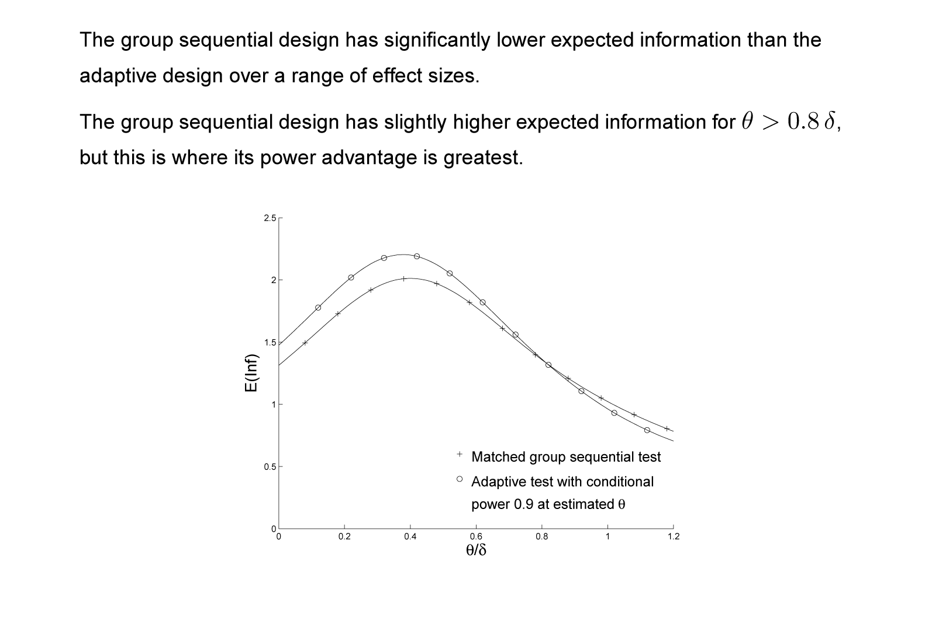
Sample size modification to increase power
29
Notes:
29

Slide 30
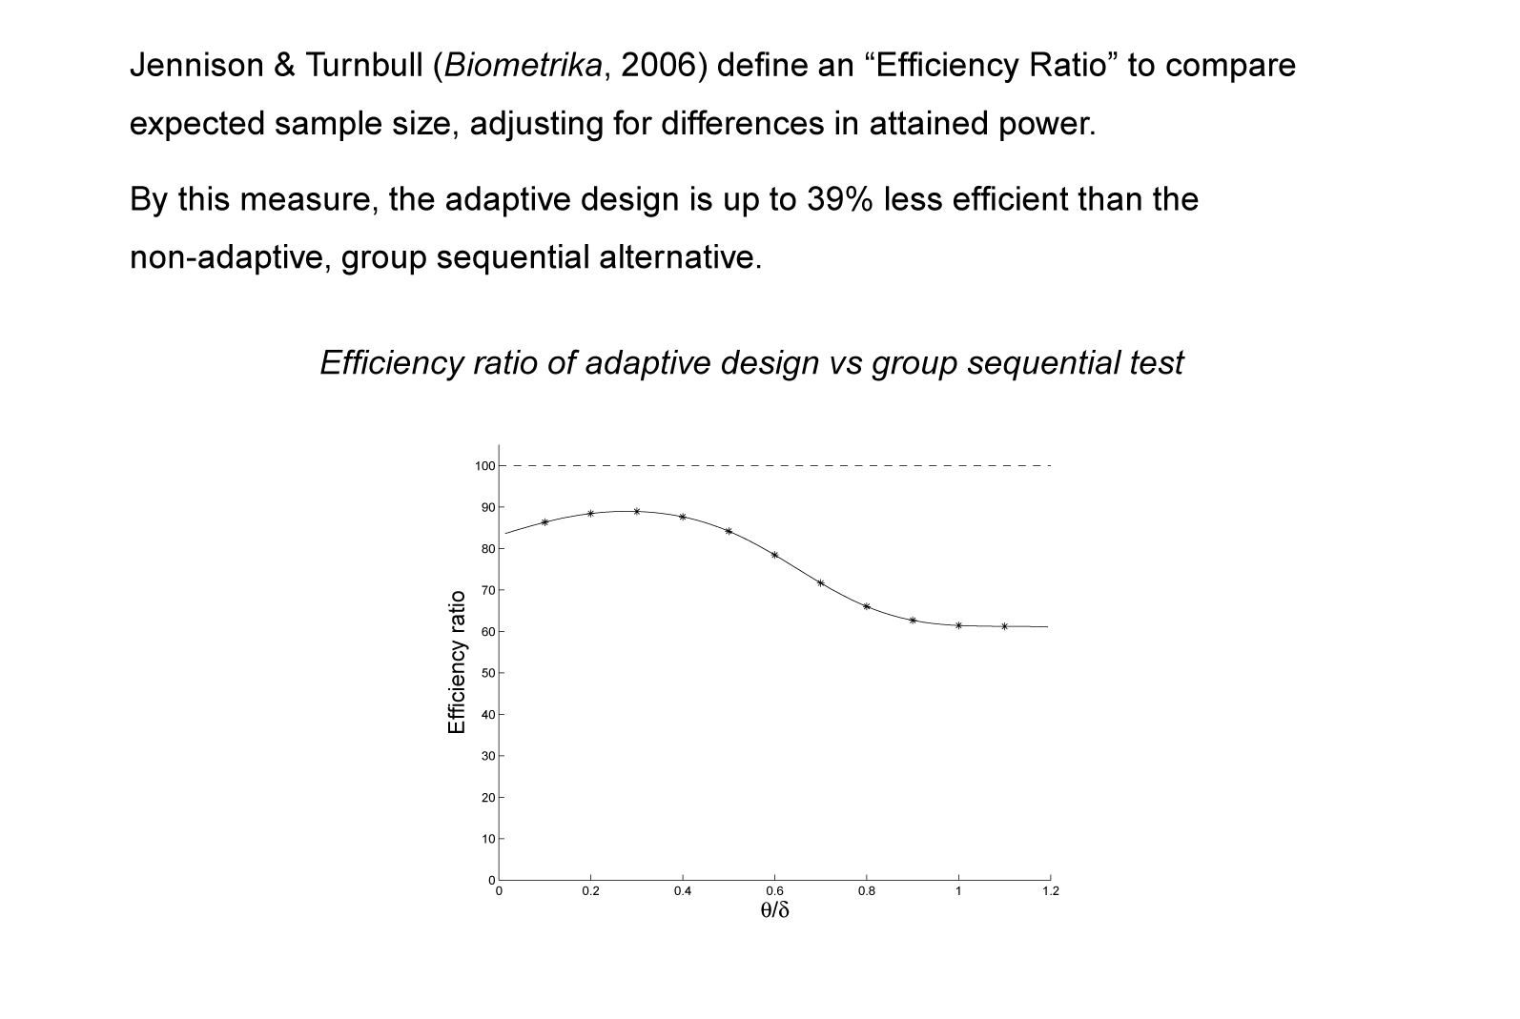
Sample size modification to increase power
30
Notes:
30

Slide 31
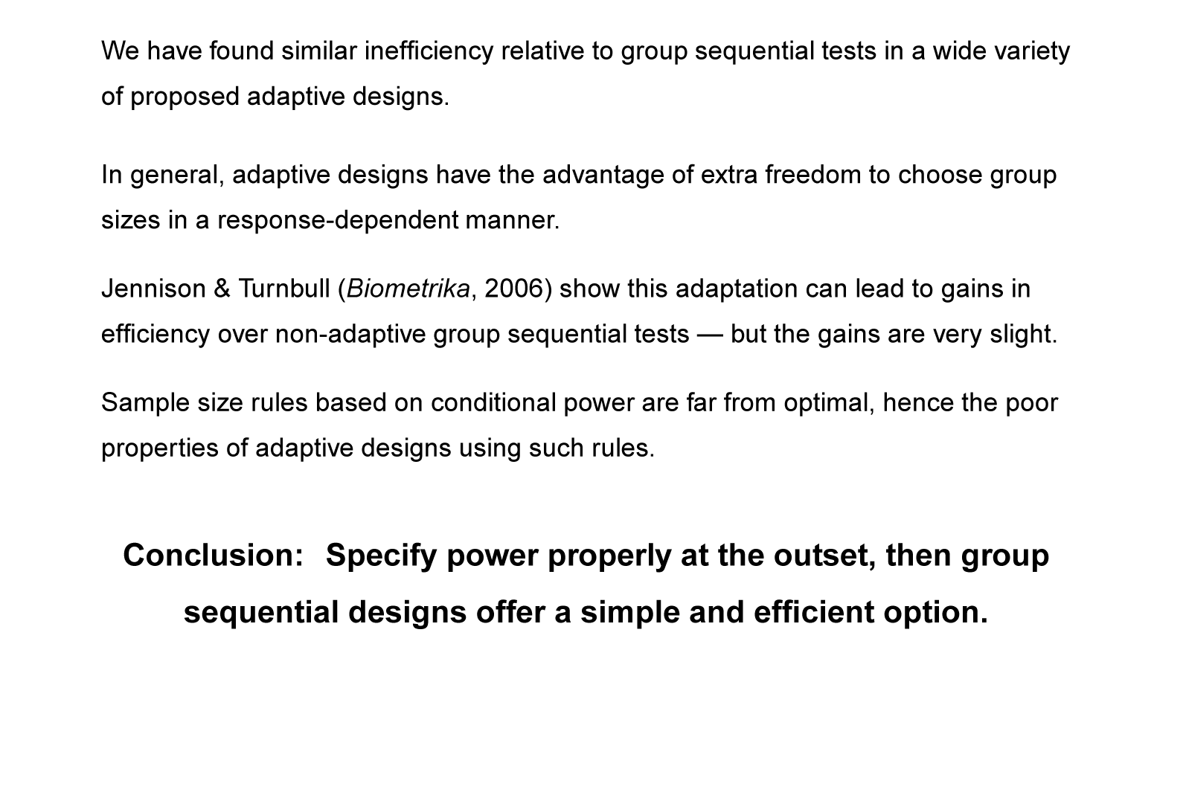
Sample size modification to increase power
31
Notes:
31

Slide 32
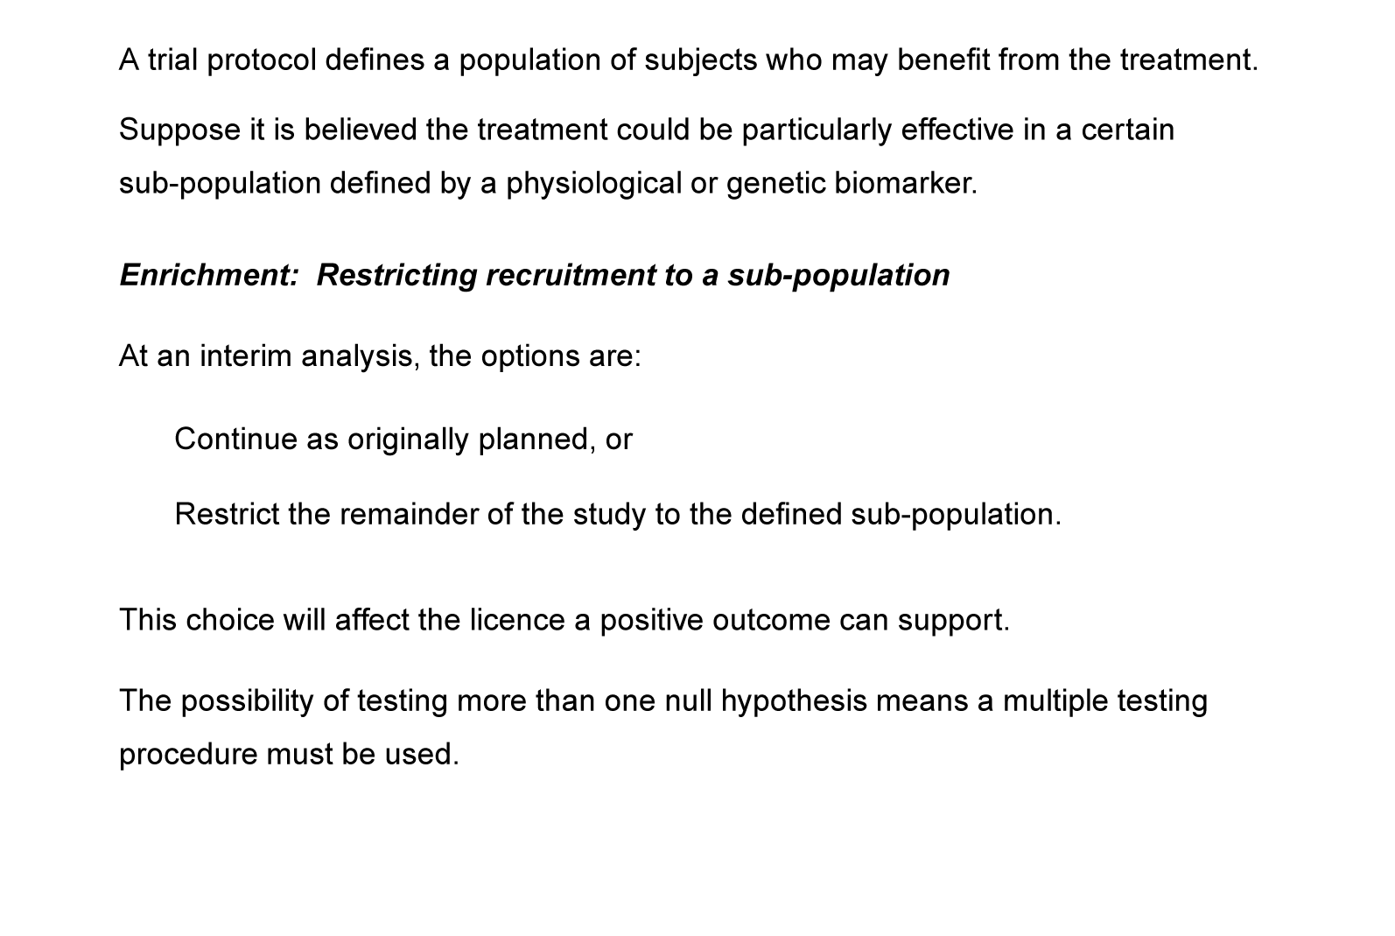
3. Switching to a patient sub-population
32
Notes:
32

Slide 33
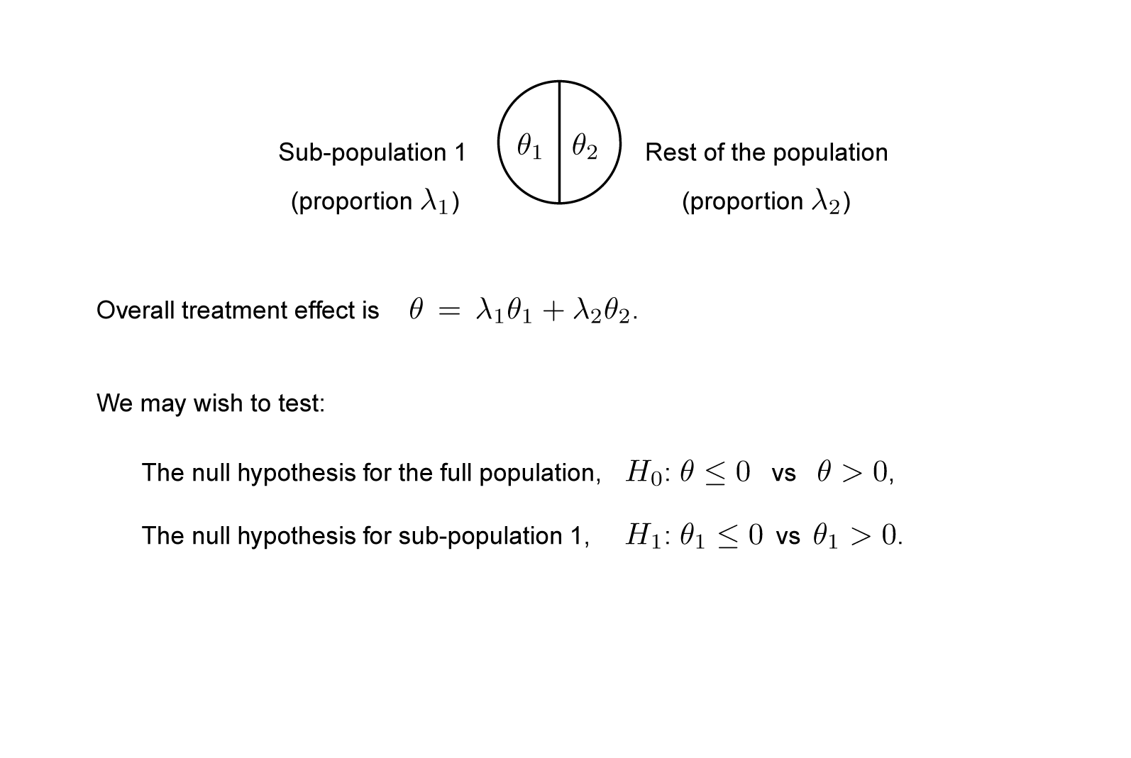
Enrichment: Example
33
Notes:
33

Slide 34
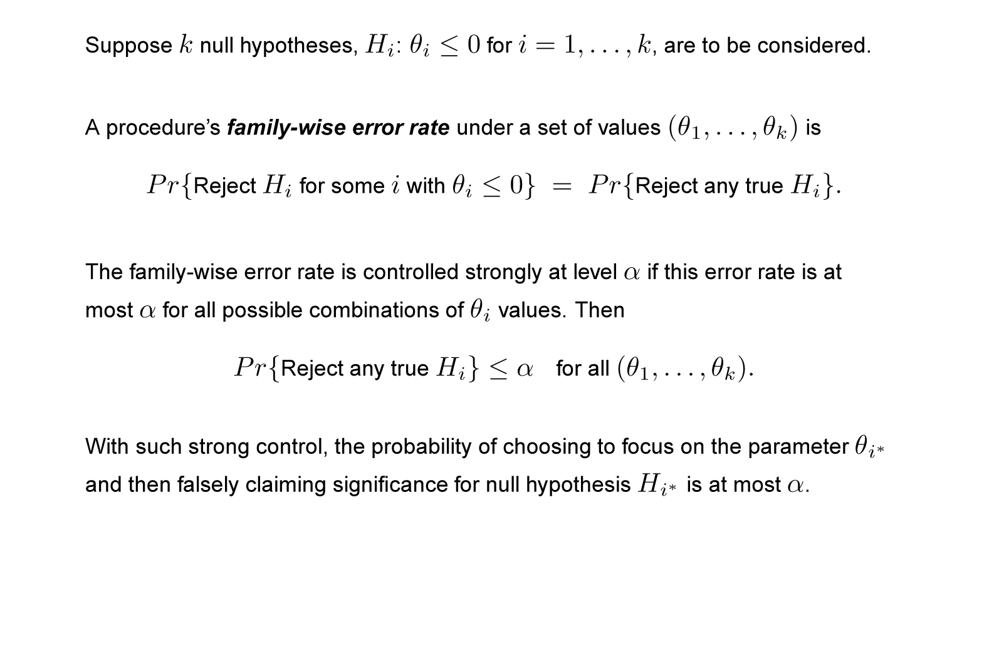
Multiple testing procedures
34
Notes:
34

Slide 35
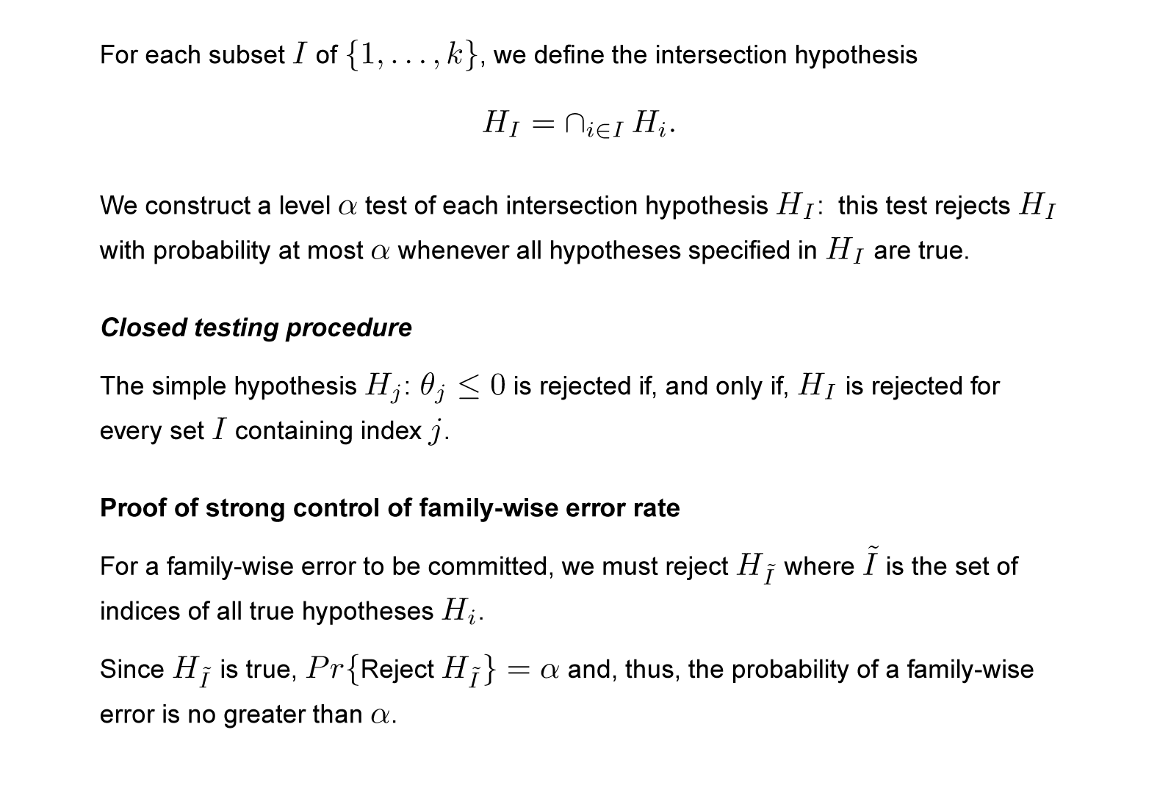
Closed testing procedures (Marcus et al, Biometrika, 1976)
35
Notes:
35

Slide 36
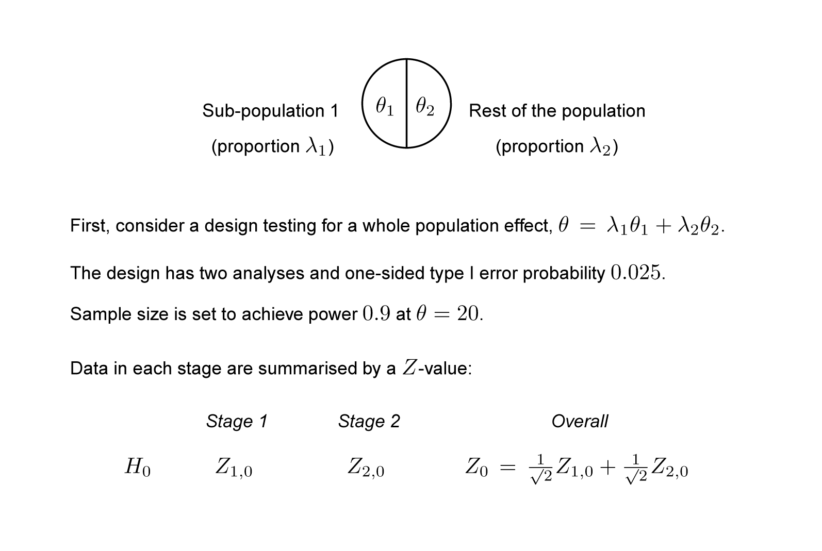
Enrichment: Example
36
Notes:
36

Slide 37
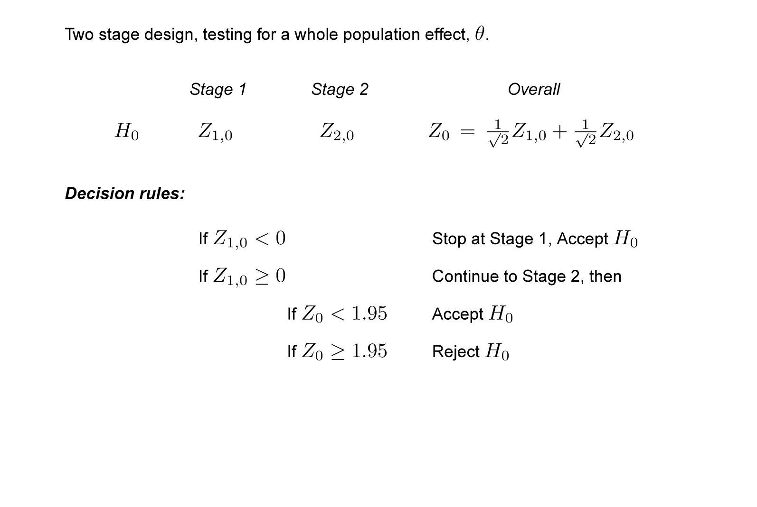
Enrichment: Example
37
Notes:
37

Slide 38
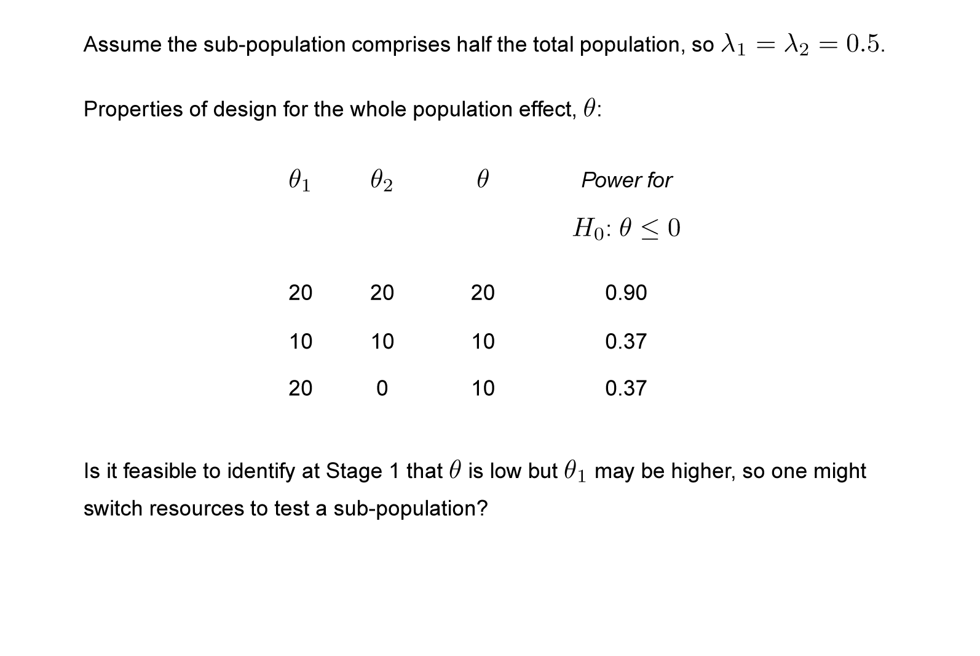
Enrichment: Example
38
Notes:
38

Slide 39
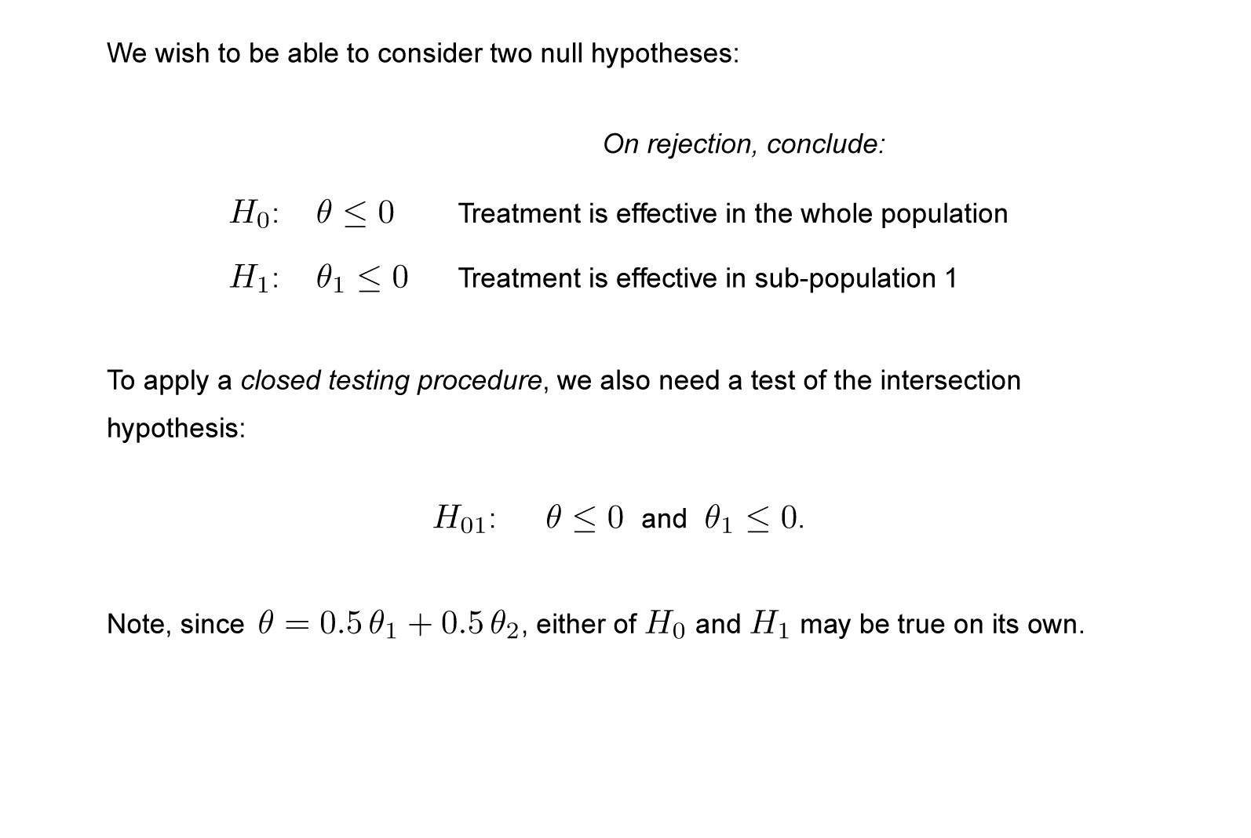
Enrichment: A closed testing procedure
39
Notes:
39

Slide 40
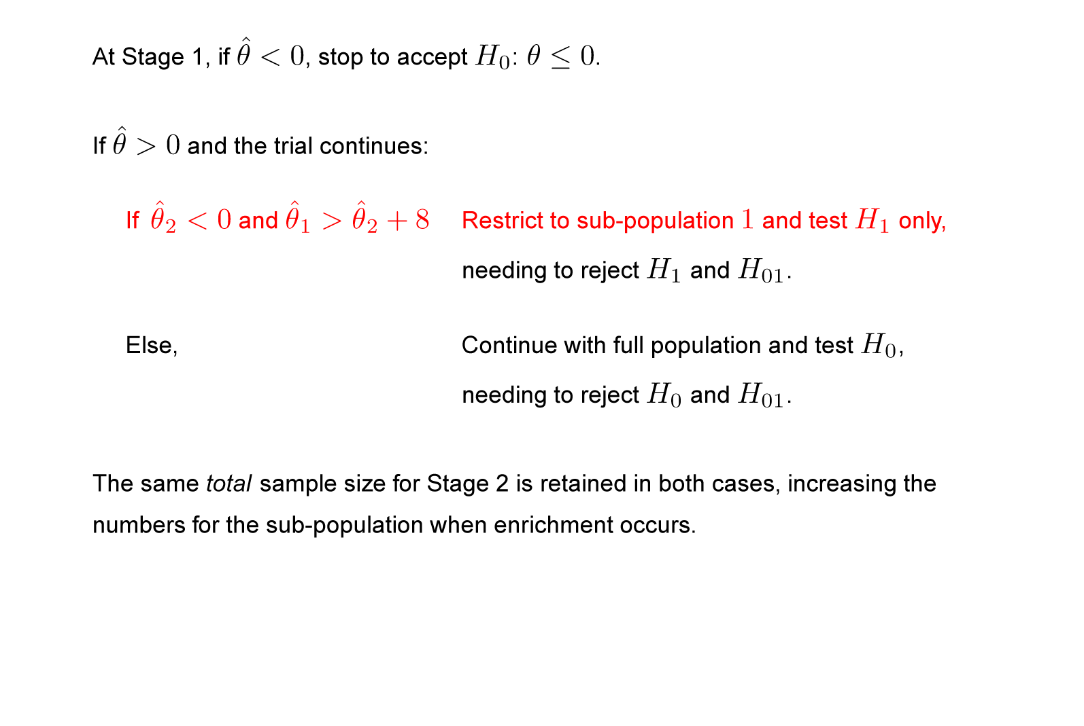
Enrichment: An adaptive design
40
Notes:
40

Slide 41
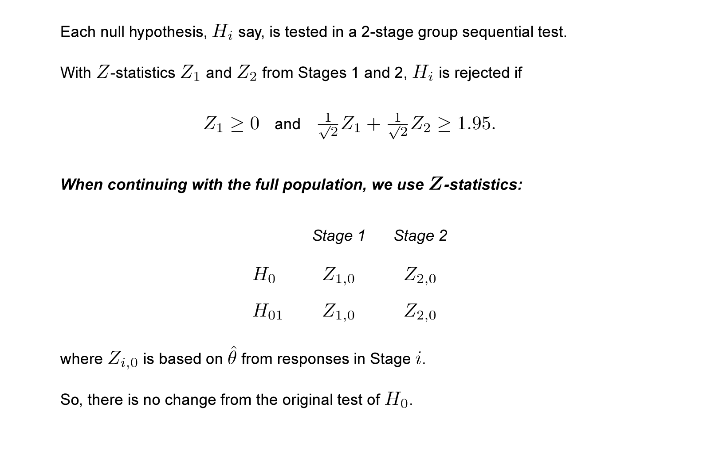
Enrichment: An adaptive design
41
Notes:
41

Slide 42
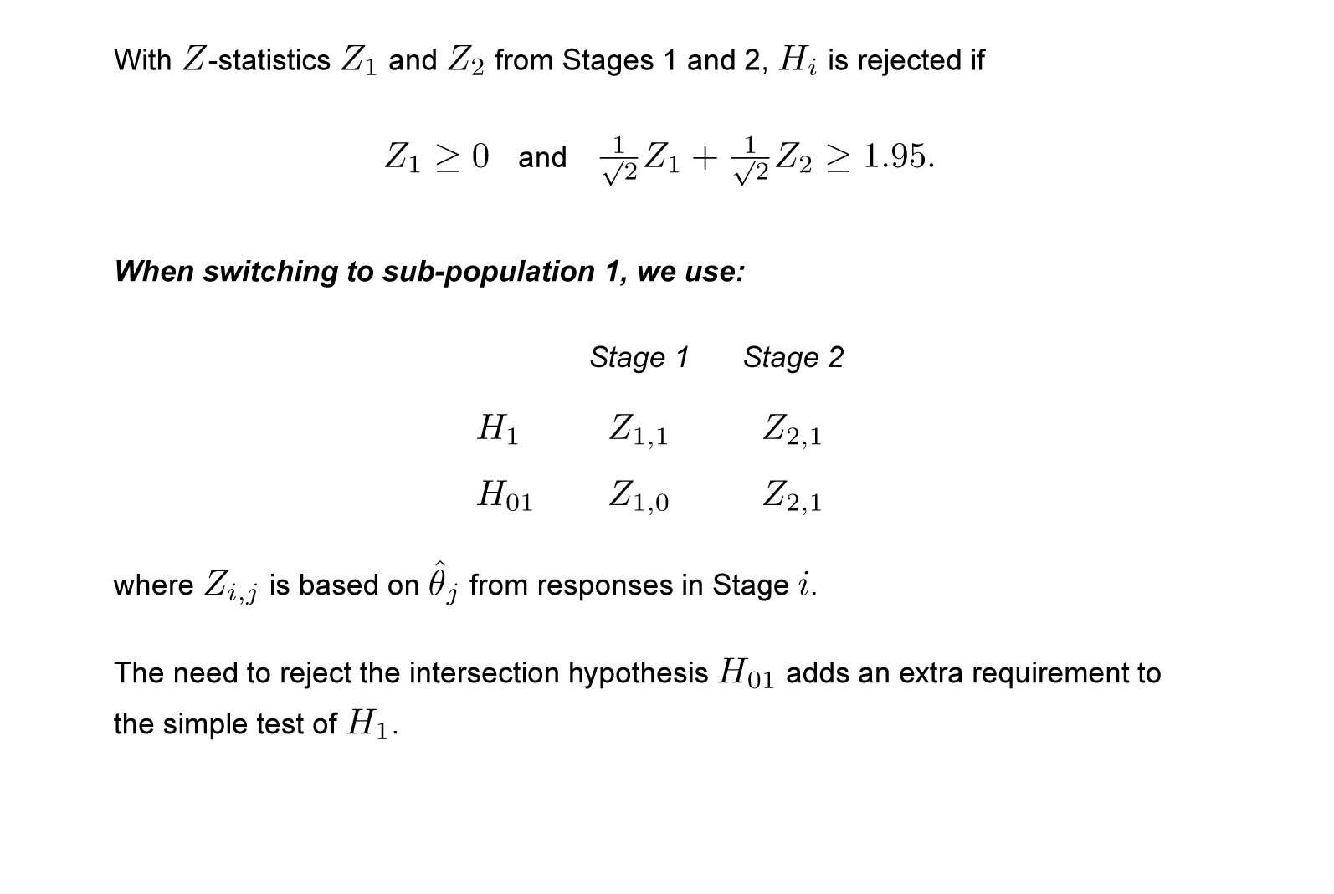
Enrichment: An adaptive design
42
Notes:
42

Slide 43
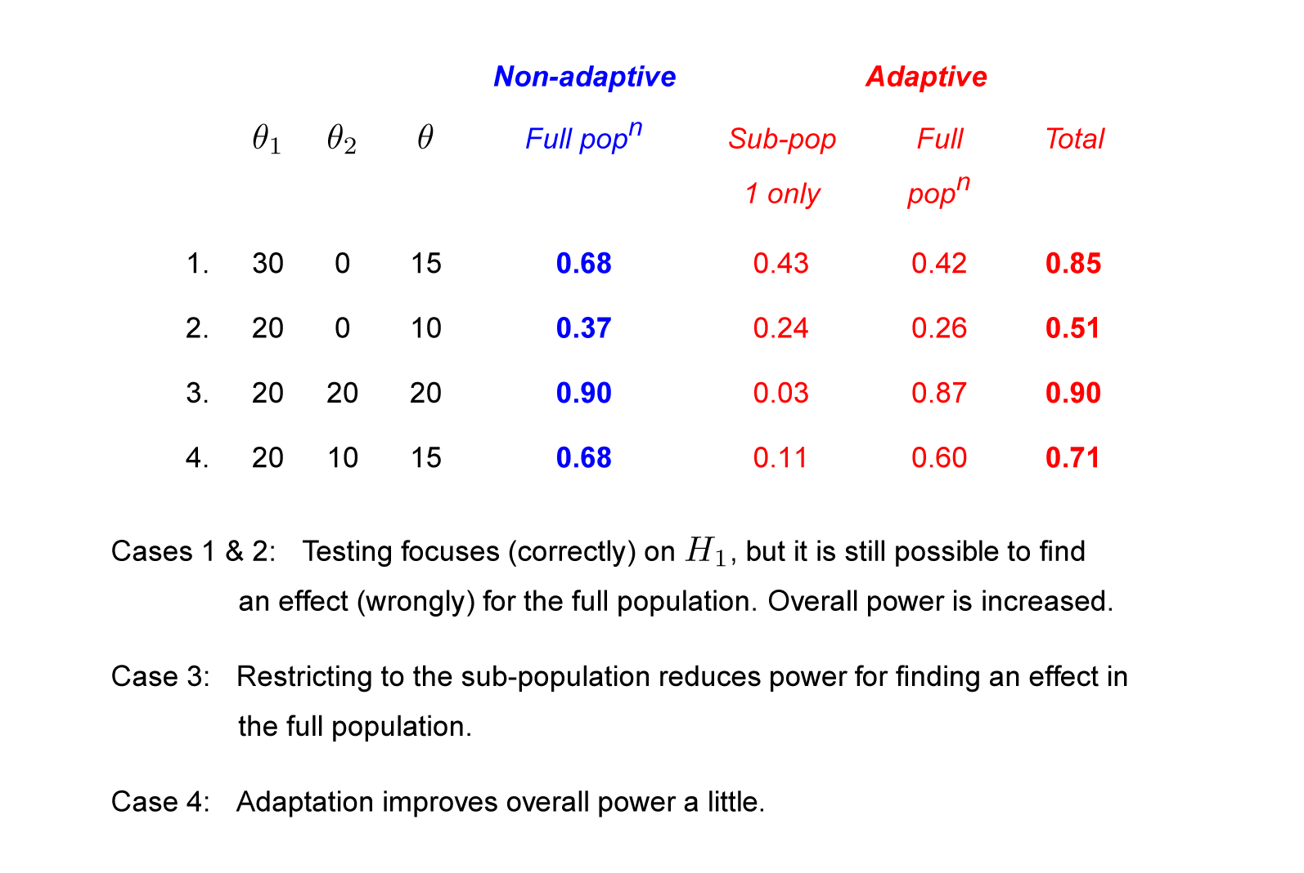
Simulation results: Power of non-adaptive and adaptive designs
43
Notes:
43

Slide 44
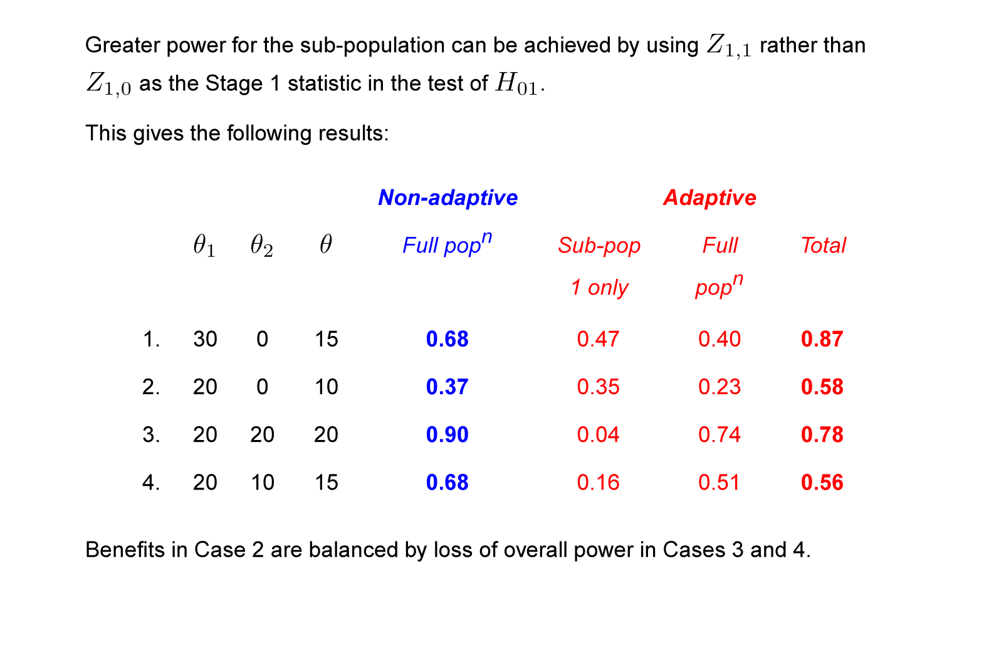
Increasing power for finding a sub-population effect
44
Notes:
44

Slide 45
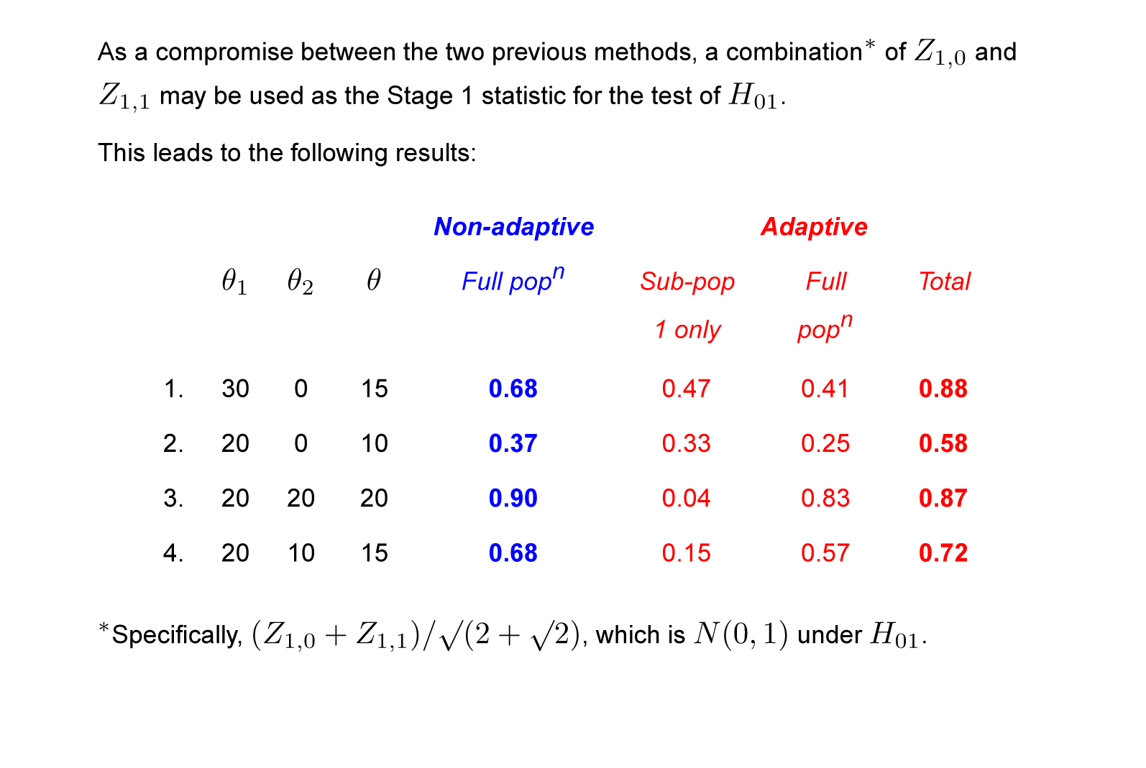
Increasing power for finding a sub-population effect
45
Notes:
45

Slide 46
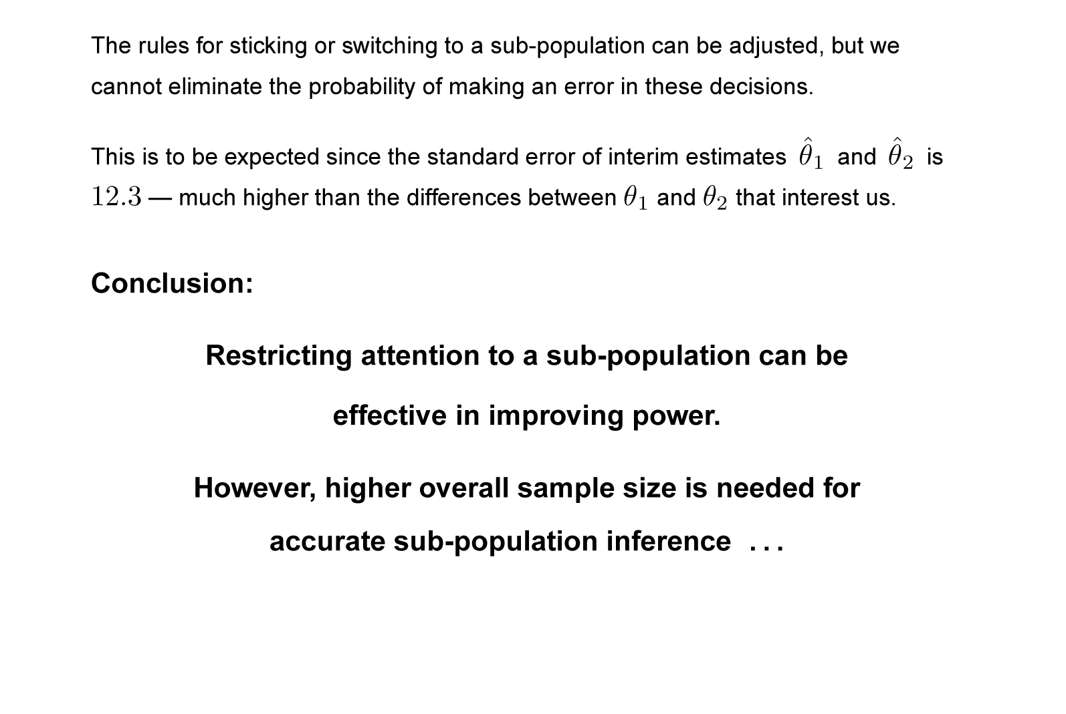
Enrichment: Example
46
Notes:
46

Slide 47
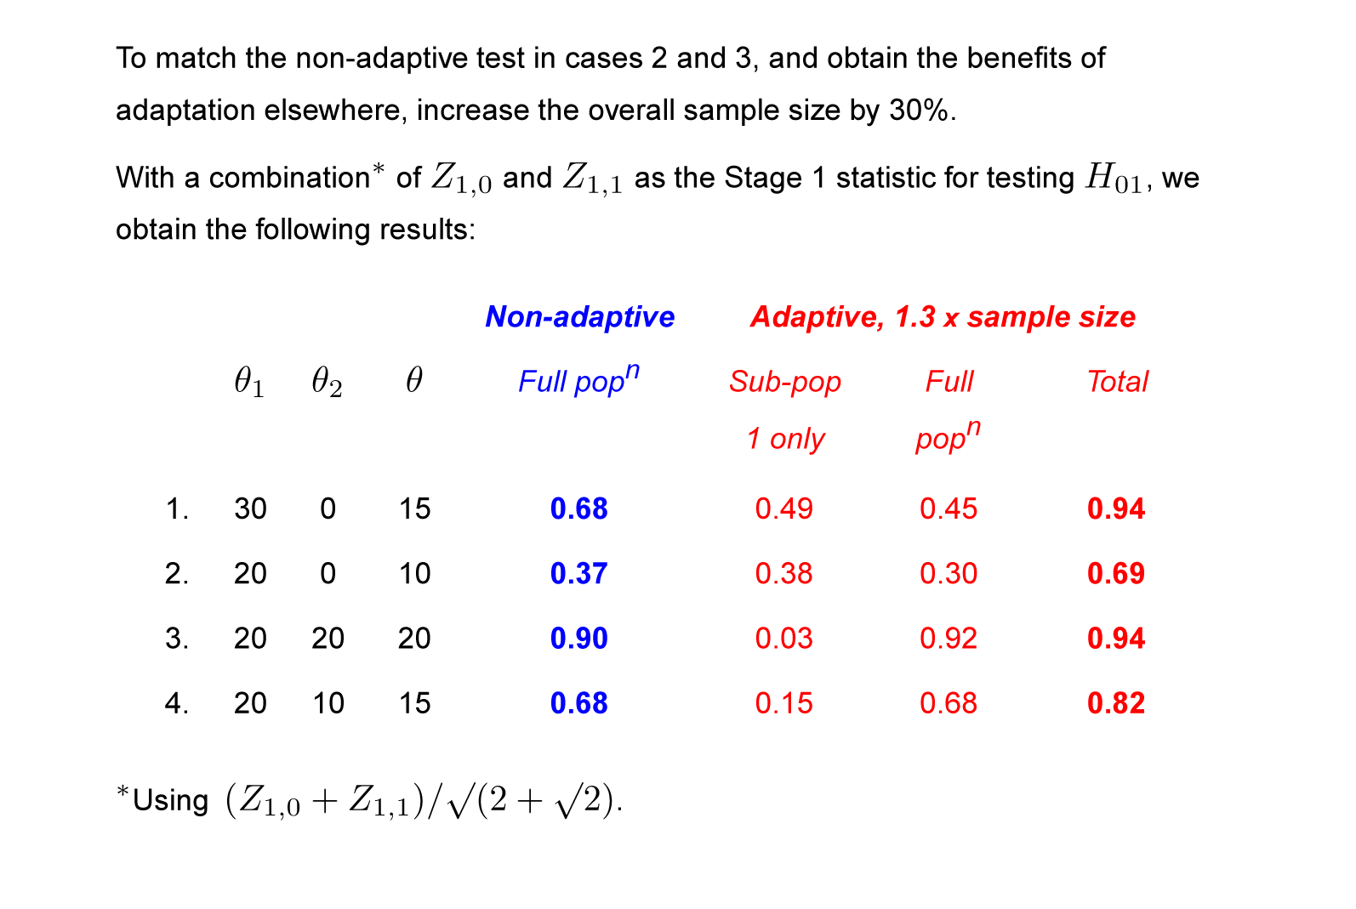
Increasing power for finding a sub-population effect
47
Notes:
47

Slide 48
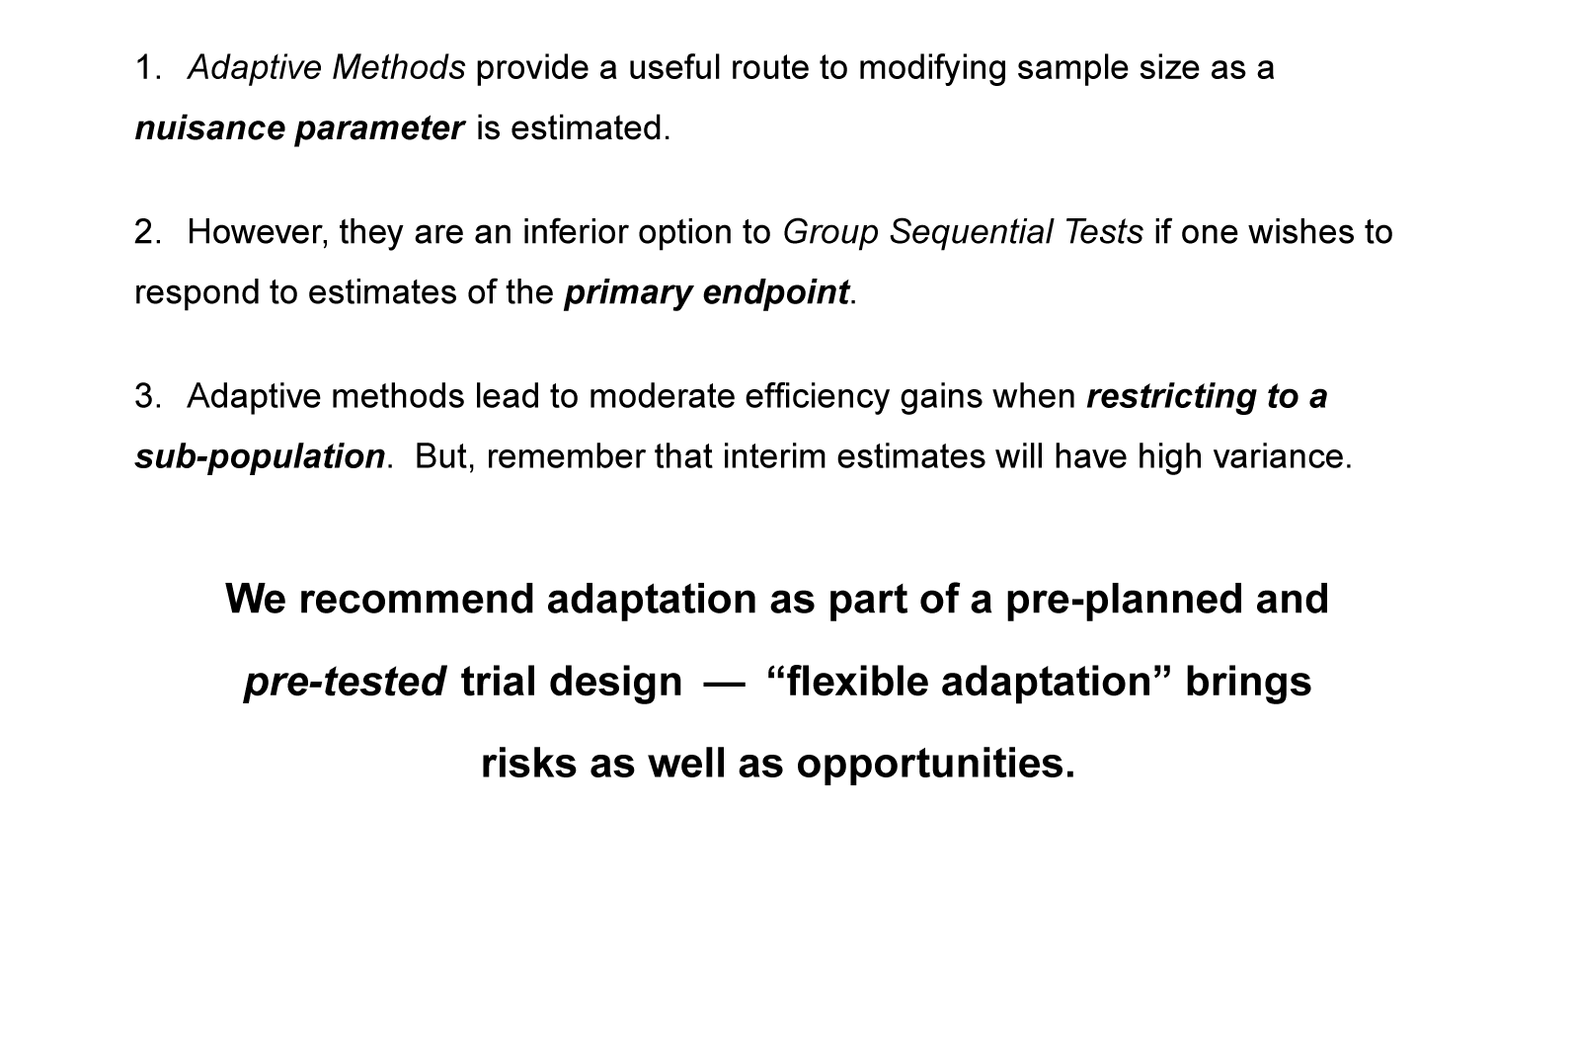
Conclusions
48
Notes:
48

