Slide 1
Breakout Session 4: Personalized Medicine and Subgroup Selection
Christopher Jennison, University of Bath
Robert A. Beckman, Daiichi Sankyo Pharmaceutical Development and University of California at San Francisco

Slide 2
Agenda
TOPIC 1: Where do subgroups come from? Empirical data or basic science? How does this vary as a function of developmental stage?
TOPIC 2: Purpose of subgroups? Clinical ‒ to treat patients better? Commercial ‒ defining a niche market? How to handle continuous biomarkers ‒ what are tradeoffs involved in setting the cutoff?
TOPIC 3: How to design studies with subgroups in them?

Slide 3
Topic 1: Where do Subgroups come from? Chris Jennison’s thoughts
The science behind the treatment’s mode of action and how it disrupts the disease pathway may imply that certain patients are more likely to benefit from the treatment.
If the treatment targets a particular protein, say, patients with high levels of this protein are likely to have the greatest benefit.
However, other patients may still benefit, but to a lesser degree.

Slide 4
Topic 1: Where do Subgroups come from? Bob Beckman’s thoughts
Phase 2 subgroups would come from preclinical, Phase 0, and Phase 1 data
This early experimental data needs to be validated clinically
Recommend formal testing of a single lead predictive biomarker hypothesis defining subgroups. Single lead biomarker hypothesis avoids multiple comparisons
Other biomarker hypotheses/subgroups can be exploratory endpoints. If positive result in Phase 2, an exploratory subgroup would have to be prospectively confirmed in a new Phase 2 study
Phase 3 subgroups should be derived from Phase 2 clinical evidence
Phase 3 subgroup discovery generally does not allow enough time for companion diagnostic co-development

Slide 5
Topic 2: Purpose of subgroups
Clinical: tailor therapy to patients who will benefit most
Increase benefit risk ratio for patients
Increase probability of success for drug developers
Possible cost reduction in phase 3 due to larger effect sizes
Commercial: greater benefit may allow acceptance by payors in increasingly demanding environment
May have smaller market, but larger effect size could lead to higher price and longer treatment times

Slide 6
Continuous Biomarkers: the tradeoff involved in setting a cutoff
From Fridlyand et al, Nature Reviews Drug Discovery, 12: 743-55 (2013).

Slide 7
Topic 3: Recommendations for Trials with Subgroups Chris Jennison
Within a Phase III clinical trial
Define biomarker positive (BM+) and biomarker negative (BM-) subgroups
Set up null hypotheses
H_{0,1}: no effect in the BM+ group
H_{0,2}: no effect in the full population
Start the trial with recruitment of patients from the full population (BM+ and BM-)
At an interim analysis, decide whether to continue with the full population or recruit only BM+ patients in the remainder of the trial (“enrich” the BM+ group)

Slide 8
A Phase III trial with enrichment
At the end of the trial
If recruitment continued in the full population, test H_{0,1} and H_{0,2}
If enrichment occurred, test H_{0,1} only
Use a closed testing procedure to protect familywise error rate for 2 null hypotheses
Use combination tests to combine data across stages

Slide 9
Power of an adaptive trial design: an illustrative example
We can assess the benefits of an adaptive enrichment design by comparing operating characteristics with a non-adaptive design.
In the table below, θ₁ denotes the treatment effect (treatment vs control) in the BM+ group and θ₂ the treatment effect averaged over the full population.
Scenario 1: Treatment effect is the same for BM+ and BM- patients.
Scenarios 2 and 3: Treatment effect is zero in the BM- group, all of θ₂ comes from the BM+ group.
 |  |  | Non-adaptive design | Adaptive trial design
 | θ₁ | θ₂ | P(RejectH_{0,2}) | P(RejectH_{0,1}) | P(RejectH_{0,2}) | Total
1 | 20 | 20 | 0.90 | 0.04 | 0.83 | 0.87
2 | 30 | 15 | 0.68 | 0.47 | 0.41 | 0.88
3 | 20 | 10 | 0.37 | 0.33 | 0.25 | 0.58
4 | 20 | 15 | 0.68 | 0.15 | 0.57 | 0.72

Slide 10
Topic 3: Recommendations for Trials with Subgroups Bob Beckman
Power Phase 2 subgroups in efficiency optimized fashion
Randomized stratified Phase 2 study based on single prioritized biomarker hypothesis
2D decision rule based on BM+ and BM- subgroups
If inconclusive, proceed to adaptive Phase 3 study (see below)
Beckman, Clark, and Chen, Nature Reviews Drug Discovery, 10: 735-48 (2011).

Slide 11
Example of adaptive study design (I) The Biomarker enriched P2 study
Biomarker (BM) enriched P2 study:
Designed to optimally test BM hypothesis by enrolling 50% BM+.
Trial powered for independent analysis of BM+ and BM- subsets.
Study has 4 groups: BM+ experimental, BM+ control, BM- experimental, BM- control
Size using Chen-Beckman method applied to BM+ and BM- subsets
2D decision rule (Clark): see next slide
11
Notes:
Optional: discuss practical aspects of preselection, pre-enrollment etc.
Optional: discuss 4 outcomes of 2D decision analysis
Optional: point out use of combination tests to do same thing

Slide 12
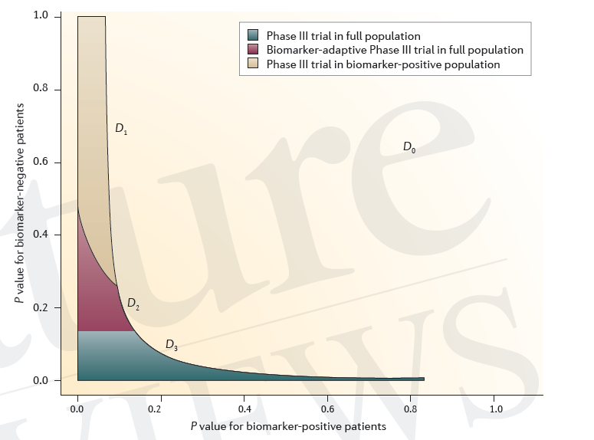
2D Decision rule for MK-0646 triple negative breast cancer (Clark)
12

Slide 13
Example of adaptive study design (II) The Biomarker adapted P3 study
BM Adaptive P3*
Study proceeds in full population.
Use data from P3 up to interim analysis and maturing data from P2 to:
Optimally focus analysis (“allocate alpha”) between full and sub-population
Maximize utility per cost function, such as power per study size, or expected ROI
Greater ROI than either traditional or biomarker driven P3
*Chen and Beckman, Statistics in Biopharmaceutical Research, 1: 431-40. (2009).
13
Notes:
Optional: Details of combining P2 and P3 information still being discussed within BARDs.

