Slide 1
Assessing the benefits of a stratified treatment strategy which improves average HbA1c in a proportion of patients with Type 2 diabetes: a MASTERMIND study
C. Jennison¹, A. Jobling¹, E. Pearson²,
A Hattersley³, A. Gray⁴ and C. Hyde³
¹University of Bath, ²University of Dundee, ³Exeter University,
⁴University of Oxford

Slide 2
Background
Current guidelines indicate treating type 2 diabetes patients with a standard, stepwise protocol.
However, stratification based on predicted drug response or predicted risk factors has the potential to improve life expectancy and slow progression of diabetes.
Identifying patient subgroups and treating each group of patients in the most appropriate way could reduce risk and prolong patient lifetimes.

Slide 3
Aims
A treatment by subgroup interaction:
Our starting point is the case of two subgroups of patients who respond differently to a pair of treatment options.
A key goal of the MASTERMIND project is to identify such subgroup and treatment pairs.
The purpose of the work reported here is to assess the benefits that can arise from stratified treatment.
 | Benefits of Treatment A | Benefits of Treatment B
Group 1 | High | Low
Group 2 | Low | High

Slide 4
Methods: The UKPDS Model
We used the UKPDS Outcomes Model (version 2.0) to evaluate the benefits of treatment strategies that reduce HbA1c in the patient population.
The model takes as input a patient’s pattern of HbA1c and other risk factors over a period of years.
Its output is a prediction of quality adjusted life expectancy and the cost of treating diabetes related complications.
This allows us to asses the effects of reduced HbA1c on patient outcomes.

Slide 5
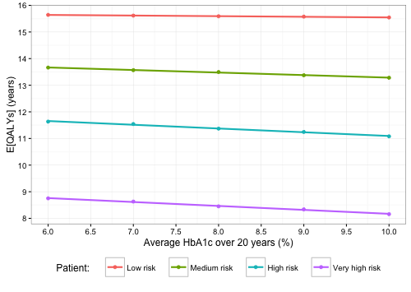
Results: Applying the UKPDS Model
We took four cases from the GoDARTS database of patients with Type 2 diabetes in Tayside and evaluated these under modified patterns of HbA1c over a 20 year period.
Lower average HbA1c
gives higher expected
quality adjusted life
years E(QALYs).
Changes in HbA1c have
the greatest impact for
patients at the highest risk.

Slide 6
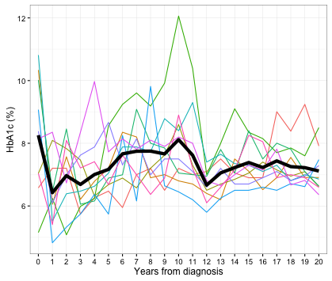
Subjects: A sample from the GoDARTS database
To assess the benefits of reducing HbA1c across the patient population, we sampled 1,000 subjects from the GoDARTS database.
The plot shows HbA1c
time-paths for 20 of these
patients.
The thick black line shows
the mean HbA1c for these
20 cases.

Slide 7
Methods: Assessing outcomes for GoDARTS patients under modified HbA1c sequences
We compared expected quality adjusted life years, E(QALYs), and the cost of treating diabetes-related complications in 3 scenarios:
The original patient data,
With HbA1c reduced for all patients by 1% in Year 1,
With HbA1c reduced for all patients in Year 1 by a
random amount, normally distributed with mean = 1
and standard deviation = 1.

Slide 8
Results: Impact of lower HbA1c on E(QALYs)
Reducing HbA1c by an average of 1% for 1 year in a patient subgroup, in either scenario (B) or (C), gave the following benefits for our sample of 1,000 GoDARTS subjects:
An increase of 0.0116 (s.e. = 0.0004) in expected QALYs
A reduction of £22.0 (s.e. = £1.8) in the costs of treating diabetes-related complications

Slide 9
Results: Impact of lower HbA1c on E(QALYs)
Effect on E(QALYs) of reducing HbA1c by 1% for 1 year:
An increase of 0.0116 in expected QALYs
The increase in E(QALYs) can be attributed to a large benefit for a small proportion of patients who avoid a serious event such as MI or stroke.
In general, benefits increase in proportion to average reduction in HbA1c, summed over years.
Average benefits are greater for higher risk patients.

Slide 10
Results: Impact of lower HbA1c on E(QALYs)
Effect on E(QALYs) of reducing HbA1c by 1% for 1 year:
An increase of 0.0116 in expected QALYs
Valuing one QALY at £20k, this increase translates to a value of £232 per subgroup patient − to be set against the cost of determining subgroup membership and rise in treatment costs.
Reducing HbA1c by 1% for one year for one tenth of the approx. 3 million UK patients with Type 2 diabetes, would gain
3,500 quality adjusted life years
equivalent to £70 million at £20,000 per QALY.

Slide 11
Conclusions
Even modest and short-term improvements in HbA1c from a stratified treatment approach have quantifiable effects on patient lifetimes and quality of life, and on the costs of treating complications.
These benefits indicate how much can be spent on stratified treatment, both in identifying a patient subgroup and treating these patients differently, while remaining cost-effective.

