Slide 1
Reinforcement Learning and Uplift modeling
Jin Cui
May 14th 2020

Slide 2
Content
Markov Decision Process
Bellman equation
Deep Q Network & Jupyter demo
Policy Gradient & Jupyter demo
Actor Critic & Jupyter demo
RL used in uplift modeling (multiple offers)

Slide 3
Markov Decision Process (MDP)
The future is independent of the past given the present:
Gaming: chess, Super Mario, flappy bird
Route navigation, robotic control
P[St+1 | St] = P[St+1 | S1, ….. , St]

Slide 4

The Bellman equation and Q table
We make decisions which maximize the expected reward in the future:
Q(s_{t}, a_{t}) =
r_{t} + E[γ*r_{t+1} + γ²*r_{t+2} + … + γ^{n-1}*r_{t+n}]
= r_{t} + γ*Q(s_{t+1}, a_{t+1})
$$Q\left(s,a\right)=r+γ∗\max{Q(s^{′},a′)}$$
R: Reward
s: state (feature vectors)
a: action (↑↓←→)
γ: discount factor (0<= γ <=1)

Slide 5









Term demonstration (Q, V, G)
Q table | ↑ | ↓ | ← | → | stay
s0 | 0 | 0 | 0 | +30 | +3
s1 | 0 | 0 | +3 | +100 | -5
s2 | 0 | 0 | 0 | 0 | 0
s3 | +4 | +1 | -5 | -2 | -5
s4 | +10 | +2 | -4 | +10 | -2
s5 | +100 | -5 | +5 | +7 | +7
s6 | +3 | +1 | +1 | +1 | 0
s7 | +10 | +5 | +8 | +3 | +2
s8 | +10 | +2 | +5 | +2 | +2
+30 | -20 | +150
-50 | -30 | -20
+10 | ? | -50
s0
s3
s6
$Q(s,a)$: 2-D matrix of (n_states, n_actions)
$$V\left(s\right)=max{Q\left(s,a\right) }$$
1-D matrix of n_states
$$G\left(t\right)$$
s7->s4->s1->s2: (100,130,150,150) 1-D matrix of n_steps
Notes:
G: 1D array length equal to num_steps in a game
Q: 2D matrix (num_states, num_actions): yelp review
V: 1D array length equal to num_states
In order to get a complete yelp review, you need to explore first, and if you stick to that review, you can’t explore

Slide 6
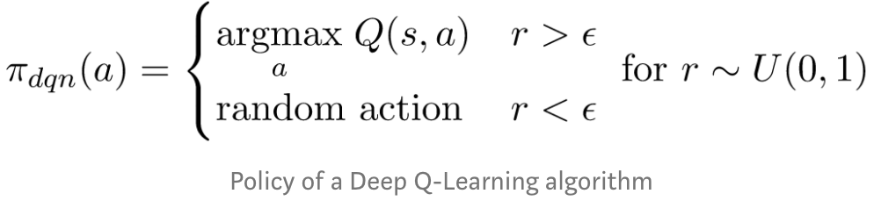
Epsilon-greedy strategy (Exploitation vs eploration)
π(s|a)
Notes:
You need to explore the world before settling down
Local maxima

Slide 7
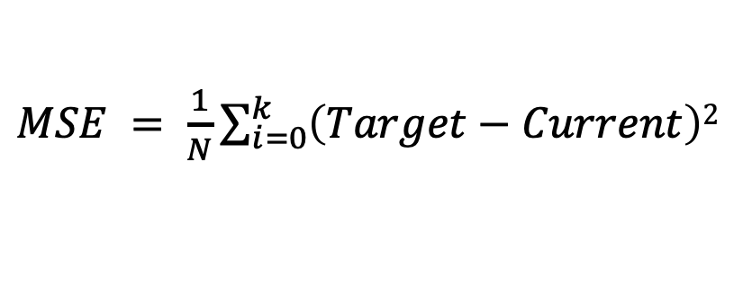
Q-learning and Deep Q Network
How does the Q table update itself ? (use future to guide the present)
$$Current: Q\left(s,a\right) Target: r+ γ∗maxQ(s^{′},a′)$$
Vanilla Q-learning:
$Q\left(s,a\right)←Q\left(s,a\right)+α (Target−Current$)
Deep Q Network (DQN):
$MSE = \frac{1}{N}\sum_{i=0}^{k}{\left(Target−Current\right)2}$
Notes:
Update present based on the future
Double and Duel DQN I don’t understand

Slide 8




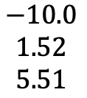


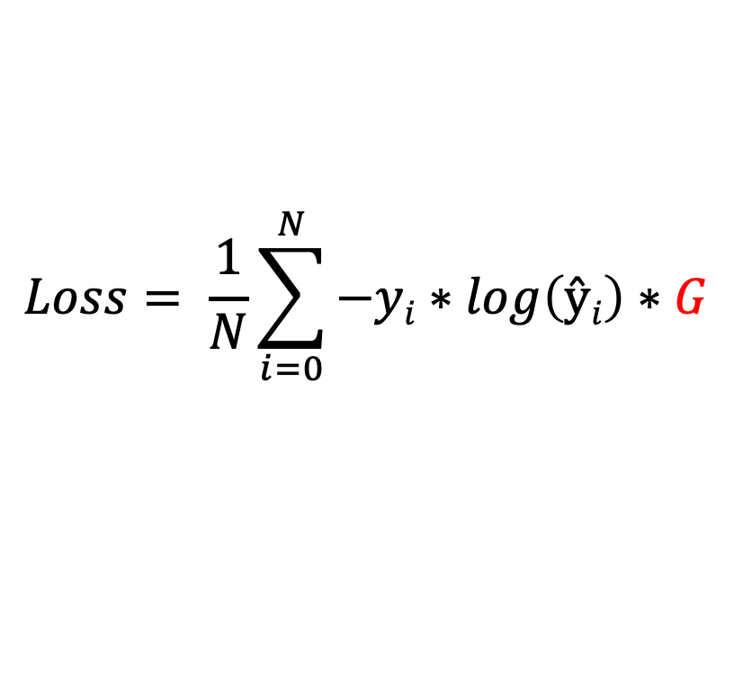








Policy gradient method
Instead of approximating Q table, policy gradient directly approximate the policy (probability distribution of actions)
Takes random actions and check rewards
Increase probabilities of action that give positive rewards and decrease otherwise
Weighted cross entropy
$$Si$$
$$ŷ$$
$$y$$
$$G$$
$$Loss= \frac{1}{N}\sum_{i=0}^{N}{−yi∗\log\left(ŷi\right)∗G}$$
$$\begin{matrix}0.7 \\ 0.2 \\ 0.1\end{matrix}$$
$$\begin{matrix}1 \\ 0 \\ 0\end{matrix}$$
$$\begin{matrix}10.0 \\ 5.46 \\ 4.93\end{matrix}$$
$$Sj$$
$$ŷ$$
$$y$$
$$G$$
$$\begin{matrix}0.1 \\ 0.2 \\ 0.7\end{matrix}$$
$$\begin{matrix}1 \\ 0 \\ 0\end{matrix}$$
$$\begin{matrix}−10.0 \\ 1.52 \\ 5.51\end{matrix}$$
$$G is not updated$$

Slide 9
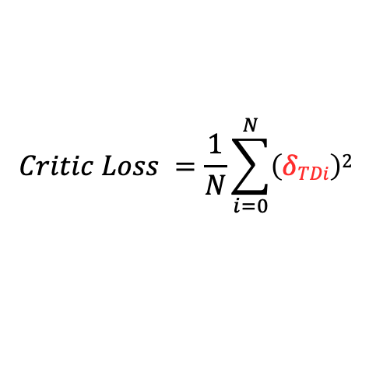
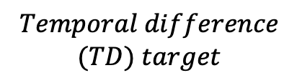
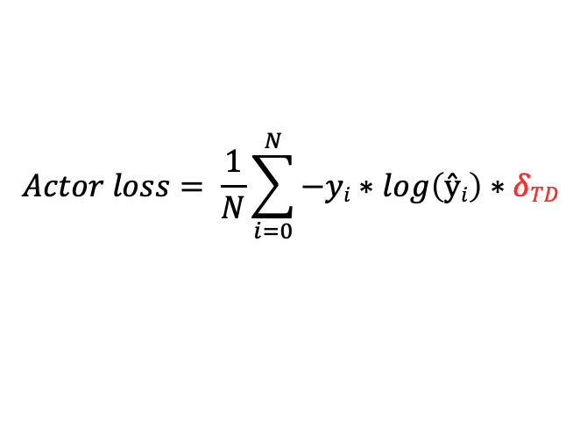

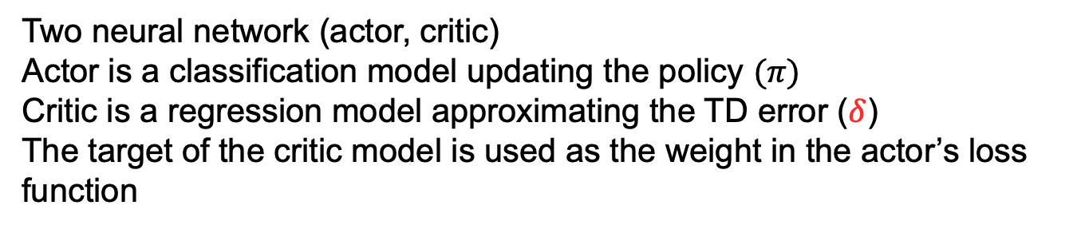
Actor critic
Two neural network (actor, critic)
Actor is a classification model updating the policy $(π)$
Critic is a regression model approximating the TD error ($δ$)
The target of the critic model is used as the weight in the actor’s loss function
$Targetcritic= r+ γ∗maxQ\left(s^{′},a^{′}\right)=r+γ∗V(s′)$
$$Temporal difference$$
$$(TD) target$$
$δTD = r+γ∗V\left(s^{′}\right)−V(s)$
$$Critic Loss =\frac{1}{N}\sum_{i=0}^{N}{\left(δTDi\right)2}$$
$$Actor loss= \frac{1}{N}\sum_{i=0}^{N}{−yi∗\log\left(ŷi\right)∗δTD}$$
Notes:
Use the future to guide the present

Slide 10
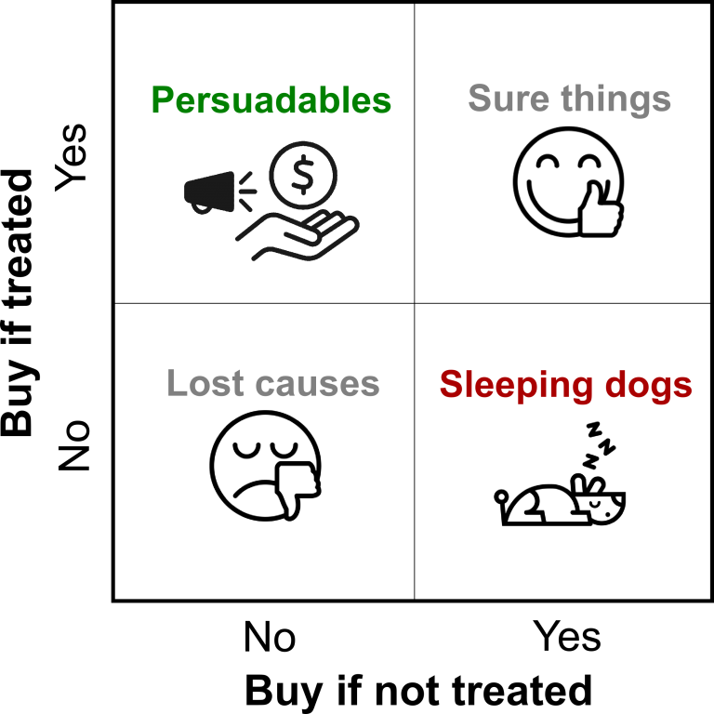
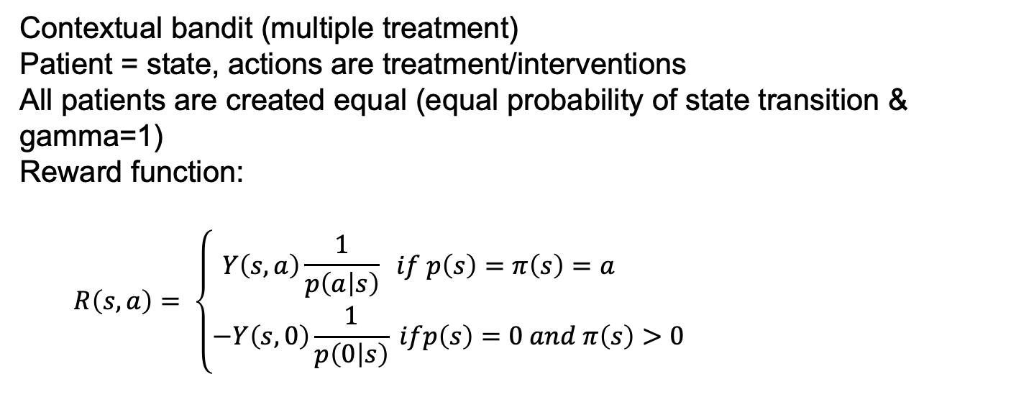

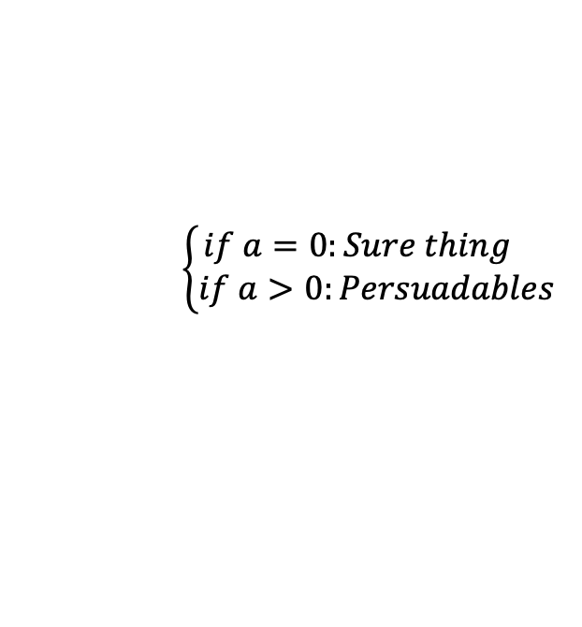
RL in uplift modeling
Contextual bandit (multiple treatment)
Patient = state, actions are treatment/interventions
All patients are created equal (equal probability of state transition & gamma=1)
Reward function:
$$R\left(s,a\right)= \left\{\begin{aligned}Y\left(s,a\right)\frac{1}{p\left(a | s\right)} if p\left(s\right)=π\left(s\right)=a \\ −Y\left(s,0\right)\frac{1}{p\left(0 | s\right)} ifp\left(s\right)=0 &and π\left(s\right)>0\end{aligned}\right.$$
$\left\{\begin{aligned}if a=0:Sure thing \\ if a>0:Persuadables\end{aligned}\right.$
$$Sleeping dogs$$
https://arxiv.org/pdf/1811.10158.pdf
Notes:
If both the patient and our policy picks action a

