Slide 1
Reinforcement Learning and Uplift modeling
Jin Cui
May 14th 2020

Slide 2
Content
Markov Decision Process
Bellman equation
RL used in uplift modeling (contextual bandit)
Deep Q Network & Jupyter demo
Policy Gradient & Jupyter demo
Actor Critic & Jupyter demo

Slide 3
Content Markov Decision Process (MDP)
The future is independent of the past given the present:
Gaming: chess, Super Mario, flappy bird
Route navigation, robotic control
P[St+1 | St] = P[St+1 | S1, ….. , St]
Examples where MDP assumptions are violated:
Weather forecast
Mortgage approval

Slide 4

The Bellman equation and Q table
We make decisions which maximize the expected reward in the future:
Q(s_{t}, a_{t}) =
R_{t+1} + γR_{t+2} + γ²R_{t+2} + … + γ^{n}R_{t+n}
= R_{t+1} + γQ(s_{t+1}, a_{t+1})
$$Q\left(s,a\right)=r+γ∗\max{Q(s^{′},a′)}$$
R: Reward
s: state (feature vectors)
a: action (↑↓←→)
γ: discount factor

Slide 5








Term demonstration (Q, V, G)
Q | ↑ | ↓ | ← | → | V | G
s0 |  |  |  |  |  | \
s1 |  |  |  |  |  | \
s2 |  |  | +15 | +130 | +130 | \
s3 |  |  |  |  |  | \
s4 |  |  |  |  |  | \
s5 |  |  |  |  |  | \
s6 | +120 | +110 | +70 | +90 | +120 | \
s7 | +140 |  |  |  | +140 | \
s8 |  |  |  |  |  | \
s9 | 0 | +70 | -35 |  | +70 | +70
s10 |  |  |  | 0 | 0 | 0
s11 |  |  |  |  |  | \
s12 |  |  |  |  |  | \
s13 |  |  |  | +60 | +60 | +60
s14 | 0 |  |  | -45 | 0 | \
s15 |  |  |  |  |  | \
 |  | -10 | +150
 |  | -30 | -20
-50 | ?
+30 | +10 | +60 | -50
s0
s4
s8
→
↓
↑
→
s12
$$G\left(t\right) \& Q\left(s,a\right)?$$
$$V\left(s\right)= max{Q(s,a)}$$
Notes:
G: 1D array length equal to num_steps in a game
Q: 2D matrix (num_states, num_actions): yelp review
V: 1D array length equal to num_states
In order to get a complete yelp review, you need to explore first, and if you stick to that review, you can’t explore

Slide 6
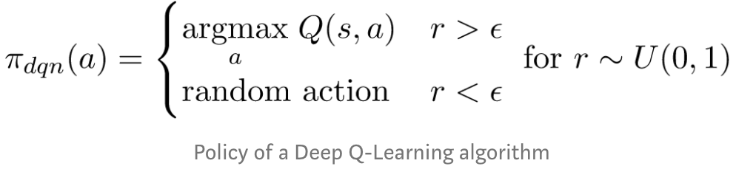
Explore-exploit dilemma (epsilon-greedy strategy)
π(s|a)
Notes:
You need to explore the world before settling down
Local maxima

Slide 7
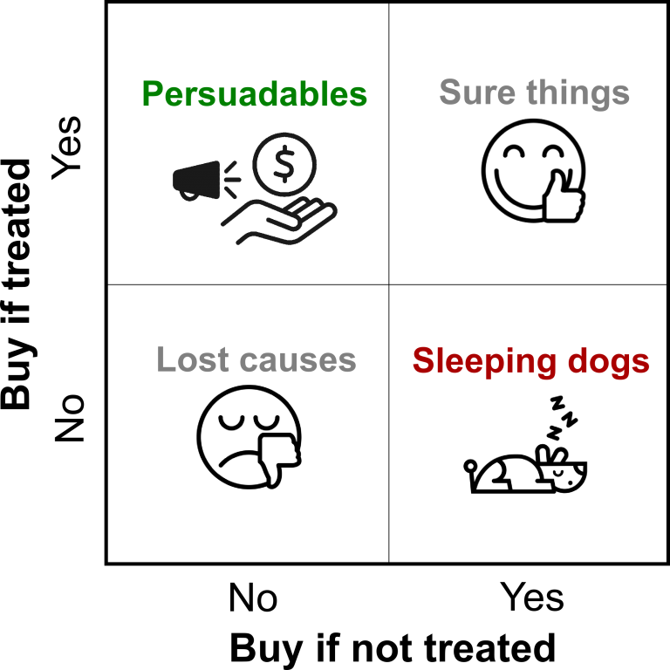
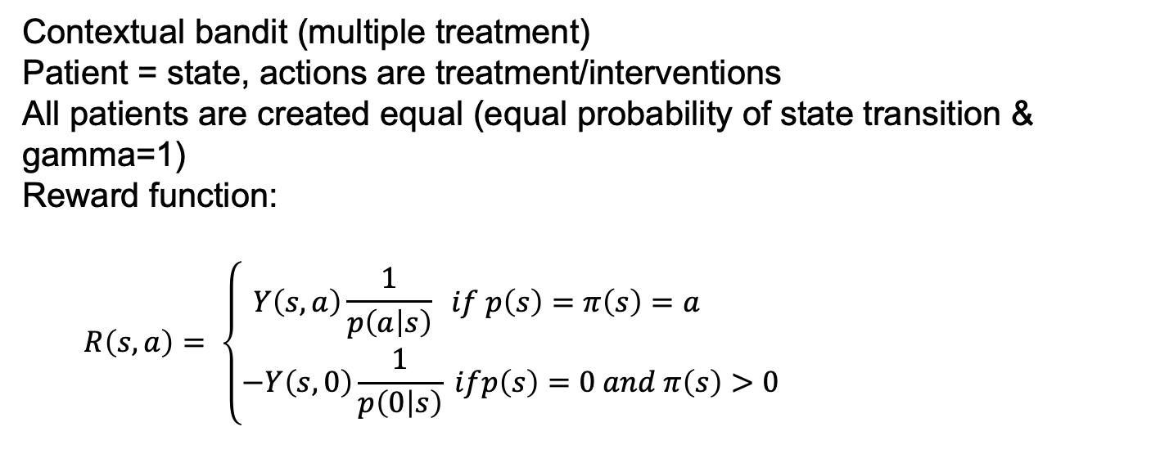

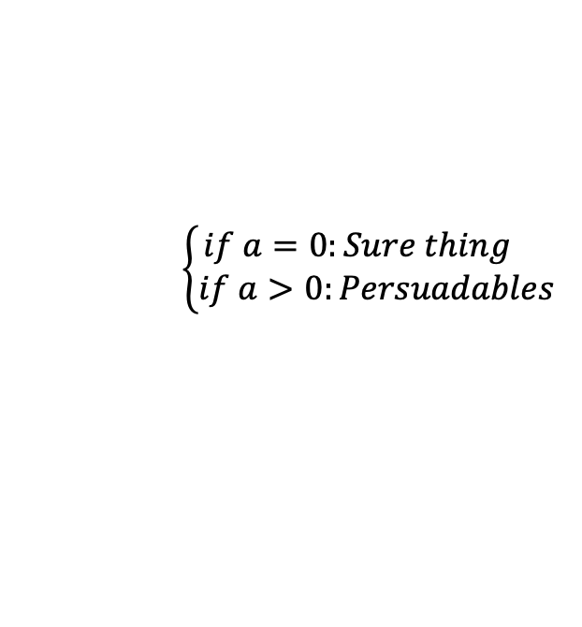
RL in uplift modeling
Contextual bandit (multiple treatment)
Patient = state, actions are treatment/interventions
All patients are created equal (equal probability of state transition & gamma=1)
Reward function:
$$R\left(s,a\right)= \left\{\begin{aligned}Y\left(s,a\right)\frac{1}{p\left(a | s\right)} if p\left(s\right)=π\left(s\right)=a \\ −Y\left(s,0\right)\frac{1}{p\left(0 | s\right)} ifp\left(s\right)=0 &and π\left(s\right)>0\end{aligned}\right.$$
$\left\{\begin{aligned}if a=0:Sure thing \\ if a>0:Persuadables\end{aligned}\right.$
$$Sleeping dogs$$
https://arxiv.org/pdf/1811.10158.pdf
Notes:
If both the patient and our policy picks action a

Slide 8
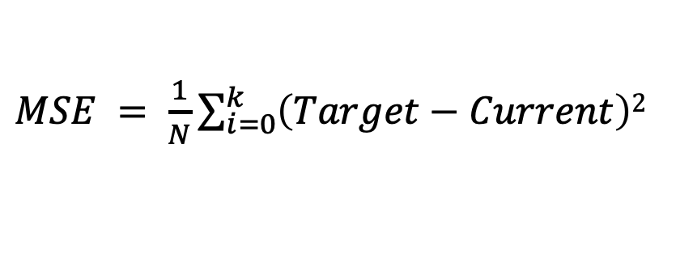
Q-learning and Deep Q Network
How does the Q table update itself ? (use future to guide the present)
$$Current: Q\left(s,a\right) Target: r+ γ∗maxQ(s^{′},a′)$$
Vanilla Q-learning:
$Q\left(s,a\right)←Q\left(s,a\right)+α (Target−Current$)
Deep Q Network (DQN):
$MSE = \frac{1}{N}\sum_{i=0}^{k}{\left(Target−Current\right)2}$
Notes:
Update present based on the future
Double and Duel DQN I don’t understand

Slide 9




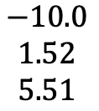


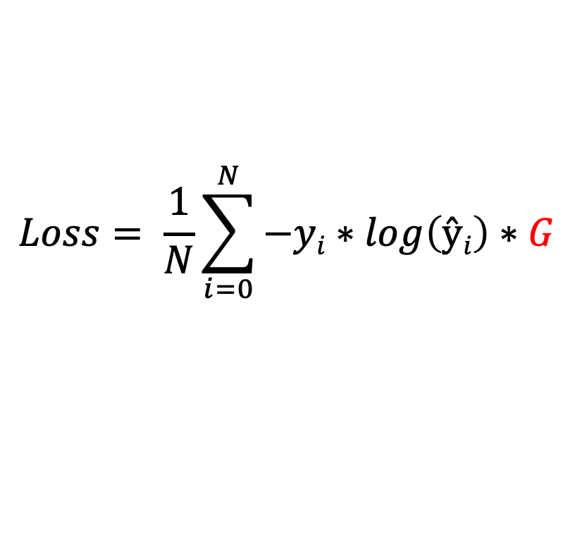








Policy gradient method
Instead of approximating Q table, policy gradient directly approximate the policy (probability distribution of actions)
Takes random actions and check rewards
Increase probabilities of action that give positive rewards and decrease otherwise
Weighted cross entropy
$$Si$$
$$ŷ$$
$$y$$
$$G$$
$$Loss= \frac{1}{N}\sum_{i=0}^{N}{−yi∗\log\left(ŷi\right)∗G}$$
$$\begin{matrix}0.7 \\ 0.2 \\ 0.1\end{matrix}$$
$$\begin{matrix}1 \\ 0 \\ 0\end{matrix}$$
$$\begin{matrix}10.0 \\ 5.46 \\ 4.93\end{matrix}$$
$$Sj$$
$$ŷ$$
$$y$$
$$G$$
$$\begin{matrix}0.1 \\ 0.2 \\ 0.7\end{matrix}$$
$$\begin{matrix}1 \\ 0 \\ 0\end{matrix}$$
$$\begin{matrix}−10.0 \\ 1.52 \\ 5.51\end{matrix}$$
$$G is not updated$$

Slide 10
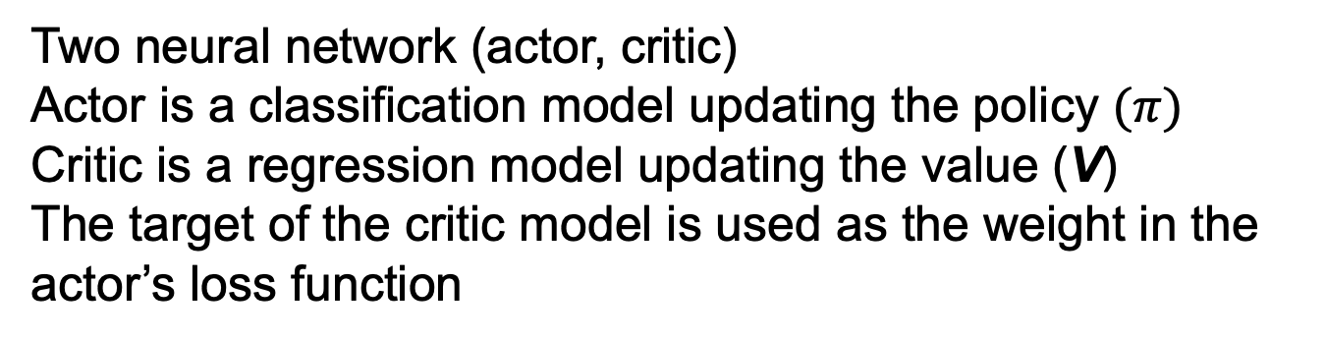
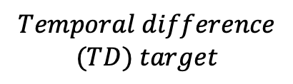
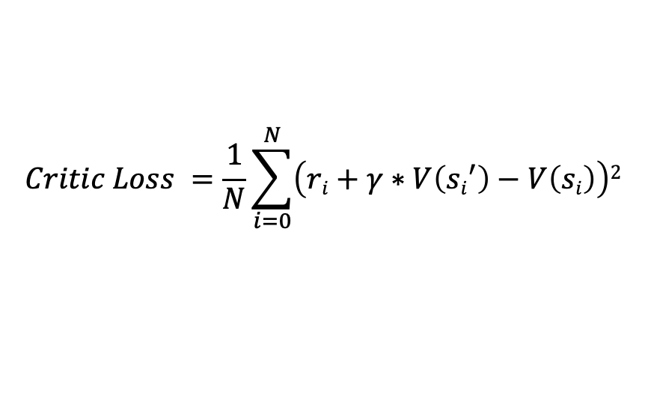
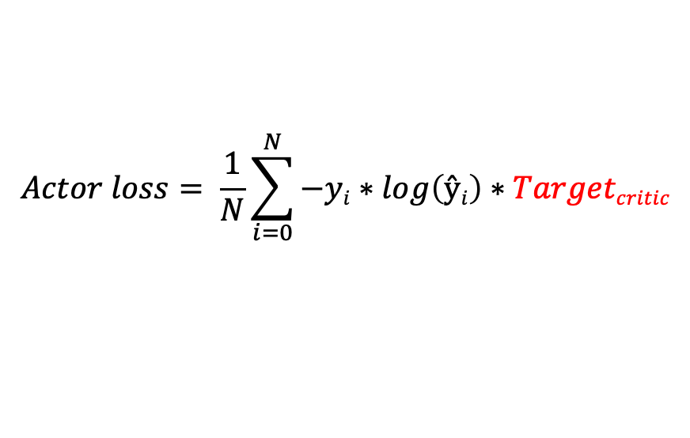
Actor critic
Two neural network (actor, critic)
Actor is a classification model updating the policy $(π)$
Critic is a regression model updating the value (V)
The target of the critic model is used as the weight in the actor’s loss function
$Targetcritic= r+ γ∗maxQ\left(s^{′},a^{′}\right)=r+γ∗V(s′)$
$$Temporal difference$$
$$(TD) target$$
$$Critic Loss =\frac{1}{N}\sum_{i=0}^{N}{\left(ri+γ∗V\left({si}^{′}\right)−V\left(si\right)\right)2}$$
$$Actor loss= \frac{1}{N}\sum_{i=0}^{N}{−yi∗\log\left(ŷi\right)∗Targetcritic}$$
Notes:
Use the future to guide the present

