Slide 1
Advanced Computing Training
Advanced Research Computing Technology and Innovation Core
(ARCTIC)
Web: https://arctic.gsu.edu Email: arc@gsu.edu Slack: gsu-hpc.slack.com

Slide 2
Agenda
Git Overview
Git Terminology
Git commands
GitHub

Slide 3
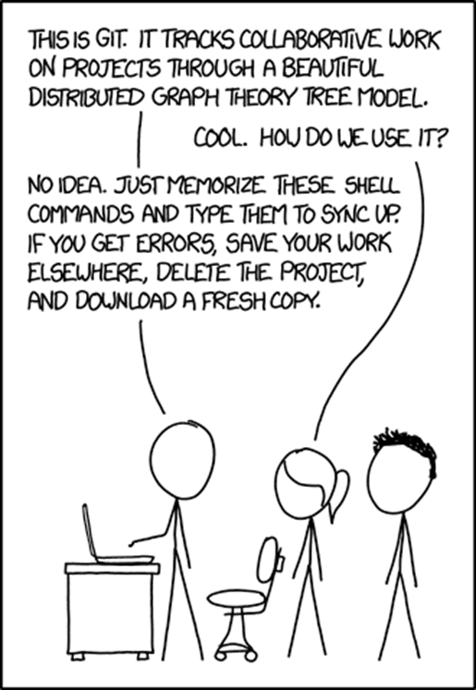
Why Git?
Pros
complete history of every change to files
work in multiple isolated spaces at once
Distributed, history is everywhere at once
Geared towards performance
Cons
It’s complicated, that’s why we are here
https://xkcd.com/1597/

Slide 4

Verbs and Terms
Stage
Add
Commit
Branch
Pull
Push
Reset
Merge
Rebase

Slide 5
First Steps
Who are you?
“git config --global user.name <name>”
“git config --global user.email <email>”
Start a repository in current directory
“git init”
Ignoring files - only track source code
What is .gitignore?
What should you ignore?
Do not upload sensitive info!

Slide 6
Adding a file to track
“git add <file or directory>”
This only stages your changes
Adds file to tracking
“git commit”
Places staged changes to the git history
Files are now tracked

Slide 7
Practical use
Use Case
Adding an existing project to a git repo
Commands in sequence:
cd /path/to/existing/project
git init
touch .gitignore
Add ignored files to .gitignore
git add .
git commit -m “Initial commit for project”

Slide 8
Now What? Basic Process for tracking changes
Make changes to your files
Use “git add <filename>” to add them to the staging area
git commit to record staged changes to history
Best Practices:
Commit often
Write descriptive commit messages

Slide 9
Dealing with whoopsies (before commit)
git reset --hard
undoes all changes to file directory and staged changes since previous commit
nuclear option
git clean
can remove untracked files
use git clean -n to see changes (dry run)
-i for interactive
-d for directories
ALWAYS use dry run option first to see changes

Slide 10
Dealing with whoopsies (after commit)
“git rm <file or directory>”
removes file from directory and records removal in history
Does not remove file from previous history
git commit --amend
Let’s you make changes to the previous commit
git revert
Makes a new commit that undoes changes of previous commits

Slide 11
Collaboration (GitHub)
Getting Started
Generate a key for GitHub
ssh-keygen -t ed25519 -C your_github_email@example.com
Add key to ssh-agent
ssh-add ~/.ssh/id_ed25519
Add key to GitHub account
Click profile picture in upper right-hand corner
Settings
SSH and GPG keys
New SSH Key or Add SSH Key
Paste Key into Text Area
Click Submit
Test
ssh -T git@github.com
Continue Connecting: yes
Terminal should return your username

Slide 12
GitHub
Create a new repository on GitHub using web interface
Grab the ssh link from the next page
git remote add origin git@github.com:username/repo.git
git push
Takes your changes and puts them somewhere else
git push -u origin main

Slide 13
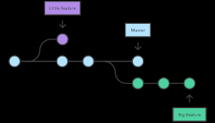
GitHub Branches
A branch is a linked but separate history
Create a branch
git branch <branch_name>
To use a branch
git checkout <branch_name>
You can also checkout remote branches
git checkout origin/branch
When to branch?
It’s best to have every feature you add or major revision in its own branch
Once done with the changes, you can merge them to the main branch

Slide 14
Getting Upstream Changes
git fetch
grabs all the changes in the remote repository and updates the local repo
git pull
grabs the remote copy of the local branch and merges changes into the local copy

Slide 15
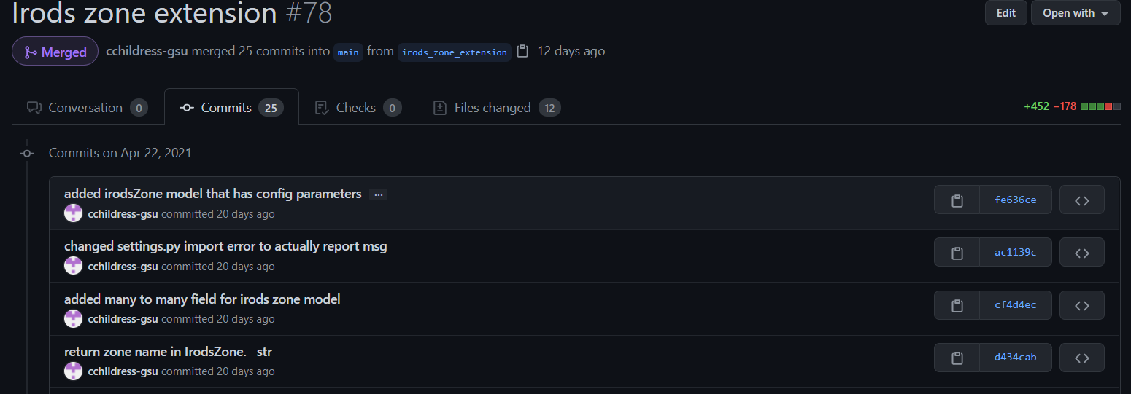
Merging Changes
Once done with a branch, you can create a pull request.
GitHub will look at all the changes you made between one branch and another and attempt to automatically merge the two.
You might have conflicts, i.e., both branches have changes to the same space in a file.
GitHub will walk you through looking at which changes to keep.

Slide 16
Rewriting History (merge vs. rebase)
Merge
makes a commit in the branch that ties both branches together (non-destructive)
Rebase
Takes the entire branch and moves it to the tip of another (Rewrites History)
Never rewrite history of public (shared) repositories
If you have ever pushed commits to a remote repository, don’t rewrite the history.
Local branches are fine

Slide 17
Q & A
Contact us
https://arctic.gsu.edu
https://gsu-hpc.slack.com
arc@gsu.edu

