Slide 1
Interfacing between Jetson Nano and Arduino
Advanced Research Computing Technology and Innovation Core
(ARCTIC)
Web: https://arctic.gsu.edu Email: arc@gsu.edu Slack: gsu-hpc.slack.com

Slide 2
Jetson Nano
Single Board Computer
Quad-core ARM A57 @ 1.43 GHz
4 GB 64-bit LPDDR4 25.6 GB/s
128-core Maxwell
Arduino
Microcontroller
Pyserial

Slide 3
Options to connect
Option 1:
Connect Jetson directly to I/O pins on Arduino and code everything in C
Option 2:
Piggyback with App controls and send the JSON over the serial port

Slide 4
PySerial
Python library to interface with the serial port (USB in our case)
Documentation at https://pyserial.readthedocs.io
Allows us to create a serial connection and interact using a class and methods

Slide 5
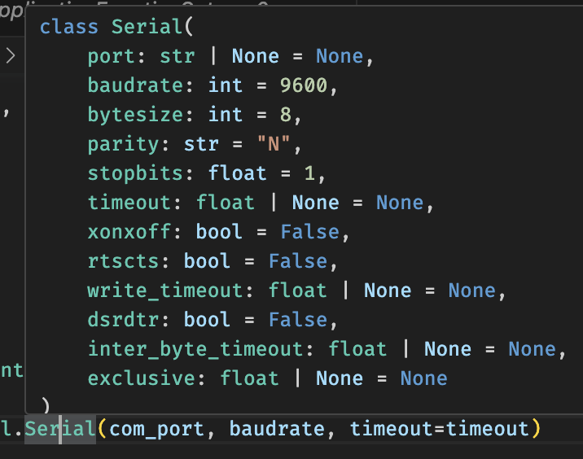
How to use
Instantiate the serial class
baudrate (determined in serial.begin(int) of Arduino)
port (/dev/ttyUSB0 on jetson)
timeout (short)

Slide 6
Read/Write Buffers
Everything that the Arduino prints will sit in the input buffer
you can check length via
serial.in_waiting
this returns the number of bytes in the buffer
serial.out_waiting
checks write buffer
this means the Arduino is waiting to process commands from jetson

Slide 7
Read/Write to serial port
Call serial.write
must be a ascii byte encoded string
serial.readline()
returns a single line
serial.readall()
reads the entire buffer

Slide 8
Interfacing with Arduino
Uses json with specific parameters to call the motor changes from yesterday
Movement is
{N: 102, D1: int for direction, D2: speed}
Forward at 100 speed
{N: 102, D1: 4, D2: 100}

Slide 9
serial_car_control.py
Providing a wrapper that gives simple easy commands to control car

Slide 10
To the code…

