Slide 1


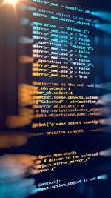

7 Programming Basics for Beginners
(Using Python)

Slide 2
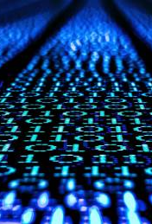
What is a programming language?
A programming language is somewhat like a natural language but with a very limited set of statements and strict syntax rules.
Has statements to implement sequential, conditional, and iterative processing – algorithms.
Examples: FORTRAN, COBOL, Lisp, Basic, Pascal, C, C⁺⁺ Java, C#, Python, …

Slide 3
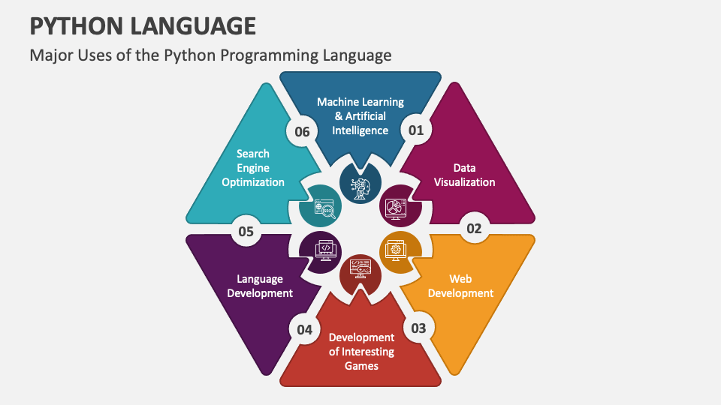

Slide 4

1. Variables & Data Types
Variables are used to store and manipulate data.
Python has several built-in data types such as integers, floating-point numbers, strings, lists, dictionaries, and more.

Slide 5
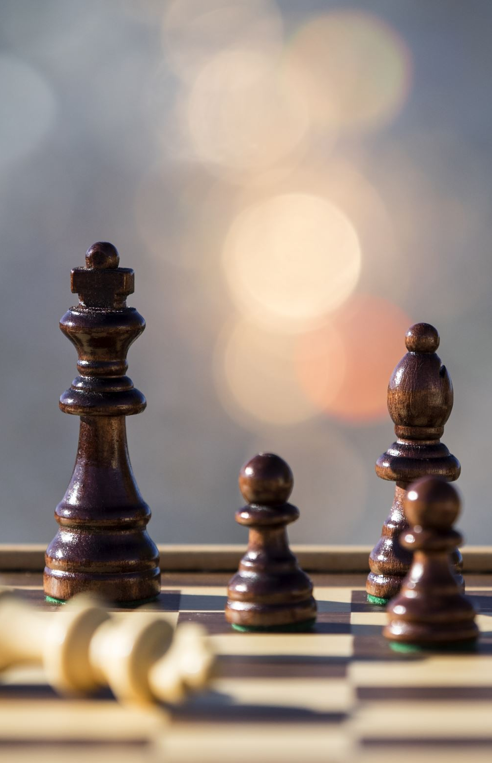
2. Control Flow
Control flow refers to the order in which statements are executed. Beginners should understand concepts like conditional statements (if, elif, else) for decision-making and loops (for, while) for repetition.

Slide 6
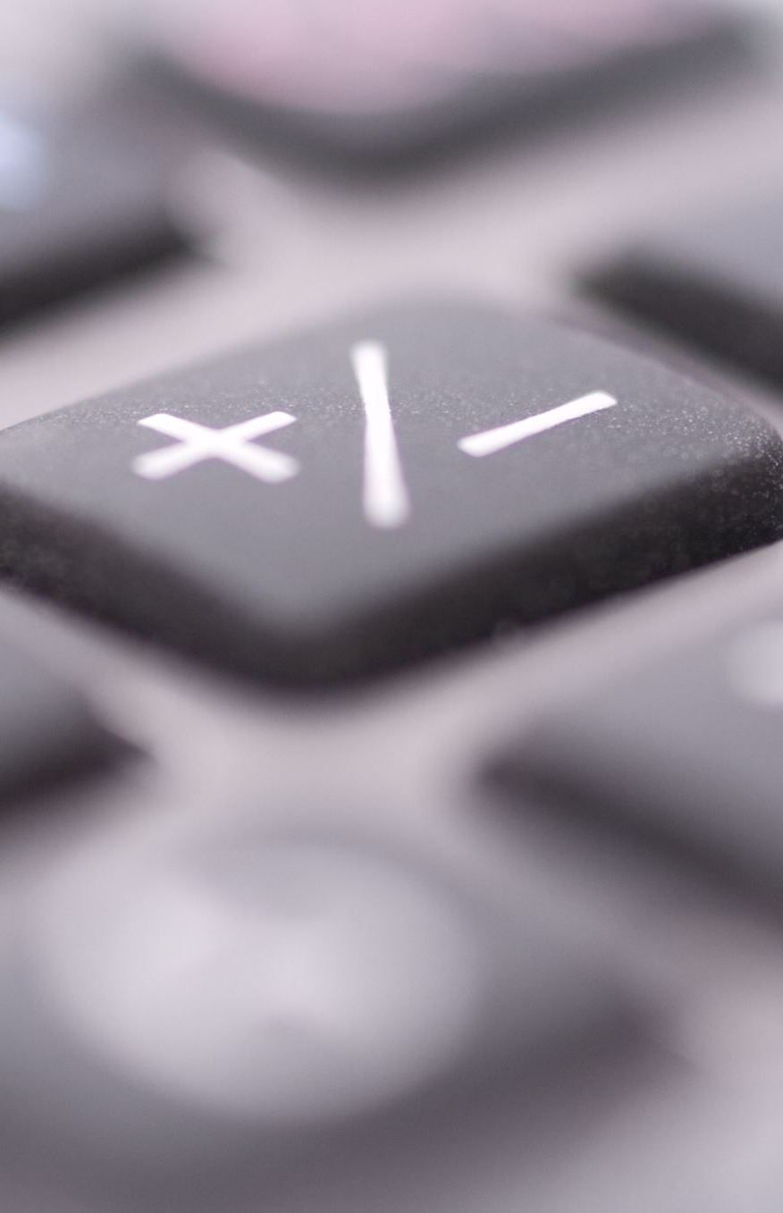
3. Functions
Functions are reusable blocks of code that perform specific tasks. Beginners should learn how to define their own functions, pass arguments, and return values.

Slide 7

4. Input and Output
Input and output operations allow interaction between the program and the user. Beginners should understand how to read input from the user and display output using functions like input() and print().

Slide 8
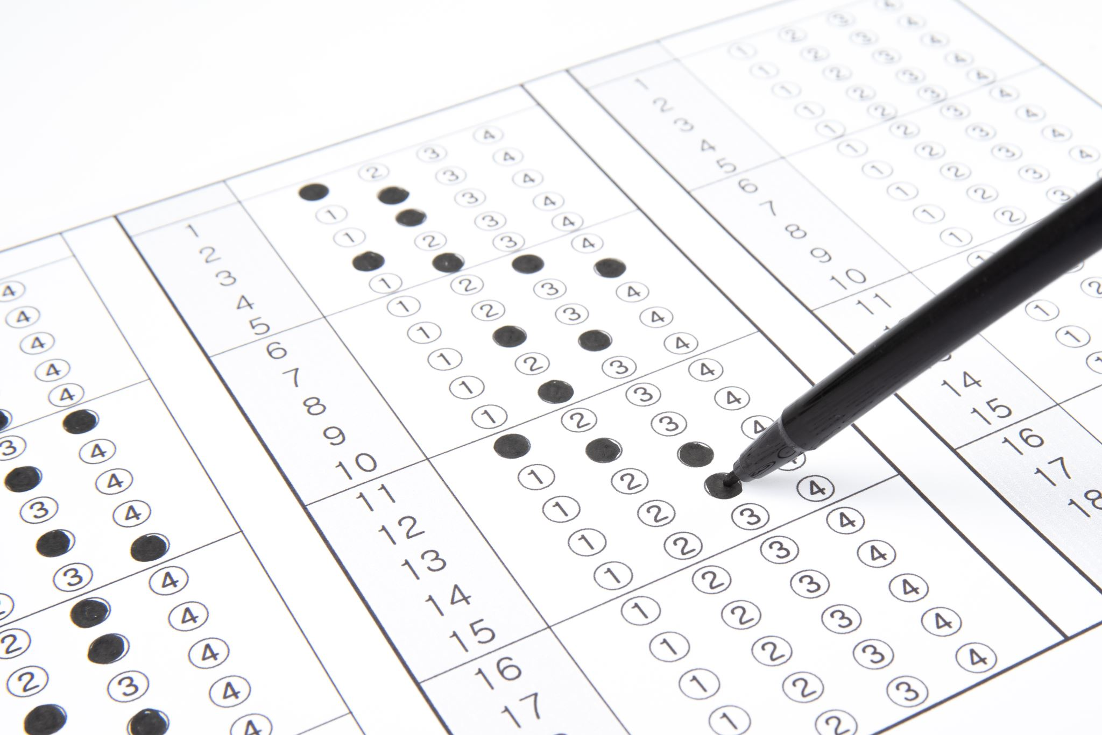
5. Lists and Indexing
Lists are ordered collections of items. Beginners should learn how to create and manipulate lists, as well as access individual elements using indexing (e.g., my_list[0]).

Slide 9
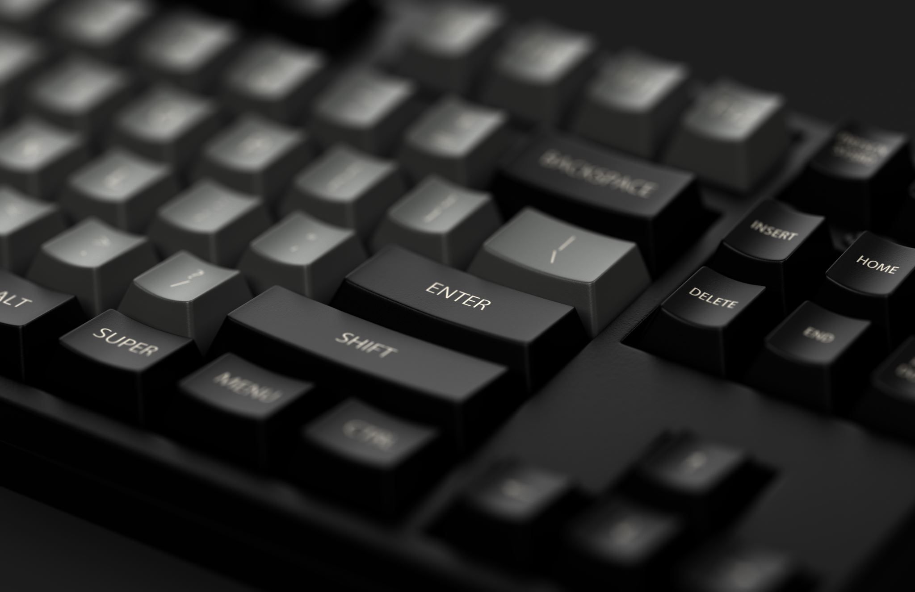
6. Error Handling
Errors are a normal part of programming. Beginners should learn how to handle errors using try-except blocks to catch and handle exceptions gracefully.

Slide 10
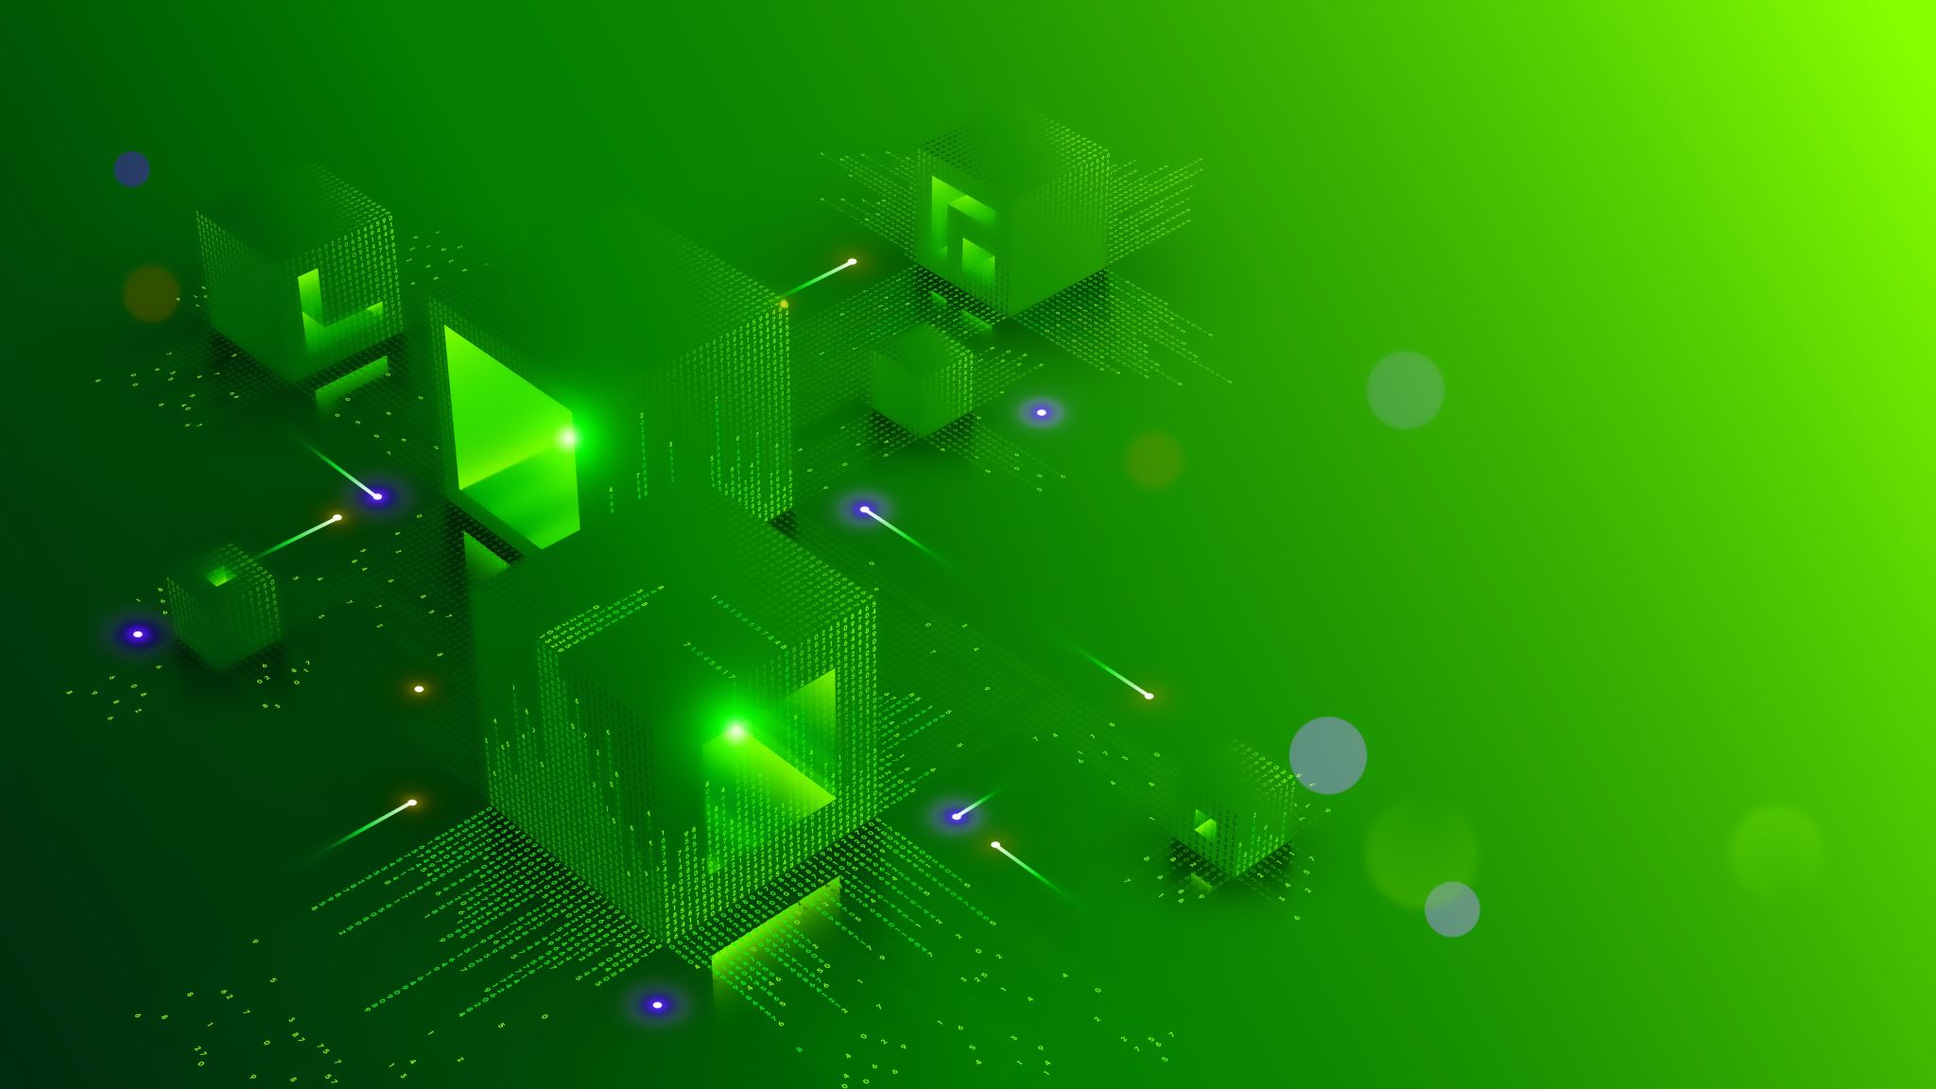
7. Modules and Libraries
Python has a vast ecosystem of modules and libraries that extend its functionality. Beginners should explore and learn how to import and use modules to leverage existing code for tasks like mathematical calculations (math module) or working with dates and times (datetime module).

