Slide 1
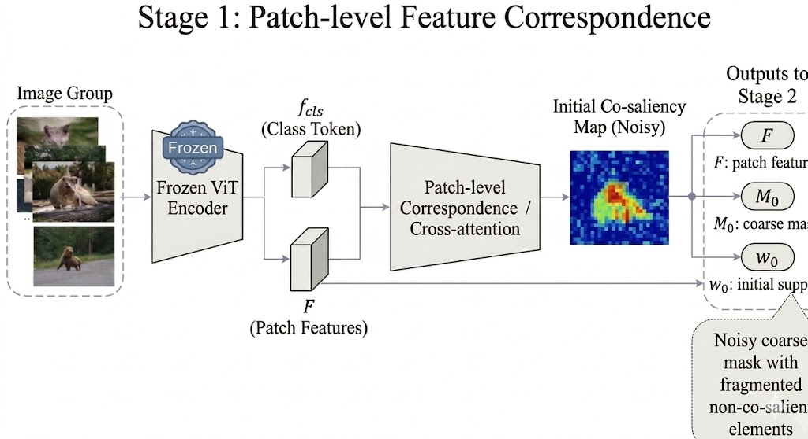

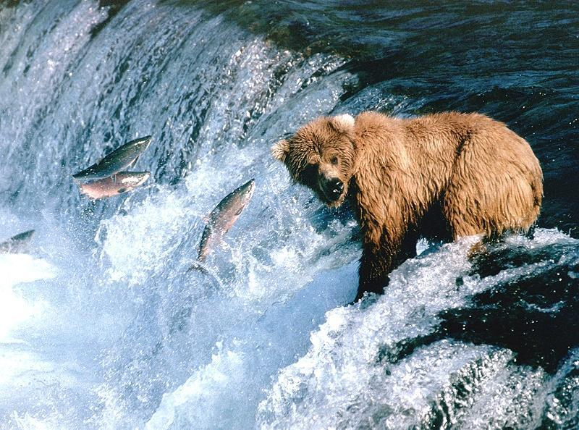
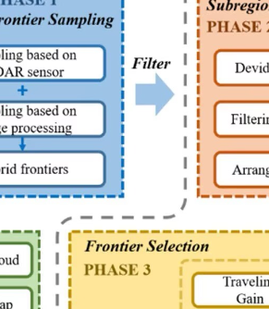


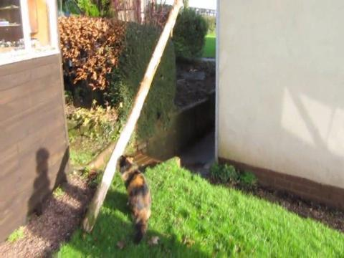
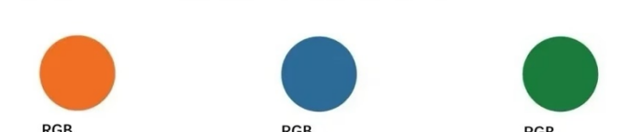
Class Token
Encoder
(ViT)
Patch-level
Correspondence
Cross-attention
...
Patch Token

Slide 2
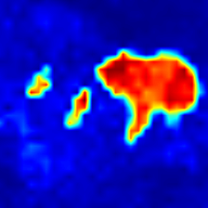
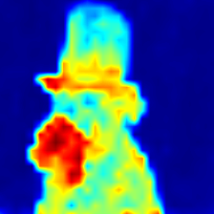
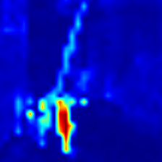
Class Token
Encoder
(ViT)
Patch-level
Correspondence
Cross-attention
...
...
Patch Token

Slide 3
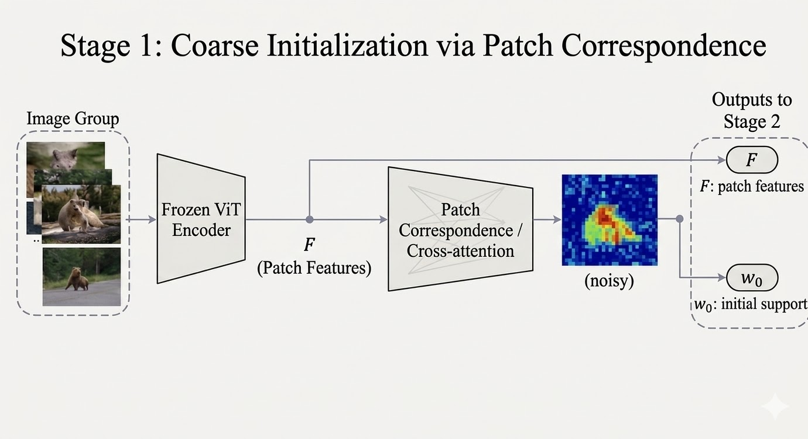
Class Token
Encoder
(ViT)
Patch-level
Correspondence
Cross-attention
...
...
Patch Token

Slide 4


Inputs
Encoder
(ViT)
Patch-level
Correspondence/
Cross-attention
F:patch
feature
Patch
Features
$$ω_{0}$$
...
...
initial support

Slide 6
...
Inputs
Encoder
(ViT)
Patch-level
Correspondence/
Cross-attention
F:patch
feature
Patch
Features
$$ω_{0}$$
...
initial support

Slide 7
Encoder
(ViT)
Patch-level
Correspondence/
Cross-attention
Patch
Features
...
...

Slide 8
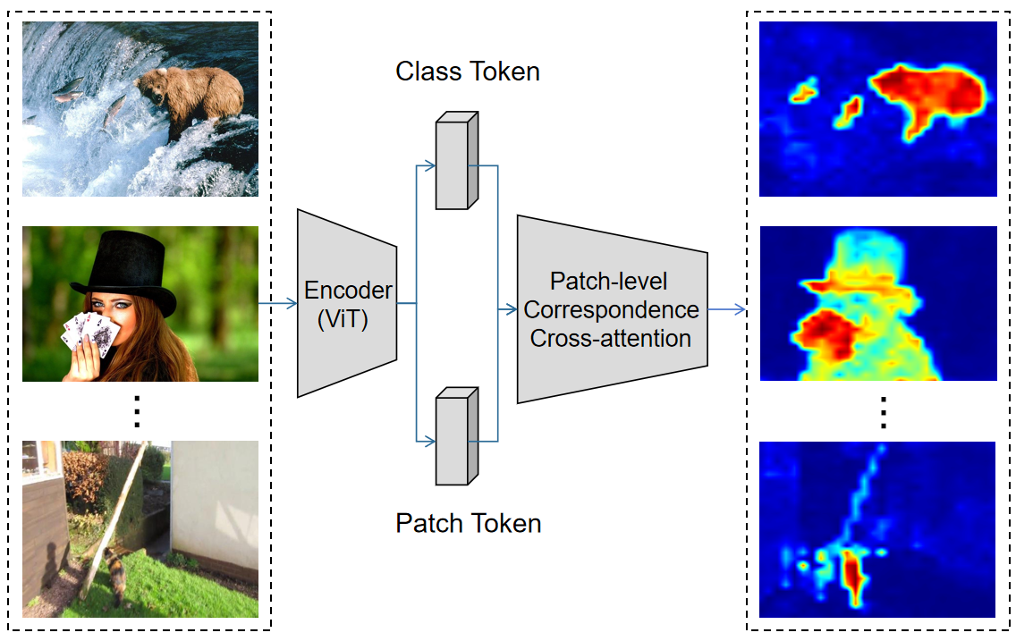

Slide 9
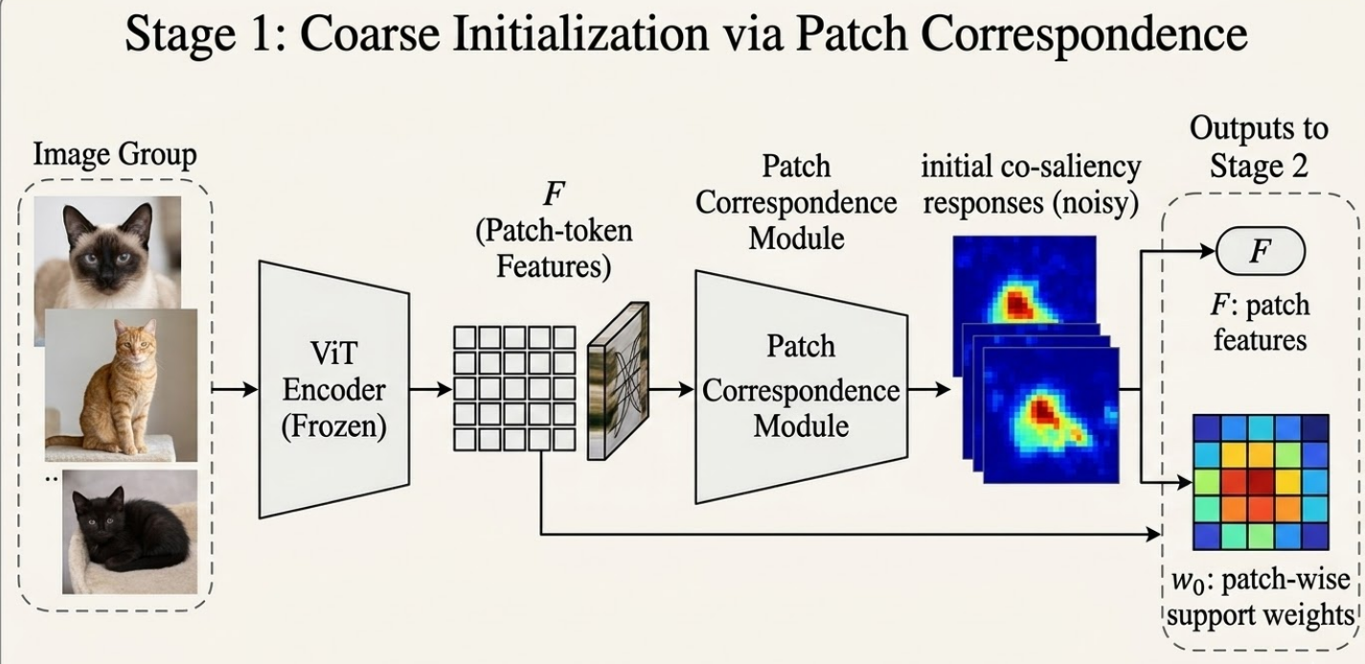


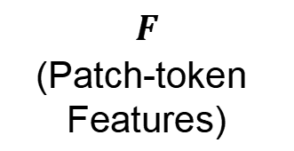
Image Group
Noisy initial responses
ViT
Encoder
Patch-level
Correspondence/
Cross-attention
$F$:patch
features
$$F$$
(Patch-token
Features)
...
...
$ω_{0}$:initial support

Slide 10
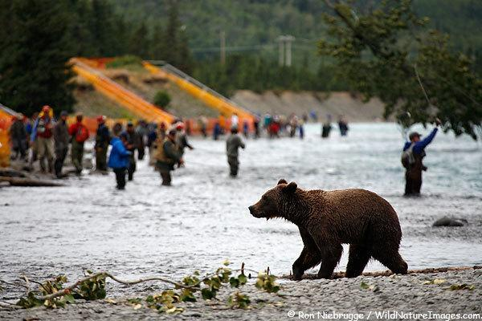
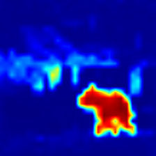
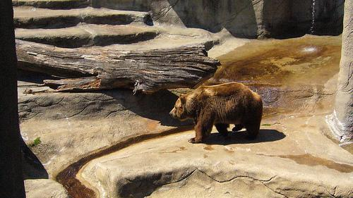
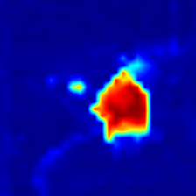
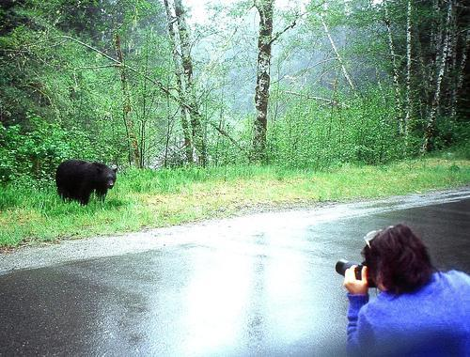
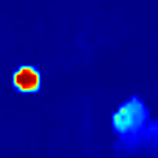
Image Group
Noisy initial responses
ViT
Encoder
Patch-level
Correspondence
Cross-attention
$F$:patch
features
$$F$$
(Patch-token
Features)
...
...
$ω_{0}$:initial support

Slide 11
Image Group
Noisy initial responses
ViT
Encoder
Patch-level
Correspondence
Cross-attention
$F$:patch
features
$$F$$
(Patch-token
Features)
...
...
$ω_{0}$:initial support

Slide 12
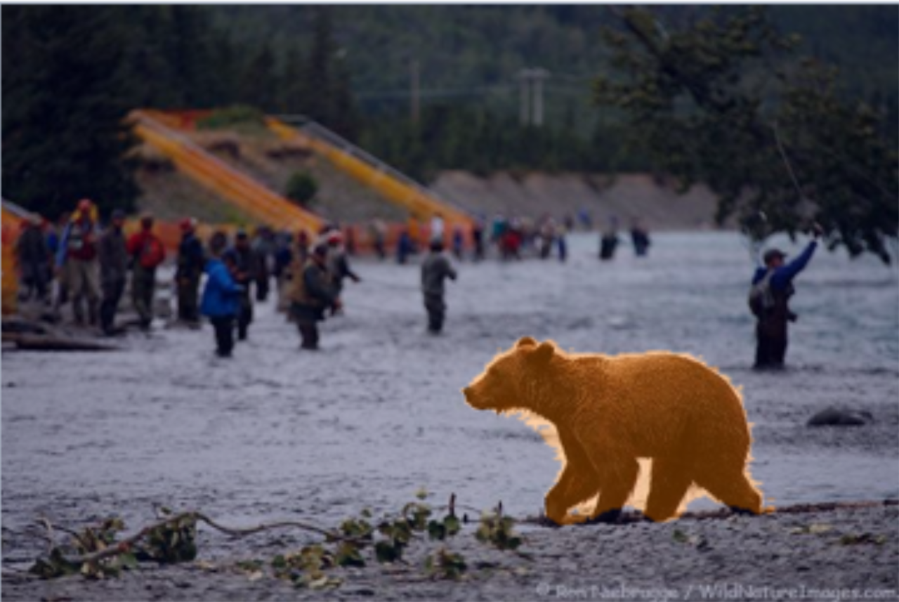
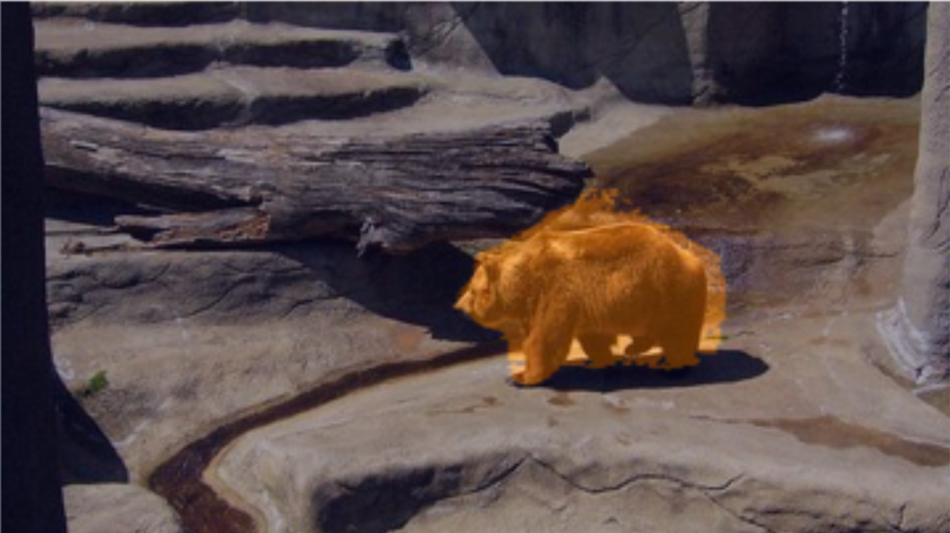
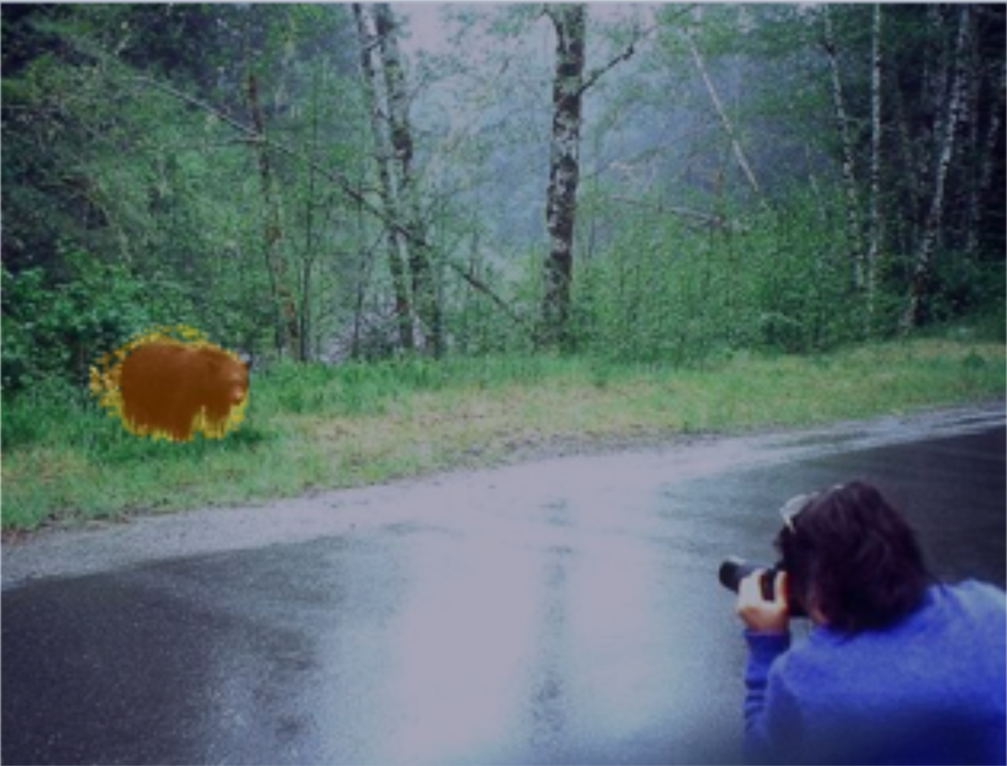
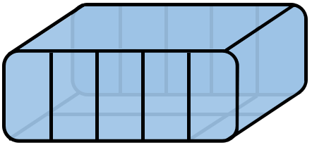


Image Group
Noisy initial responses
ACRE
prototype pooling
$$P$$
ViT
Encoder
Patch-level
Correspondence
Cross-attention
$F$:patch
features
A
$$ω$$
$$F$$
(Patch-token
Features)
...
...
$ω_{0}$:initial support

Slide 13








K Gate
Token Pool
$$k=ceil(r∙HW)$$
Top-K
Ranking Belt
$$ω_{topk}$$
$$conf_{i}<c_{gate}$$
$$ω_{res}−(1−α)ω_{topk}+αω_{full}$$
$$ω_{final}$$
$${mass}_{keep}≥m_{min}$$
$$ω_{full}$$
$$δ≤δ_{th}$$

Slide 14
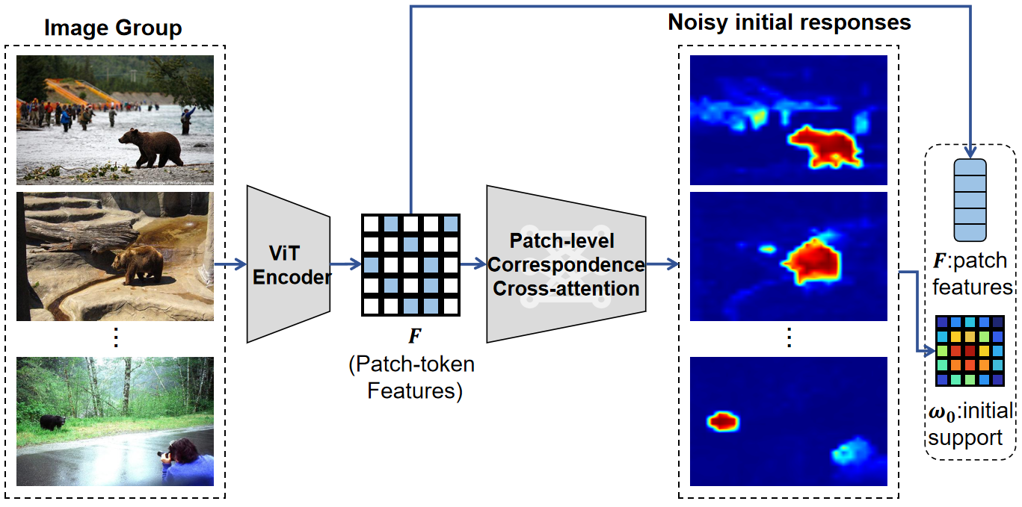

Slide 15
