Slide 1
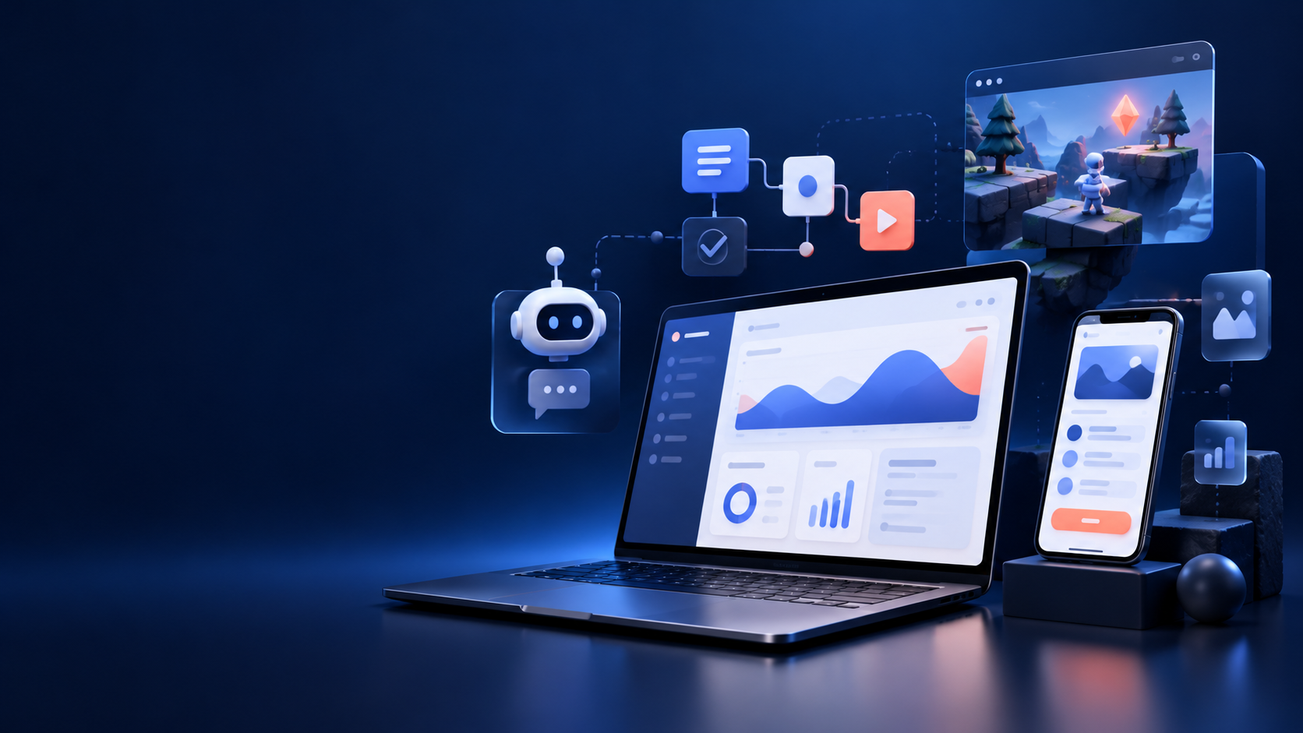
KOPYTOV DIGITAL
Digital studio
and development
Websites, web apps, automation, Telegram bots and browser games.
Portfolio demo presentation
KOPYTOV DIGITAL / COMPANY PROFILE
01

Slide 2
ABOUT US
Who we are
A small digital studio focused on clear, useful products.
KOPYTOV DIGITAL is a digital studio concept. We design and build products for businesses and users.
Our work starts with clear goals, sound structure and ease of use.
FOCUS
Clear interfaces
Practical value
Predictable results
KOPYTOV DIGITAL / COMPANY PROFILE
02

Slide 3
EXPERTISE
What we do
Five formats that can work together in one project.
01
02
03
Landing pages
Web interfaces
Automation
Structure, responsive design and clarity
User portals and workspaces
Forms, workflows and data handling
04
05
Telegram bots
Browser games
Chats, requests and alerts
Interactive mechanics and UI
KOPYTOV DIGITAL / COMPANY PROFILE
03

Slide 4
METHOD
Our approach
From a clear goal to a working solution.
01
02
03
Goal
→
Structure
→
Implementation
Define goals and requirements
Plan flows and logic
Build the design and features
Every stage supports the project goal and user journey.
KOPYTOV DIGITAL / COMPANY PROFILE
04

Slide 5
WORKFLOW
Five development stages
Deliverables and review points are agreed upfront.
01
02
03
04
05
Discussion
Prototype
Build
Testing
Handover
Goals and requirements
Structure and flows
Design and features
Tests and fixes
Files and materials
KOPYTOV DIGITAL / COMPANY PROFILE
05

Slide 6
PORTFOLIO
Example project types
Demo project formats, without fictional clients or metrics.
01
Company website
02
CRM interface
Service pages, forms and responsive layout
Workspaces, statuses and filters
03
Bot and automation
04
Browser game
Requests, notifications and reporting
Game mechanics, controls and UI
All examples represent demo project categories.
KOPYTOV DIGITAL / COMPANY PROFILE
06

Slide 7
QUALITY CONTROL
Quality principles
We test workflows as well as visuals.
Responsiveness
Functionality
The interface works on desktop and mobile
Core actions are tested
Performance
Handover
We consider load speed and responsiveness
Sources and structure remain easy to update
KOPYTOV DIGITAL / COMPANY PROFILE
07

Slide 8
KOPYTOV DIGITAL
Let's discuss your needs
Describe your goal and requirements. We'll outline scope, timing and an initial estimate.
Kopytovdv1999@gmail.com
Next step: a brief project outline
Portfolio demo material
KOPYTOV DIGITAL / COMPANY PROFILE
08

