Slide 1
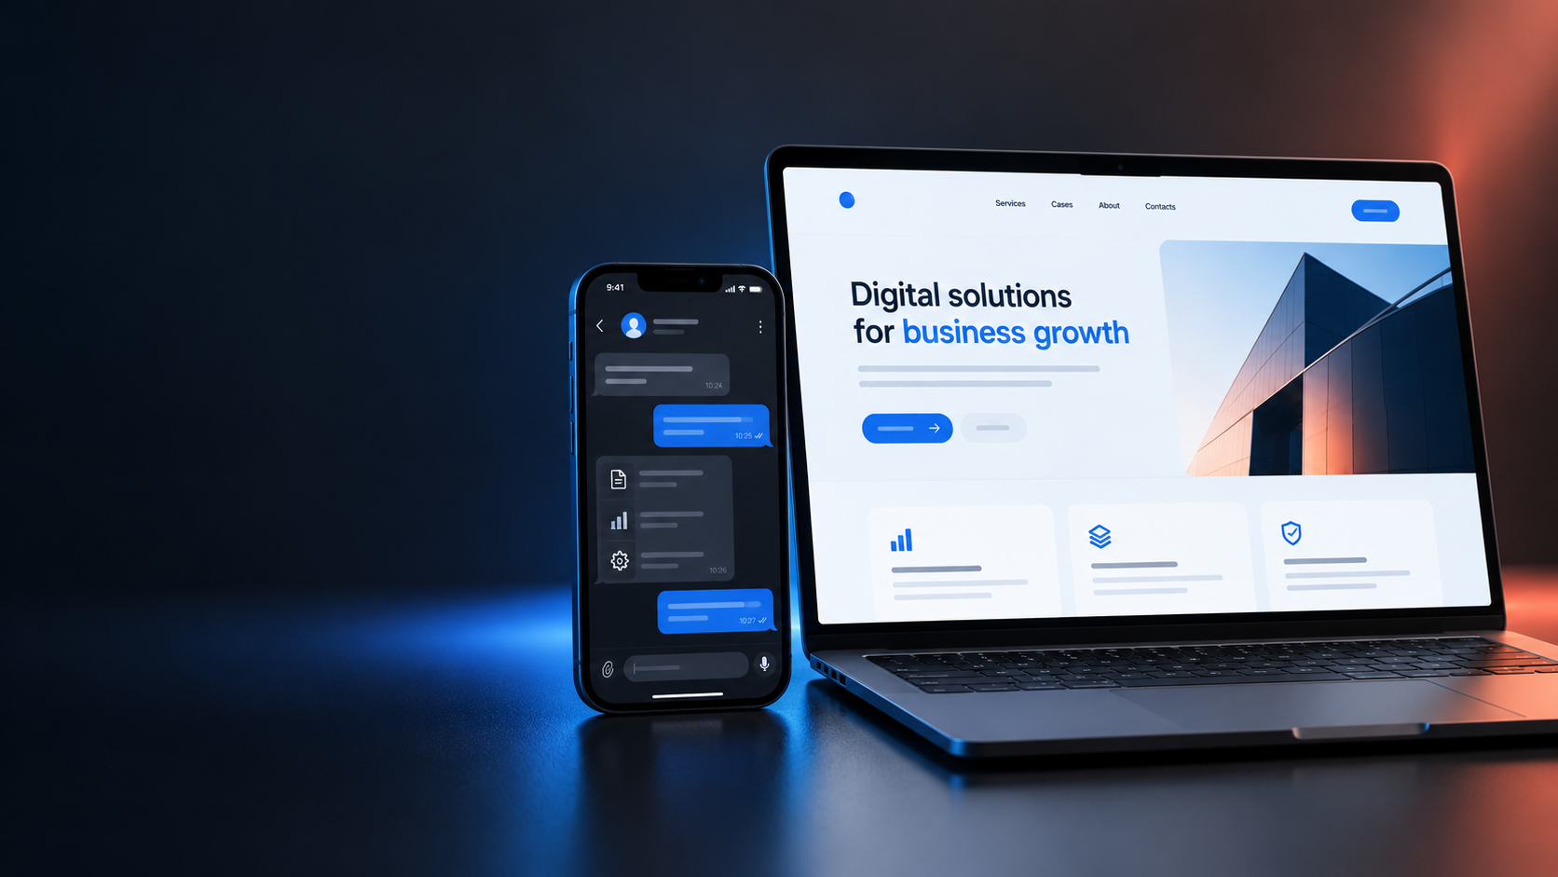
KOPYTOV DIGITAL
Websites and digital tools for business
Project proposal
Demonstration project
KOPYTOV DIGITAL / PROPOSAL
01

Slide 2
CLIENT NEED
When business needs better digital tools
Requests, information and tasks need a clear flow.
01
Customers cannot find answers
Information is spread across channels
Project goal
Simplify customer interactions and daily team work.
02
Requests handled manually
Staff repeat the same steps
03
Request status is unclear
The team spends time checking
KOPYTOV DIGITAL / PROPOSAL
02

Slide 3
SOLUTION
Built around business needs
We agree on features after discussing the project.
Landing page
Web interface
Automation
Clear structure and mobile-friendly layout
Workspace for staff or customers
Forms, Telegram bot and request handling
KOPYTOV DIGITAL / PROPOSAL
03

Slide 4
WORK STAGES
How development works
01
02
03
04
05
Discuss needs
Structure and design
Build features
Testing
Handover
Scope and deliverables are agreed before development.
KOPYTOV DIGITAL / PROPOSAL
04

Slide 5
DELIVERABLES
What the client receives
A digital product within the agreed scope.
●
Responsive interface
●
Configured features
Works on desktop and mobile
Forms and flows are tested
●
Source files
●
Agreed scope
Code and a short guide are handed over
Integrations agreed in advance
KOPYTOV DIGITAL / PROPOSAL
05

Slide 6
TERMS
Illustrative package
Final estimate depends on features and integrations.
PRICE
TIMELINE
from 60,000 ₽
15 business days
Budget and schedule follow the requirements review.
KOPYTOV DIGITAL / PROPOSAL
06

Slide 7
KOPYTOV DIGITAL
Let's discuss your project
Tell us your goal and needed features. We'll prepare an estimate after reviewing the requirements.
START A CONVERSATION
Kopytovdv1999@gmail.com
KOPYTOV DIGITAL / PROPOSAL
07

