Slide 1
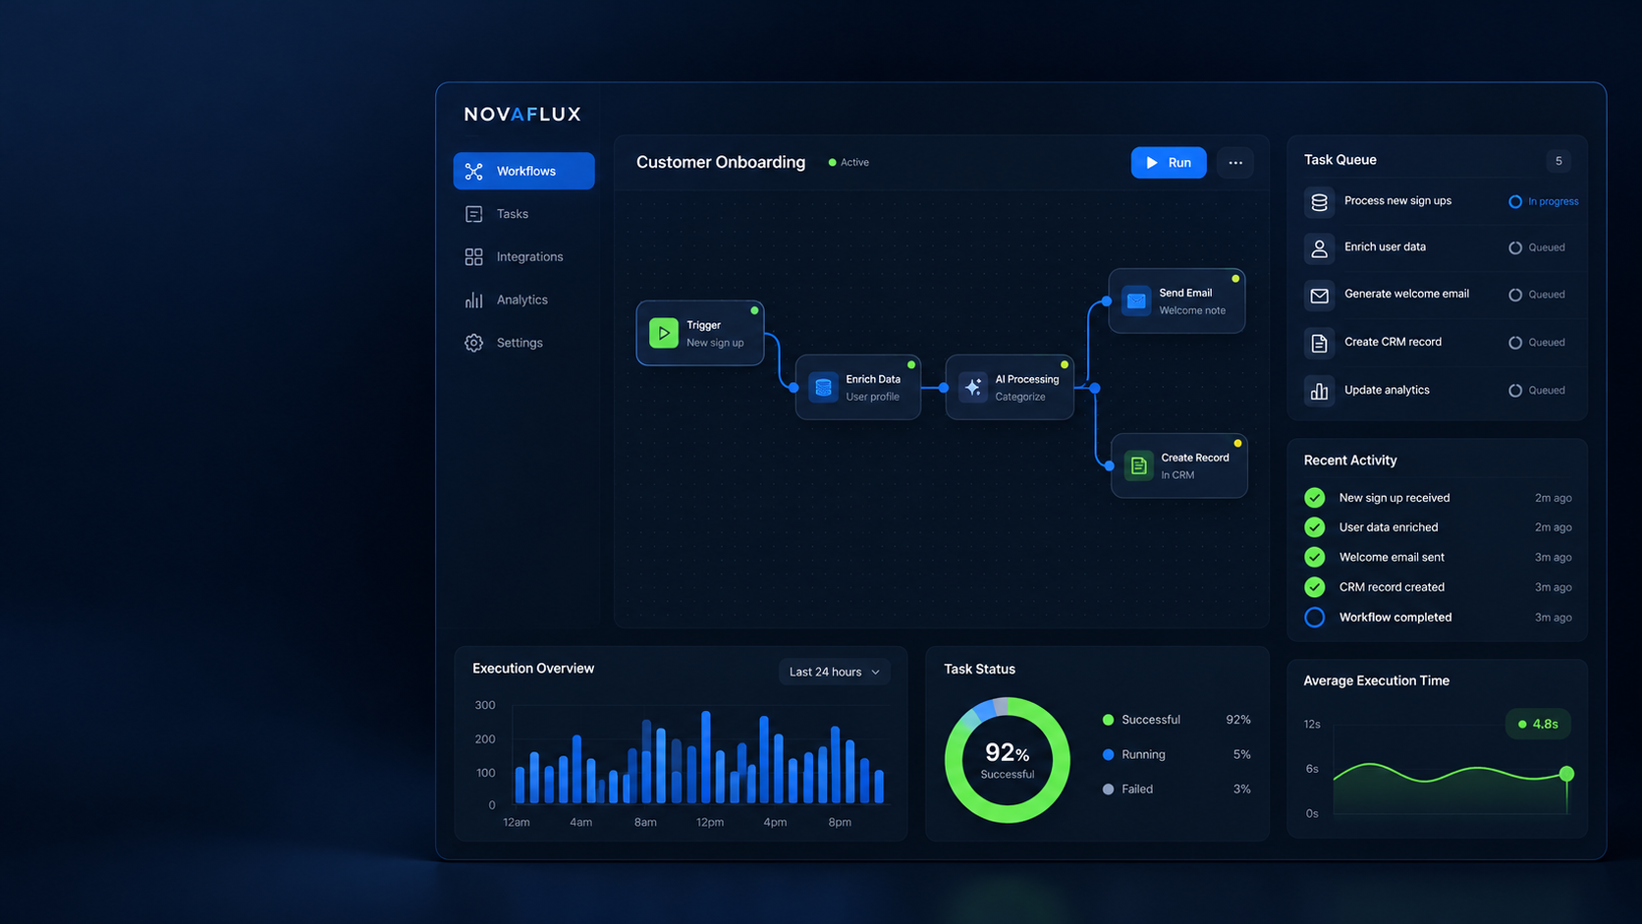
NOVAFLUX
Automation without manual busywork
A digital workflow management concept
PRODUCT DECK
NOVAFLUX / PRODUCT OVERVIEW
01

Slide 2
CONTEXT
Manual handoffs slow work down
Concept deck. The scenarios shown are illustrative, not real client results.
01
Request received
Email, form or spreadsheet
One missed step is enough
As requests grow, manual steps cause delays and rework. NOVAFLUX brings the flow into one path.
02
Data copied
A team member copies fields manually
03
Status unclear
The team checks who is responsible
NOVAFLUX / PRODUCT OVERVIEW
02

Slide 3
PRODUCT
A clear visual workflow
Connect steps, set conditions and see the outcome.
Trigger
Processing
Action
Result
New request
Data check
CRM entry
Team notified
Each step stays editable. Errors appear at the relevant node; reruns need no rebuild.
NOVAFLUX / PRODUCT OVERVIEW
03

Slide 4
FEATURES
Four everyday features
01
Workflows
02
Integrations
Visual steps and conditions
Connect forms, email and CRM
03
Monitoring
04
Retry
Run history and step status
Retry from an error without restarting
NOVAFLUX / PRODUCT OVERVIEW
04

Slide 5
LAUNCH
Pilot one repeatable workflow
Start with a clear input, owner and measurable outcome.
1
2
3
4
Choose a workflow
Build the flow
Testing
Expand
One frequent task
Steps and owners
Check for errors
More teams and integrations
Pilot success: the team completes the flow without manual data transfers.
NOVAFLUX / PRODUCT OVERVIEW
05

Slide 6
NOVAFLUX
One workflow, fewer manual steps
N
Product concept ready for demos, workflow testing and UI refinement.
PRODUCT CONCEPT
Portfolio demonstration project
NOVAFLUX / PRODUCT OVERVIEW
06

