Slide 1
TMF Pitch Deck | Template
This template is for teams requesting funding from the Technology Modernization Fund. Each slide covers a topic you may wish to cover as part of your funding pitch. This template contains suggestions for what you could include. What you cover, and in what order, is up to you.
This is an opportunity to tell your story to the Board in as creative and compelling a format as possible. It is not a requirement that you complete each slide. Add slides, remove them, illustrate them, animate them, or use your own presentation deck if you wish. Please remember that the total time allotted for this presentation is ten minutes and structure your pitch to accommodate this timeframe.
The TMF team is here to support and advise you as you prepare your pitch. We’re not voting members of the Board, which means we can give you practical, impartial support. We strongly encourage you to reach out to us at tmf@gsa.gov for help, advice, and encouragement.

Slide 2
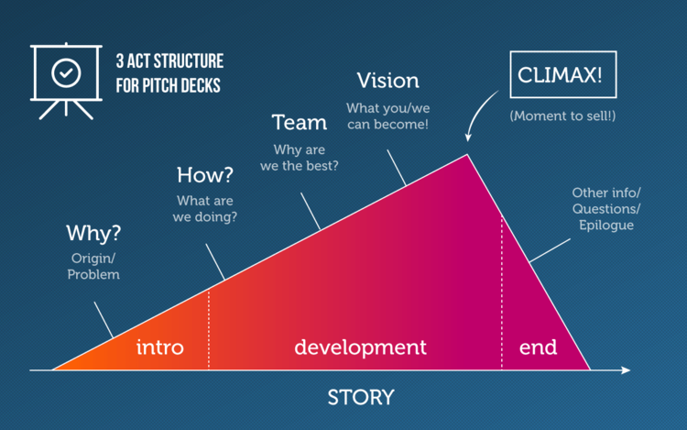
Source: https://slidebean.com/blog/startups/pitch-deck-template/

Slide 3
[Project Name]
Name of Project
[One-sentence elevator pitch description of your project]
Technology Modernization Fund Full Project Proposal
[Name(s) and organization(s) of participants, date of presentation]

Slide 4
The problem
Tell (and show) your story. Be as narrative as possible.
What problem are you trying to solve?
How is this problem related to the mission of your agency?
Include project or product history that is relevant, data that demonstrates the scope of the problem, and/or images, including legacy product images, that help explain the problem.

Slide 5
The solution
Focus on outcomes. If this project is successful, what will change?
How do you plan to address the problem?
Why did you choose this solution?
Why is this a good idea?
Why is now the right time for it?

Slide 6
Demo or prototype
If you’ve got something to show, show it here.
Options include a product demo, a prototype, design wireframes, visual comps, etc.
Keep it short—just enough to show core functionality.
Live demos are never a good idea. Drawings, screenshots, or pre-recorded demos are preferable.

Slide 7
The team
Cross-functional teams representing talent from across your agency have a higher likelihood of success.
Who are the core team members for this project?
What are the roles of these team members on the project? What expertise to do they bring to the team?
What roles or skills will you need to recruit to the team, if any, and how do you intend to locate them?

Slide 8
Public-facing impact
Beyond the value to your agency, help us understand how the impact of this project will be seen and felt by the American public.
How will the public benefit from the approach you are proposing to solve this problem?
Include user stories, relevant research, customer citations, and any market indicators that show your project will be effective and well-received.

Slide 9
Risks
A thoughtful, detailed list of potential risks and how to address them
is considered a positive, not a negative, when determining whether
or not to fund a project. A helpful list of types of project risk.
What risks do you foresee to this project? What could fail and why?
How might you address these risks?
What is the risk to the federal government? If we don’t fund this project, what happens?

Slide 10
Policy hotspots
Outline the policy landscape for this project.
Are there any policy barriers or statutory limitations that will need to be overcome in order to successfully execute this project?
What policy changes, if any, will have to be made in order to ensure successful delivery of this project?

Slide 11
“Special sauce”
What’s unique about this project that makes it an especially appealing option for the government to pursue?
If your project has elements that are interesting or unusual that make this project particularly notable, share them here.
Examples include but are not limited to: aspects of your business model, repayment model, implementation approach, procurement approach, opportunity for agency reuse, or opportunity for the vendor community.

Slide 12
Milestones
What major milestones will this project include?
What are the metrics that you will associate with these milestones to determine whether or not they’ve been met?

Slide 13
Thanks!
[Name] [Agency] [Email]

