Slide 1
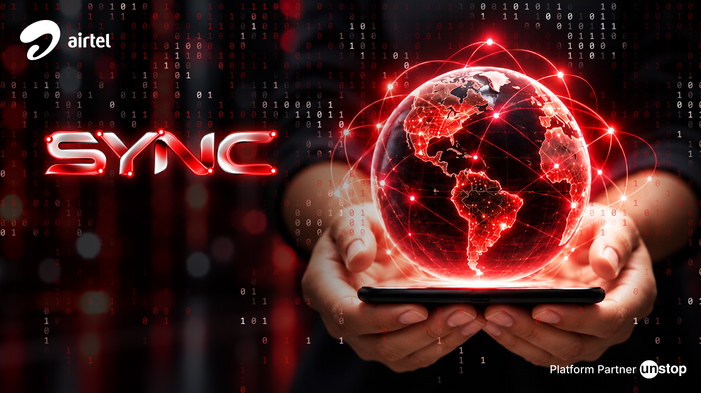
Project Udyam Digital
A small business finds its bundle, buys it and tracks it on a phone, in English or Hindi.
Team BlackHack
Ayush Sahu | Chandrakant Gorain
NIT Jamshedpur
Accel YTL Hackathon 2026 | Enterprise Track A
Notes:
We are team BlackHack from NIT Jamshedpur. Project Udyam Digital is a working prototype for Accel Business, the B2B arm of the fictional operator Accel Telecom. A small business owner talks to an AI advisor, sees one clear monthly price, finishes KYC by photo and tracks the order, without a sales visit. All data is synthetic. Next: the numbers behind the problem, what we built, what is proven and what is not.

Slide 2

Only 7.4% of small-business leads activate, and the quote is the weakest step
Leads reaching each stage, April to June 2026
17.6 days
from lead to activation
3 calls
by each customer to chase status
₹15,053
cost per activation
1,291 vs 621
leads lost to how we sell (visits, slow quotes, paperwork) vs lost on price
Only 44% of assessed leads accept a quote, the lowest step in the funnel.
Notes:
From 5,000 leads in April to June 2026, only 368 activated. The steepest step is from needs assessed to quote accepted, where only 44% continue. Those who activate wait 17.6 days on average and call 3 times to chase status. Each activation costs ₹15,053. Process problems such as missed visits, slow or complex quotes and paperwork lost 1,291 leads, about twice the 621 lost on price. Source: smb_leads.csv.

Slide 3
The leads data told us what to build
What the data shows | Number | What we built
Field visits to Micro don't pay back | ₹53,026 per activation vs ₹2,505/month bundle | Micro is digital first; routing refuses field visits
We lose leads on process, not price | 1,291 lost on process vs 621 on price | Quote inside the chat, with no visit needed
Past sales broke the rules | 48 of 368 bundles; 18 activations on a cancelled GSTIN | Rules engine decides every sale; KYC checks GST status
Waiting and chasing hurt loyalty | NPS 7.3 at 11-15 days, 5.8 at 26+; churn 6% with 0-1 calls, 23% with 4-5 | Tracker with a date per service and self-service slots
Tier 2 loses more after KYC | 51.8% activate vs 72.7% in tier 1 | Holds shown to owner and staff. Partly addressed: install capacity not built
GSTIN predicts activation | 9.6% with GSTIN vs 2.0% without | Advisor asks for it; lookup fills in details; score uses it
Notes:
We analysed all 5,000 leads. Field visits to Micro cost ₹53,026 per activation against a bundle of ₹2,505 a month, a 20.3-month payback. 48 of 368 sold bundles broke catalogue rules, and 18 activations used a cancelled GSTIN. Customers activated in 11 to 15 days give NPS 7.3; at 26 days or more, 5.8. Churn is 6% with 0 to 1 status calls (34 customers, a small group) and 23% with 4 to 5. After KYC, tier 2 activates 51.8% against 72.7% in tier 1. We only partly address that: install capacity is outside this prototype.

Slide 4
Start with professional offices and Micro; add bigger sites with sales help
Segment | Leads | Activated | Conv. rate | Cost per activation | Payback (months) | Example bundle (live quote) | Per month | Today's spend* | Plan
Professional offices | 1,247 | 138 | 11.1% | ₹10,695 | 1.6 | CA firm, 13 people: Biz Fibre 300, 3 lines, email, security, backup; 12 months | ₹5,738 | ₹2,600 | First: digital
Micro retail & services | 2,709 | 110 | 4.1% | ₹20,007 | 8.0 | Kirana, 3 people: Biz Fibre 100, 2 lines; 12 months | ₹1,597 | ₹900 | First: digital only
Small multi-site | 755 | 83 | 11.0% | ₹15,614 | 0.5 | Restaurant chain, 7 sites: fibre, 5 lines, failover, POS, CCTV, SD-WAN; 24 months; ₹88,200 setup | ₹41,460 | ₹9,150 | Next: sales help
Small manufacturers | 289 | 37 | 12.8% | ₹15,324 | 0.8 | Packaging unit, 74 people: leased line, 4 lines, email, security; 12 months; ₹10,000 setup | ₹12,688 | ₹14,300 | Next: sales help
Price: the catalogue's lowest price; one monthly total; no discounts or taxes.
*Today's spend: median monthly telecom spend of all leads in the segment. Quote profiles are our examples, near each segment's median size.
Notes:
Professional offices come first: the most activations, 138, and a 1.6-month payback. Micro has the most leads but an 8.0-month payback and 22.7% churn, so it is digital only. Multi-site and manufacturers pay back fastest but need site work and carry bigger setup, so they follow with sales help. Bundles are live quotes from our rules engine, at the catalogue's lowest price, with no discounts or taxes. Honest point: except for manufacturers, these bundles cost more than today's median telecom spend, because they include more services. Price sensitivity needs testing in the pilot.

Slide 5
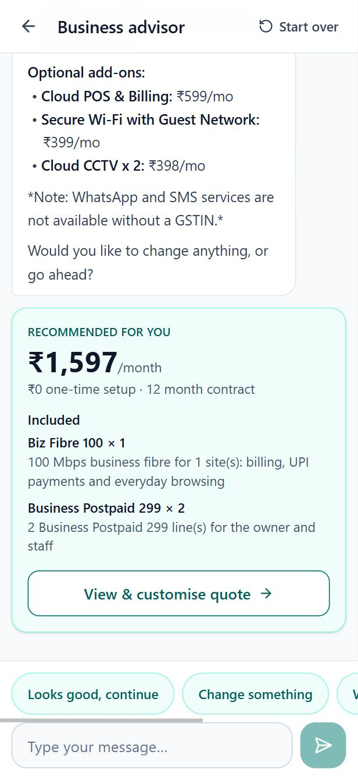
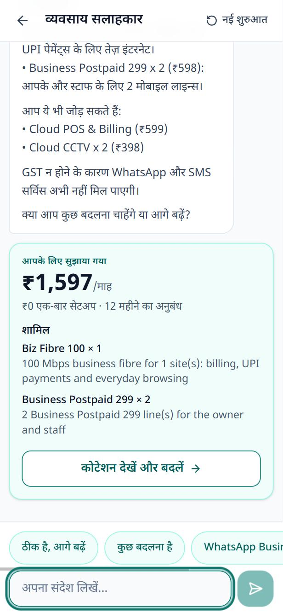
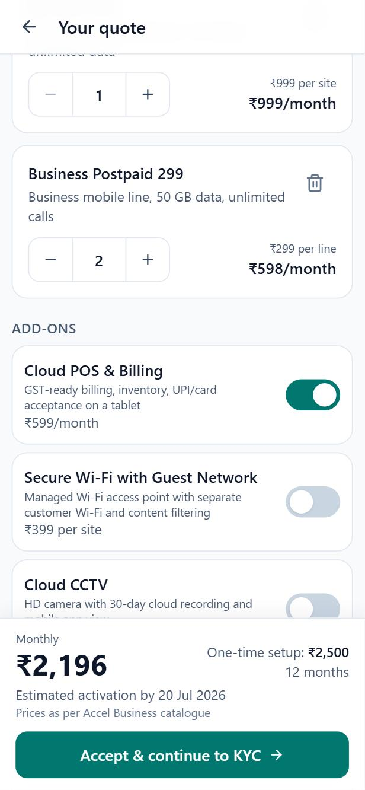
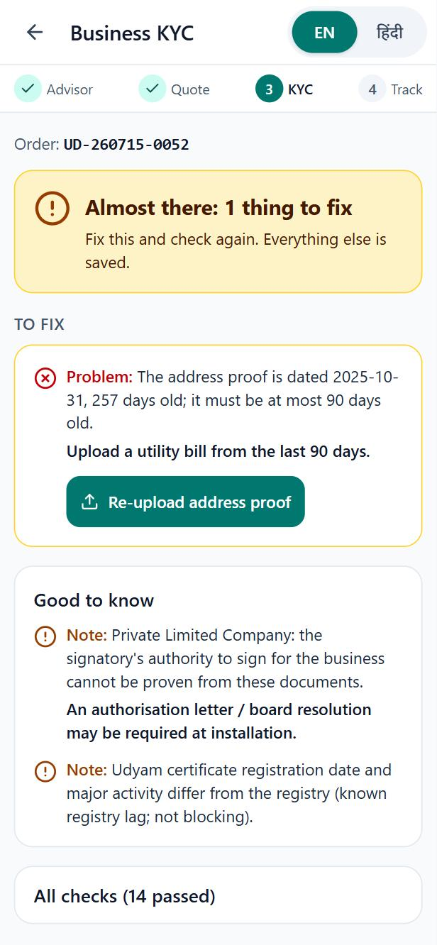
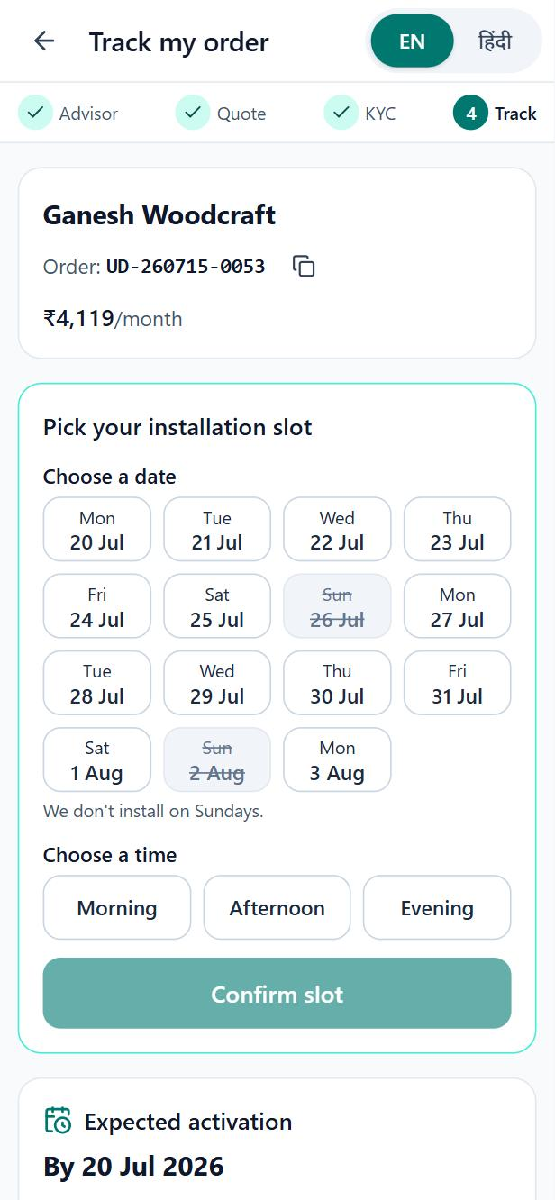
From first question to tracked order on a phone, with no salesperson
Advisor
Asks about the business, recommends and explains why
Hindi
Same advisor; replies in Hindi, same engine price
Quote
One monthly price; add-on on: ₹1,597 to ₹2,196
Smart KYC
Finds the problem and says what to upload
Tracker
Date per service; owner picks an install slot
Real prototype screens. Not built: voice, WhatsApp and regional-language screens.
Notes:
These are real screens from the prototype, captured on 31 October on real Gemini. The advisor needs business type, city, staff and sites, and asks about GST. Current tools are saved if mentioned, but it doesn't ask yet. It answered correctly in English and Hindi here. The quote shows one price: switching on Cloud POS moves ₹1,597 to ₹2,196. KYC found the old address proof and said what to upload. The tracker gives a date per service and install slots. Not built: voice, WhatsApp and regional-language screens.

Slide 6
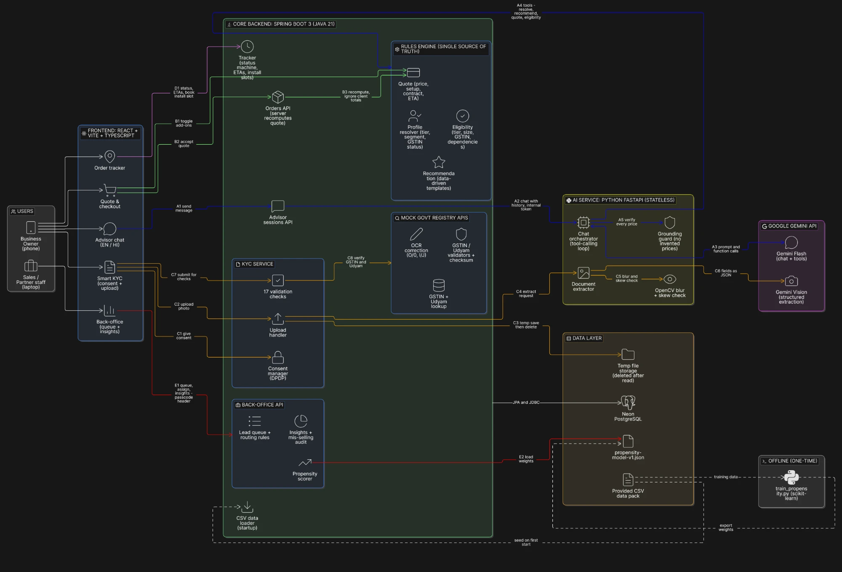
The AI explains; the rules engine decides every product and price
AI safeguard
Every ₹ amount and product in a reply is checked against the engine. Wrong? One retry, then a template.
Proof | Result
Automated tests | 789 pass (480 + 146 + 163)
KYC verdicts vs answer key | 12 of 12, on hand-transcribed fields
KYC read by real Gemini | K03 and K11 as expected; blurry K04 refused
Advisor scenarios run live | 3 of 15 passed; 12 not run yet
Advisor in the browser, real Gemini | English and Hindi replies showed the engine's ₹1,597
Main components and data flows
Notes:
The AI service holds the Gemini key and runs the chat, but every product, quantity and price comes from our Spring rules engine. A guard checks every rupee amount and product in each reply; if one doesn't match, it retries once and then uses a template. Proof: 789 automated tests pass. KYC verdicts match the answer key 12 of 12, on hand-transcribed fields. On real Gemini, K03 and K11 gave the expected verdicts. Advisor evals: 3 of 15 have run live and passed; the other 12 have not run. New API keys need newer Gemini models, which was a settings change only.

Slide 7
KYC moves from paper and email to one sitting, with consent first
Consent
by purpose
4 photos
Blur check
(no AI call)
Gemini
reads fields
17 checks +
registry lookup
Verified, fix
or rejected
DPDP principle | What we built (designed to align with the DPDP Act 2023)
Consent | Boxes start unticked; versioned notice in English and Hindi; no upload without consent
Purpose limitation | Two required purposes (verification, installation); WhatsApp updates optional
Data minimisation | Photos deleted right after reading; only the needed fields are kept
Withdrawal | Deletes extracted fields and check results, before service is installed
Masking | GSTIN, Udyam and ID numbers masked on screens and in logs
Not built yet
DigiLocker and e-sign
Automatic deletion when retention ends
Mocked
GST and Udyam lookups use the provided data
To fix before pilot
Notice must name Google Gemini; move to a paid or enterprise AI tier
Notes:
The owner consents first, then uploads four photos. Blurry photos are refused before any AI call. Gemini reads the fields, and 17 checks compare them with each other and with mocked GST and Udyam registries. The result is verified, one specific fix, or rejected. We say designed to align with the DPDP Act 2023, not certified compliant. Not built: DigiLocker and e-sign. Known gaps: no automatic deletion job yet, the notice doesn't yet name Google Gemini, and chat text is sent to Gemini after only a line in the greeting.

Slide 8
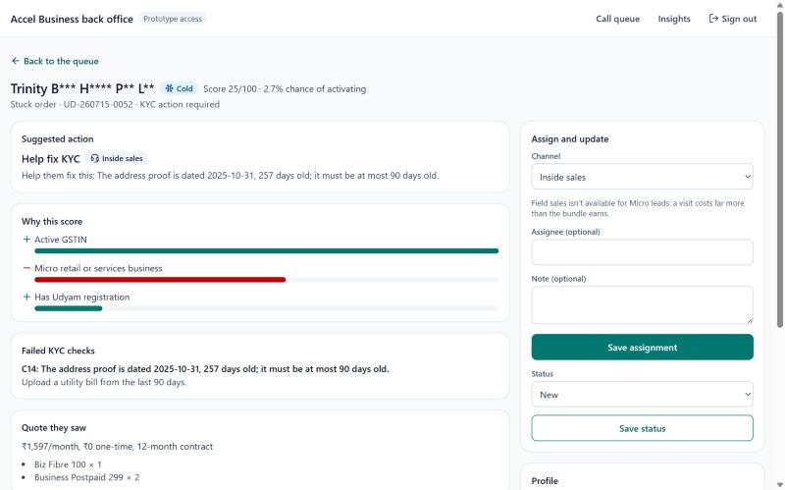
Digital handles simple leads; sales and partners get the ones worth their time
Lead | Who follows up
Micro | Digital reminder; call if Hot. Never a field visit
Bigger business, Hot | Channel partner if in the city, else field sales
Bigger business, Warm | Inside sales call (Cold: digital reminder)
Saw a quote and left | Inside sales call, with the quote
Stuck in KYC | Inside sales, with the failed check
Inactive GSTIN | Fix GST before anyone visits
Per activation | All | Micro | Multi-site
Field sales | ₹24,335 | ₹53,026 | ₹15,921
Channel partner | ₹20,851 | ₹11,382 | ₹42,149
Website form | ₹6,352 | ₹13,124 | ₹4,189
Back-office: score, reasons, failed check, suggested action. Names are masked.
Top 20% of leads by score hold 37.5% of activations (AUC 0.699). Hot means this top 20%.
Gap: no phone number collected yet. Partner cost on multi-site needs review.
Notes:
Field and partner sales stay, but on the right leads. The back-office scores unclosed leads and suggests who follows up, with the reason. Micro never gets a field visit. The score has an AUC of 0.699 on cross-validation, and the top 20% of leads hold 37.5% of activations. It ranks likely buyers; it doesn't prove a call causes a sale. Two honest points: no phone number is collected yet, so staff can't reach leads from here. And partners on multi-site cost ₹42,149 per activation against ₹15,921 for field, so partner-first routing needs review.

Slide 9
Five metrics to judge the pilot: baselines from data, targets are our proposal
Metric | Today | Target | Why this target
Lead to activation | 7.4% | 11% | ASSUMPTION: win back half of 1,291 process-lost leads, about 184 more activations
Time to activate | 17.6 days | 10 days | Quote and KYC in one sitting; catalogue fibre install is 5 days, plus buffer
Cost per activation | ₹15,053 | Under ₹10,000 | Stop ₹14.3 lakh of Micro field spend; about ₹7,825 before AI and support costs
Status calls per customer | 3.0 | 1 | Tracker replaces chasing; customers with 0-1 calls give the best NPS, 7.5
6-month churn | 15.2% | 12% | Customers with 2-3 calls churn 13%; no more rule-breaking sales
Value for Accel Business, per quarter
₹14.3 lakh saved on Micro field visits
About 184 more activations (ASSUMPTION)
Those add about ₹12.7 lakh a month, at the ₹6,900 median bundle (ASSUMPTION)
Value for the owner
A quote in the chat, instead of 3-5 days as a PDF
One price and plain reasons, not product codes
Status on the phone, instead of calling
Notes:
Baselines come from the data; targets are proposals not yet tested with real customers. Conversion: if we win back half the 1,291 process-lost leads, an assumption, each stage's normal rate gives about 184 more activations, 552 or 11%. Cost: removing ₹14.3 lakh of Micro field spend over 525 activations gives about ₹7,825 before AI and support costs, so we target under ₹10,000. Time: quote and KYC in one sitting, fibre install 5 days. Calls and churn: the tracker, and no rule-breaking sales.

Slide 10
Roll out in three gated steps, and close the known gaps first
1. Close the gaps | about 4 weeks
Finish 12 advisor scenarios and all KYC on real Gemini
Fix consent wording; add phone number and staff login
Risk | How we handle it
AI misreads a document | 17 checks and registry comparison; a failed check stops the order
AI model is withdrawn | Models are settings, not code; newer models tested for new keys
Customer data reaches an outside AI | Paid or enterprise tier; name it in the notice; keep only needed fields
Tier 2 orders drop after KYC (51.8% vs 72.7% activate) | Check site early; show holds; pilot tier 1 first
Bundle costs more than today's spend | Test price in pilot; show what each item is for
Sales see digital as a threat | Send them the Hot, high-value leads, with reasons
2. Pilot | about 3 months
Professional offices and Micro, tier 1, English and Hindi
Gate: the five targets on the previous slide
3. Scale | after the gate
Tier 2; multi-site and factories with sales help
Regional languages, WhatsApp, DigiLocker, e-sign
Notes:
Today this is a prototype running locally. Before any pilot we must finish the 12 advisor scenarios and all 12 KYC applicants on real Gemini, fix the consent wording, collect a phone number and add proper staff login. The pilot covers professional offices and Micro in tier 1 cities, in English and Hindi. Durations are our proposal. We scale only if the targets hold. The biggest risks are wrong AI readings, data going to an outside AI service, and tier 2 installation, where 51.8% activate after KYC.

