Slide 1
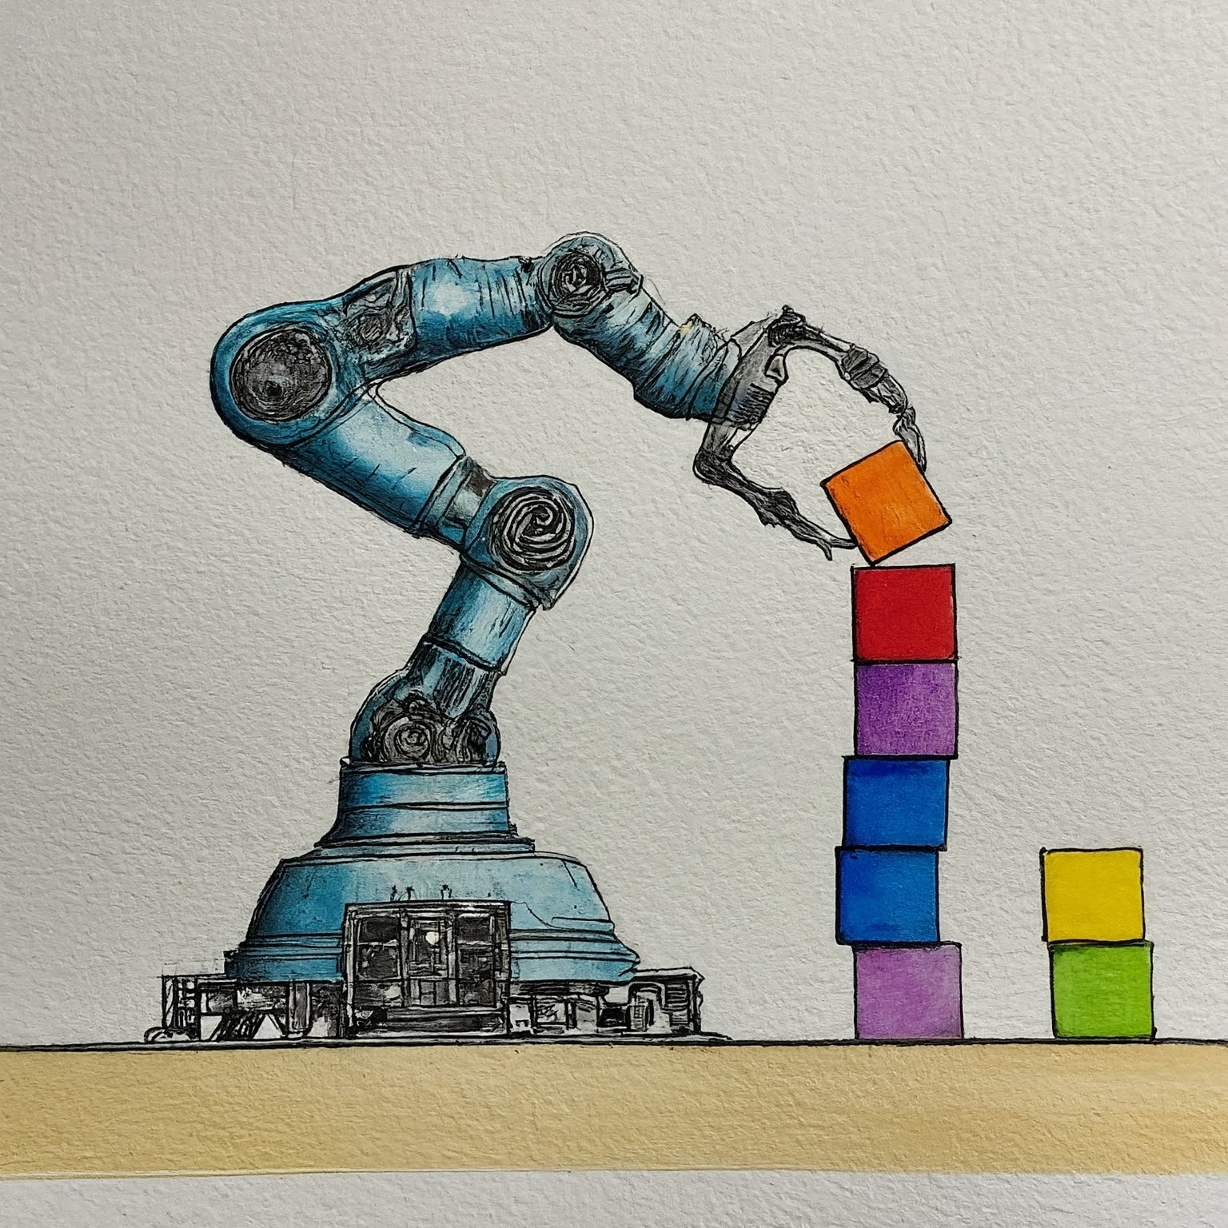

Introduction to ur5 simulation
AIR 24-25
Ido Jacobi & Shiran Peeran & Sarah Keren

Slide 2
Setting Up AIR_robots_sim Repository
1. Clone the Repository
git clone https://github.com/CLAIR-LAB-TECHNION/AIR_robots_sim.git
cd AIR_robots_sim
We recommended you work on virtual environment
Create a new Python virtual environment and Install requirements.

Slide 3
Repository Structure Overview
The repository is organized into several key directories:
abstract_motion_planner/ - Contains the base motion planning implementations
sim_ur5/ - Main simulation package with several important subdirectories:
motion_planning/ - Contains motion planning implementations and robot assets
mujoco_env/ - MuJoCo simulation environment setup
utils/ - Utility functions for logging and other operations

Slide 4
Key Files for Robot Control - Essential Files
sim_ur5/mujoco_env/sim_env.py - Main simulation environment
sim_ur5/motion_planning/motion_executor.py - Handles robot movement execution
sim_ur5/motion_planning/configurations.py - Robot configuration settings
sim_ur5/motion_planning/assets/ - Contains robot and object models
sim_ur5/motion_planning/klampt_world.xml - Contains the simulation environment

Slide 5
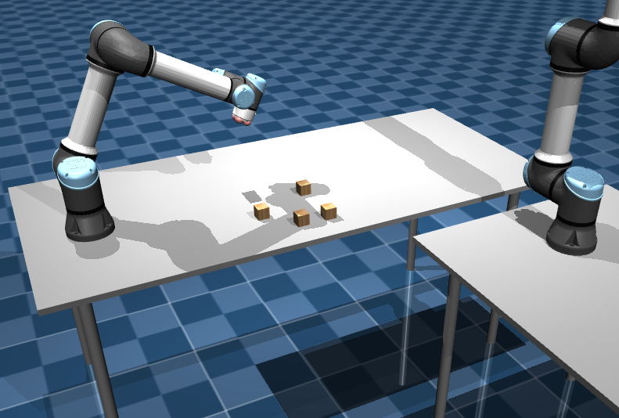

Slide 6
