Slide 1
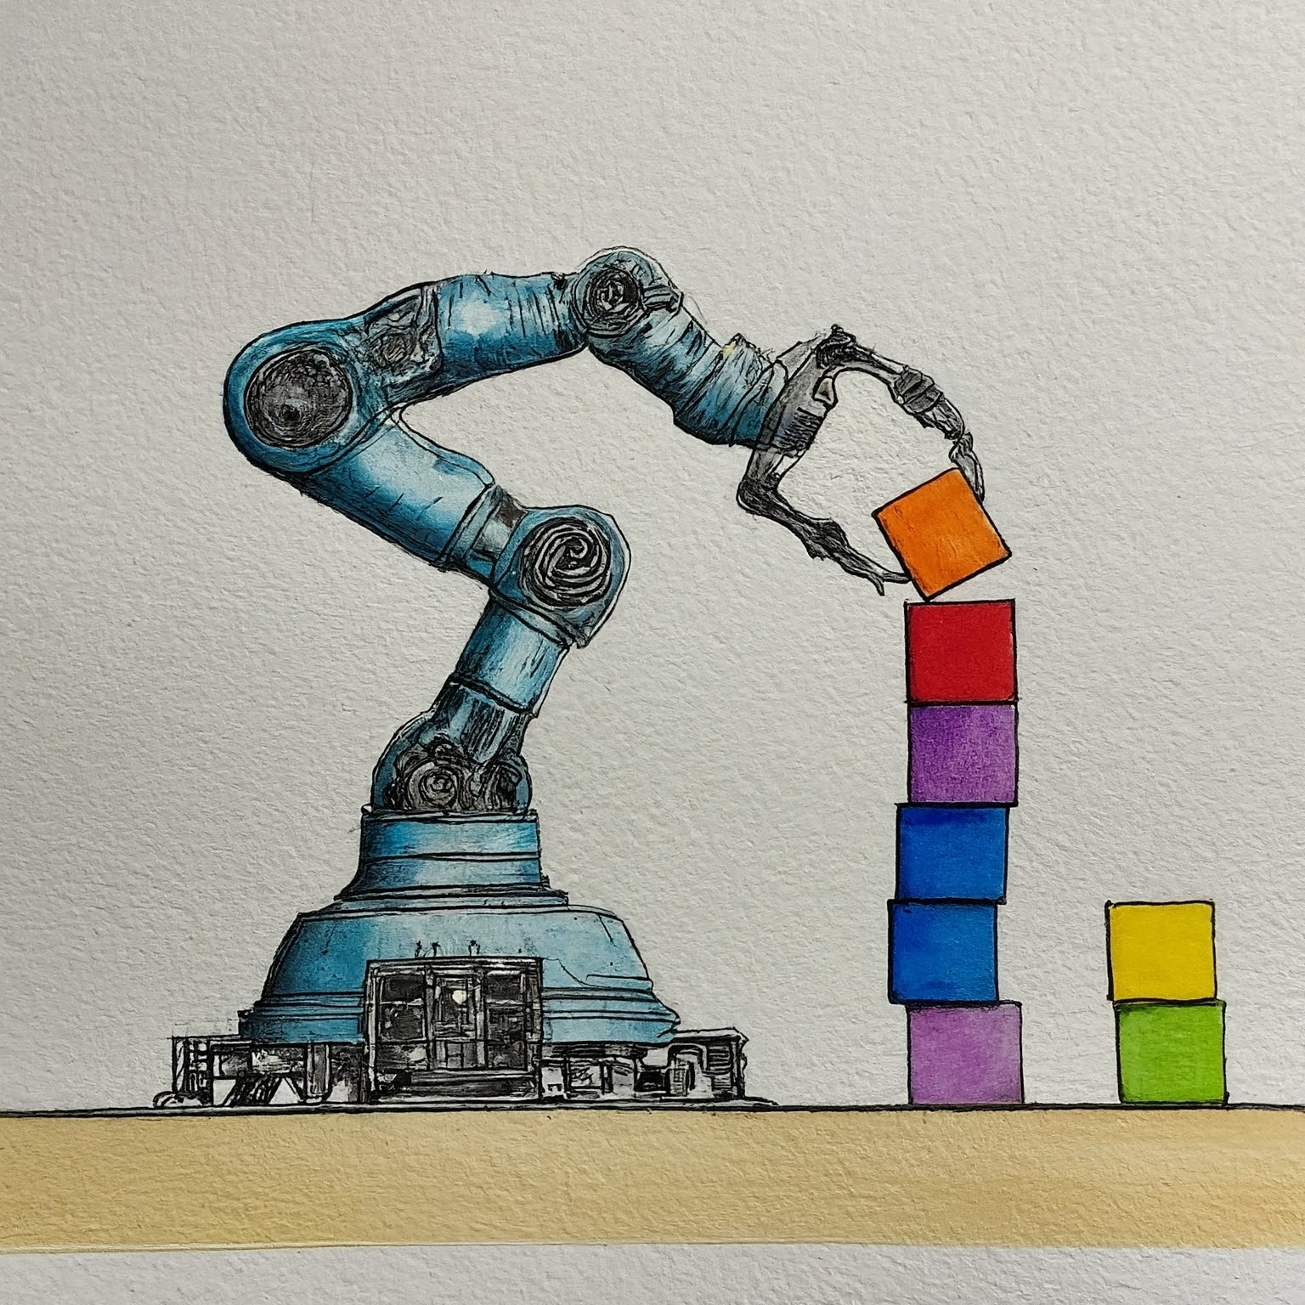

Tutorial 5 – MP: Sampling Based AIR 24-25
Ido Jacobi & Shiran Peeran & Sarah Keren

Slide 2
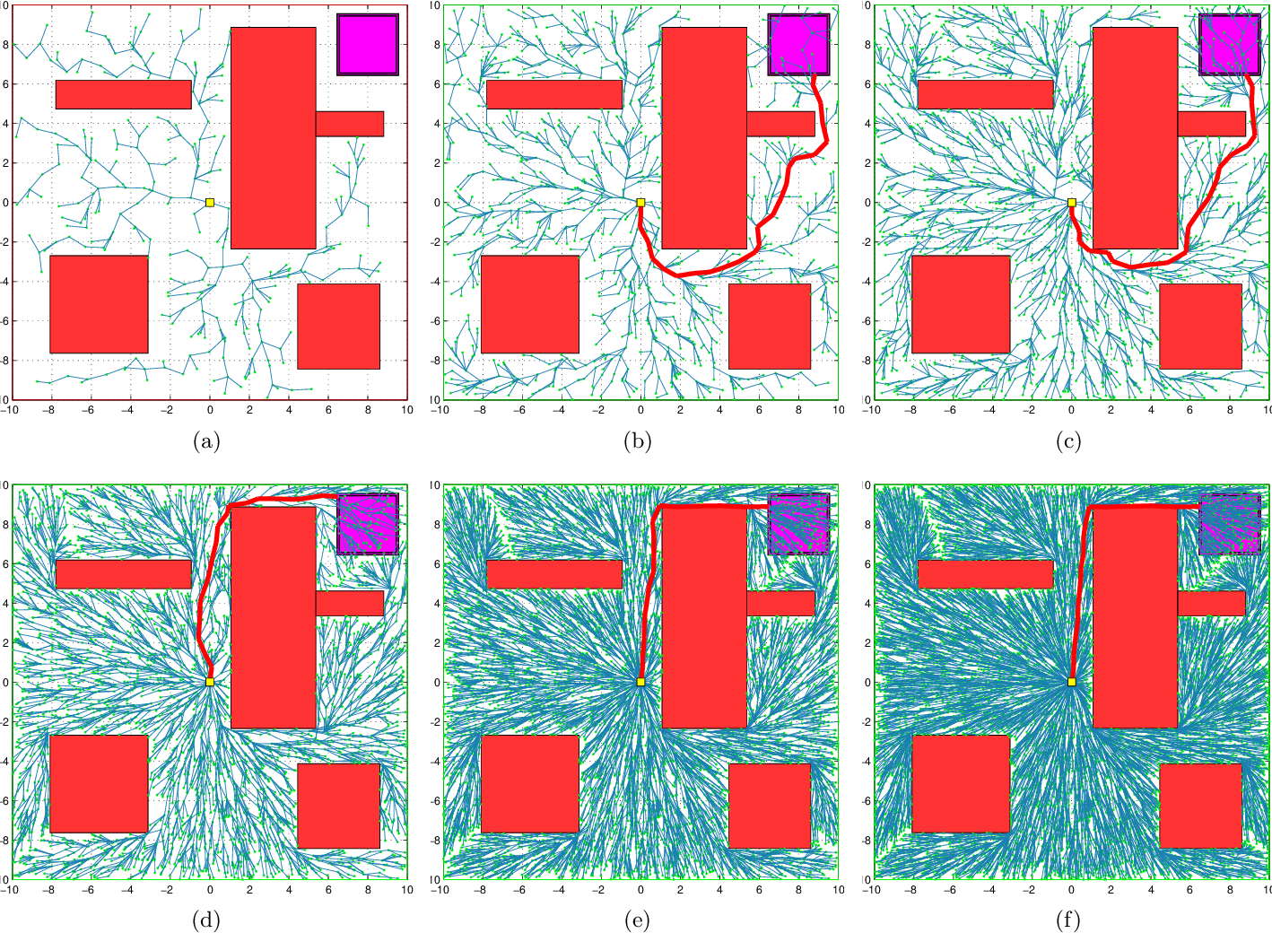
Tutorial 5 - Objectives
Sampling based MP-algorithms

Slide 3
Sampling based methods
Motivation:
Exact methods rely on explicit representation of
Their running time is exponential in the complexity of obstacles!
Sampling based can be used to solve multi-query problems
In today’s tutorial we will learn about two famous MP-algorithms: RRT and PRM

Slide 4
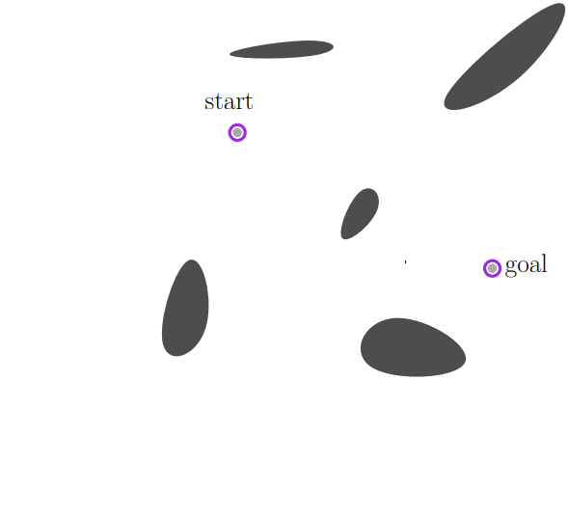
PRM – Probabilistic Roadmap Method
Given the following setting:

Slide 5
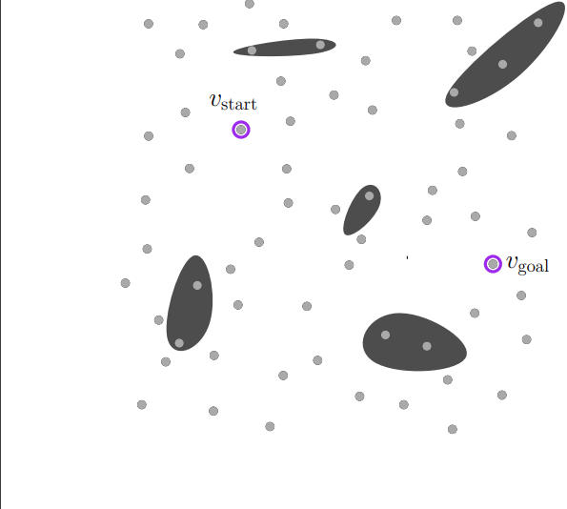
PRM
Given the following setting:
1. Sample points

Slide 6
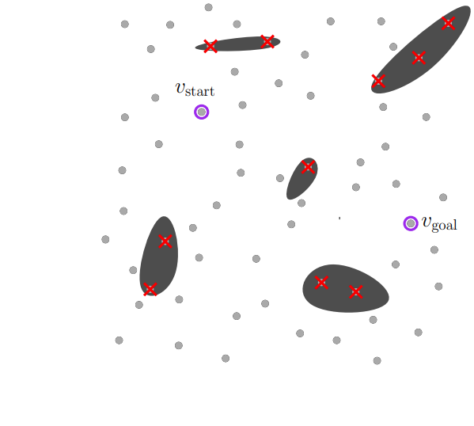
PRM
Given the following setting:
Sample points
Remove invalid samples

Slide 7
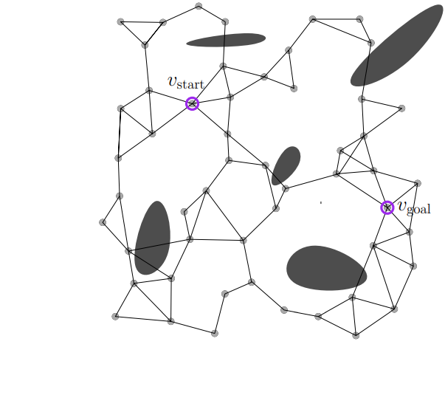
PRM
Given the following setting:
Sample points
Remove invalid samples
Connect N-nearest neighbors

Slide 8
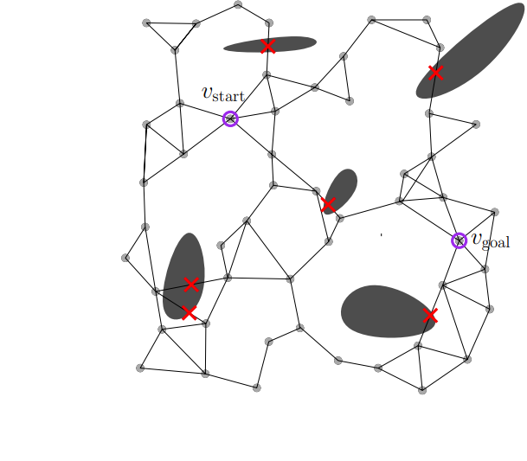
PRM
Given the following setting:
Sample points
Remove invalid samples
Connect N-nearest neighbors
Remove in-collision motions

Slide 9
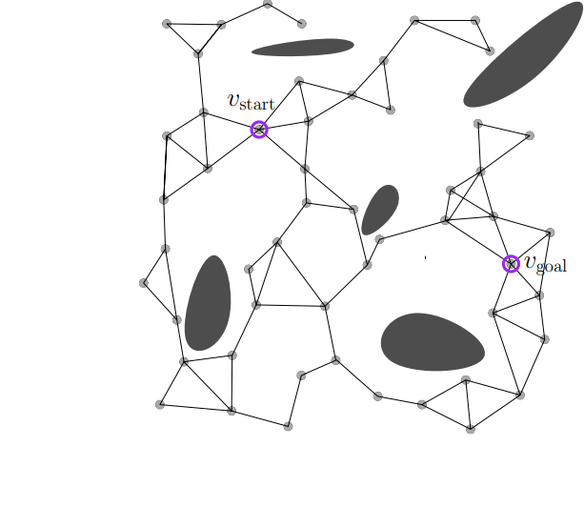
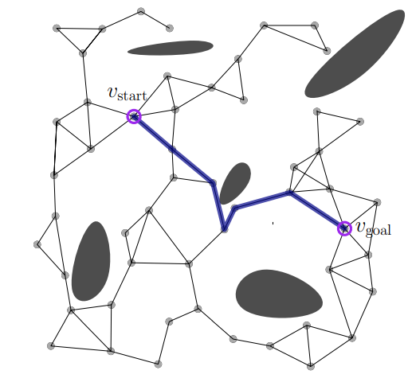
PRM
Given the following setting:
Sample points
Remove invalid samples
Connect N-nearest neighbors
Remove in-collision motions
Now what?
We got a connected graph on which we can run any path finding algorithm.

Slide 10
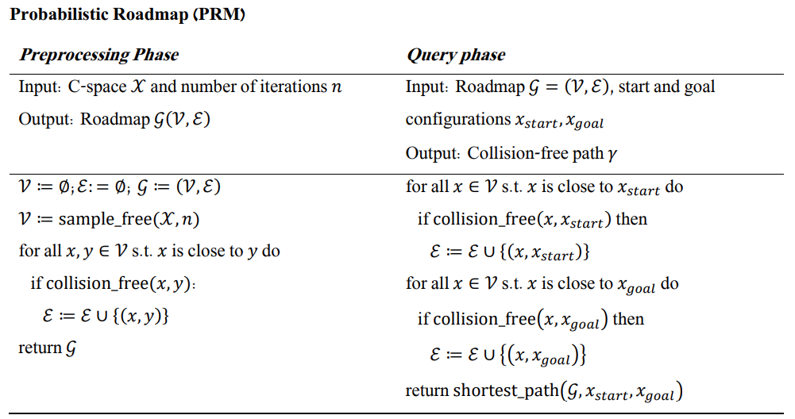
PRM – Algorithm Description
Notes:
We have two phases. Phase 1 sample in free space, connect neighbors in collision free.
2. Add neighbors to X start . Add neighbors to X goal.

Slide 11
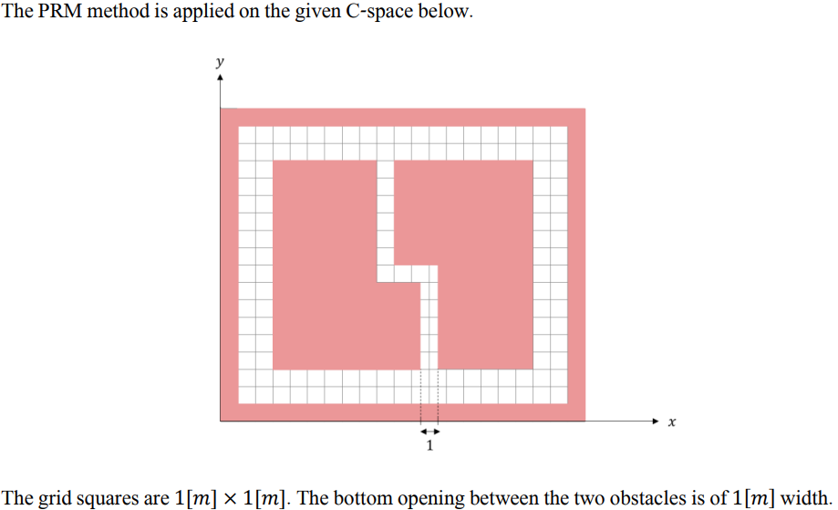
PRM – Problem 1

Slide 12
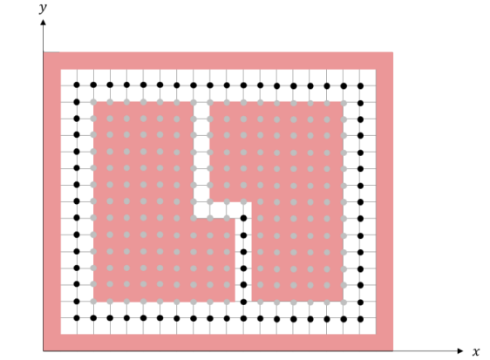
PRM – Problem 1
1. Assume the C-space is uniformly sampled. The sampling resolution is 1[𝑚] in both axes. Prove or disprove: the suggested sampling necessarily allows to find the shortest path between every two configurations.
Solution: wrong.

Slide 13
PRM – Problem 1
2. Part of the samples are now taken along the medial axis of the narrow passage and on the gridlines. Prove or disprove: the suggested sampling necessarily allows to find the shortest path between every two configurations.

Slide 14
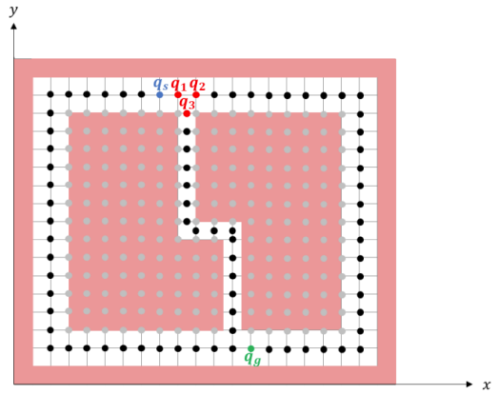
PRM – Problem 1
2. Part of the samples are now taken along the medial axis of the narrow passage and on the gridlines. Prove or disprove: the suggested sampling necessarily allows to find the shortest path between every two configurations.
Solution: The statement is wrong.
Notes:
If we connect only 1-nearest neighbor, we will not connect q1 to q3. but q1 to q2

Slide 15
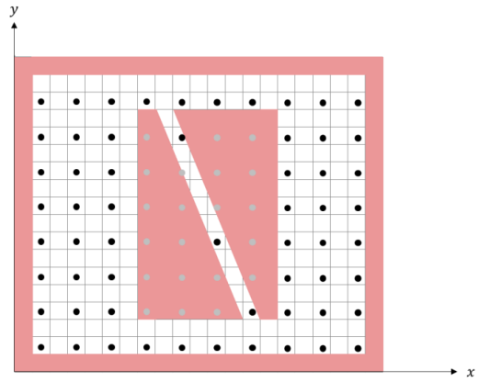
PRM – Problem 1
3. The C-space and the sampling resolution now changed:
What two potential problems which might stem from local planner?

Slide 16
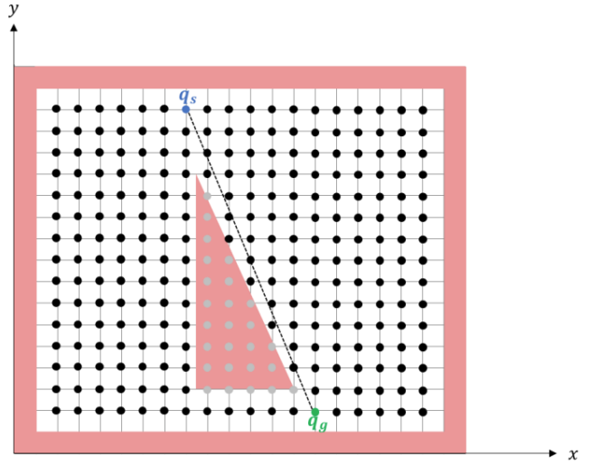
PRM – Problem 1
4. The C-space and the samples now changed as follows: will Dijkstra on the samples will find a path on the right hand side of the obstacle?

Slide 17
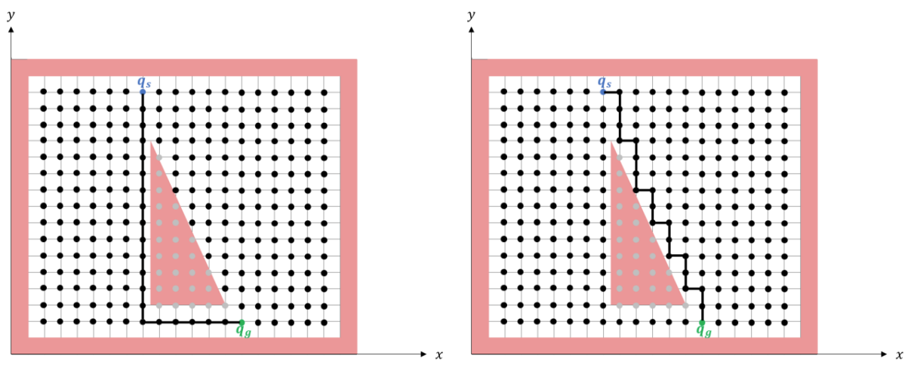
PRM – Problem 1
4. Solution: the total length of both paths below is identical

Slide 18
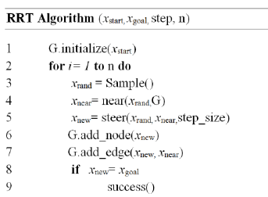
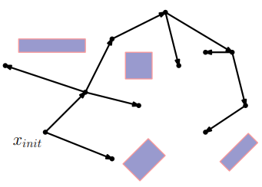
RRT

Slide 19
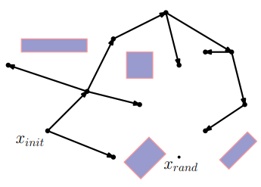
RRT

Slide 20
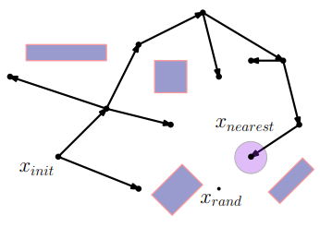
RRT

Slide 21
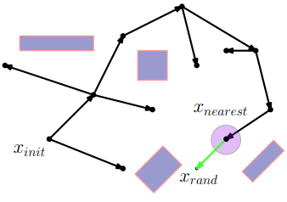
RRT

Slide 22
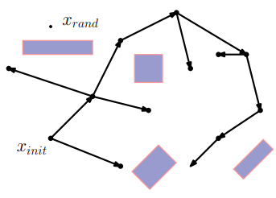
RRT

Slide 23
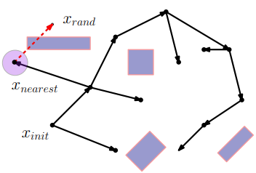
RRT

Slide 24
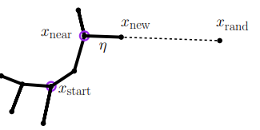
RRT – steering param/ step size
When RRT is “steering”, he is steering towards for a distance of .
Different values will generate different paths

Slide 25
RRT – goal biasing
We can also modify the randomize pick, to be biased toward picking the goal state every few iterations.
Let’s play RRT

Slide 26
RRT*
Will add here

