Slide 1


Tutorial 4 – MP: Exact Methods
AIR 24-25
Ido Jacobi & Shiran Peeran & Sarah Keren
Notes:
היום נלמד על שיטות מדוייקות לתכנון תנועה

Slide 2
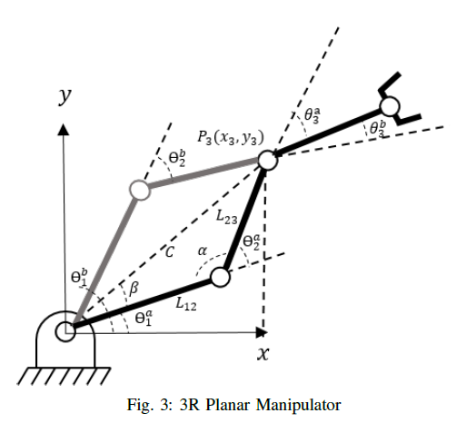
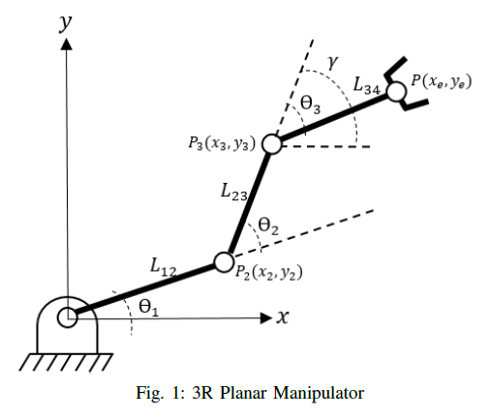
Recap tutorial 3
Last week we talked about a robot arm – manipulator, its “claw” called End Effector, and direct and inverse kinematics.
Notes:
דיברנו בתרגול הקודם על קינמטיקה הפוכה וישירה

Slide 3
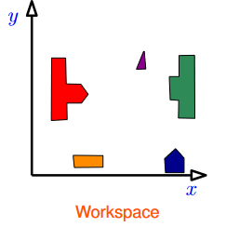
Recap – problem settings
We begin by defining our workspace.
Where does the robot operate?
What is the robot’s DOF?
Notes:
היום נחזור רגע לבעיית התנועה שלנו

Slide 4
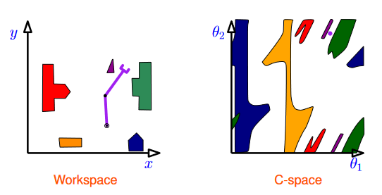
Recap – problem settings
We can now define a C-space, which is dependent on what obstacles exists in our workspace. The free-space would be any configuration that is obstacle free.
Notes:
בואו נדבר שנייה על המרחבים שלנו
מרחב הקונפיגורציה ומרחב העבודה
איך עוברים ביניהם וכו

Slide 5

Motion Planning Problem - Motivation
Why do we care?
Let’s do Task 3!

Slide 6

MPP – formally
Let $R$ be a robot system with $d$ degrees of freedom, moving in a known environment cluttered with obstacles. Given start and target configurations $s$ and $t$ for $R$, decide whether there is a collision-free continuous path $γ:\left[0,1\right]→𝒳_{free}$ such that $γ\left(0\right)=s$ and $γ\left(1\right)=t$ and if so, plan such a motion.

Slide 7

MPP – bit of History
The first efforts were aimed towards exact analytical techniques.
There are efficient techniques that solve the problem when DOFs$≤4$.
However, this problem is PSPACE-hard.
Finding the optimal solution, even in $R^{3}$ is NP-hard.

Slide 8
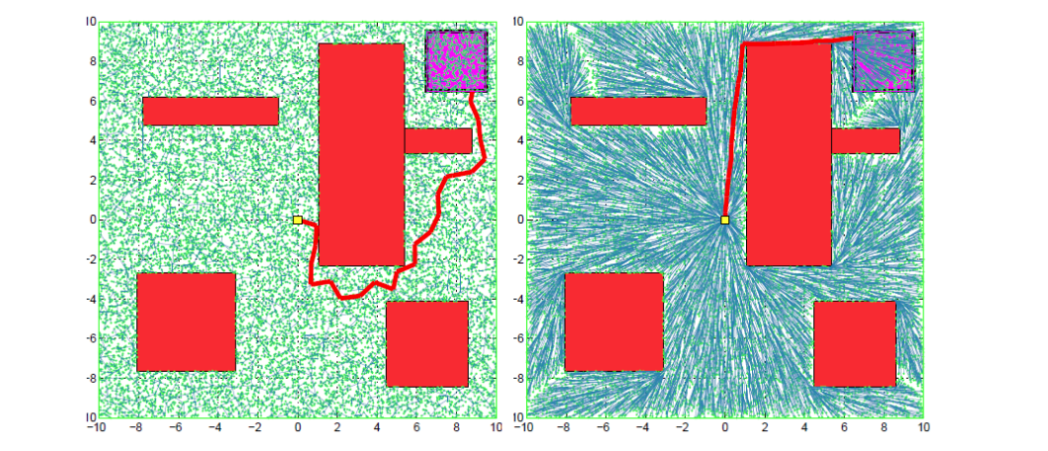
What do we care about in MPP?
We need to ask the following questions:
Will the algorithm generate the shortest path?
Will the algorithm the least-cost path? (given a heuristic function)
Which do we need – optimal/near optimal/ feasible?
Notes:
RRT vs RRT*, The robot motion in space is feasible. But in one is optimal

Slide 9
Exact method analysis
Begin with a simple point only robot, using exact method [In class].
Let’s analyze the following scenario. Already solved
Notes:
On white board, draw start, draw goal, draw polygon obstacles.
Ask, how do I know where to go? Do they see something regarding the polygons vertices?

Slide 10
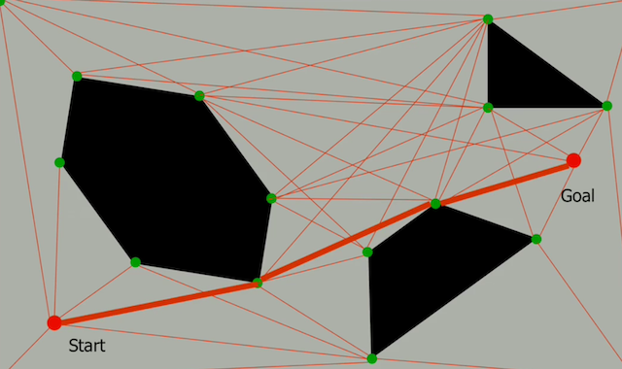
Exact method analysis
Begin with a simple point only robot, using exact method [In class].
Let’s analyze the following scenario. Already solved
Notes:
On white board, draw start, draw goal, draw polygon obstacles.
Ask, how do I know where to go? Do they see something regarding the polygons vertices?

Slide 11
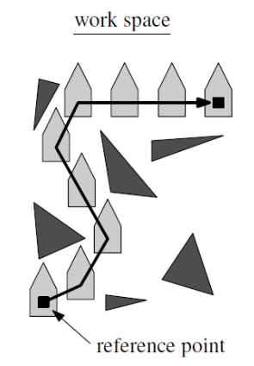

That was easy! How about a translating polygonal robot?
A question we want to ask is: given a polygonal robot, how does obstacle $𝒫$ transform to a C-space?

Slide 12
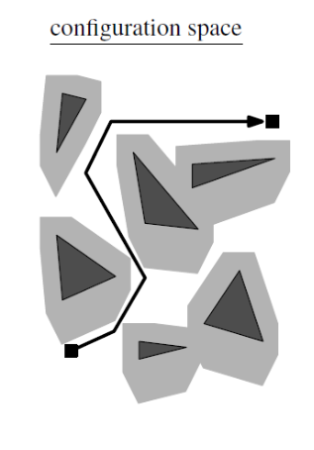
Planning for a translating polygonal robot
Given a workspace, we calculate all the Minkowski sums of the robot with the obstacles.

Slide 13
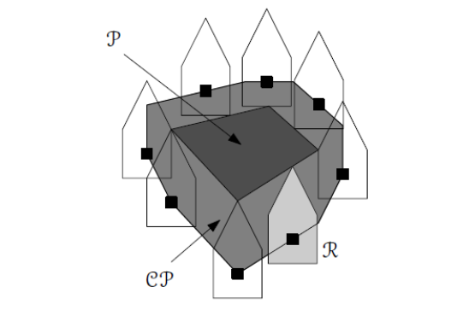

The answer – Minkowski sums
We wish to enlarge our obstacles, and reduce the robot size back to a point.
We can do it as shown under, where: $P−\text{obstacle}, R−\text{robot}, CP−\text{C} \text{space} \text{obstacle}$

Slide 14
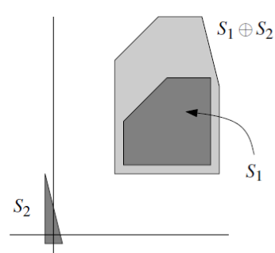

The answer – Minkowski sums
The Minkowski sum of two sets $S_{1}⊂R^{2}$ and $S_{2}⊂R^{2}$ is defined as:
$$S_{1}⊕S_{2}=\left\{p+q:p∈S_{1},q∈S_{2}\right\}$$
Here $p+q$ is the vector sum of $p$ and $q$

Slide 15
Planning for a translating polygonal robot
Now our problem is “reduced” to a translating point robot in the configuration space.

Slide 16
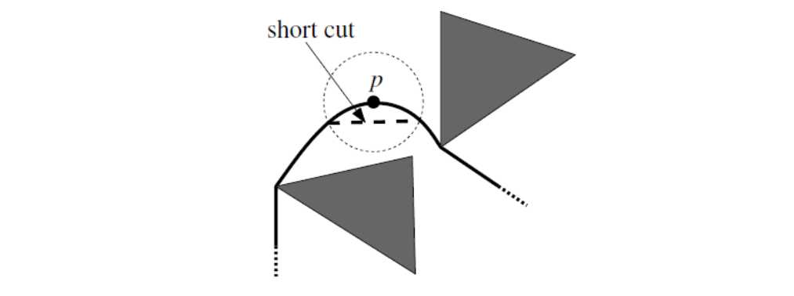
Optimality
So far, we found a motion plan from start configuration to a goal configuration.
Was our path optimal in length-size? Let’s take some short cuts!

Slide 17
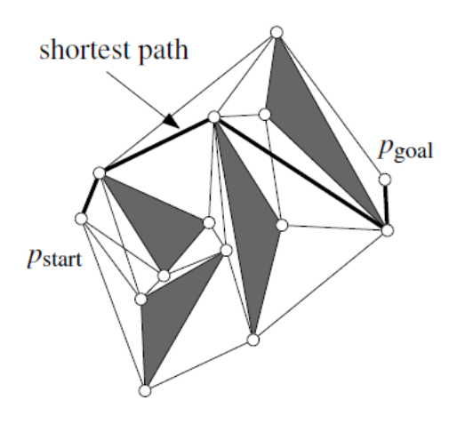
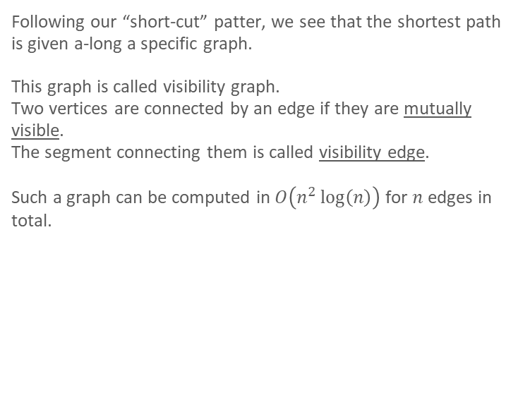
Optimality – visibility graph
Following our “short-cut” patter, we see that the shortest path is given a-long a specific graph.
This graph is called visibility graph.
Two vertices are connected by an edge if they are mutually visible.
The segment connecting them is called visibility edge.
Such a graph can be computed in $O\left(n^{2}\log\left(n\right)\right)$ for $n$ edges in total.

Slide 18
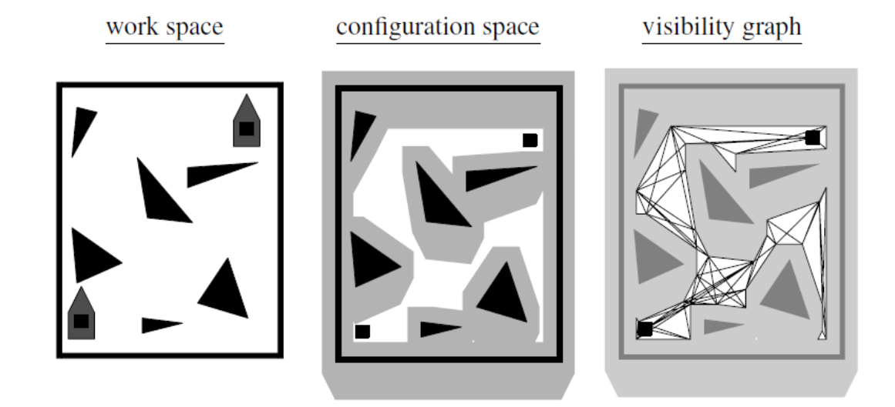

Back to translating polygon robot
Back to our second scenario, we:
Compute the C-space obstacles $O\left(n\log^{2}{n}\right)$
Compute the visibility graph $O(n^{2}\log{n})$
Run a shortest-path algorithm on vis-graph

