Slide 1


Lab 2 - Introduction to MuJoCo
AIR 24-25
Ido Jacobi & Shiran Dapht & Sarah Keren

Slide 2

MuJoCo is a physics engine designed for fast and accurate simulation.
Originally developed for robotics research, MuJoCo has become widely popular in fields such as biomechanics, machine learning, and reinforcement learning.

Slide 3
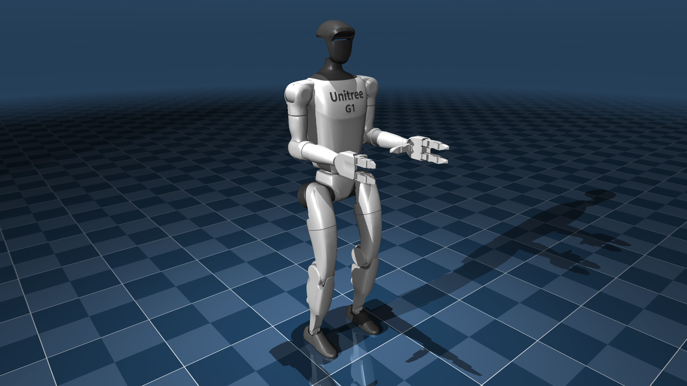
MuJoCo's key concepts

Slide 4
In this tutorial, we are going to cover the following MuJoCo concepts:
XML String Representation in MuJoCo
Overview of MuJoCo's mjModel
Understanding mjData in MuJoCo
Simulation and Animation in MuJoCo
Degrees of Freedom (DoF) in Robotic Systems
Analysis of Forces in MuJoCo

Slide 5

Open AIR-Lab2 jupyter notebook

