Slide 1
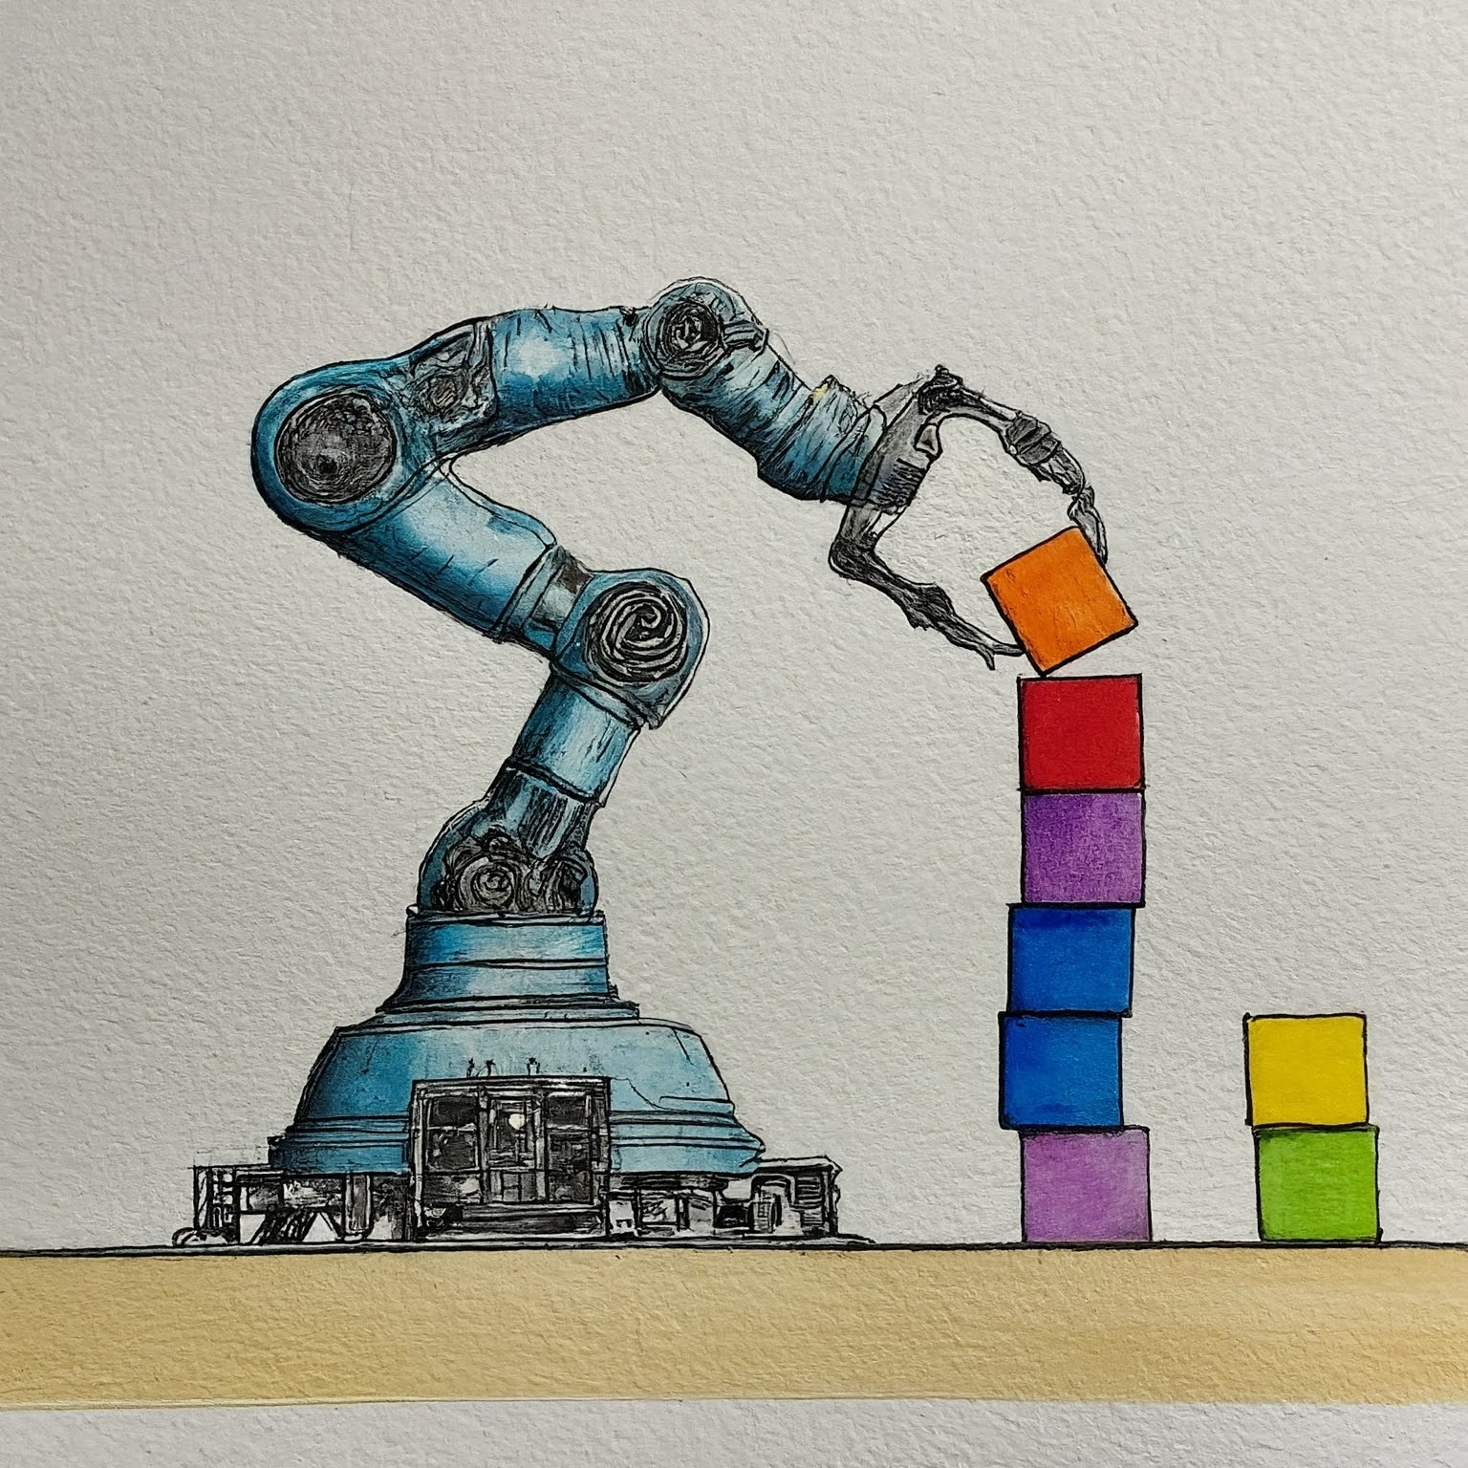

Tutorial 6 – Trajectory Planning AIR 24-25
Ido Jacobi & Shiran Peeran & Sarah Keren

Slide 2

Tutorial 6 - Objectives
The other 3 tutorials, we talked about Motion Planning: Exact and Sampling-based
Assume we used some MP algorithm, found a Motion Plan $γ\left[0,1\right]→𝒳_{free}$
We wish to activate the motors, such that our robot follows the MP
This problem is called Trajectory Planning

Slide 3
Trajectory Planning - Formally
Formally:
A trajectory is a path on which a timing law is specified, for instance in terms of velocities and/or accelerations at each point.
The goal of trajectory planning is to generate the reference inputs to the motion control system which ensures that the manipulator executes the planned trajectories.
Question: why do we want acceleration? (HINT: phyiscs)

Slide 4
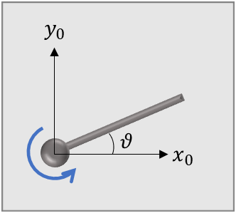
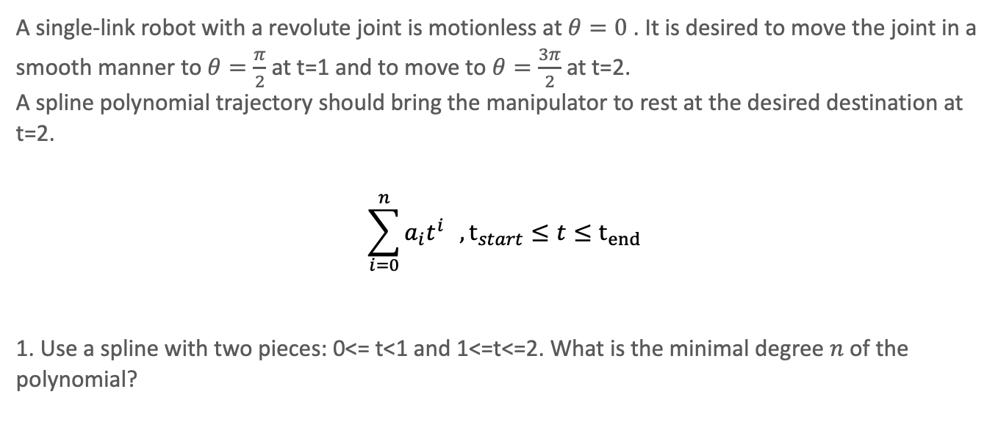
TP – Problem 1
A single-link robot with a revolute joint is motionless at $θ=0$ . It is desired to move the joint in a smooth manner to $θ=\frac{π}{2}$ at t=1 and to move to $θ=\frac{3π}{2}$ at t=2.
A spline polynomial trajectory should bring the manipulator to rest at the desired destination at t=2.
$$\sum_{i=0}^{n}{a_{i}t^{i}} , t_{start}≤t≤t_{end}$$
1. Use a spline with two pieces: 0<= t<1 and 1<=t<=2. What is the minimal degree $n$ of the polynomial?

Slide 5
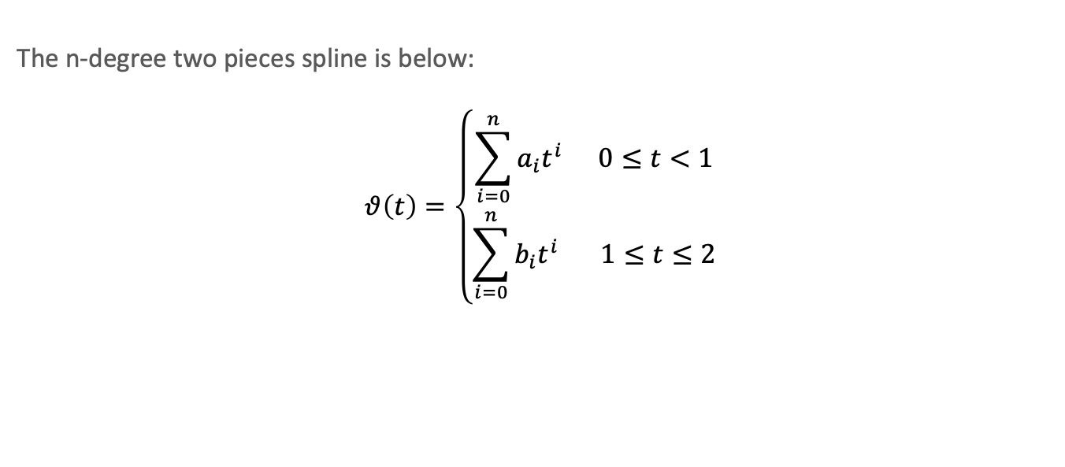
TP – Solution 1
The n-degree two pieces spline is below:
$$θ\left(t\right)=\left\{\begin{aligned}\sum_{i=0}^{n}{a_{i}t^{i}} 0≤t<1 \\ \sum_{i=0}^{n}{b_{i}t^{i}} 1≤t≤2\end{aligned}\right.$$

Slide 6
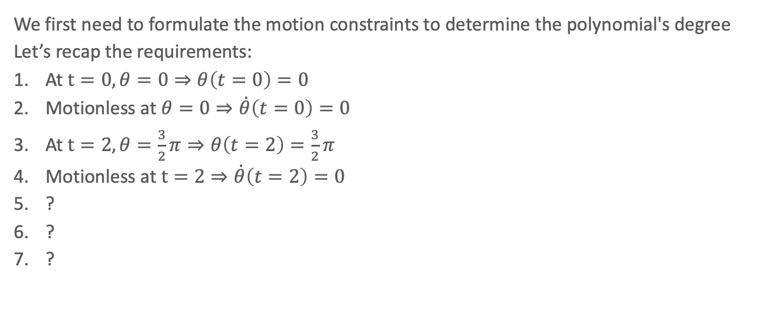
TP – Solution 1
We first need to formulate the motion constraints to determine the polynomial's degree
Let’s recap the requirements:
At $t=0, θ=0⇒θ\left(t=0\right)=0$
Motionless at $θ=0⇒\dot{θ}\left(t=0\right)=0$
At $t=2, θ=\frac{3}{2}π⇒θ\left(t=2\right)=\frac{3}{2}π$
Motionless at $t=2⇒\dot{θ}\left(t=2\right)=0$
?
?
?

Slide 7
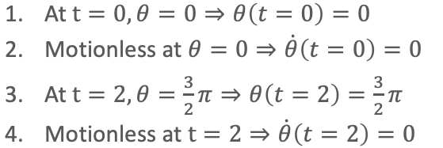
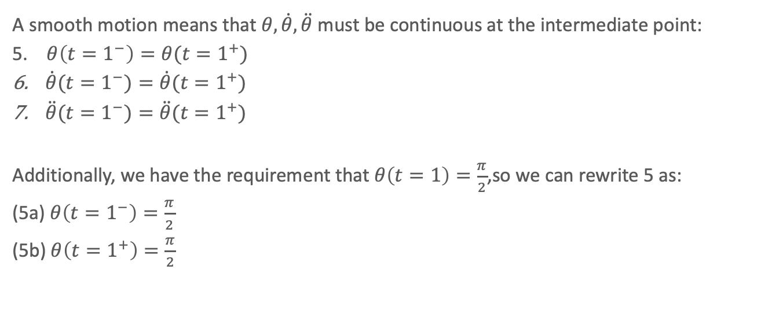
TP – Solution 1
A smooth motion means that $θ,\dot{θ},\ddot{θ}$ must be continuous at the intermediate point:
5. $θ\left(t=1^{−}\right)=θ(t=1^{+})$
$\dot{θ}(t=1^{−})=\dot{θ}(t=1^{+})$
$\ddot{θ}(t=1^{−})=\ddot{θ}(t=1^{+})$
Additionally, we have the requirement that $θ\left(t=1\right)=\frac{π}{2}$,so we can rewrite 5 as:
(5a) $θ\left(t=1^{−}\right)=\frac{π}{2}$
(5b) $θ\left(t=1^{+}\right)=\frac{π}{2}$

Slide 8

TP – Solution 1
In total we got 8 constraints:
$θ\left(t=0\right)=0$
$\dot{θ}\left(t=0\right)=0$
$θ\left(t=2\right)=\frac{3}{2}π$
$\dot{θ}\left(t=2\right)=0$
$θ\left(t=1^{−}\right)=\frac{π}{2}$
$θ\left(t=1^{+}\right)=\frac{π}{2}$
$\dot{θ}\left(t=1^{−}\right)=\dot{θ}(t=1^{+})$
$\ddot{θ}\left(t=1^{−}\right)=\ddot{θ}(t=1^{+})$

Slide 9
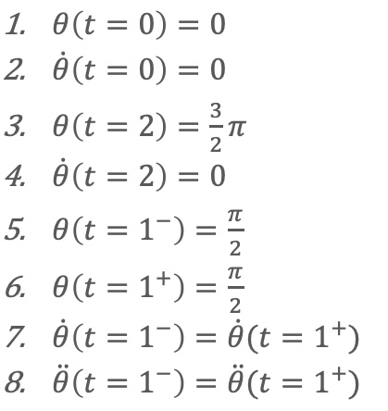

TP – Solution 1
For each constraint we need a coefficient at one of the splines. [Each spline lives in a different time zone]. What will be the minimal polynomial degree?
$$8 coefficients⇒4 per each spline⇒n=?$$

Slide 10
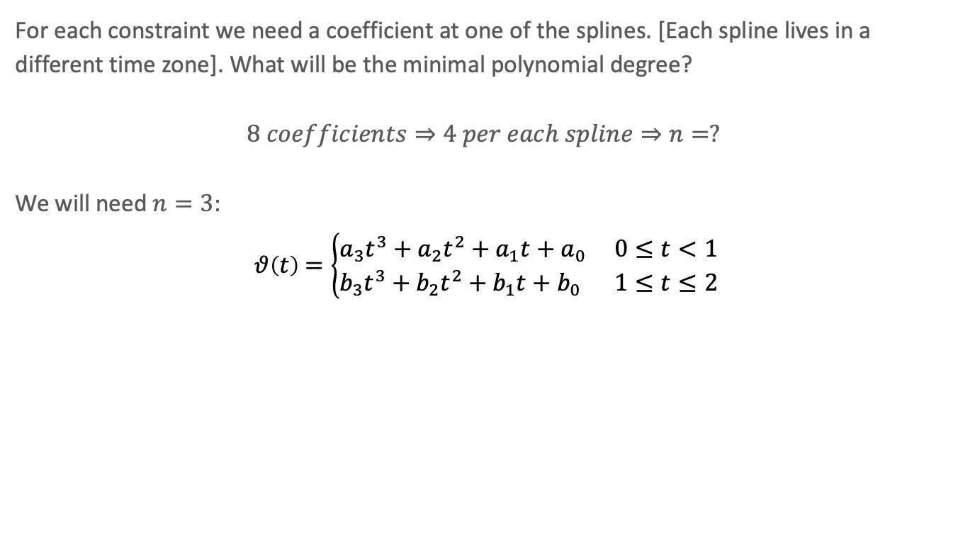
TP – Solution 1
For each constraint we need a coefficient at one of the splines. [Each spline lives in a different time zone]. What will be the minimal polynomial degree?
$$8 coefficients⇒4 per each spline⇒n=?$$
We will need $n=3$:
$$θ\left(t\right)=\left\{\begin{aligned}a_{3}t^{3}+a_{2}t^{2}+a_{1}t+a_{0} 0≤t<1 \\ b_{3}t^{3}+b_{2}t^{2}+b_{1}t+b_{0} 1≤t≤2\end{aligned}\right.$$

Slide 11
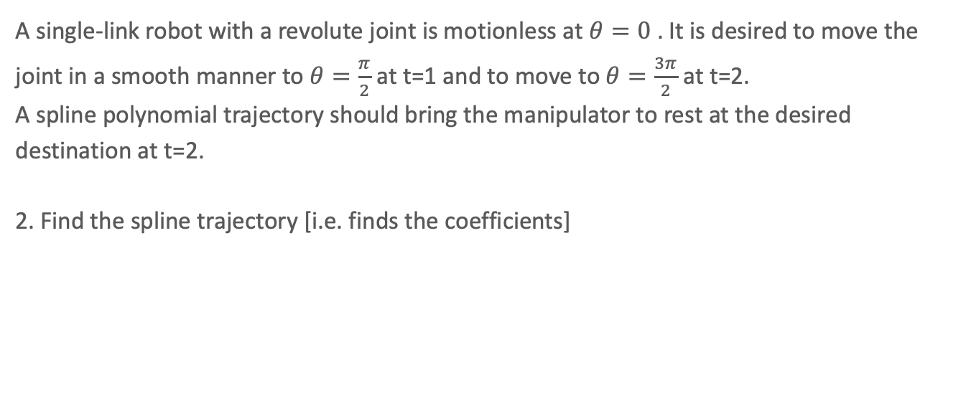
TP – Question 2
A single-link robot with a revolute joint is motionless at $θ=0$ . It is desired to move the joint in a smooth manner to $θ=\frac{π}{2}$ at t=1 and to move to $θ=\frac{3π}{2}$ at t=2.
A spline polynomial trajectory should bring the manipulator to rest at the desired destination at t=2.
2. Find the spline trajectory [i.e. finds the coefficients]

Slide 12
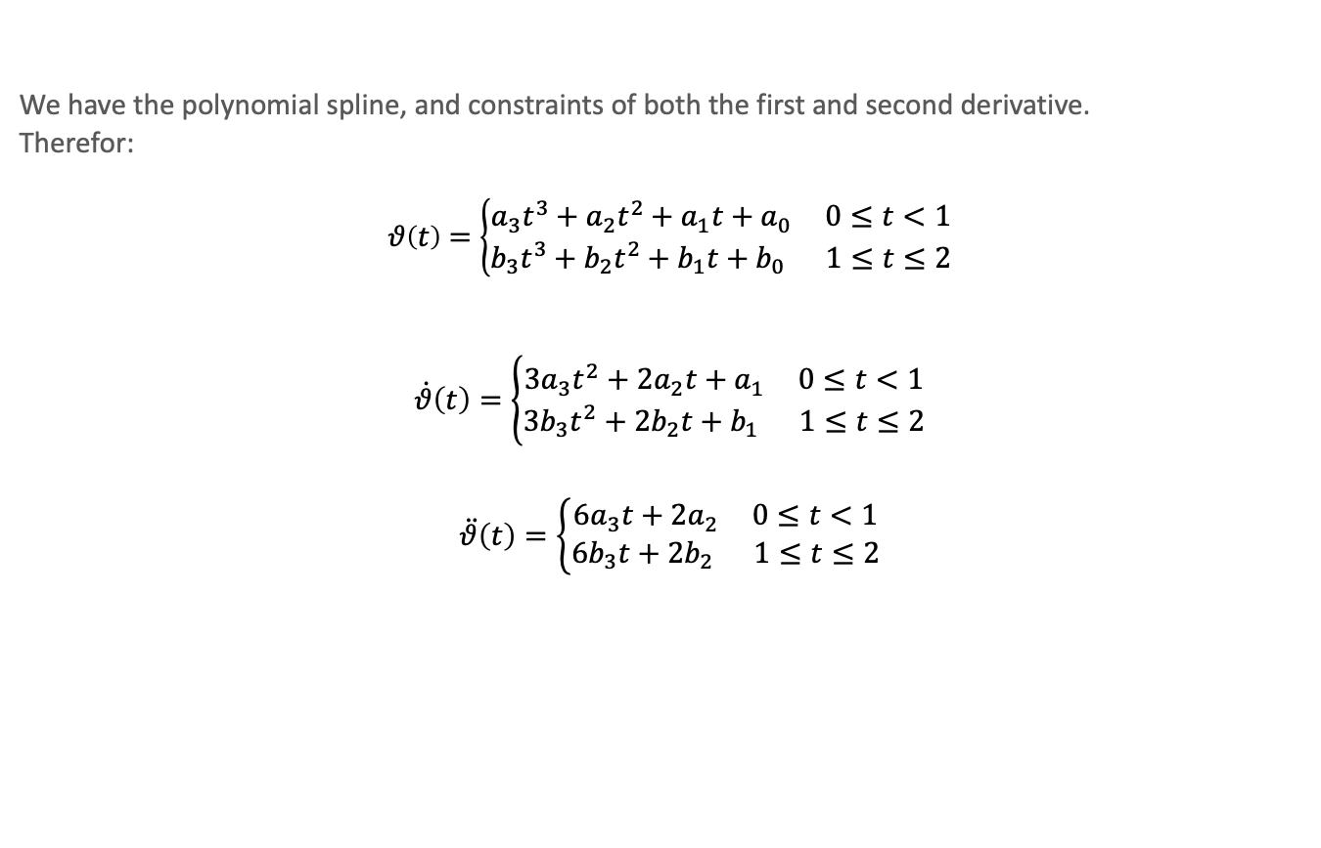
TP – Solution 2
We have the polynomial spline, and constraints of both the first and second derivative.
Therefor:
$$θ\left(t\right)=\left\{\begin{aligned}a_{3}t^{3}+a_{2}t^{2}+a_{1}t+a_{0} 0≤t<1 \\ b_{3}t^{3}+b_{2}t^{2}+b_{1}t+b_{0} 1≤t≤2\end{aligned}\right.$$
$$\dot{θ}\left(t\right)=\left\{\begin{aligned}3a_{3}t^{2}+2a_{2}t+a_{1} 0≤t<1 \\ 3b_{3}t^{2}+2b_{2}t+b_{1} 1≤t≤2\end{aligned}\right.$$
$$\ddot{θ}\left(t\right)=\left\{\begin{aligned}6a_{3}t+2a_{2} 0≤t<1 \\ 6b_{3}t+2b_{2} 1≤t≤2\end{aligned}\right.$$

Slide 13


TP – Solution 2
$$a_{0}=0$$
$$a_{1}=0$$
$$8b_{3}+4b_{2}+2b_{1}+b_{0}=\frac{3π}{2}$$
$$12b_{3}+4b_{2}+b_{1}=0$$
$$a_{3}+a_{2}+a_{1}+a_{0}=\frac{π}{2}$$
$$b_{3}+b_{2}+b_{1}+b_{0}=\frac{π}{2}$$
$$3a_{3}+2a_{2}+a_{1}=3b_{3}+2b_{2}+b_{1}$$
$$6a_{3}+2a_{2}=6b_{3}+2b_{2}$$
Let’s substitute:
$θ\left(t=0\right)=0$
$\dot{θ}\left(t=0\right)=0$
$θ\left(t=2\right)=\frac{3}{2}π$
$\dot{θ}\left(t=2\right)=0$
$θ\left(t=1^{−}\right)=\frac{π}{2}$
$θ\left(t=1^{+}\right)=\frac{π}{2}$
$\dot{θ}\left(t=1^{−}\right)=\dot{θ}(t=1^{+})$
$\ddot{θ}\left(t=1^{−}\right)=\ddot{θ}(t=1^{+})$

Slide 14


TP – Solution 2
Now we can use algebra to find all variables:
$$\left[\begin{matrix}0 & 0 & 1 & 2 & 4 & 8 \\ 0 & 0 & 0 & 1 & 4 & 12 \\ 1 & 1 & 0 & 0 & 0 & 0 \\ 0 & 0 & 1 & 1 & 1 & 1 \\ 2 & 3 & 0 & −1 & −2 & −3 \\ 2 & 6 & 0 & 0 & −2 & −6\end{matrix}\right]\left[\begin{matrix}a_{2} \\ a_{3} \\ b_{0} \\ b_{1} \\ b_{2} \\ b_{3}\end{matrix}\right]=\left[\begin{matrix}\frac{3π}{2} \\ 0 \\ \frac{π}{2} \\ \frac{π}{2} \\ 0 \\ 0\end{matrix}\right]$$
$$\left[\begin{matrix}a_{0} \\ a_{1} \\ a_{2} \\ a_{3} \\ b_{0} \\ b_{1} \\ b_{2} \\ b_{3}\end{matrix}\right]=\left[\begin{matrix}0 \\ 0 \\ 1.178 \\ 0.393 \\ 3.142 \\ −9.425 \\ 10.603 \\ −2.749\end{matrix}\right]$$

Slide 15
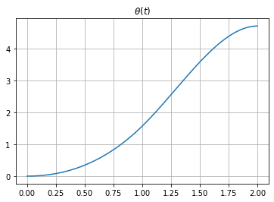
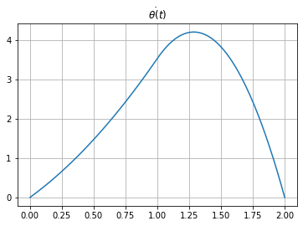
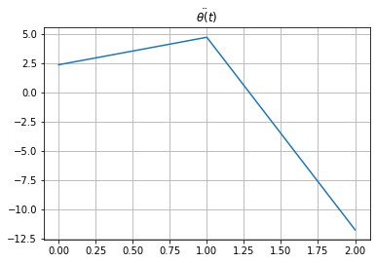
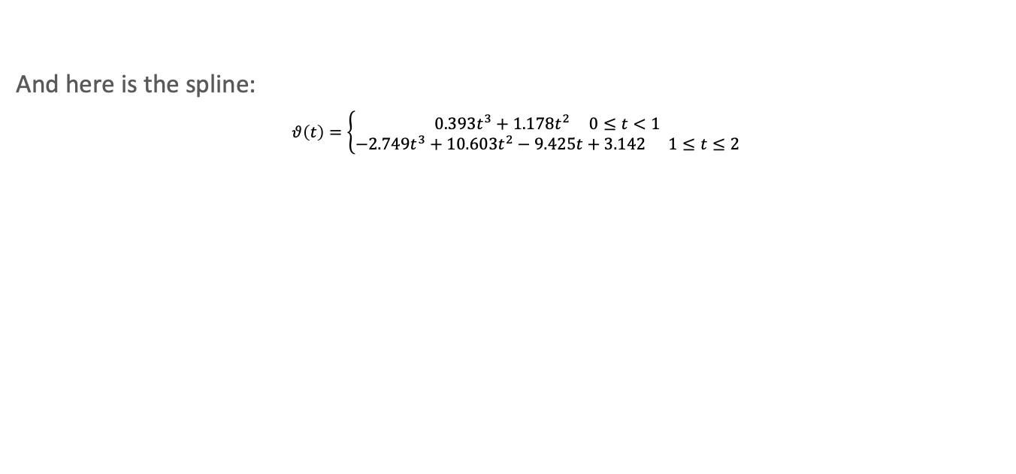
TP – Solution 2
And here is the spline:
$$θ\left(t\right)=\left\{\begin{aligned}0.393t^{3}+1.178t^{2} 0≤t<1 \\ −2.749t^{3}+10.603t^{2}−9.425t+3.142 1≤t≤2\end{aligned}\right.$$

Slide 16
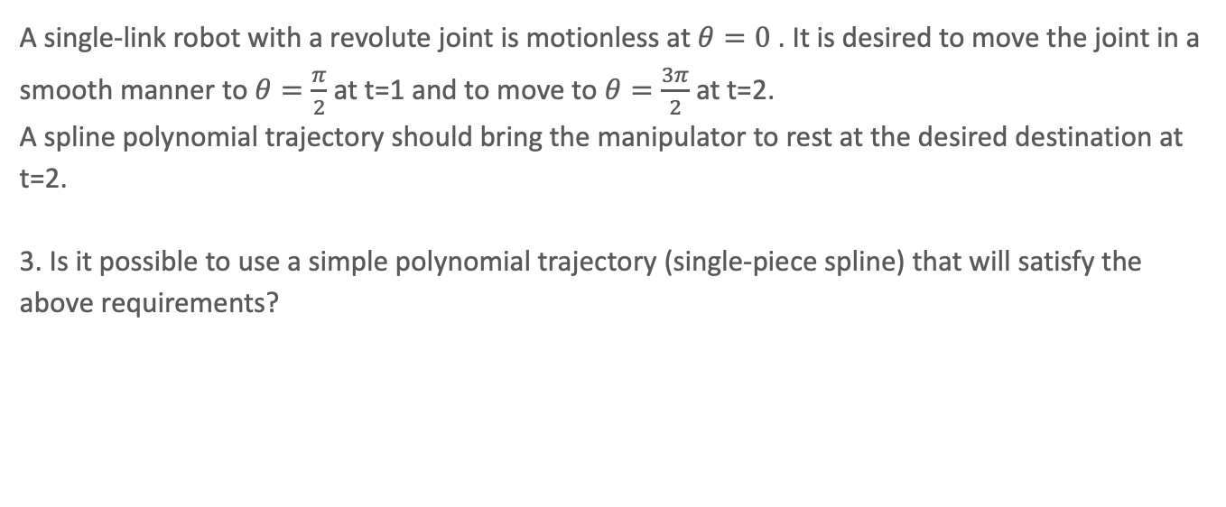
TP – Question 3
A single-link robot with a revolute joint is motionless at $θ=0$ . It is desired to move the joint in a smooth manner to $θ=\frac{π}{2}$ at t=1 and to move to $θ=\frac{3π}{2}$ at t=2.
A spline polynomial trajectory should bring the manipulator to rest at the desired destination at t=2.
3. Is it possible to use a simple polynomial trajectory (single-piece spline) that will satisfy the above requirements?

Slide 17
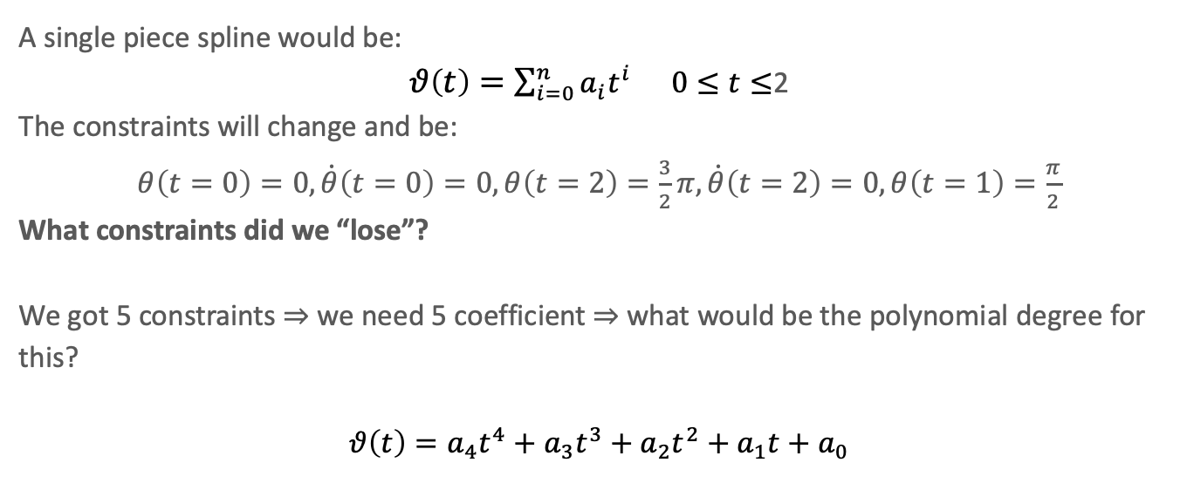
TP – Solution 3
A single piece spline would be:
$θ\left(t\right)=\sum_{i=0}^{n}{a_{i}t^{i}} 0≤t≤$2
The constraints will change and be:
$θ\left(t=0\right)=0, \dot{θ}\left(t=0\right)=0, θ\left(t=2\right)=\frac{3}{2}π, \dot{θ}\left(t=2\right)=0, θ\left(t=1\right)=\frac{π}{2}$
What constraints did we “lose”?
We got 5 constraints $⇒$ we need 5 coefficient $⇒$ what would be the polynomial degree for this?
$$θ\left(t\right)=a_{4}t^{4}+a_{3}t^{3}+a_{2}t^{2}+a_{1}t+a_{0}$$

Slide 18
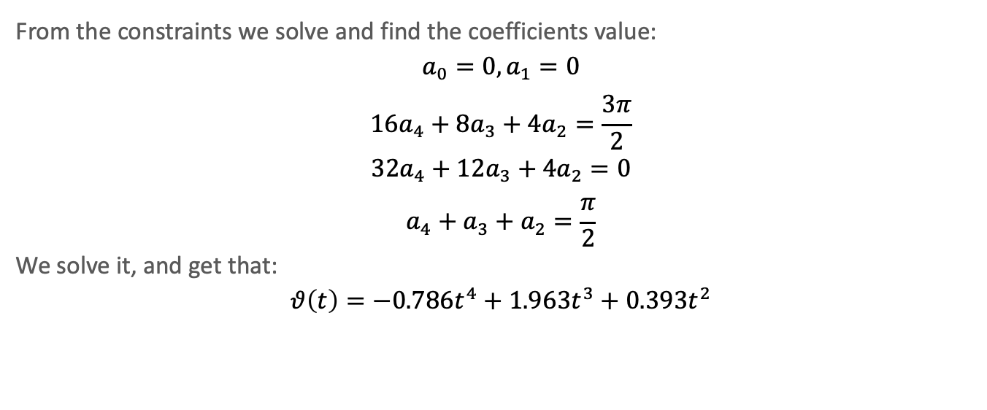
TP – Solution 3
From the constraints we solve and find the coefficients value:
$$a_{0}=0, a_{1}=0$$
$$16a_{4}+8a_{3}+4a_{2}=\frac{3π}{2}$$
$$32a_{4}+12a_{3}+4a_{2}=0$$
$$a_{4}+a_{3}+a_{2}=\frac{π}{2}$$
We solve it, and get that:
$$θ\left(t\right)=−0.786t^{4}+1.963t^{3}+0.393t^{2}$$

Slide 19

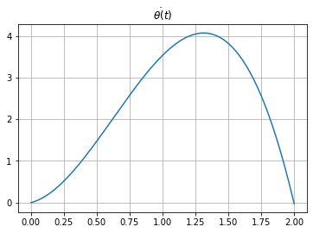
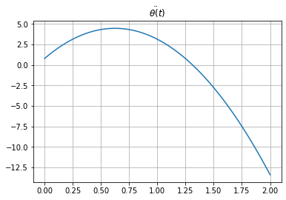

TP – Solution 3
And here is the spline:
$$θ\left(t\right)=−0.786t^{4}+1.963t^{3}+0.393t^{2}$$
Did we get the same graphs?

