Slide 1
Letters of Descartes in digital format
An exercise in conversion
Dirk Roorda
@ eHumanities 2012-01-26

Slide 2
overview
task
method
lessons
demo

Slide 3
The Task: converting from ...
JapAM
Descartes Correspondence
725 letters
2900 pages
69,237 lines
600 formulas
4.2 MB (without the 311 pictures)

Slide 4
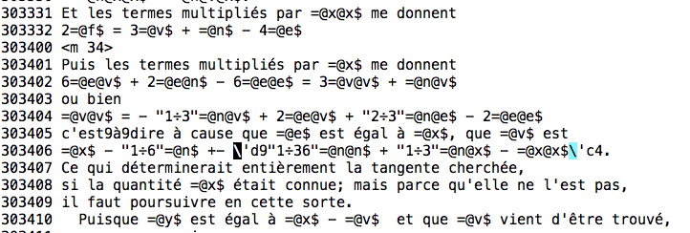

Slide 5
The task: converting to ...
CKCC corpus Descartes
XML : Text Encoding Initiative (TEI)
~ 35,000 elements, of which
7,200 metadata
7,700 paragraphs
6,200 formulas
6,000 text-formattings
4,200 structure
2,900 page-breaks
538 images

Slide 6
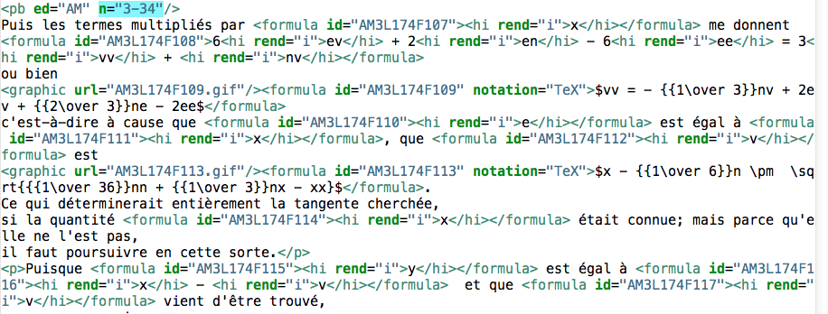

Slide 7
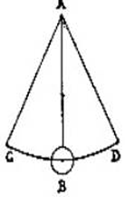
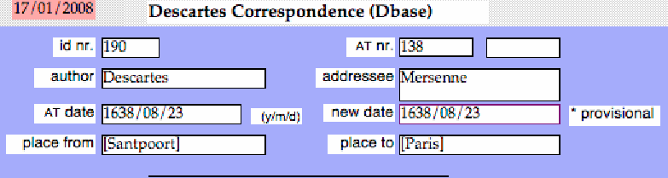
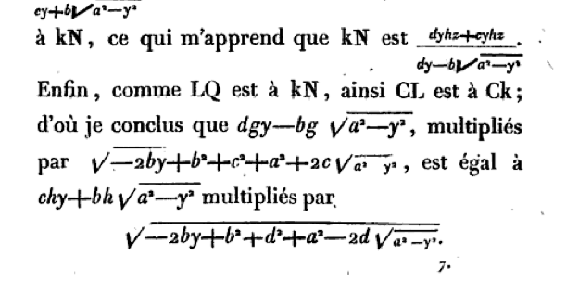
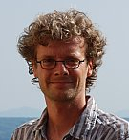
The (re)Sources
EJB Metadata
EJB ‘s head
Google Books

Slide 8




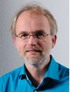

The tools

Slide 9
The method
observation
non-algorithmic changes
consolidation
proofs

Slide 10
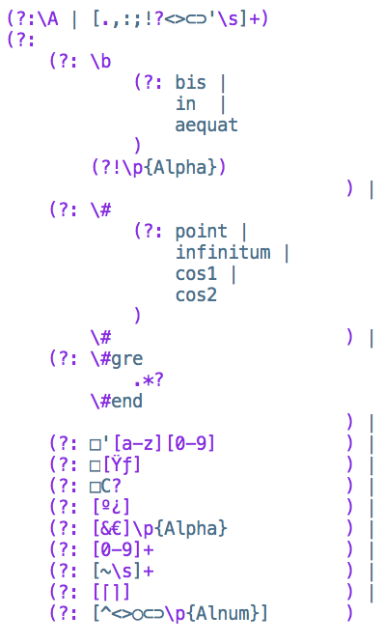
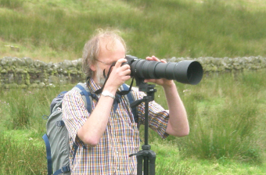
Observation
use digital equipment:
-your text-editor
-your scripting language
-your regular expressions

Slide 11

greek

Slide 12
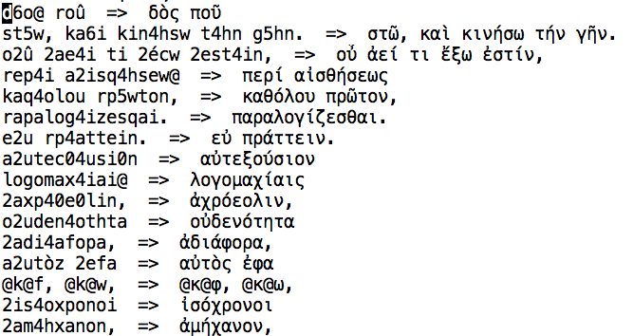

Slide 13

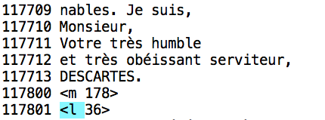
non-algorithmic changes
Notes:
closer detection

Slide 14
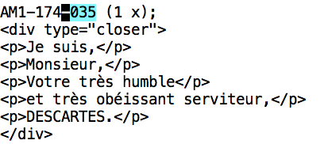
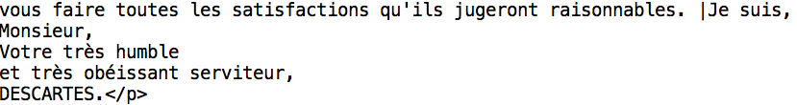
closers: hints

Slide 15
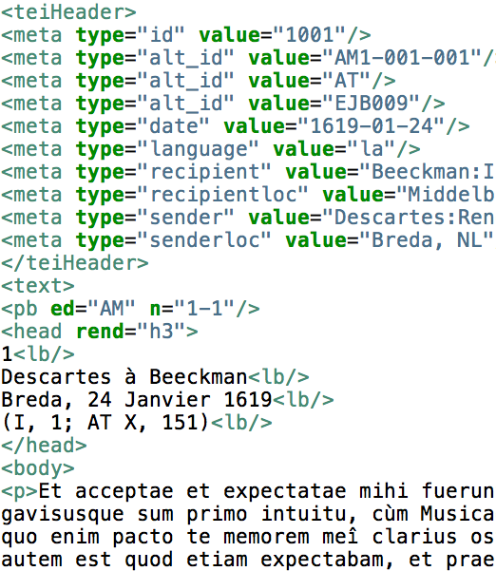
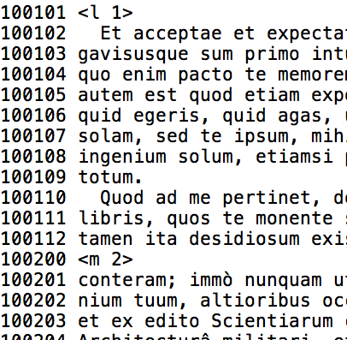
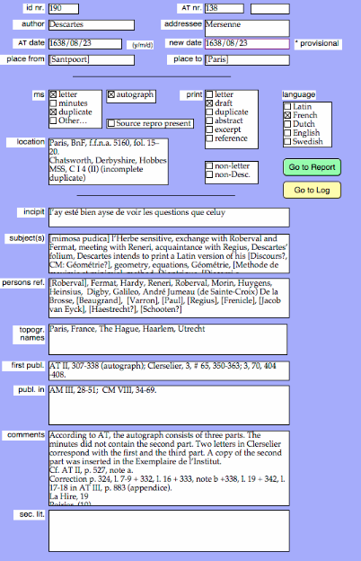
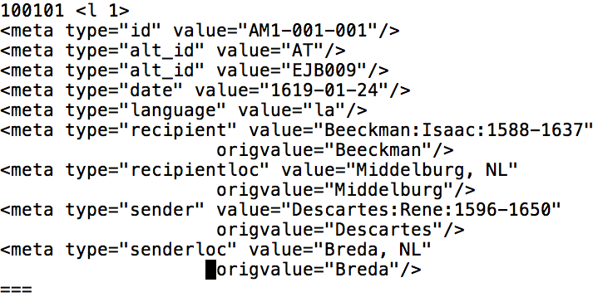
consolidating: metadata
conversion process
formulas
meta
closers
...
...
canonical
initial
corrected
improved
checked
metadata combining

Slide 16
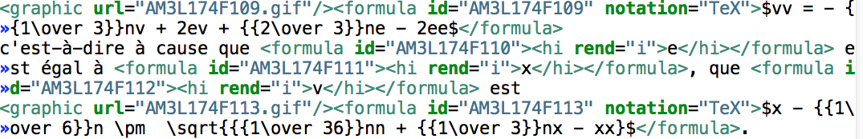
proofs: formulas

Slide 17
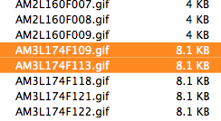
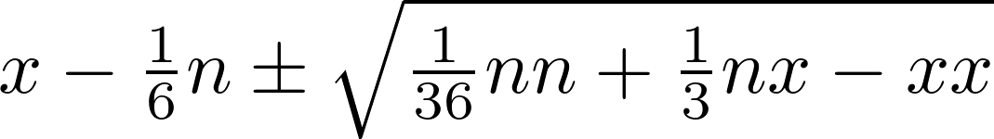
proofs: formulas in gif

Slide 18
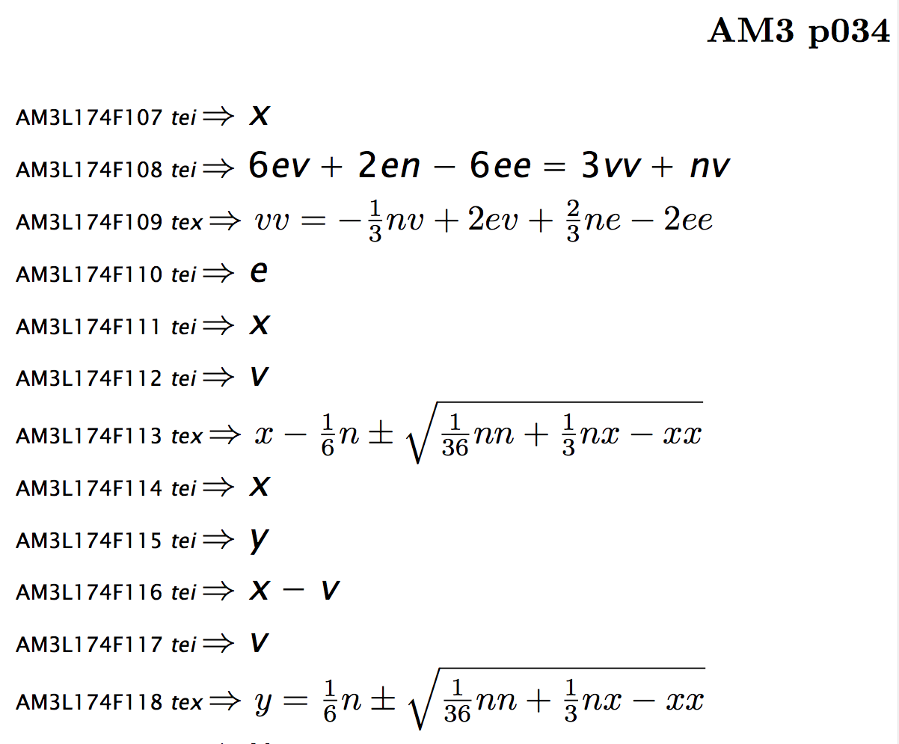

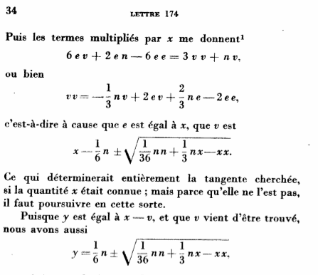
friendly proofs

Slide 19
The tricks of conversion
Unicode is your friend
Split into many subtasks
task = configuration + workflow
Count and check
Performance matters
Do not give up automation

Slide 20
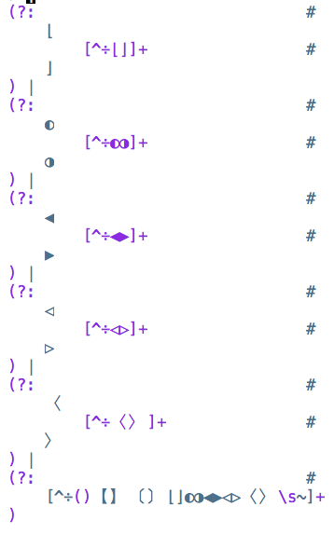
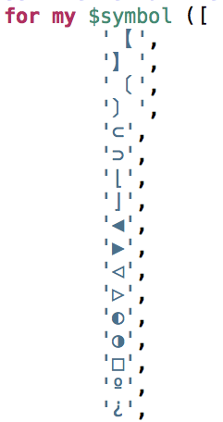

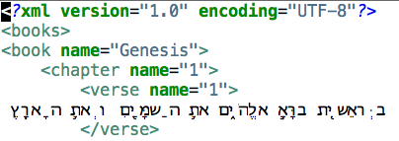

1. Unicode is your friend

Slide 21
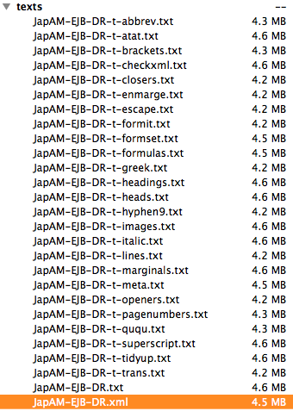
2. Split into many subtasks
(2a) that can be run separately
(2b) that can be reordered easily

Slide 22
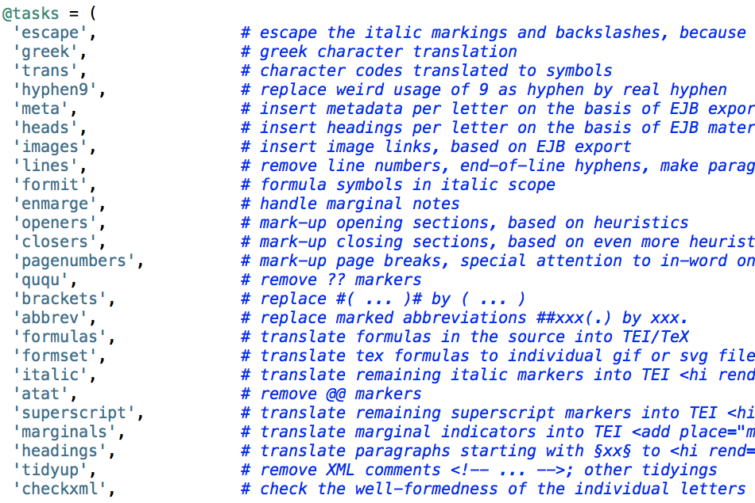
Notes:
split into (many) tasks
enable isolated tasks
input consolidated corrections
output material for feedback
build in checks
show statistics
make performance optimisations
reduce duplicate code
maintain automation

Slide 23
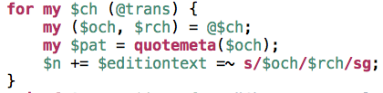
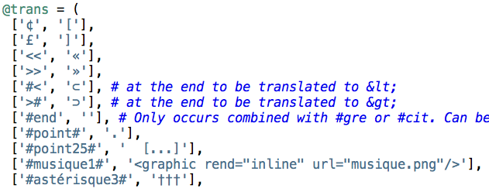
3. task = config + workflow

Slide 24
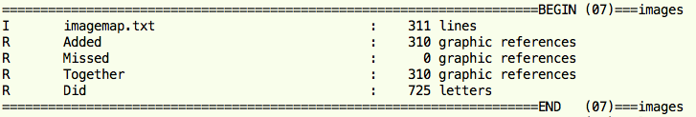
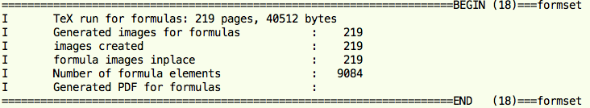
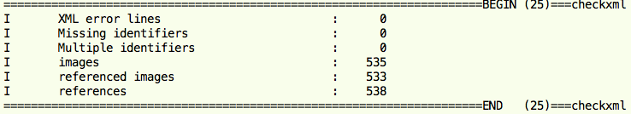
4. Count and check (ad nauseam)

Slide 25
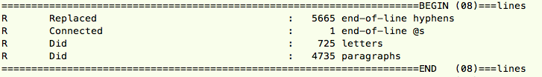
5. Performance matters!
was 30+ seconds
is now 2.07 seconds
many new subtasks based on same template
(gain = 15 * 30 = 7.5 min per run)
many, many runs before everything is OK
(gain = 100 * 7.5 = 12.5 hours CPU-time)

Slide 26
6. Do not give up automation
we used a lot of expert knowledge
which has all been transferred to
the source
consolidated extra inputs
so the conversion is still repeatable and modifiable
Thank You
hints
hints
hints
corrections
CKCC
formulas
meta
closers
source
results
conversion program

