Slide 1
Hotel Booking and Management System
Group Project Pitch Presentation
Department of Computer Engineering
May 2025

Slide 2
Project Overview
- Purpose: Build a responsive hotel booking platform
- Problem: Manual booking inefficiencies, no user tracking
- Scope: Web-based, users & admins, booking & management
- Users: Hotel clients, reception/admin staff

Slide 3
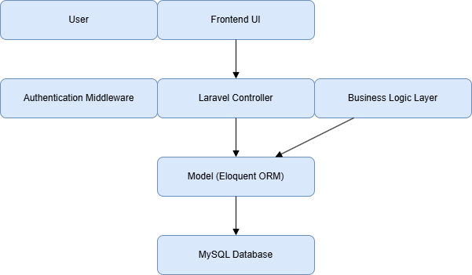
System Architecture
- MVC pattern with Laravel (PHP)
- Frontend → Controller → Model → Database
- Admin & User interfaces interact via web routes

Slide 4
UML Diagrams Summary
- Use Case: Guest, Registered User, Admin
- Class Diagram: User, Room, Reservation
- 6x Sequence Diagrams: user/reservation scenarios
- 6x State & 6x Activity Diagrams by team members

Slide 5
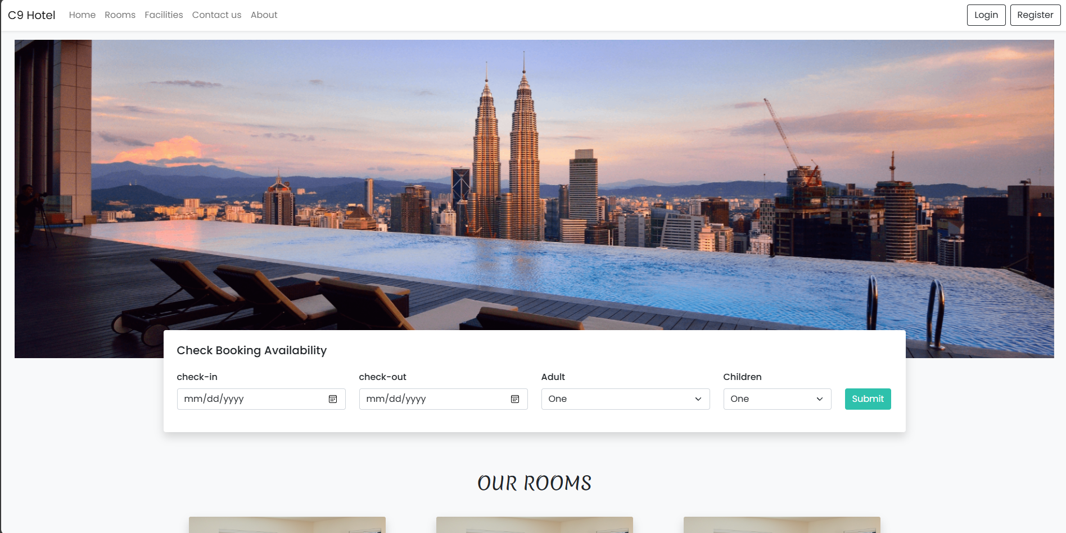
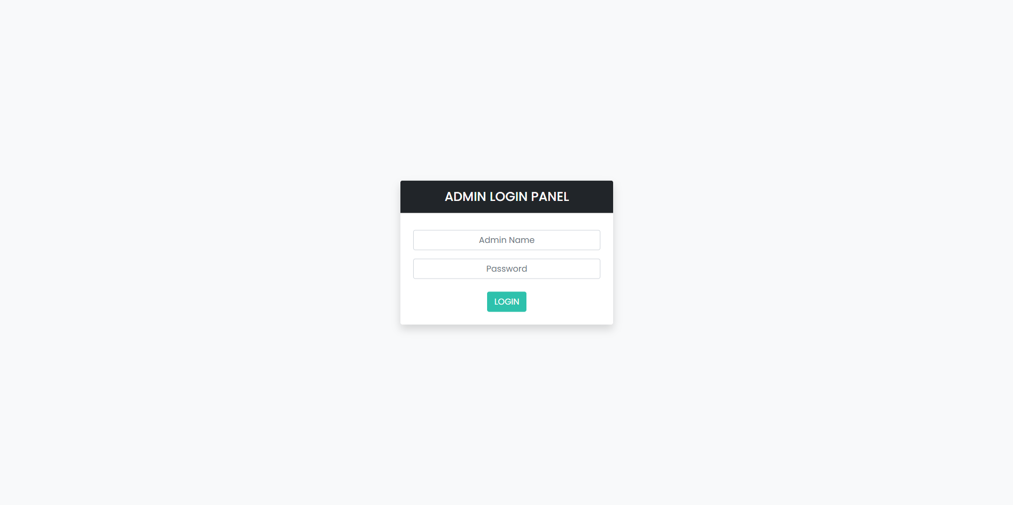
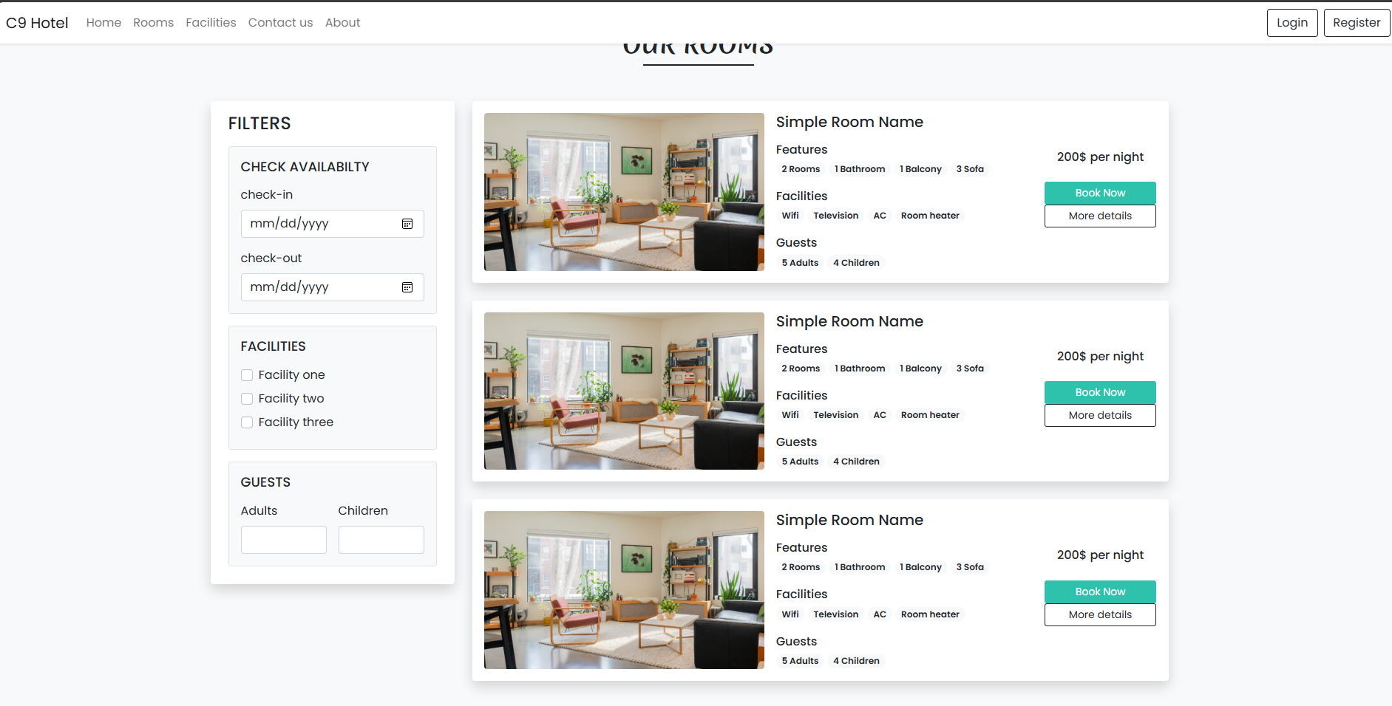
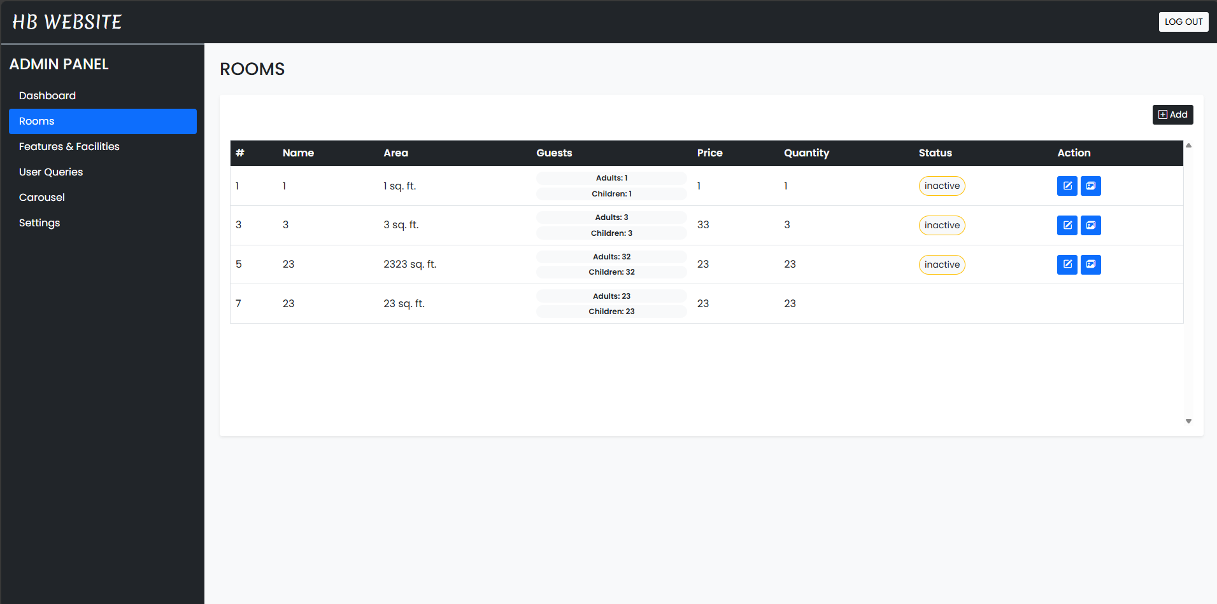
Prototype Overview
- Live Laravel application with full functionality
- Screens: Homepage, Room List, Booking, Admin Panel
- Responsive layout, Bootstrap used

Slide 6
Test Plan Summary
- Manual test cases defined for all features
- Includes Unit, Integration, Functional testing
- Example: Booking with valid dates → success
- Each member authored 2 test cases

Slide 7
User Documentation
- Sections: How to register, book, manage rooms
- Admin use guide, screenshots
- Stored with project repo in PDF form

Slide 8
Value and Impact
- Meets real-world hotel needs
- Simplifies booking & improves traceability
- Helps admin monitor rooms and user actions
- Enhances client experience

Slide 9
Challenges & Achievements
- Challenges: diagram syncing, Laravel setup, deadlines
- Achievements:
• All diagrams completed
• Working system demo
• Balanced teamwork

Slide 10
Conclusion & Q&A
- Complete, documented, and tested system
- Aligns with stakeholder goals
- Ready for feedback
Thank you!

