Slide 1
Telco Churn Demo UI Setup

Slide 2
Deployment – Predict Customer Churn Web Application
The objective of the Predict Customer Churn web application (http://predictcustomerchurn.mybluemix.net/) is to demonstrate the deployment of predictive models to personalize customer interactions
The Predict Customer Churn web application interacts with a deployed Spark ML model in IBM WML repository, to score a customer record in real-time.
Follow the instructions in this slide deck to deploy the web application into your own Bluemix account.
When you have deployed the code into your own Bluemix account, you can edit it to customize the app and point it to your own deployed model.

Slide 3
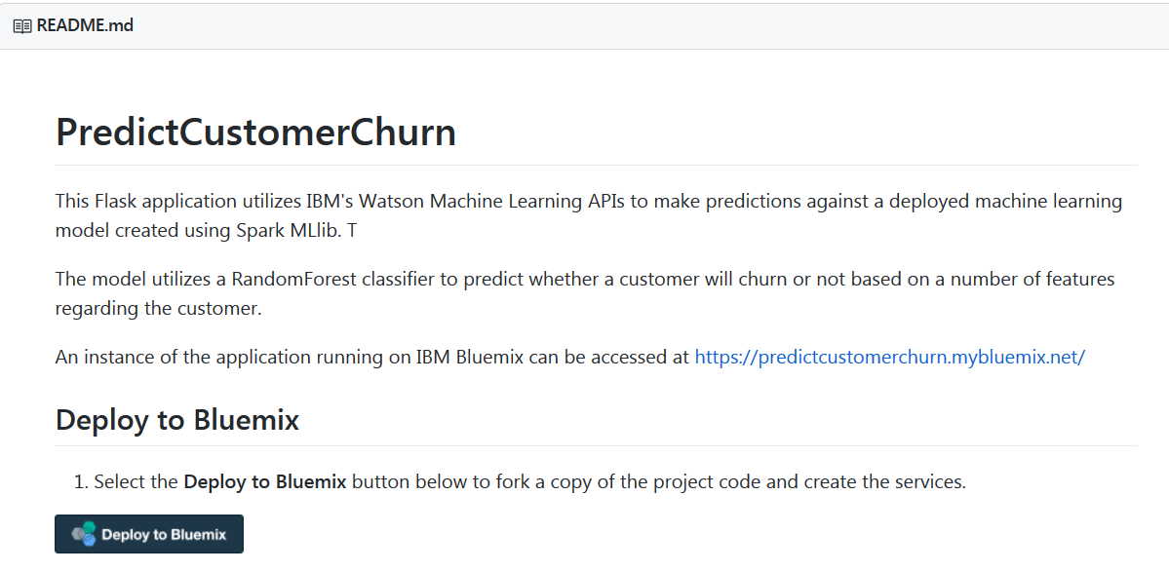
Go to https://github.com/yfphoon/PredictCustomerChurn_SparkML
Click the “Deploy to Bluemix” button

Slide 4
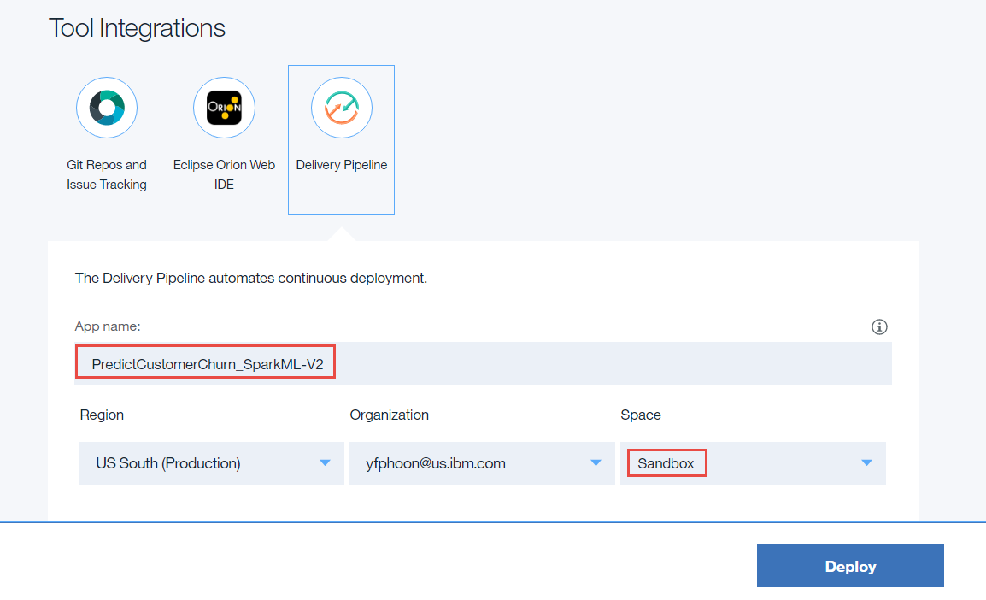
Replace the default App name with your own unique App name
Select your own pre-defined space
Click Deploy

Slide 5
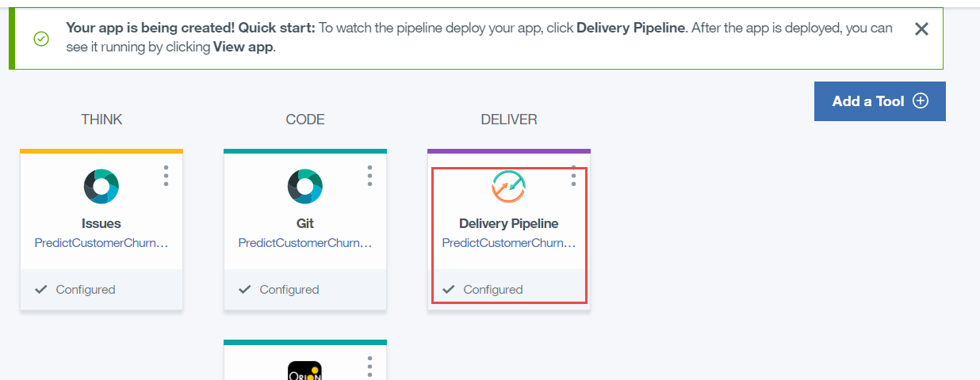
Click Delivery Pipeline to view the status of your deployment

Slide 6
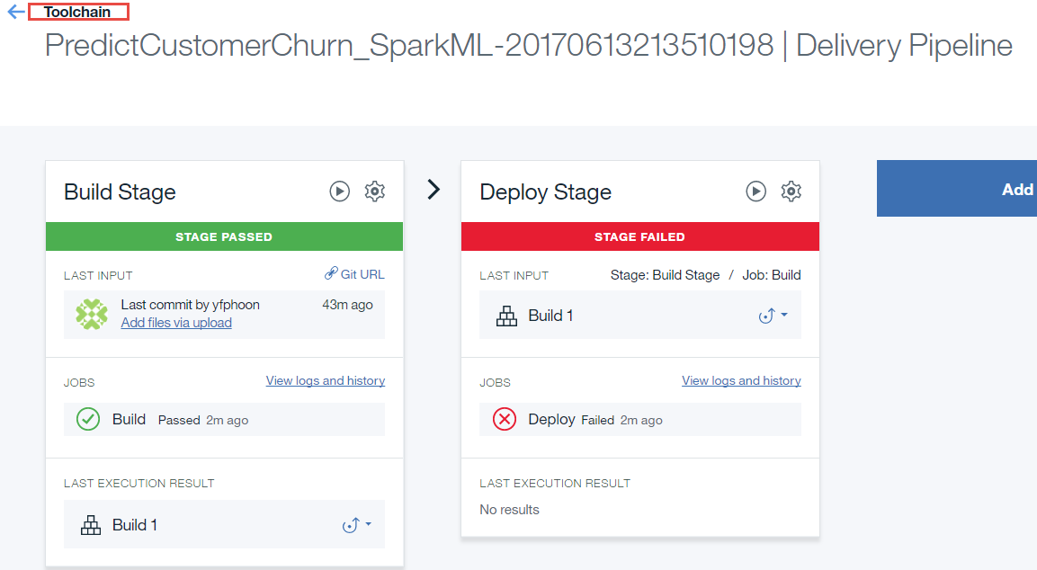
You should see the failure in the Deploy Stage. The reason for the failure is that the generated route is already in used.
Click Toolchain on the top left corner

Slide 7
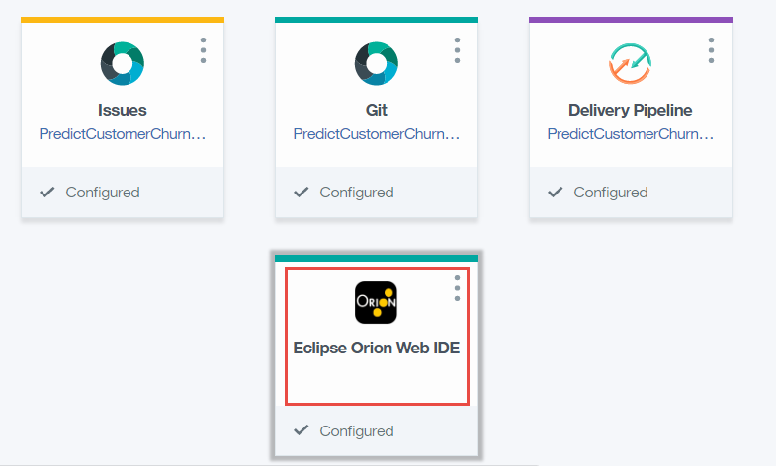
To resolve the Deploy issue, click Eclipse Orion Web IDE to edit the code

Slide 8
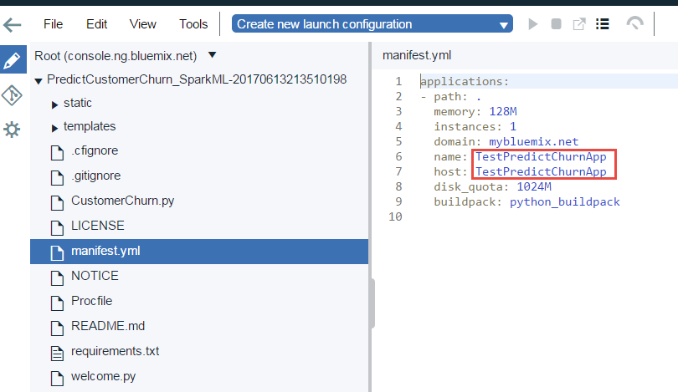
Edit the manifest.yml and replace the name and host. For example, set name:PredictChurnXYZ678 and host: PredictChurnXYZ678
Click File -> Save

Slide 9
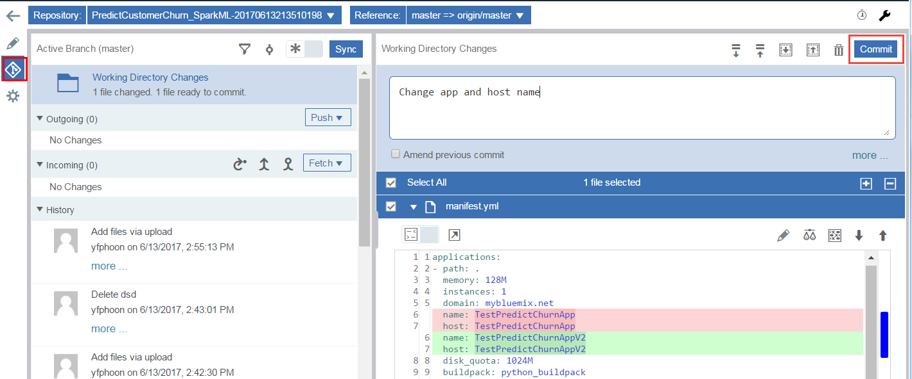
Click the Git icon on the left
Enter a commit message and click Commit to commit your change

Slide 10
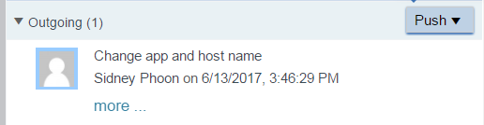
On the right side of the screen, click Push to push your changes into the repository

Slide 11
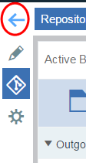
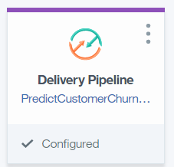
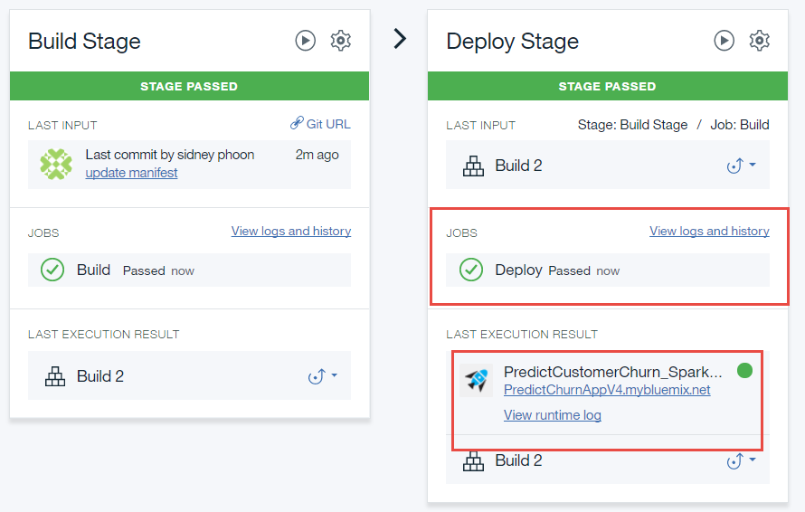
Go back to Deliery Pipeline and verify that the Deploy Stage executes successfully
1
2
3
4
Click the URL in step 4 to launch the application

Slide 12
