Slide 1
The Db8 (Debate) Project:
Visual Demo Tool
Carsten Wood – COMP1004 Interim Video

Slide 2
Project Background – The Problem
In an age where Social Media is the only form of large online group communication, and where platforms are governed by algorithms that only serve to keep user retention as high as possible, the marketplace of ideas is the biggest looser.
Likes, limited word count, algorithmic bias are all things that prevent social media from being able to hold meaningful and resolving discussion. There is a need for a platform that can hold constructive discussions about topics, and where ideas can be legitimately critiqued and improved upon.

Slide 3
Project Background – What is Db8?
The Db8 Project is a platform that intends to benefit society by surfacing arguments for positions in a public and open environment and making them available to all.

Slide 4
Project Background – The Goal of Db8
Generate Well Argued and Informed Discussion of Topics
Give People the Tools to Have
Understanding Individual Thought Processes
Comprehensive Repository of Arguments
Benefiting Society

Slide 5
Project Vision
With these requirements in mind...
My Aim is to create a single page website to work as a proof of concept for this platform (The Db8 Project). Something that could be used as a visual aid or demo tool in a pitch to potential investors or team members.
It should highlight the key functions that will demonstrate the advantages of using Db8 for constructive online discussion.

Slide 6
How to achieve this?
What methods will I employ to develop a Visual Demonstration Tool that captures the key aspects and features the platform would need to encourage useful and rational discussion?
Code Sprints – Plan sprints around each key aspect of the
Clear UML diagrams – A series of detailed UML diagrams that will be used to plan each component of the tool.
Strong Documentation – Issues and Challenges should be documented so that they can be addressed in testing.

Slide 7
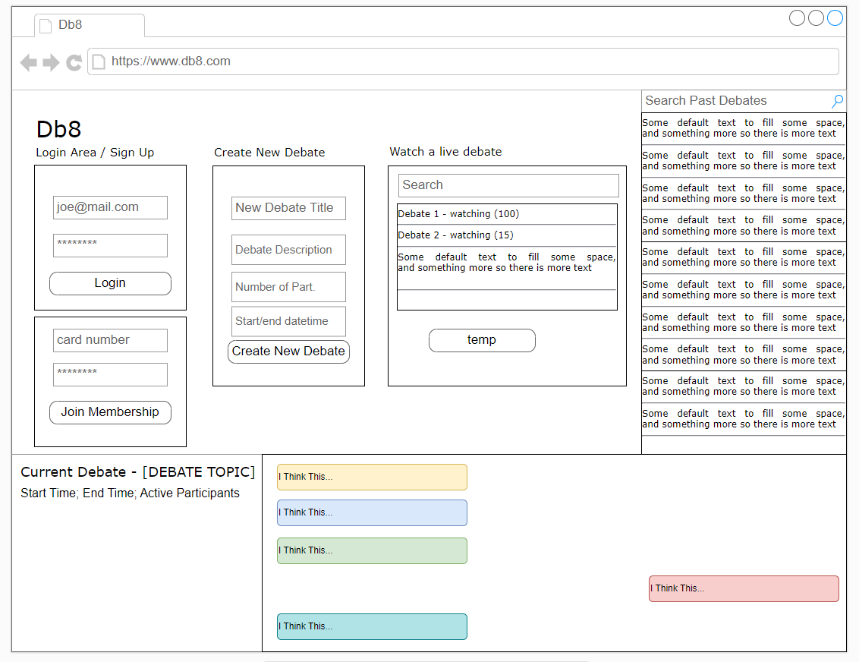
The Plan
An initial draft of what core functionality the site should include
Login / Membership
Create a New Debate
Watch a Live Debate
Messages in Your Current Debate
Search a Past Debate

Slide 8
The Plan
Before the Christmas Break, have a working prototype for:
Create New Debate Box
Search Past Debates

Slide 9
The Sprints
I created a series of sprints to structure the design of the page in order of functionality. Each sprint has the following sections:
Start / End date; shows when the task should be started by, and when it must be completed by.
Task description which will explain the task and what additions or changes need to be made.
Status which can either be “Not completed”, “In progress” or “Completed”.
Additional Notes section at the bottom of each sprint where and issues that were encountered or other ideas regarding the section can go.

Slide 10
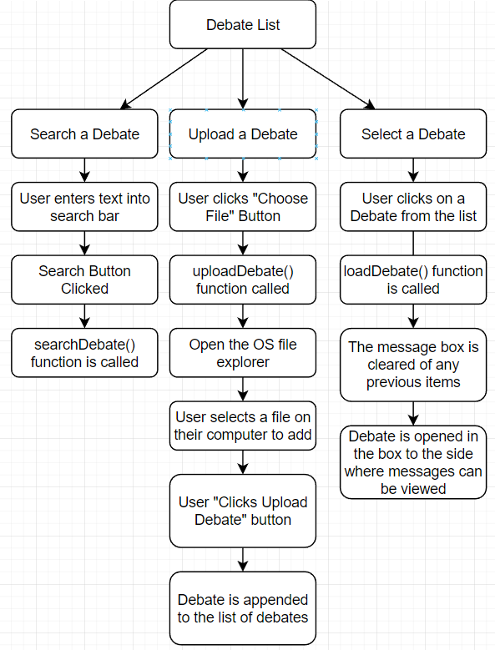
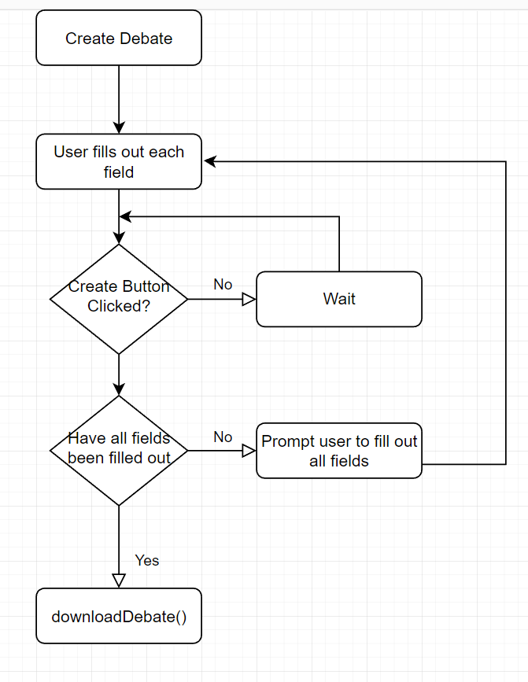
UML Diagrams – Use Case
Use case diagrams show the interactions between the user and the system.
The two diagrams here show the way a user should interact with the Debate List plane and the Create Debate plane.

Slide 11
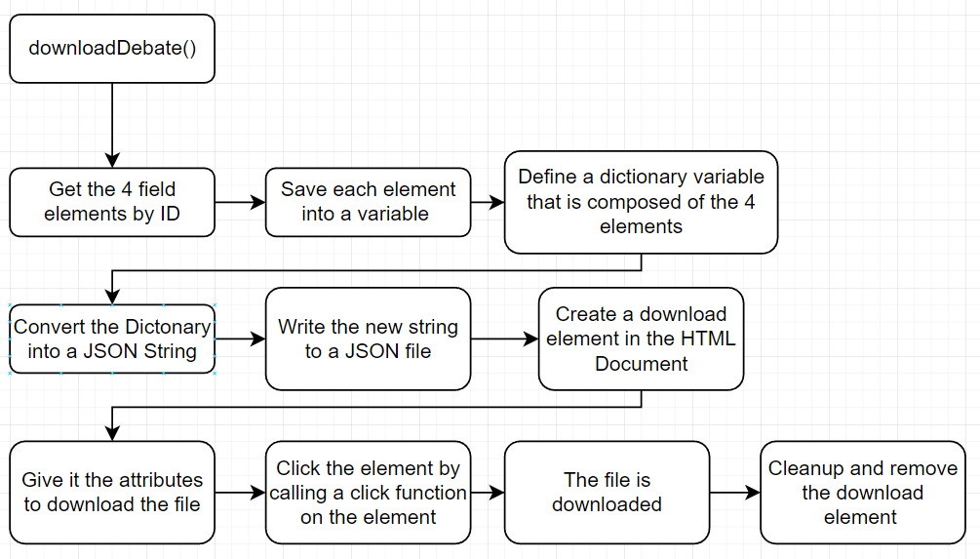
UML Diagrams
Here is a breakdown of the downloadDebate() Function that was written in JavaScript

Slide 12
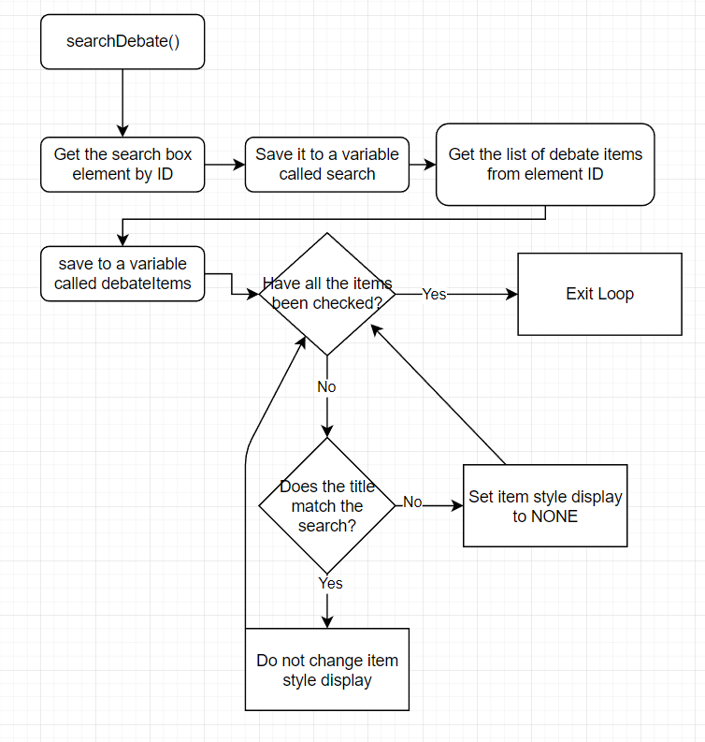
UML Diagrams
Here is a breakdown of the searchDebate() Function that was written in JavaScript

Slide 13
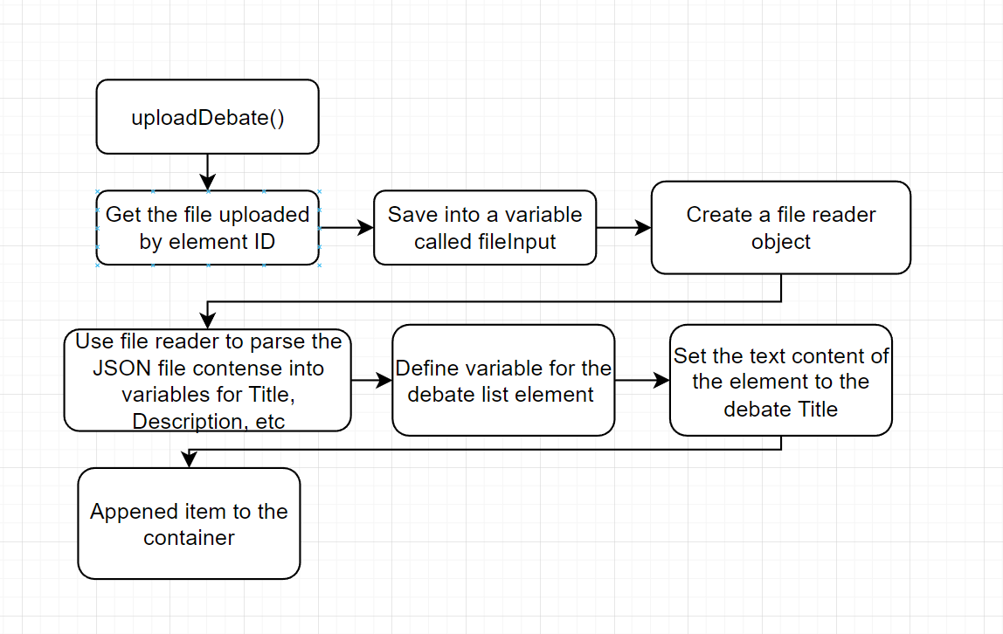
UML Diagrams
Here is a breakdown of the uploadDebate() Function that was written in JavaScript

Slide 14
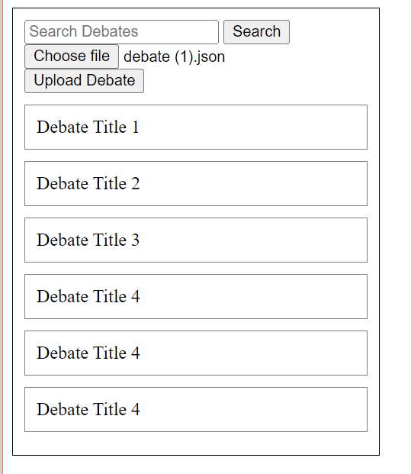
Challenges
Here’s an example of a user being able to submit a JSON file multiple times to the list, causing it to display repeated entries.
The screen shot shows “Debate Title 4” in the list 3 times after repeated uploads.
A modification to the uploadDebate() function added a check that compared the upload to existing entries before appending it to the list.
If a match was found it would not add the file.

Slide 15
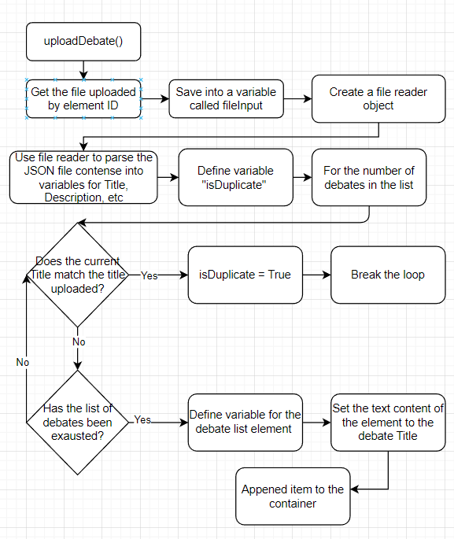
Resolving Issues
Updated logic for uploadDebate()

