Slide 1
Uptane Research Project
Rob Lorch
October 15, 2021

Slide 2
Uptane Overview
Over the air updates are vulnerable to attack
Read updates
Deny updates
Deny functionality
Gain control over the system
Vehicles are safety-critical systems that run large codebases
Design principles
Checks and balances
Fault tolerance
Digital signatures and key revocation

Slide 3
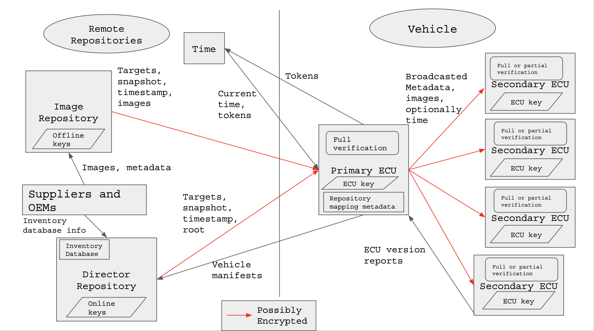
Uptane Components
Repositories
Director
Image
ECUs
Primary
Secondary
Time server

Slide 4
Uptane Processes
Full verification
Required for primary ECUs, optional for secondary
Individual integrity checks of all metadata (both repos)
Cross-referencing
Partial verification
Mandatory for secondary ECUs (if not doing full verification)
At minimum, check targets metadata from the Director
Attacks we defend against
Arbitrary software
Rollback
Freeze
Mix-and-match

Slide 5
Modeling Uptane in Electrum
Signatures and relations
abstract sig Metadata {
signatures: set Signature,
signature_count: SignatureCount,
version: Version,
expiration: MyTime,
role: Role,
hashes: some Hash,
source: Repository,
}
abstract sig Repository {
var out_primary: set Metadata,
}
one sig DirectorRepo extends Repository {}
one sig ImageRepo extends Repository {}

Slide 6
Modeling Uptane in Electrum
Signatures and relations
Ordered signatures: Version, SignatureCount, FileSize, Time
sig RootMetadata extends Metadata {
key_mapping: Role lone -> some MetadataKey,
signature_count_mapping: Role -> one SignatureCount,
}
abstract sig ECU {
key: ECUKey,
var current_metadata: set Metadata,
var new_metadata: set Metadata,
var current_image: Image,
var new_image: Image,
}

Slide 7
Modeling Uptane in Electrum
Predicates
Operators
Operator granularity
SendMetadataToPrimary*
SendMetadataToSecondaries
FullVerification*
PartialVerification*
VerifyImage
Dynamic modeling
Track
Scheduler
Trans
Frame conditions

Slide 8
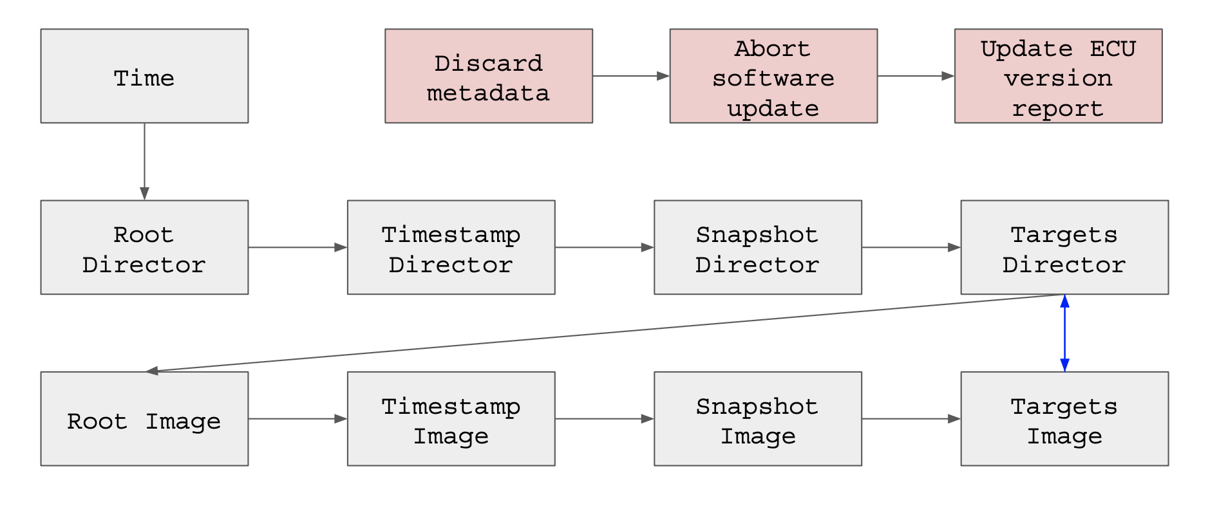
Full Verification (ECU)
9 steps (operators)
Integrity check for all four metadata types for each repository (8 steps)
Targets metadata cross-referencing

Slide 9
Full Verification
Conditional preconditions
(
FullVerificationPreconditions[p,
(p.current_metadata & TargetsMetadata),
t,
(p.current_metadata & RootMetadata)]
and
-- Make sure there are targets
some t.image_hashes
and
-- Target metadata version number should match the version number
-- listed in snapshot metadata
let t = (p.new_metadata & TargetsMetadata) |
t.version = (p.current_metadata & SnapshotMetadata).targets_info[t]
)
implies
Track.status' = Success
else
Track.status' = Abort

Slide 10
Full Verification
“Actual” preconditions
Postconditions
-- From FullVerificationTargets
ECU.verification_step = FullVerificationSnapshot
ECU.status = Success
-- From FullVerificationRoot
-- If Timestamp keys have been rotated, delete current Timestamp metadata
((r.key_mapping[Timestamp] !=
(p.current_metadata & RootMetadata).key_mapping[Timestamp])) implies
(p.current_metadata' & TimestampMetadata) = none

Slide 11
Full Verification
Frame conditions
NoChangeExceptDirector[out_primary, none]
NoChangeExceptPrimary[current_metadata,none]
NoChangeExceptPrimary[new_metadata, none]
NoChangeExceptPrimary[out_secondaries, none]
NoChangeExceptPrimary[current_image, none]
NoChangeExceptPrimary[new_image, none]

Slide 12
Global Constraints
Assertions
Global constraints
assert A_e {
-- Primary ECUs always have a full set of metadata
(Scheduler and Environment) implies
always all p : PrimaryECU | #(p.current_metadata) = 4 &&
one (p.current_metadata & RootMetadata) &&
one (p.current_metadata & TargetsMetadata) &&
one (p.current_metadata & SnapshotMetadata) &&
one (p.current_metadata & TimestampMetadata)
}
check A_e for 15
-- Different files should produce different hashes
all disj m1, m2: Metadata | no (m1.hashes & m2.hashes)

Slide 13
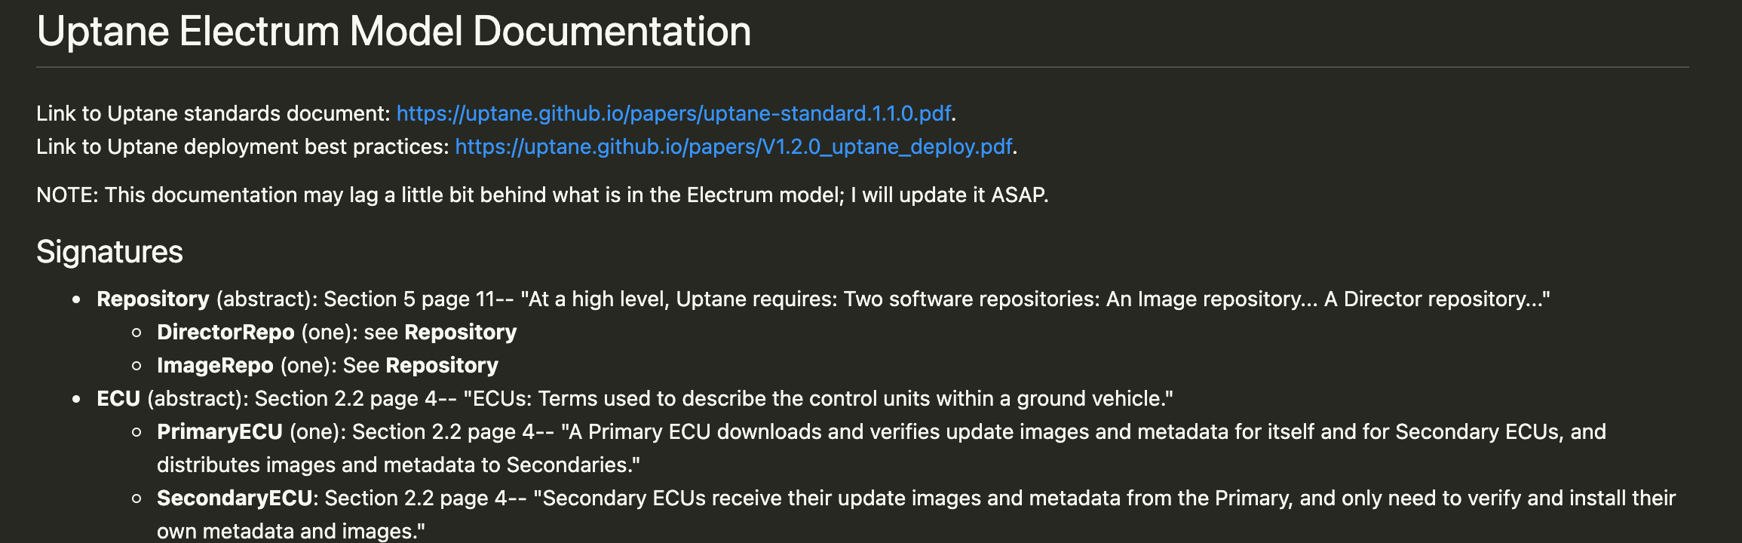
Documentation
Links to Uptane standards document and deployment best practices
Signatures
Relations
Operators
Preconditions
Postconditions
Frame conditions
Facts
Notes/questions

Slide 14
Challenges
Model size/complexity
Number of verification steps
Optional steps
Operator granularity
Many points of failure in full verification
Documentation
Modeling communication between primary ECU and repositories
Reference implementation

