Slide 1

SSH Remote Support Tunnel

Slide 2


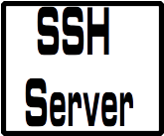

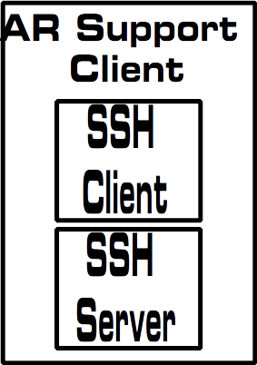


System Overview
support-server.domain.com
User = support-customer
User = support-agent
14000
Support
Customer
Support
Agent

Slide 3
Support Server Setup
Create support user
  /usr/local/bin/supportconnect.bash
    Set /usr/local/bin/supportconnect.bash as shell for support-customer
  /home/support-customer/.ssh/authorized_keys (for support user)
    Will add key for each customer that can access support tunnel
  /home/support-agent/.ssh/authorized_keys (for support agent)
    Will add key for each agent
  /etc/ssh/sshd_config
    Ensure only key based authentication is enabled
    Match User support section
      Limit to remote tcp forwarding only

Slide 4
Local Support Client
(optional) Add section to .ssh/config for support server
  ProxyCommand
  Test connection to support-server first (get in known_hosts)

Slide 5
Support Customer Install
Ensure openssh-server and openssh-client are installed on customer pc
!!! Ensure ONLY public key authentication is allowed in sshd_config !!!
Copy ssh_support_tunnel dir into users/ home dir
Add your ssh public key to BOTH the user and root accounts
Create an ssh key for the local user if they don’t have one
Append public portion to /home/support-customer/.ssh/authorized_keys file on support-server
Move remote-support.desktop to /home/<user>/Desktop and edit
  Change Exec= and Icon= lines to have actual username in path for the local user
Manually connect tunnel by entering the following on the CLI:
  ~/ssh_support_tunnel/reverse-ssh.bash
    This adds the server to the known_hosts file
Test

Slide 6
Support Tunnel Use
Support customer double clicks on Remote Support icon on desktop
Support tech opens terminal on his pc and
  ssh support-agent (for root) or
  ssh <username on customer machine>@support-agent

Slide 7
Limitations
There is some security exposure here, no known exploits but more pieces to be exploited, so use with trusted clients, family, etc.
  We have taken steps to secure some aspects, however, there is still an increased risk from this service
Targeted at small scale support
It’s relatively quick and easy and safe and controllable for the customers

Slide 8
Congratulations!
You should now have the remote support tunnel installed and able to be used. Enjoy!

