Slide 1
CSE5026 Introduction and Frontiers of Cognitive Science
认知科学导论与前沿
Lecture 0x - Context-Free Grammars and Constituency Parsing
Instructor: Yang Xu
主讲人：徐炀
xuyang@sustech.edu.cn

Slide 2
Overview
Context Free Grammars (CFG)
Constituency Parsing
Neural Constituency Parsing

Slide 3
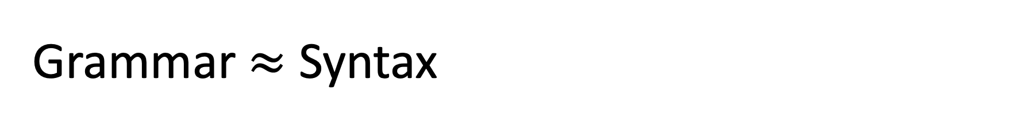
Grammar $≈$ Syntax
Greek: syntaxis, meaning “setting out together”
The way words are arranged together
Syntax: n.句法，句法规则；
Part-of-speech is already a kind of syntactic notions
Determinator
Noun
Verb
Determinator
Noun
the Sun rises every morning

Slide 4
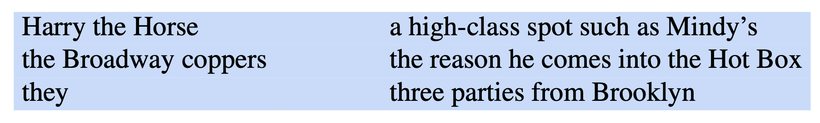
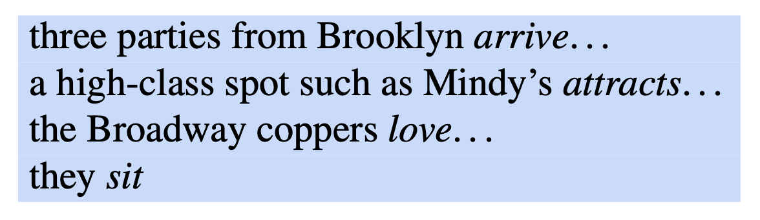
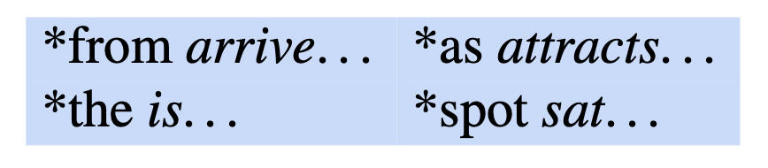
Constituency
(n. 成分)
Groups of words can behave as single units, or constituents
Ex. noun phrases (NP, sequence of words surrounding at least one noun)
Why they form constituents? (the following NPs all appear before verbs)
Invalid sentences:
Notes:
noun phrase: a sequence of words surrounding at least one noun
why (evidence): can all appear in similar syntactic environments, say, before a verb （都可以出现在动词前面）

Slide 5
Evidence for constituency (more examples)
Preposed (前置) or postposed (后置)
“On February 2nd” is a prepositional phrase (PP)
On February 2nd, I’d like to fly from Shanghai to Osaka.
I’d like to fly on February 2nd from Shanghai to Osaka.
I’d like to fly from Shanghai to Osaka on February 2nd.
* On February, I’d like to fly 2nd from Shanghai to Osaka.
* I’d like to fly on February 2nd from Shanghai to Osaka.
I’d like to fly on February from Shanghai to Osaka 2nd.

Slide 6
Terminology
Phrase: 词组
Noun Phrase: 名词词组；Prepositional Phrase: 介词词组
Proper Noun: 专有名词
Nominal: 名词性的词

Slide 7
How do we use constituency to describe grammar?
How do we describe rules such as
“Noun Phrases can occur before verbs”,
“Prepositional Phrases can occur after verbs”
and so on?
Need a more formal way!
-- Context-Free Grammar

Slide 8
Context-Free Grammars (CFG)
Wundt, German psychologist
Chomsky, American linguist
Backus & Naur, American computer scientists (FORTRAN, ALGO)
Also called Phrase-Structure Grammar
Wilhelm Wundt (1900), Chomsky (1956), Backus (1959), Naur (1963)
A set of rules or productions that express the ways symbols can be grouped and ordered together.
Ex.
A NP (noun phrase) can be composed of
either a ProperNoun (专有名词)
or a determiner (Det 冠词) followed by a Nominal (名词性词)
A Nominal can be one or more Nouns (名词)
NP → Det Nominal
NP → ProperNoun
Nominal → Noun | Nominal Noun
Notes:
→: goes to

Slide 9
Rules can be hierarchically embedded
Ex.
Det → a
Det → the
Noun → | flight
NP → Det Nominal
NP → ProperNoun
Nominal → Noun | Nominal Noun
Two classes of symbols: terminal and non-terminal
terminal: symbols that are actual words in language (“a”, “the”, …)
non-terminal: symbols that express abstractions over terminals
Notes:
The symbols that are used in a CFG are divided into two classes: terminal and non terminal

Slide 10
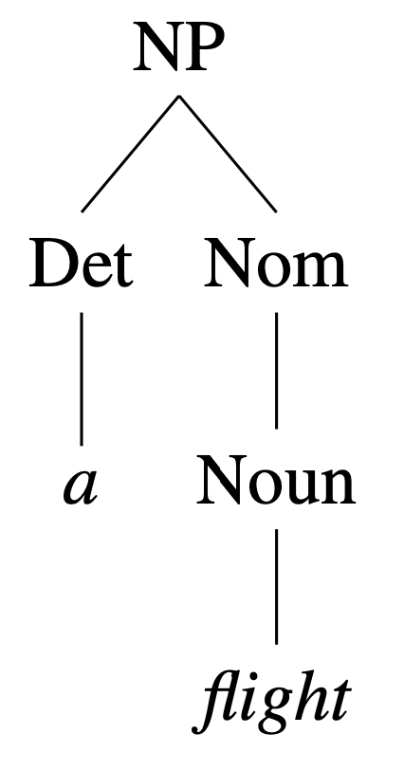
CFG as a device for generating sentences
(生成)
Rules:
Start from NP
Use rule ① to rewrite NP as: Det Nominal
①
NP → Det Nominal
NP → ProperNoun
Nominal → Noun | Nominal Noun
②
Use rule ③ to rewrite Nominal as: Noun
③
Use rule ④ to rewrite Det as: a
④
Det → a
Det → the
Noun → | flight
⑤
Use rule ⑥ to rewrite Noun as: flight
⑥
Result: parse tree

Slide 11
CFG: More terms and rules
A grammar must have one designated start symbol, often called S.
Common rules:
NP dominates all nodes in the tree
A sentence can consist of a noun phrase followed by a verb phrase
S → NP VP
I prefer a morning flight
A VP can consist of a verb followed by assorted things
VP → Verb NP
prefer a morning flight
Or VP may have a verb followed by a prepositional phrase
VP → Verb PP
leaving on Thursday
A PP generally has a preposition followed by a noun phrase
PP → Preposition NP
from Los Angeles
Notes:
S is for “sentence”

Slide 12
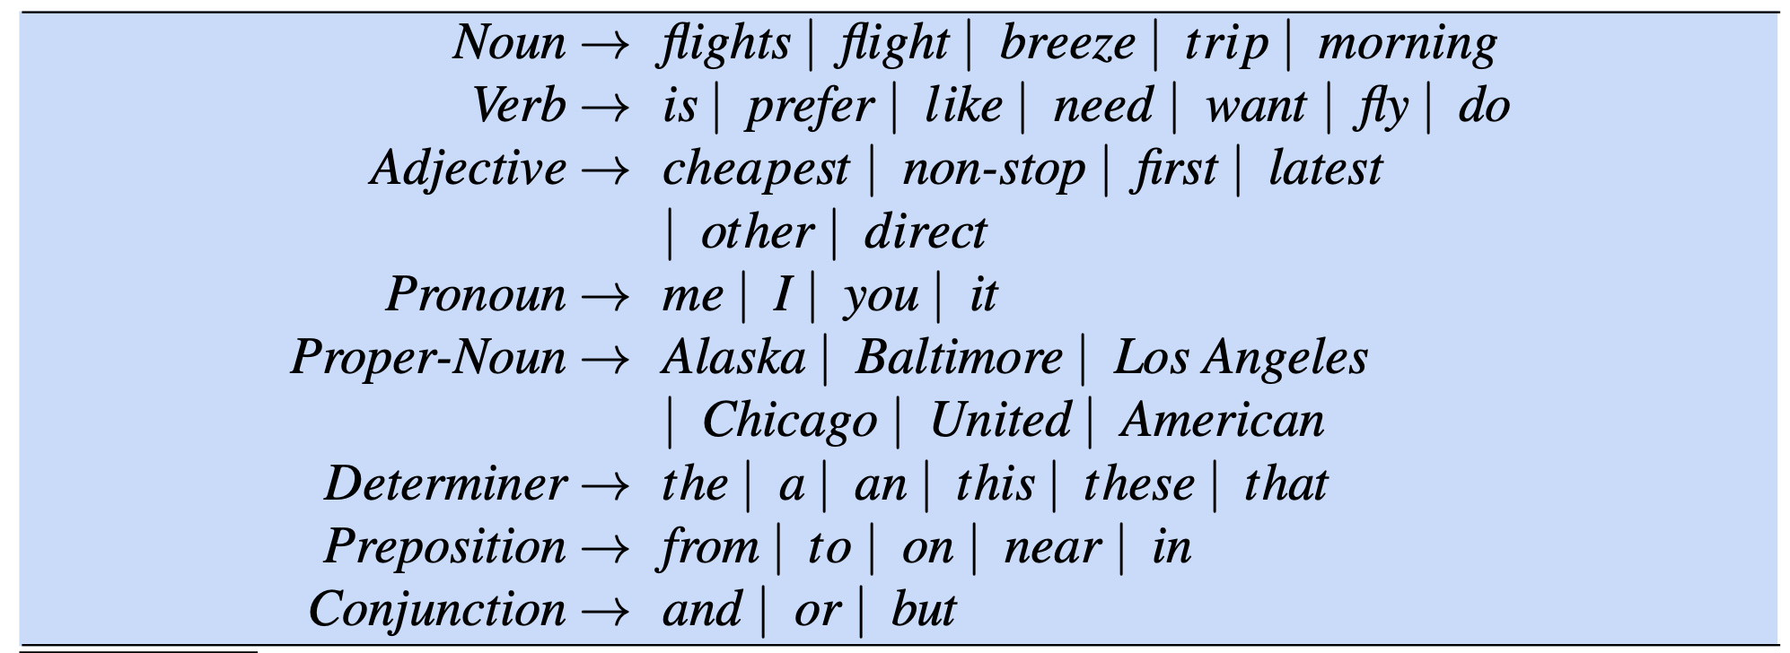
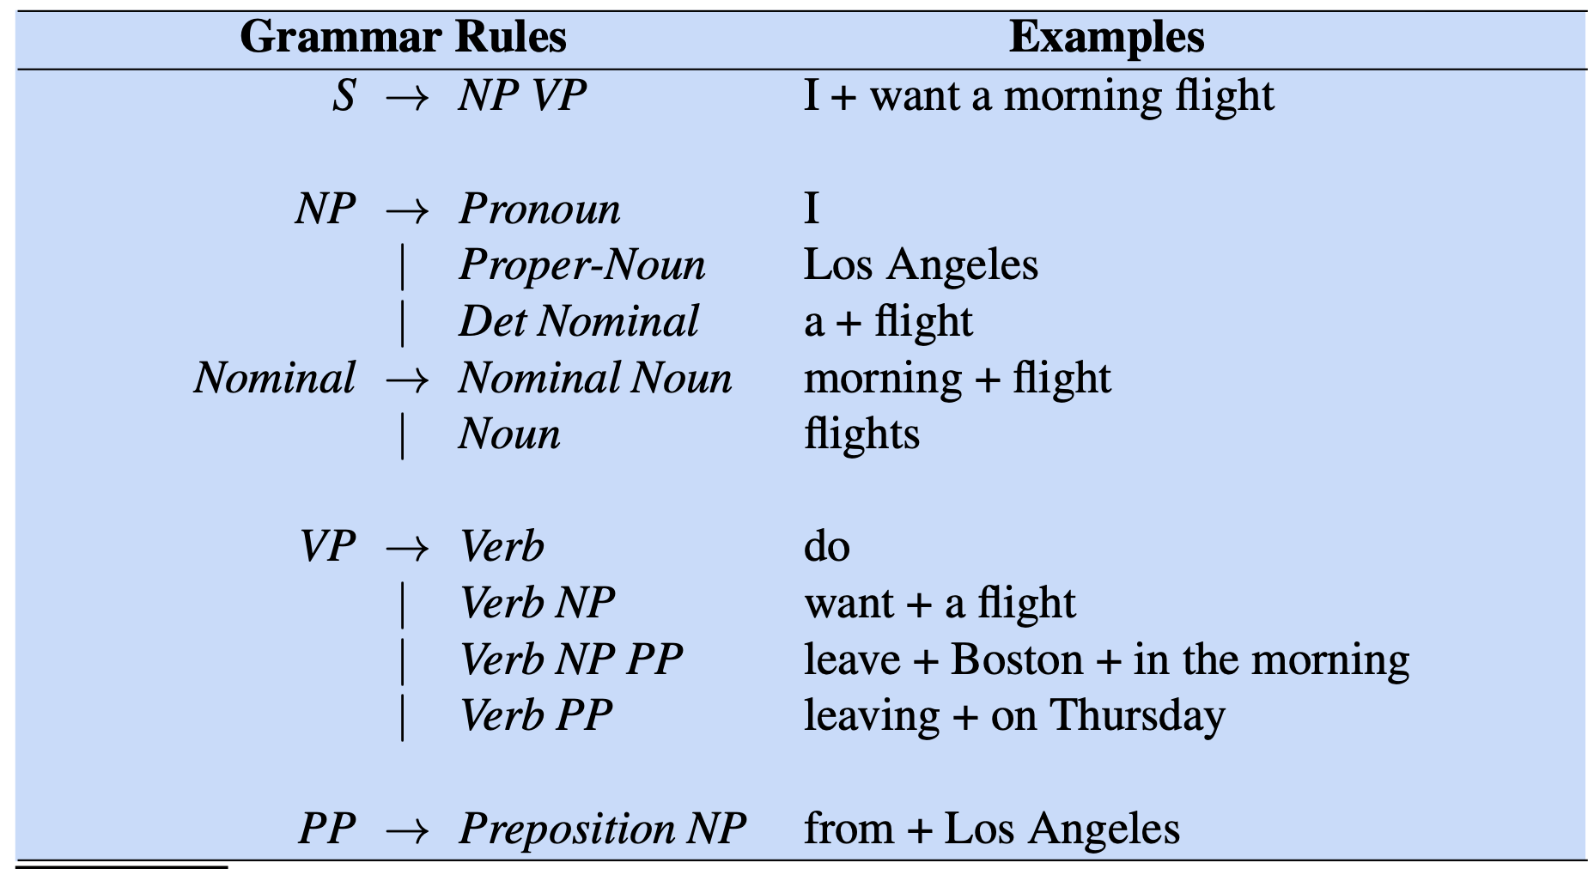

CFG: Examples from AITS corpus
A sample lexicon
A sample of grammar rules $ℒ_{0}$
Air Travel Information System (ATIS) pilot corpus
https://aclanthology.org/H90-1021/

Slide 13
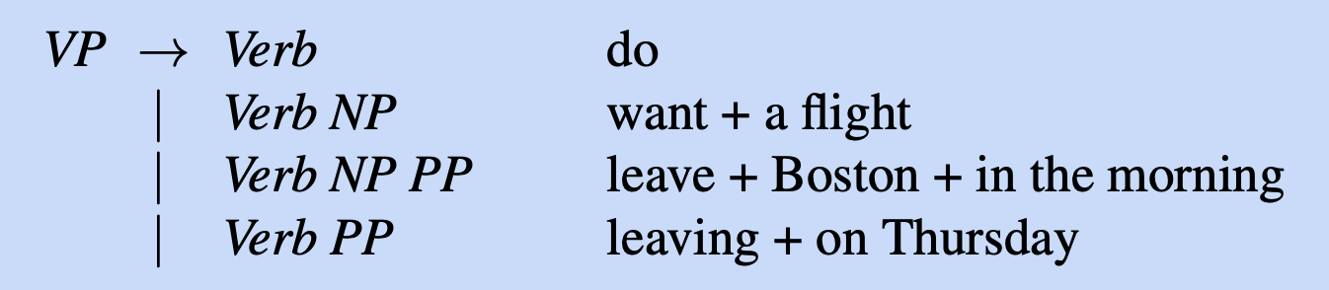
Use ATIS grammar to generate “AITS-language”
S → NP VP
Start with S, expand it with NP VP
Choose a random expansion of NP: I
Choose a random expansion of VP: Verb NP
want + a flight
I prefer a morning flight
Verb NP
want + a morning flight
prefer + a morning flight
……

Slide 14
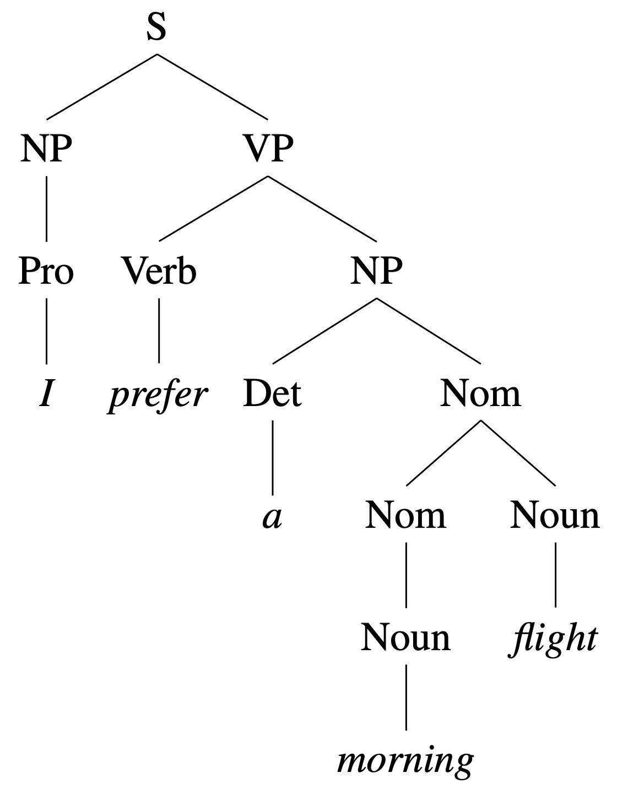
CFG: Bracketed Notation
(S (NP (PRO I)
(VP (V prefer)
(NP (Det a) (Nom (N morning) (N flight))))))
Sentences that can be derived by a grammar are called grammatical;
those cannot be derived are referred to as ungrammatical.
This distinguishment is vague, and only a very simplified model of how natural language really work.

Slide 15
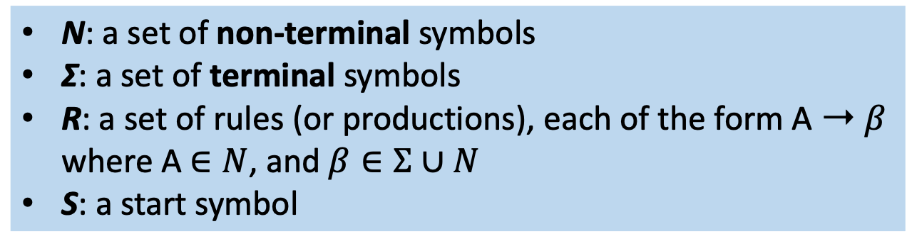
Formal definition of CFG
A context-free grammar G is defined by 4 parameters:
N, Σ, R, S
N: a set of non-terminal symbols
Σ: a set of terminal symbols
R: a set of rules (or productions), each of the form A ➝ 𝛽
where A $∈N$, and $β∈Σ∪N$
S: a start symbol
Syntactic parsing: the problem of mapping from a string of words to its parse tree

Slide 16
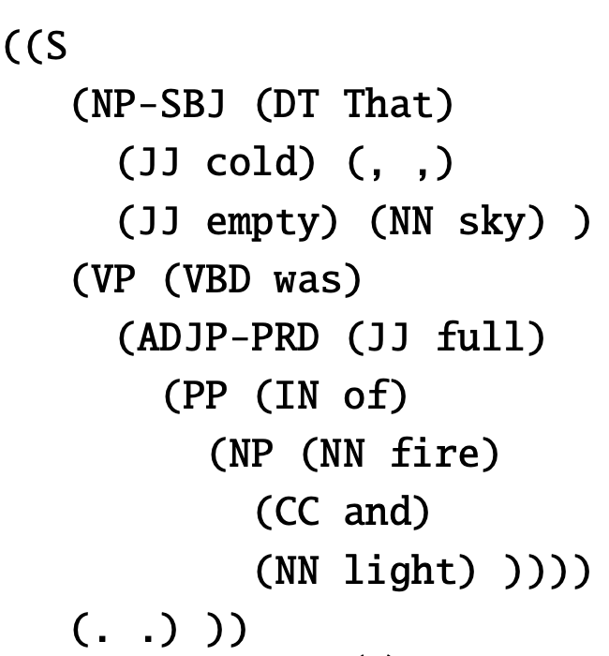
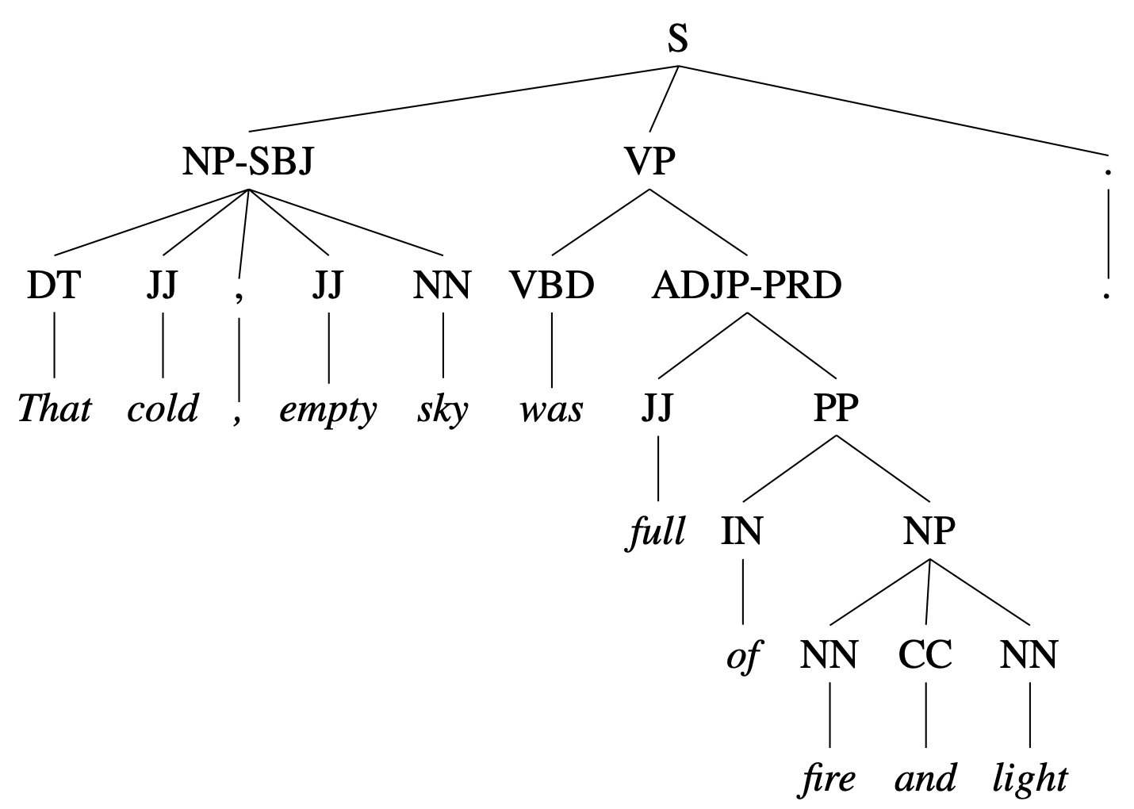
Treebank
句法树库
A corpus in which every sentence is annotated with a parse tree
Penn Treebank project: English, Arabic, Chinese.
First parsed by a parser (algorithm), then hand-corrected by human linguists
The grammar is very flat
Ex, approximately 4,500 different rules for expanding VPs
VP → VBD PP
VP → VBD PP PP
VP → VBD PP PP PP
VP → VBD PP PP PP PP VP → VB ADVP PP
VP → VB PP ADVP
VP → ADVP VB PP
……

Slide 17
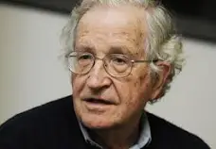
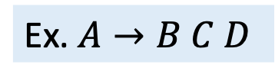
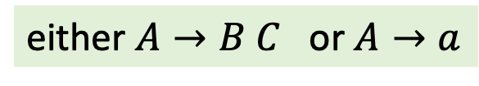
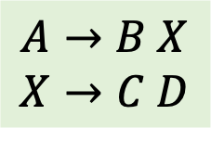
Chomsky normal form (CNF)
Noam Chomsky, "the father of modern linguistics"
It is sometimes useful to have a normal form for grammars
A grammar is in Chomsky normal form (CNF) if each production is
That is, the right-hand side has two non-terminals or one terminal
Any context-free grammar can be converted to a (weakly) equivalent CNF
either $A→B C$ or $A→a$
$$A→B X$$
$$X→C D$$
Ex. $A→B C D$

Slide 18
Why CNF?
Result in binary branching parse trees
Produce smaller grammars
VP → VBD NP PP
VP → VBD NP PP PP
VP → VBD NP PP PP PP
VP → VBD NP PP PP PP PP
…
VP → VBD NP PP
VP → VP PP

Slide 19
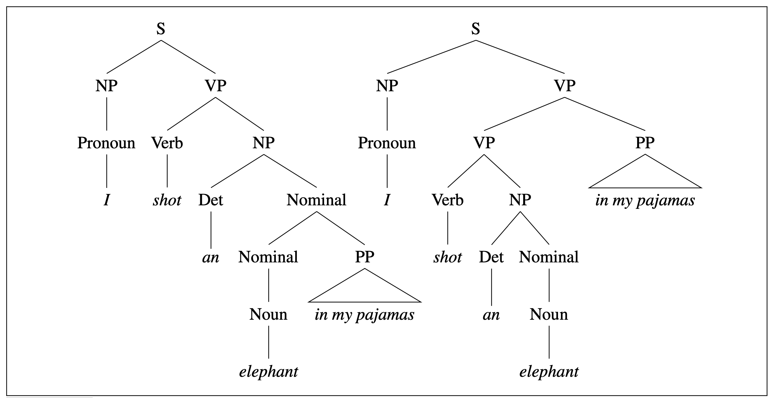
Problem in syntactic parsing: Ambiguity
Structural ambiguity occurs when the grammar can assign more than one parse to a sentence.
I shot an elephant in my pajamas
Left: elephant is in pajamas
Right: the action of shooting is done by me in my pajamas
PP-attachment ambiguity: the preposition phrase can be attached either as part of the NP or as part of the VP.
Need a way to deal with these syntactic disambiguation

Slide 20
Overview
Context Free Grammars (CFG)
Constituency Parsing
Neural Constituency Parsing
成分句法分析

Slide 21
Parsing: A Dynamic Programming Approach
Dynamic programming provides a powerful framework for addressing the problems caused by ambiguity in grammars
  A dynamic programming approach fills in a table of solutions to subproblems
  The complete table has the solution to all the subproblems
  In the case of parsing: the subproblems represent parse trees for all the constituents detected in the input
Basic assumption: the context-free nature of grammar rules -- once a constituent has been discovered in a segment of input, we can store it and make available for use in any subsequent derivation that might require it
CKY algorithm (Cocke-Kasami-Younger, 1961)

Slide 22
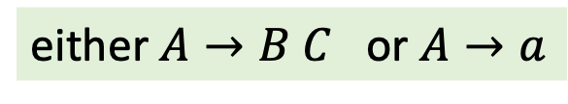
CKY Algo. Preprocessing: Conversion to CNF
CKY algorithm requires grammars to first be in Chomsky Normal Form (CNF)
I.e., the right-hand side of each rule must expand either to two non-terminals or to a single terminal
The remedy for rules that mix terminals and non-terminals is to introduce a new dummy non-terminal
either $A→B C$ or $A→a$
INF-VP → to VP
INF-VP → TO VP
TO → to

Slide 23
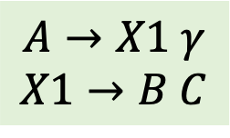

CKY Algo. Preprocessing: Conversion to CNF
For rules with right hand side longer than 2, introduce new non-terminals:
For rules with a single non-terminal on the right (unit productions), rewrite the right hand side with non-unit production rules that they ultimately lead to
Ex.
$$A→B C γ$$
$$A→X1 γ$$
$$X1→B C$$
S → Aux NP VP
S → X1 VP
X1 → Aux NP
Nominal → Noun
Noun → book | flight
Nominal → book | flight

Slide 24
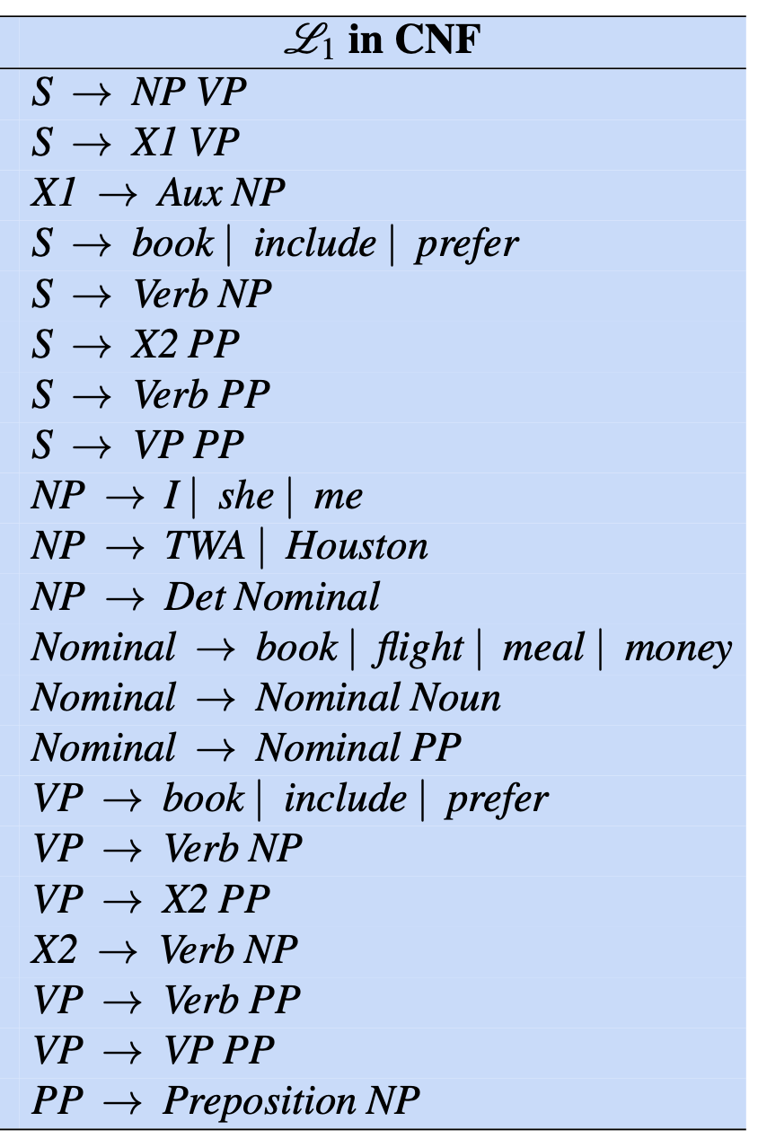
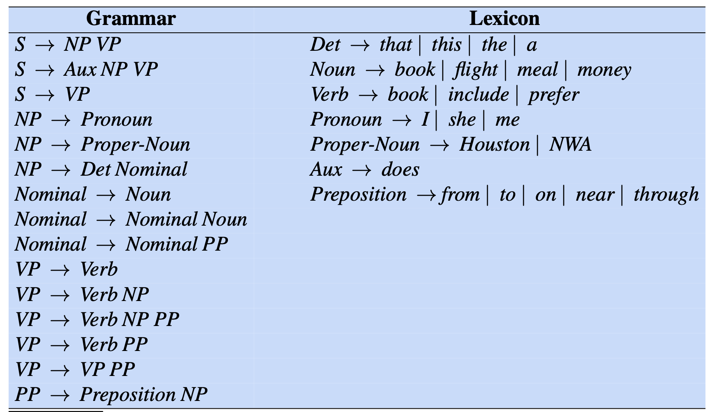


Grammar in CNF: Example
Grammar $ℒ_{1}$ in CNF
Grammar $ℒ_{1}$ (with adds to $ℒ_{0}$)

Slide 25
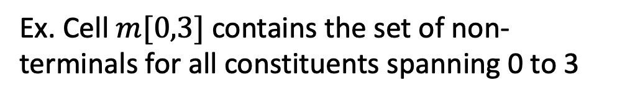
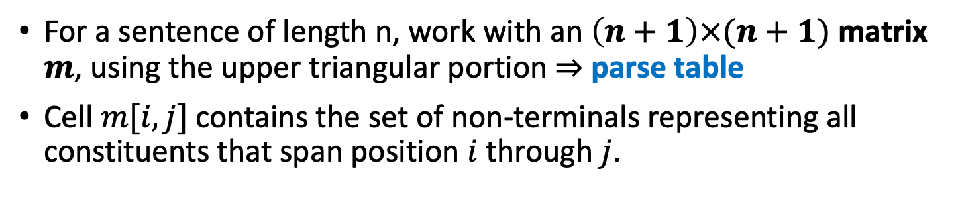
CKY Recognition
For a sentence of length n, work with an $\left(n+1\right)×(n+1)$ matrix $m$, using the upper triangular portion ⇒ parse table
Cell $m[i,j]$ contains the set of non-terminals representing all constituents that span position $i$ through $j$.
Column index
Book
the
flight
through
Houston
0
1 2 3 4 5
Book the flight through Houston
0
[0,1]
Index:
0
1
2
3
4
5
1
Ex. Cell $m[0,3]$ contains the set of non-terminals for all constituents spanning 0 to 3
Row
index
2
3
Task: Fill in the parse table correctly in a bottom-up way
4
5

Slide 26
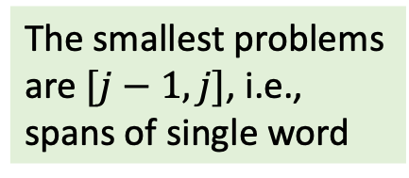
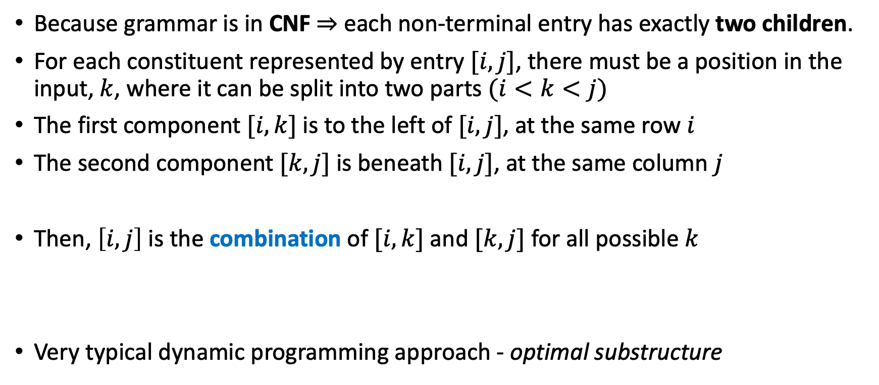
CKY Recognition: Task breakdown
Because grammar is in CNF ⇒ each non-terminal entry has exactly two children.
For each constituent represented by entry $[i,j]$, there must be a position in the input, $k$, where it can be split into two parts $(i<k<j)$
The first component $[i,k]$ is to the left of $[i,j]$, at the same row $i$
The second component $[k,j]$ is beneath $[i,j]$, at the same column $j$
Then, $\left[i,j\right]$ is the combination of $[i,k]$ and $[k,j]$ for all possible $k$
Very typical dynamic programming approach - optimal substructure
The smallest problems are $[j−1, j]$, i.e., spans of single word
In order to solve the problem, we need to solve smaller problems first

Slide 27
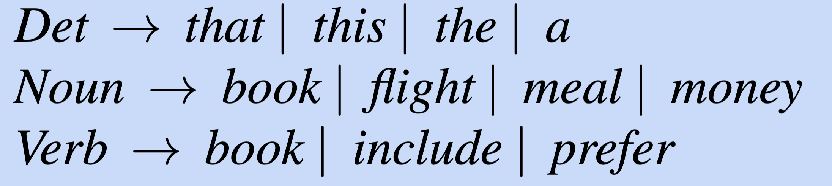
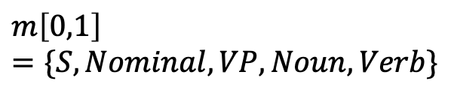
CKY Recognition: Example
Book the flight
Solve span [0, 1]
Index:
0
1
2
3
Book
the
flight
0
1
2
3
5 production rules match with “Book”
0
S, VP, Verb, Nominal,
Noun
Store them in cell [0,1]
1
$$m\left[0,1\right]=\{S,Nominal,VP,Noun,Verb\}$$
2
3

Slide 28

CKY Recognition: Example
Book the flight
Solve span [1, 2]
Index:
0
1
2
3
Book
the
flight
0
1
2
3
1 production rule matches with “the”
0
S, VP, Verb, Nominal,
Noun
Store it in cell [1,2]
1
$$m\left[1,2\right]=\{Det\}$$
Det
2
3

Slide 29
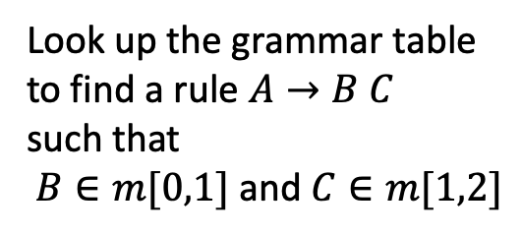

CKY Recognition: Example
Book the flight
Solve span [0, 2]
Index:
0
1
2
3
Book
the
flight
Look up the grammar table to find a rule $A→B C$
such that
$B∈m[0,1]$ and $C∈m[1,2]$
0
1
2
3
0
S, VP, Verb, Nominal,
Noun
No rule is found, so let
$$m\left[2,3\right]=∅$$
1
Det
2
Nominal,
Noun
It means the phrase “Book the” is incomplete in grammar
3

Slide 30
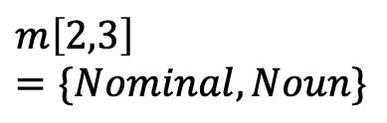
CKY Recognition: Example
Book the flight
Solve span [2, 3]
Index:
0
1
2
3
Book
the
flight
0
1
2
3
2 production rules match with “flight”
0
S, VP, Verb, Nominal,
Noun
Store them in cell [2,3]
1
$$m\left[2,3\right]=\{Nominal,Noun\}$$
Det
2
Nominal,
Noun
3

Slide 31
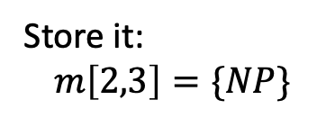
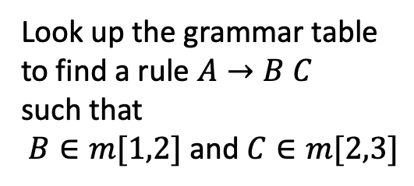
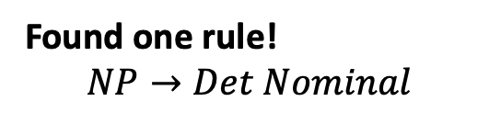
CKY Recognition: Example
Book the flight
Solve span [1, 3]
Index:
0
1
2
3
Book
the
flight
Look up the grammar table to find a rule $A→B C$
such that
$B∈m[1,2]$ and $C∈m[2,3]$
0
1
2
3
0
S, VP, Verb, Nominal,
Noun
Found one rule!
$$NP→Det Nominal$$
1
Det
NP
2
Nominal,
Noun
Store it:
$$m\left[2,3\right]=\{NP\}$$
3

Slide 32

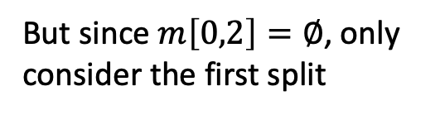
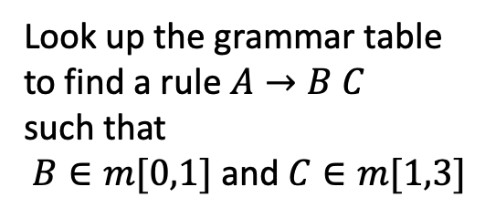
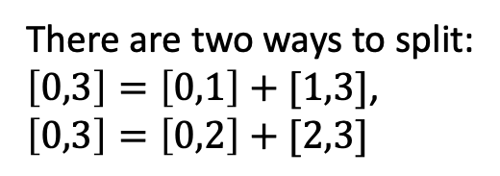
CKY Recognition: Example
Book the flight
Solve span [0, 3]
Index:
0
1
2
3
There are two ways to split:
$\left[0,3\right]=\left[0,1\right]+[1,3]$,
$\left[0,3\right]=\left[0,2\right]+[2,3]$
Book
the
flight
0
1
2
3
0
S, VP, Verb, Nominal,
Noun
S, VP, X2
But since $m\left[0,2\right]=∅$, only consider the first split
1
Look up the grammar table to find a rule $A→B C$
such that
$B∈m[0,1]$ and $C∈m[1,3]$
Det
NP
2
Nominal,
Noun
3
Found three rules
$$m\left[0,3\right]=\{S,VP,X2\}$$

Slide 33
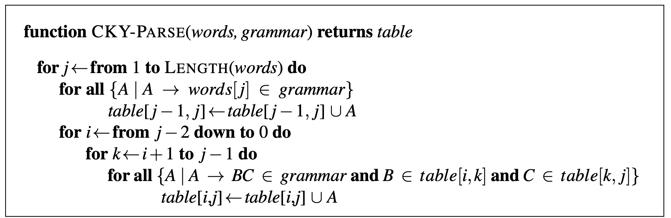
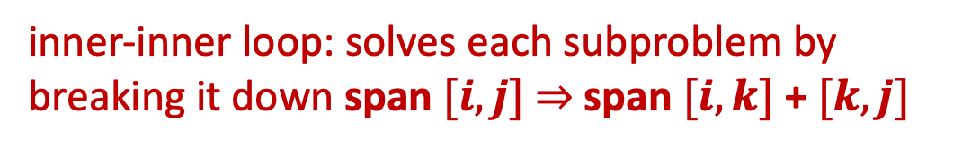

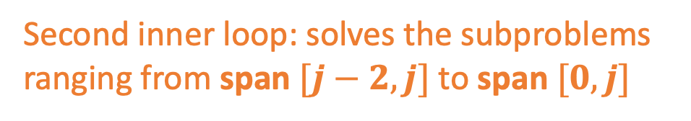
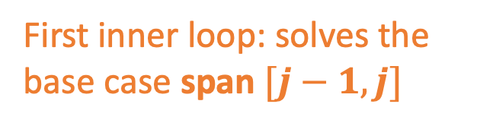
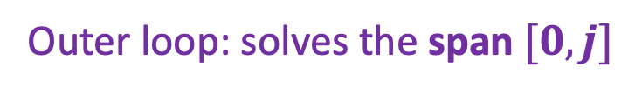

CKY Algorithm
Outer loop: solves the span $[0,j]$
First inner loop: solves the base case span $[j−1,j]$
$$j$$
0
1
2
3
$$i$$
0
Fig. CKY Algorithm. Ch 17, pp 14, SLP3
Second inner loop: solves the subproblems
ranging from span $[j−2,j]$ to span $[0,j]$
1
2
inner-inner loop: solves each subproblem by breaking it down span $[i,j]$ ⇒ span $[i,k]$ + $[k,j]$
3

Slide 34
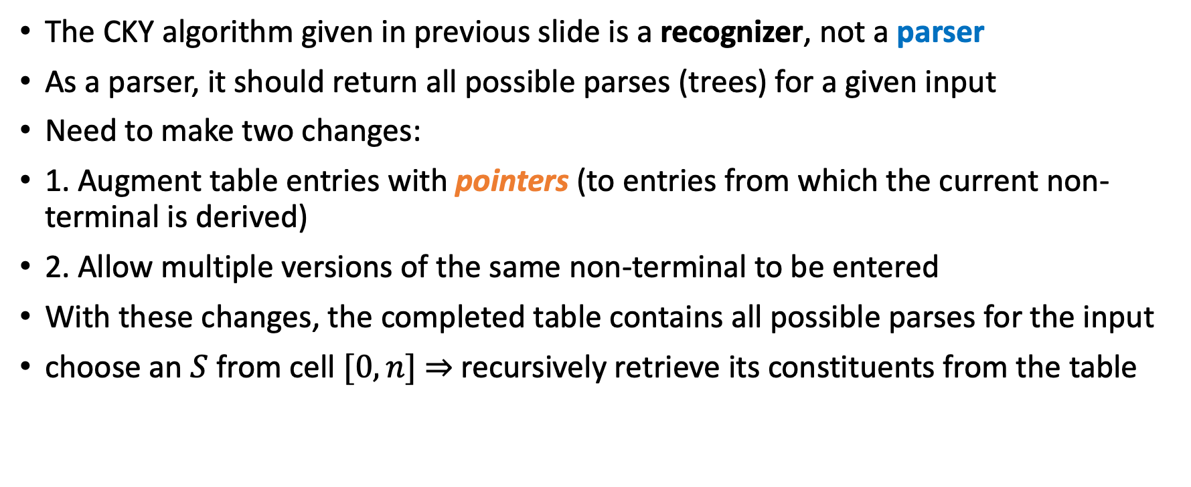
CKY Parsing
The CKY algorithm given in previous slide is a recognizer, not a parser
As a parser, it should return all possible parses (trees) for a given input
Need to make two changes:
1. Augment table entries with pointers (to entries from which the current non-terminal is derived)
2. Allow multiple versions of the same non-terminal to be entered
With these changes, the completed table contains all possible parses for the input
choose an $S$ from cell $[0,n]$ ⇒ recursively retrieve its constituents from the table

Slide 35
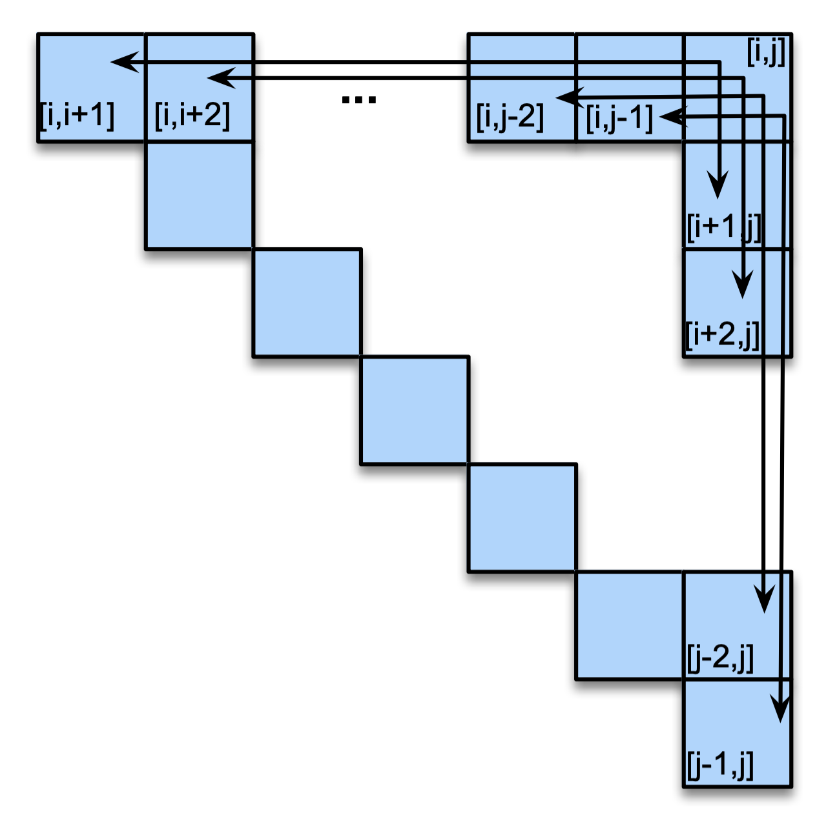
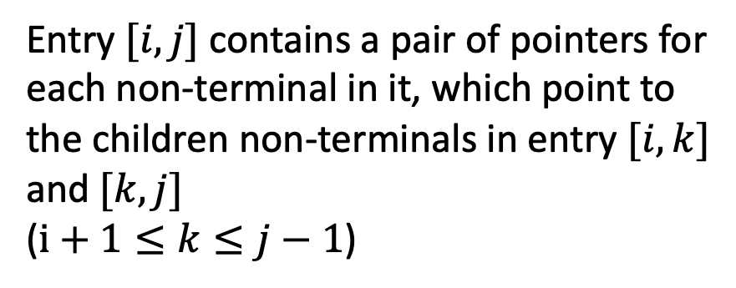
CKY Parsing - Add pointers
Entry $[i,j]$ contains a pair of pointers for each non-terminal in it, which point to the children non-terminals in entry $[i,k]$ and $[k,j]$
($i+1≤k≤j−1$)
Fig. 17.13., Ch 17, pp 15, SLP3

Slide 36
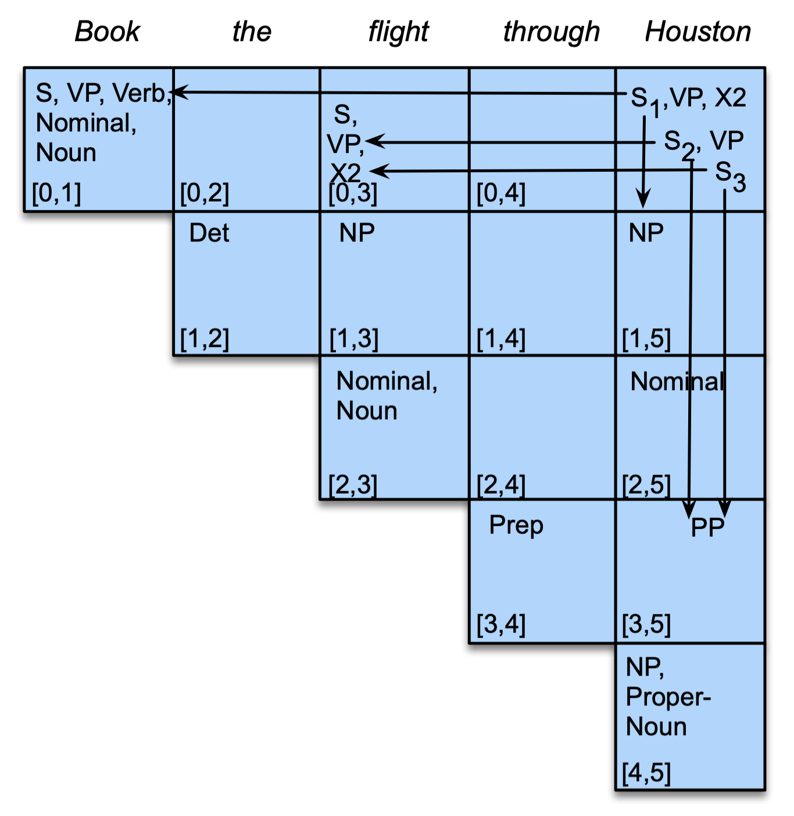

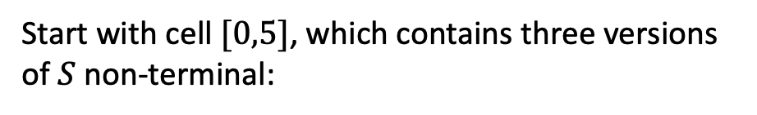





CKY Parsing - Multiple versions for same non-terminal
Start with cell $[0,5]$, which contains three versions of $S$ non-terminal:
$$S_{1}→Verb NP$$
Follow the pointers recursively to build the parse tree
$$S_{2}→VP PP$$
$$S_{3}→X2 PP$$
$$S$$
$$Verb$$
$$NP$$
Book
Fig. 17.14., Ch 17, pp 16, SLP3

Slide 37
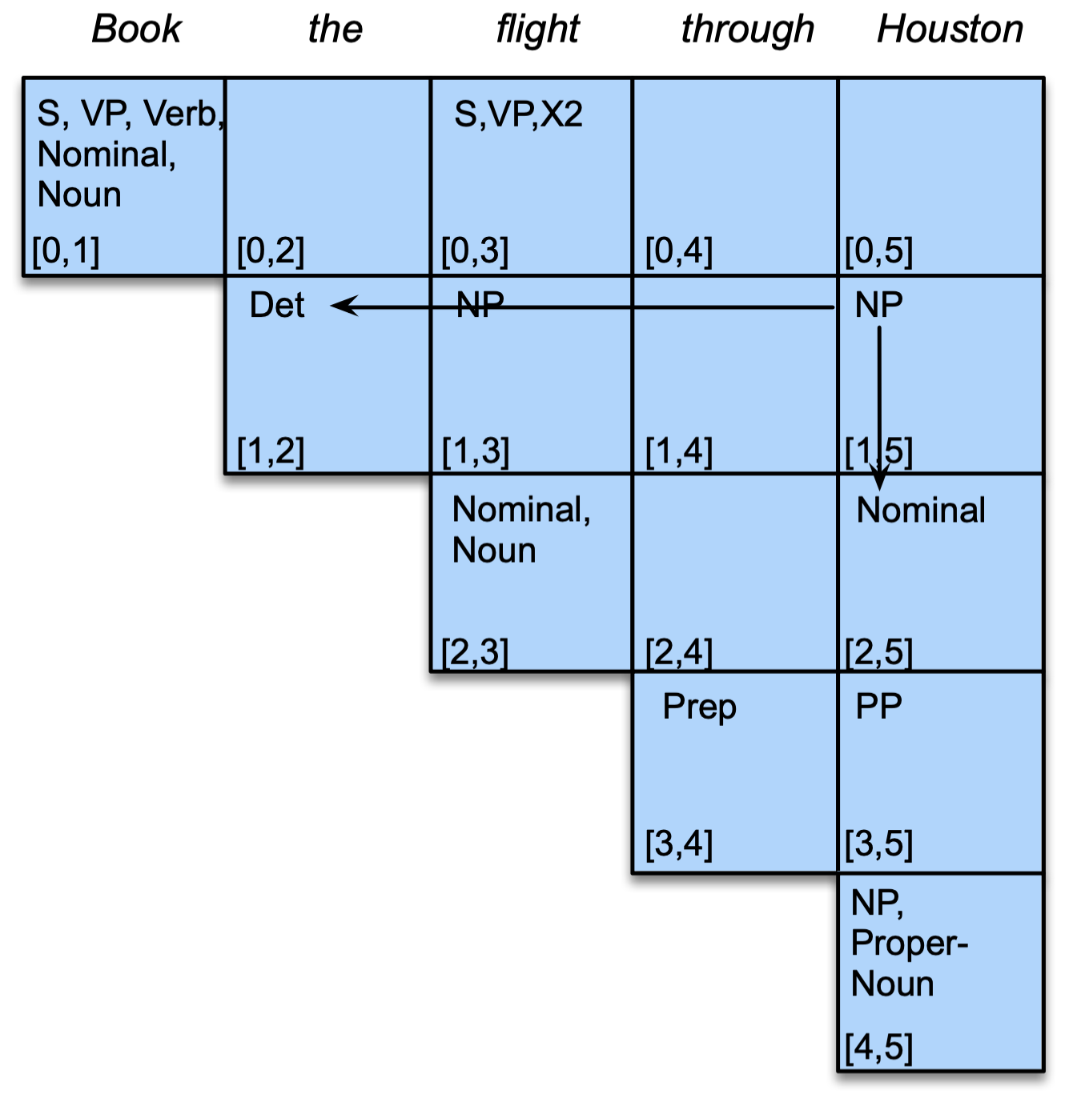







CKY Parsing - Build the parse tree recursively
Go to cell $[1,5]$
$$NP→Det Nominal$$
$$S$$
$$Verb$$
$$NP$$
Book
$$Det$$
$$Nominal$$
the
Fig. 17.14., Ch 17, pp 16, SLP3

Slide 38
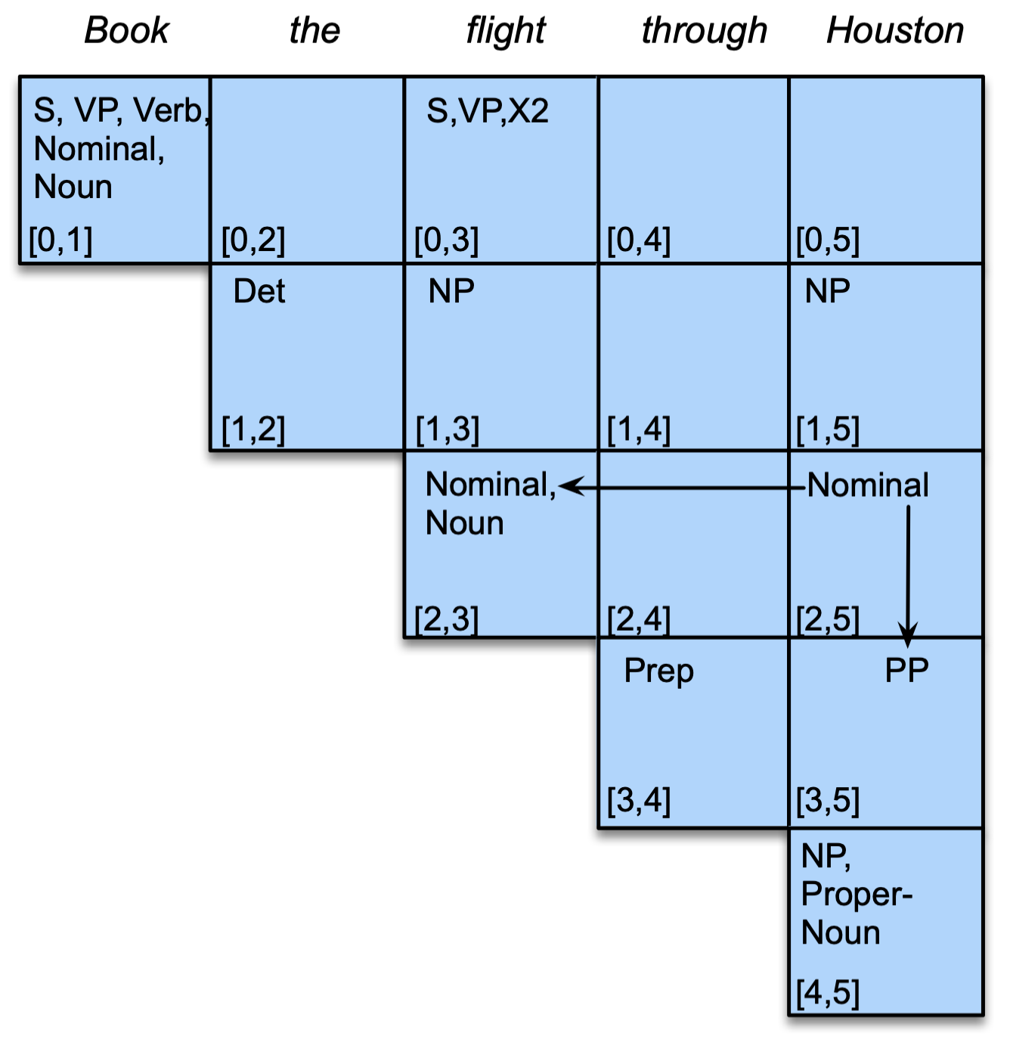









CKY Parsing - Build the parse tree recursively
Go to cell $[2,5]$
$$Nominal→Nominal PP$$
$$S$$
$$Verb$$
$$NP$$
Book
$$Det$$
$$Nominal$$
the
$$Nominal$$
$$PP$$
Fig. 17.14., Ch 17, pp 16, SLP3
flight

Slide 39
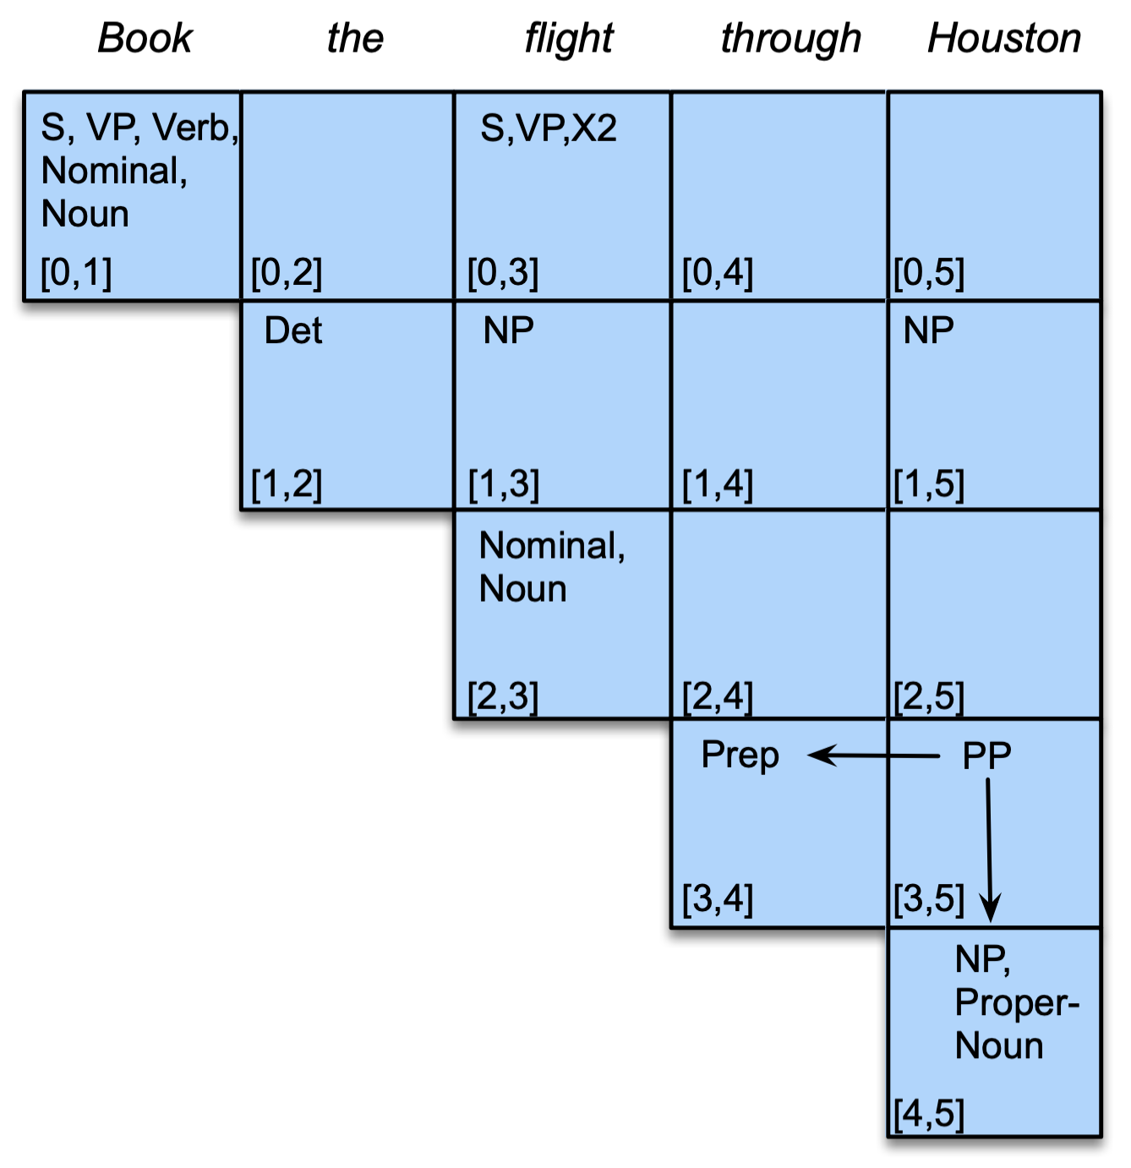











CKY Parsing - Build the parse tree recursively
Go to cell $[3,5]$
$$S$$
$$PP→Prep NP$$
$$Verb$$
$$NP$$
Book
$$Det$$
$$Nominal$$
the
$$Nominal$$
$$PP$$
flight
$$Prep$$
$$NP$$
Fig. 17.14., Ch 17, pp 16, SLP3
through
Houston

Slide 40












Basic CKY Parsing’s Problem
$$S_{1}$$
It doesn’t tell which parse tree is the correct one!
$$Verb$$
$$NP$$
Book
$$S_{1}→Verb NP$$
$$S_{2}$$
$$VP$$
$$NP$$
$$S_{2}→VP PP$$
$$S_{3}→X2 PP$$
$$S_{3}$$
$$X2$$
$$NP$$
Fig. 17.14., Ch 17, pp 16, SLP3

Slide 41
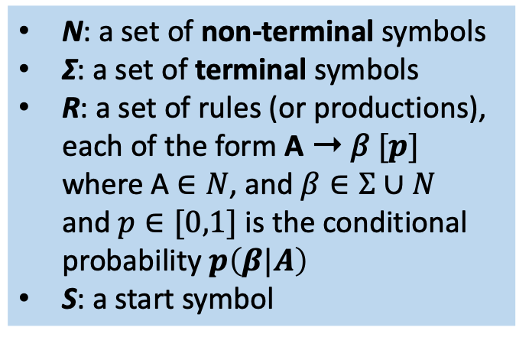
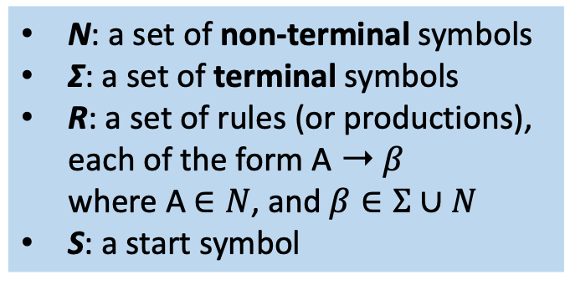

Pre-Neural Solutions
Augment CFG to Probabilistic Context-Free Grammar (PCFG)
CFG
PCFG
N: a set of non-terminal symbols
Σ: a set of terminal symbols
R: a set of rules (or productions), each of the form A ➝ 𝛽
where A $∈N$, and $β∈Σ∪N$
S: a start symbol
N: a set of non-terminal symbols
Σ: a set of terminal symbols
R: a set of rules (or productions), each of the form A ➝ 𝛽 $[p]$
where A $∈N$, and $β∈Σ∪N$
and $p∈[0,1]$ is the conditional probability $p\left(β|A\right)$
S: a start symbol
Consider all possible expansions of a non-terminal, then
$$\sum_{β}{p\left(A→β\right)}=1$$

Slide 42


PCFG Example
A PCFG version to the grammar $ℒ_{1}$
Probabilities are estimated based on a corpus
These numbers are for pedagogical purposes
Any real corpus would have more rules and the real probabilities will be much smaller

Slide 43



Use PCFG for disambiguating parsing results
The probability of a particular parse tree $T$ is defined as the product of probabilities of all the $n$ rules to expand each of the $n$ non-terminals
Consider all possible parse trees of a sentence $S$, we need to pick the tree with the highest probability
$$p\left(T\right)=\prod_{i=1}^{n}{p\left(A_{i}→β_{i}\right)}$$
$$\hat{T}\left(S\right)=\arg{\max_{T}{p\left(T\right)}}$$

Slide 44






PCFG Usage Example
“Book a flight that serves dinner”
Sentence: Book the dinner flight
two senses:
“Book a flight on behalf of ‘the dinner’”
Compute using the probabilities of PCFG $ℒ_{0}$:
$$P(T_{left}) = .05∗.20∗.20∗.20∗.75∗.30∗.60∗.10∗.40 = 2.2×{10}^{−6}$$
👍
$$P(T_{right}) =.05∗.10∗.20∗.15∗.75∗.75∗.30∗.60∗.10∗.40 = 6.1×{10}^{−7}$$

Slide 45
Overview
Context Free Grammars (CFG)
Constituency Parsing
Neural Constituency Parsing

Slide 46
Neural Constituency Parsing
消除歧义
A neural extension of CKY algorithm to disambiguate among possible parses
Span-based constituency parsing, or neural CKY
Idea:
Like classic CKY: learns to map a span of words to a constituent, and hierarchically combines larger and larger spans to build the parse-tree bottom-up
Unlike classic CKY: doesn’t use hand-written grammar to constrain what constituents can be combined;
Instead, just relying on learned neural representations of spans to predict likely combinations ⇒ probabilities
Ex. Kitaev et al. (2019)

Slide 47







Neural CKY Architecture
Consider the span that lies between positions $i$ and $j$ with non-terminal label $l$
Assign a score $s(i,j,l)$ to this span
How to compute this score? Need to represent the spans with embedding vectors
First, obtain word vectors $y^{\left\langle t\right\rangle }$ from the encoder (i.e., hidden state from LSTM, or last layer of Transformer)
$$y^{\left\langle t\right\rangle }$$
Then, split $y^{\left\langle t\right\rangle }$ into two halves:
${\vec{y}}^{\left\langle t\right\rangle }$ for spans starting from this position
${\overset{⃖}{y}}^{\left\langle t\right\rangle }$ for spans ending from this position
Encoder
Encoder (RNN | LSTM | BERT | …)
$$e^{\left\langle t\right\rangle }$$
0
1
2
3
4
5
Fig. 17.15., Ch 17, pp 17, SLP3
Based on the architecture from Kitaev et al. (2019)

Slide 48


Represent spans with embedding vectors
A span can be represented by taking the difference between its start and end embeddings (Wang and Chang, 2016)
span $[i,j]$ represented by: $v\left(i,j\right)=\left[{\vec{y}}^{\left\langle j\right\rangle }−{\vec{y}}^{\left\langle i\right\rangle };{\overset{⃖}{y}}^{\left\langle j+1\right\rangle }−{\overset{⃖}{y}}^{\left\langle i+1\right\rangle }\right]$
Then the span vector is passed through a classifier (e.g., MLP), whose output size is the vocabulary size of non-terminal labels
span [1, 3]
$$s\left(i,j,l\right)=W_{2}ReLU\left(LayerNorm\left(W_{1}v(i,j))\right)\right)$$
ref: Kitaev et al. (2019)

Slide 49



Use Span Scores for Parsing
Now we have a score for each labeled span $s\left(i,j,l\right)$. How about a score for an entire parse tree?
Formally, a parse tree is a set of labeled spans, where
the $t$th span starting at position $i^{\left\langle t\right\rangle }$ and ending at $j^{\left\langle t\right\rangle }$, with label $l^{\left\langle t\right\rangle }$:
Compute a score for the whole tree by summing over the scores of its constituent spans:
$$T=\left\{\left(i^{\left\langle t\right\rangle },j^{\left\langle t\right\rangle },l^{\left\langle t\right\rangle }\right)\right\},t=1,…,\left|T\right|$$
$$s\left(T\right)=\sum_{\left(i,j,l\right)∈T}{s\left(i,j,l\right)}$$

Slide 50

Use Span Scores for Parsing
We can choose the final parse tree as the one with the maximum score:
Simplest method ⇒ greedy decoding: choose the highest scoring label for each span
Drawback: not guaranteed to produce a tree, since the best scored label might not fit into a complete tree
In practice, 95% of predicted trees from greedy decoding are valid (Gaddy et al., 2018)
$$\hat{T}=\arg{\max_{T}{s\left(T\right)}}$$

Slide 51


Use Span Scores for Parsing
It is more common to use a variant CKY algorithm to find the parse tree, defined as follow:
Let $s_{best}\left(i,j\right)$ be the score of the best subtree spanning $[i,j]$
If $j=i+1$, i.e., spans of length one, simply choose the best label
Other wise, use the recursion:
$$s_{best}\left(i,j\right)=\max_{l}{s(i,j,l)}$$
$$s_{best}\left(i,j\right)=\max_{l}{s(i,j,l)}+\max_{k}\left(s_{best}\left(i,k\right)+s_{best}\left(k,j\right)\right)$$

Slide 52


Actually, a much earlier neural parsing solution
Maybe the very first one: Grammar as a Foreign Language. 2015. NIPS
Author list: Oriol Vinyals, Lukasz Kaiser, …, Ilya Sutskever, Geoffrey Hinton
LSTM + Attention
Input: the reversed syntactic tree
Output: the correct tree
(where the title is from)

Slide 53



Evaluating Parsers
PARSEVAL metrics (Black et al., 1991): measures how much the constituents in the hypothesis (predicted) parse tree look like the those in a hand-labeled, reference parse
Need a “golden standard” (human labeled) tree for each sentence in test set (usually drawn from Penn Treebank)
A constituent in a hypothesis parse $C_{h}$ is labeled correct
if there is a constituent in the reference parse $C_{r}$ with the same starting point $i$, ending point $j$, and non-terminal label.
Then can define precision and recall:
$$precision=\frac{\# of correct constituents in C_{h}}{\# of total consitituents in C_{h}}$$
$$recall=\frac{\# of correct constituents in C_{h}}{\# of total consitituents in C_{r}}$$

Slide 54


LLMs can do Constituency Parsing
Results from DeepSeek v3 (2025.3)

Slide 55

LLMs can do Constituency Parsing
Results from DeepSeek v3 (2025.3)

Slide 56


Universals in human languages
What a co-incidence!

Slide 57

Constituency Parsing with LLMs
Induce constituency parse trees relying only on the internal knowledge of pre-trained language models.
Competitive with common unsupervised parsers; more effective than typical supervised parsers in few-shot settings. (Kim 2022)
Figure from Taeuk Kim (2022) Revisiting the Practical Effectiveness of Constituency Parse Extraction from Pre-trained Language Models

Slide 58
References
Chomsky, N. 1956. Three models for the description of language. IRE Transactions on Information Theory, 2(3):113–124.
Backus, J. W. 1959. The syntax and semantics of the proposed international algebraic language of the Zurich ACM-GAMM Conference. Information Processing: Pro- ceedings of the International Conference on Information Processing, Paris. UNESCO.
Naur, P., J. W. Backus, et al. 1960. Report on the algorithmic language ALGOL 60. CACM, 3(5):299–314. Revised in CACM 6:1, 1-17, 1963.
Younger, D. H. 1967. Recognition and parsing of context-free languages in time n³. Information and Control, 10:189–208.
Kasami, T. 1965. An efficient recognition and syntax analysis algorithm for context-free languages. Technical Report AFCRL-65-758, Air Force Cambridge Research Laboratory, Bedford, MA.
Kay, M. 1967. Experiments with a powerful parser. COLING.
Vinyals, O., Ł. Kaiser, T. Koo, S. Petrov, I. Sutskever, and G. Hinton. 2015. Grammar as a foreign language. NeurIPS.
Kitaev, N., S. Cao, and D. Klein. 2019. Multilingual constituency parsing with self-attention and pre-training. ACL.
Wang, W. and B. Chang. 2016. Graph-based dependency parsing with bidirectional LSTM. ACL.
Black, E., et al. 1991. A procedure for quantitatively comparing the syntactic coverage of English grammars. Speech and Natural Language Workshop.
Kim, T. 2022. Revisiting the Practical Effectiveness of Constituency Parse Extraction from Pre-trained Language Models. ACL.

