Slide 1
On the Interplay Between Fine-tuning and Sentence-level Probing for Linguistic Knowledge in Pre-trained Transformers EMNLP 2020
Lao Leyi
South University of Science and Technology
Oct 25, 2024

Slide 2

Motivation
BERT, RoBERTa, and ALBERT perform well in various NLP tasks.
It is still unclear how the representations of a pre-trained model change when fine-tuning on a downstream task.
Further, little is known about whether and to what extent this process adds or removes linguistic knowledge from a pre-trained model.

Slide 3
Methods
Probing
Investigating the following questions:
How and where does fine-tuning affect the representations of a pre-trained model?
To which extent (if at all) can changes in probing accuracy be attributed to a change in linguistic knowledge encoded by the model.
Baseline
BERT
fine-tuning
BERT
Fine-tuned BERT
CLS pooling/
mean pooling
CLS pooling/
mean pooling
Probing
Probing

Slide 4
Methods
Pre-trained Models
BERT
RoBERTa
ALBERT
Fine-tuning tasks (Sentence-level )
GLUE benchmark
CoLA (The Corpus of Linguistic Acceptability, focusing on syntactic )
SST-2 (Stanford Sentiment Treebank, focusing on semantic and/or discourse)
RTE (Recognizing Textual Entailment, focusing on discourse)
SQuAD (Stanford Questions Answering Dataset, focusing on discourse)

Slide 5
Methods
Probing tasks (Sentence-level )
bigram-shift (Syntactic Task)
Testing a model’s sensitivity to word order.
semantic-odd-man-out (Semantic Task)
Testing a model’s sensitivity to semantic incongruity
coordination-inversion (Discourse Task)
Testing for a model’s broader discourse understanding.
Pooling
CLS-Pooling
mean-pooling

Slide 6
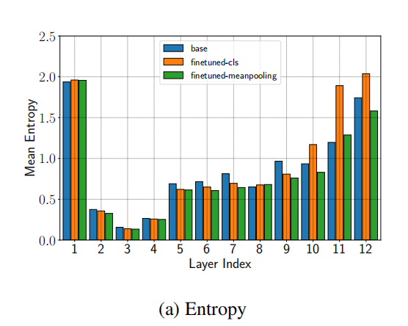
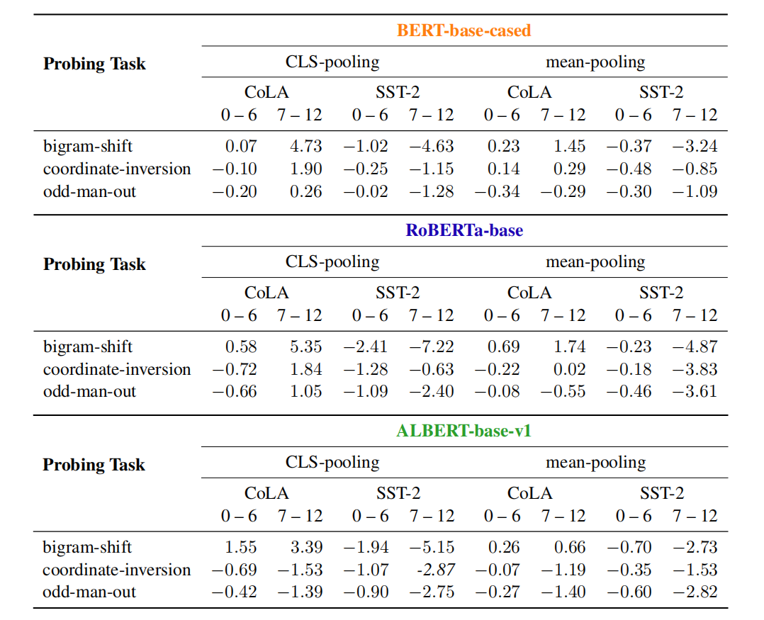
Experiment
The CLS token learns to take more sentence-level information into account.
The improvement in probing accuracy can not simply be attributed to the encoding of linguistic knowledge.

Slide 7
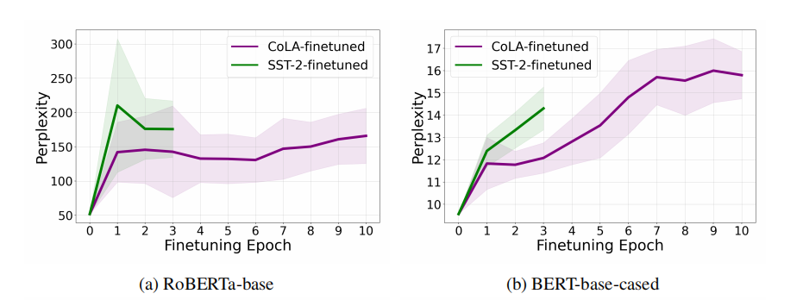
Experiment
The pretrained masked language model heads are evaluated on the Wikitext-2 test set and compare it to the masked-language modeling perplexity of fine-tuned models.
Finetuning on SST-2 has indeed more dramatic effects on the representations of both models compared to fine-tuning on CoLA.

Slide 8
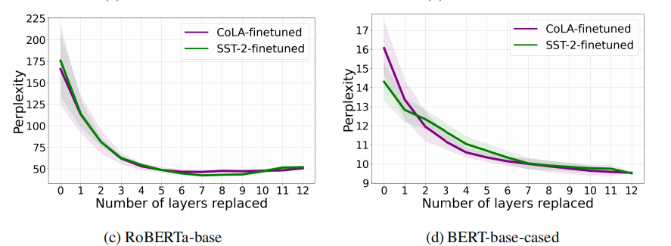
Experiment
Test which layers contribute the most to the change in perplexity and replace the layers of the fine-tuned encoder with pre-trained layers, starting with the last layer.
Finding that the changes that lead to an increase in perplexity happen in the last layers.
Fine-tuning indeed does affect the representations of a pre-trained model and in particular those of the last hidden layers.

Slide 9
Investigating the Representation Learning of Interjections in Fined-tuned Language Models
Lao Leyi
South University of Science and Technology
Oct 25, 2024

Slide 10
Motivation
Interjections (e.g., uh, mmhmm) are important signals in conversation.
Can Language model such as GPT-2 and Llama3 properly learn the representation of interjections through fine-tuning;
Does the representation of the interjection show similarity across the three chosen language from the selected dialogue datasets
Which fine-tuning task can best foster representation learning for interjections?

Slide 11
Methods
In order to verify how interjections are properly represented in the language model, we will focus on using fine-tuning task instead.
Pre-trained Models
BERT
GPT-2
Llama3
Language
Japanese
English
German

Slide 12
Methods
Fine-tuning tasks
next-token prediction (baseline)
dialogue-act prediction
turn-taking prediction

Slide 13
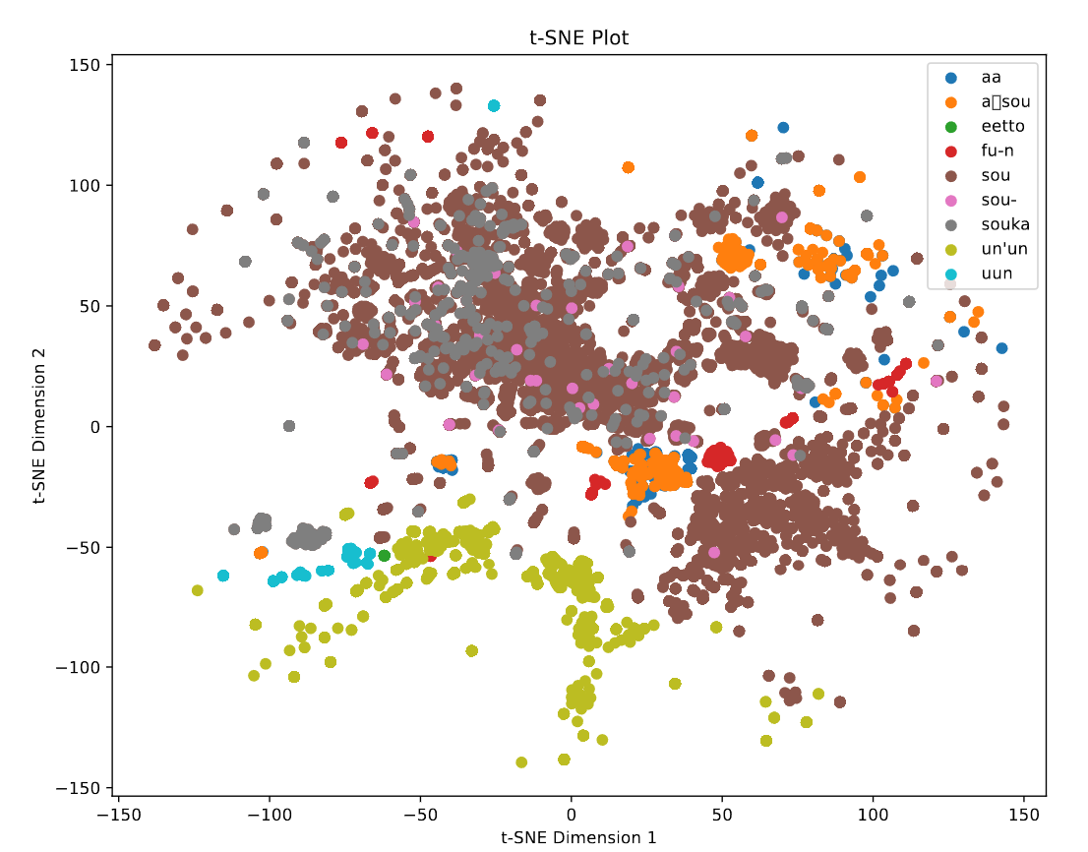
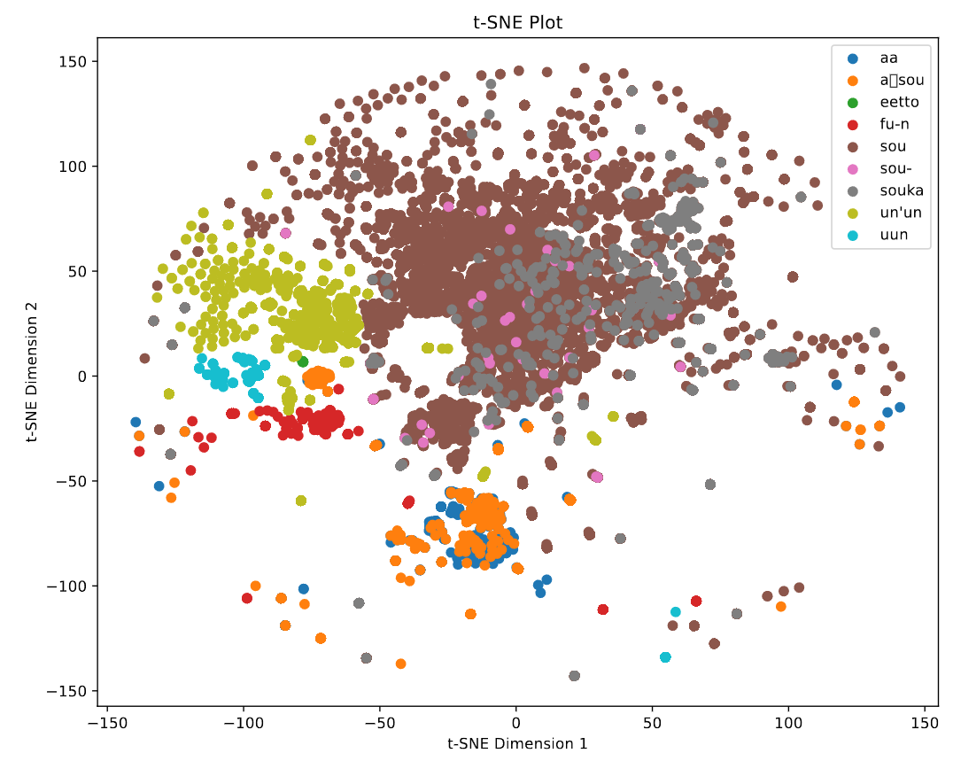
Experiment
GPT-2_next-token prediction

Slide 14
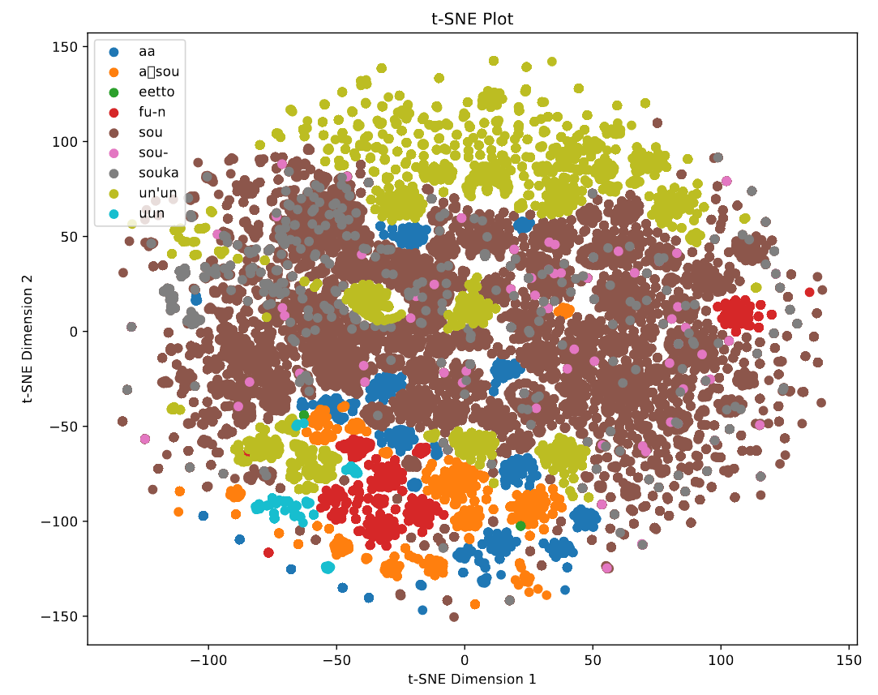
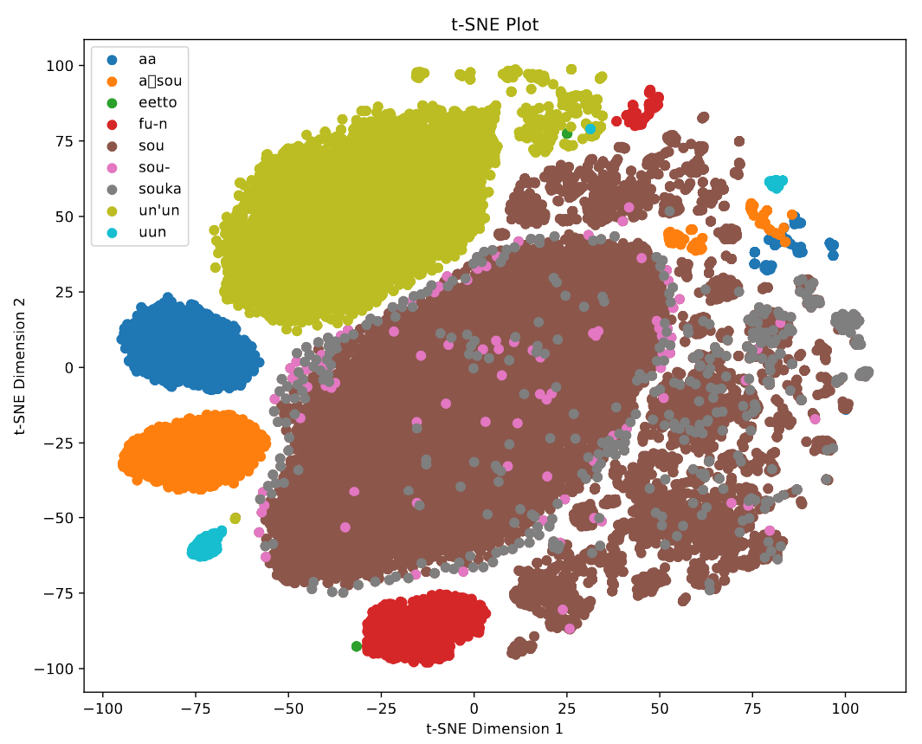
Experiment
Llama3_next-token prediction

Slide 15

Thank You

