Slide 1
Uncertainty Quantification for Large Language Models
安浩 2024-9-20

Slide 2
Outline
Sample-based Uncertainty Quantification
Sample-free Uncertainty Quantification

Slide 3
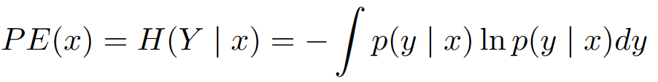

Uncertainty Quantification
To what extent should we trust LLM‘s answers?
Depends on uncertainty.
How to quantify uncertainty? Some intuitive and simple Methods:
Predictive entropy
Length-normalised predictive entropy.
P(true): ‘asking’ the model if its answer is correct.
Lexical similarity: , sim is Rouge-L

Slide 4
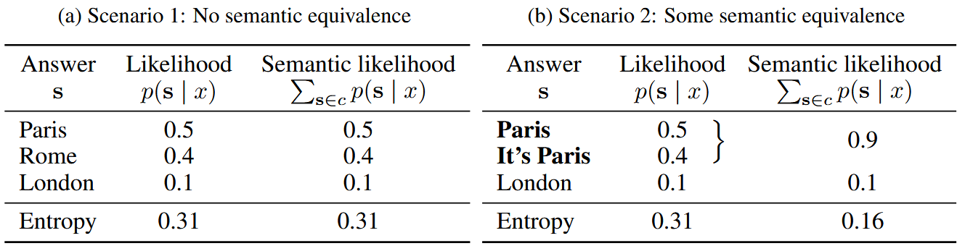
Semantic Entropy
Main idea
When considering entropy, different answers that mean the same thing should be considered in the same cluster.
Example: What is the capital of France?

Slide 5

Semantic Entropy
Method
Generation: Sample M answers from the LLM given a context x.
Clustering: Cluster the answers that mean the same thing using a bi-directional entailment algorithm.
Entropy estimation: Approximate semantic entropy by summing probabilities that share a meaning and compute entropy.

Slide 6
Semantic Entropy
Natural Language Inference (NLI)
NLI determines the logical relationship between a pair of text sequences.
Entailment: the hypothesis can be inferred from the premise.
Contradiction: the negation of the hypothesis can be inferred from the premise.
Neutral: all the other cases.
Clustering based on bi-directional entailment
Using Deberta-large model fine-tuned on NLI and MNLI dataset.
Returns equivalent if and only if both directions were entailment.
The capital of France is Paris. Paris is the capital of France.

Slide 7
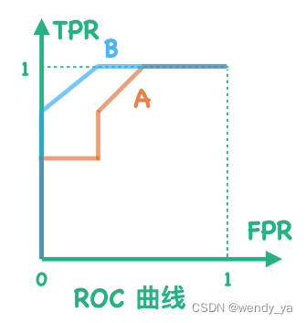
Semantic Entropy
Evaluation
Very uncertain generations should be less likely to be correct
Metric: AUROC between -uncertainty score and Y-true.
Higher scores are better.
Y-true = 1 if the most likely answer is correct; otherwise, it is 0.
AUROC=1：Perfect classifier.
0.5 < AUROC < 1: Better than random guessing.
AUROC=0.5：Random guessing.

Slide 8
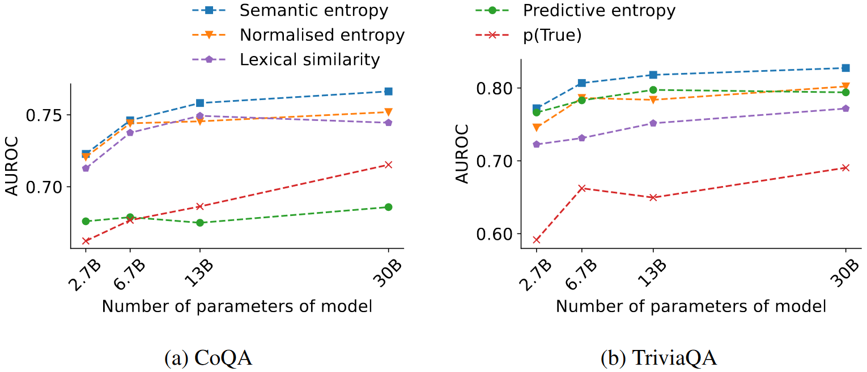
Semantic Entropy
Main Results
c

Slide 9
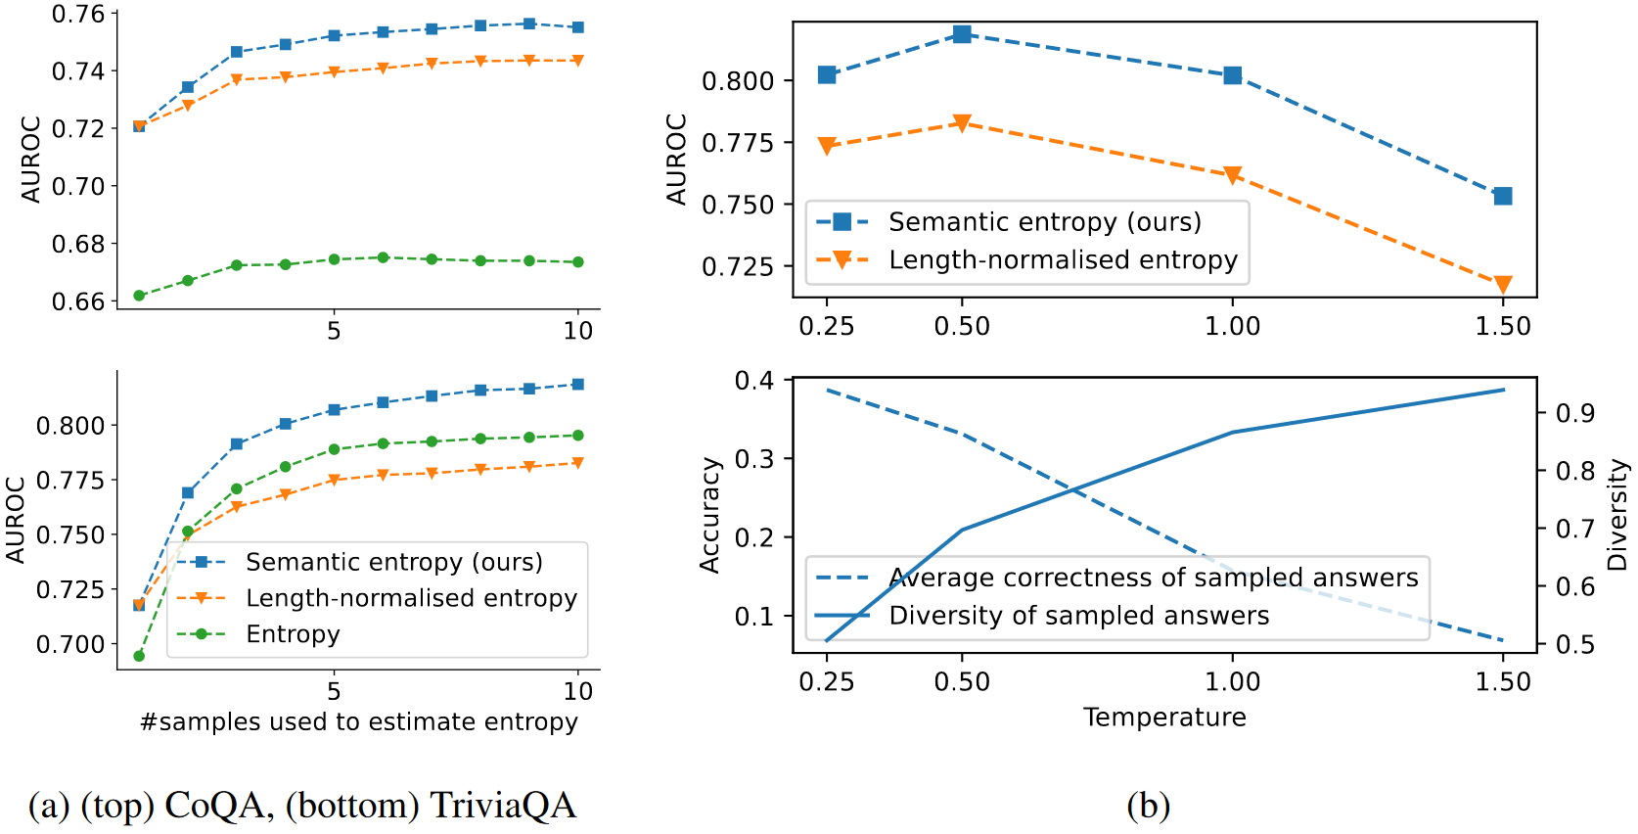
Semantic Entropy
Results on sample number and temperature
Notes:
(a) Semantic entropy makes better use of additional samples because it handles duplication better, the performance gap therefore continues to improve.
(b) (bottom) Higher temperatures result in more diversity but less accurate generations.
(top) The best-performing uncertainty comes from an intermediate temperature that balances these two forces.

Slide 10
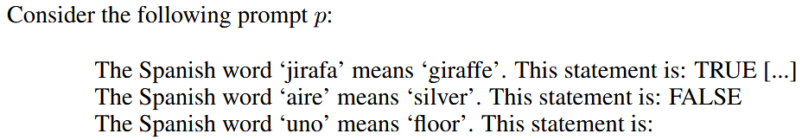
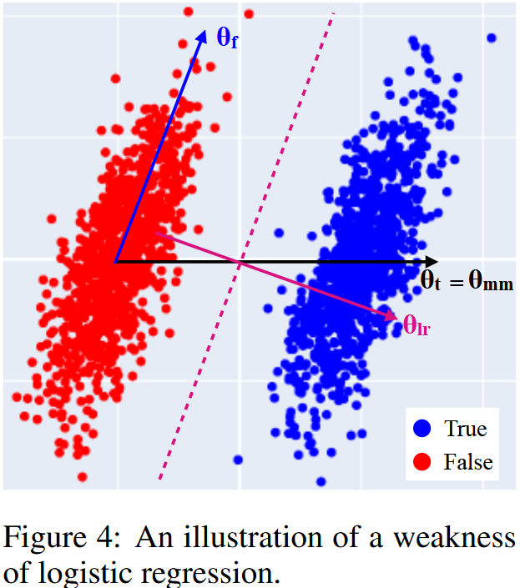
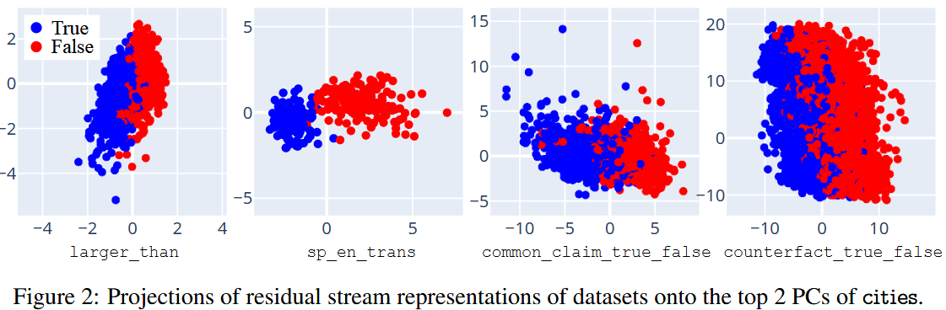
Mass Mean Probe
Linear Probe
The truth concept of simple text is linear direction in hidden pace

Slide 11
Semantic Entropy Probe
Semantic Entropy requires sampling multiple answers
Sample-free method: Semantic Entropy Probe (SEP)
Training data
X: Hidden state
Y: Semantic entropy is high or low (binarized semantic entropy)
Model: logistic regression
Probing locations of hidden state:
The last token before generating (TBG)
The last token of the model response ——second last token (SLT)
Notes:
we ultimately want to use our probes for predicting binary model correctness, so we eventually need to construct a binary classifier regardless
And it’s for compared to accuracy probe

Slide 12
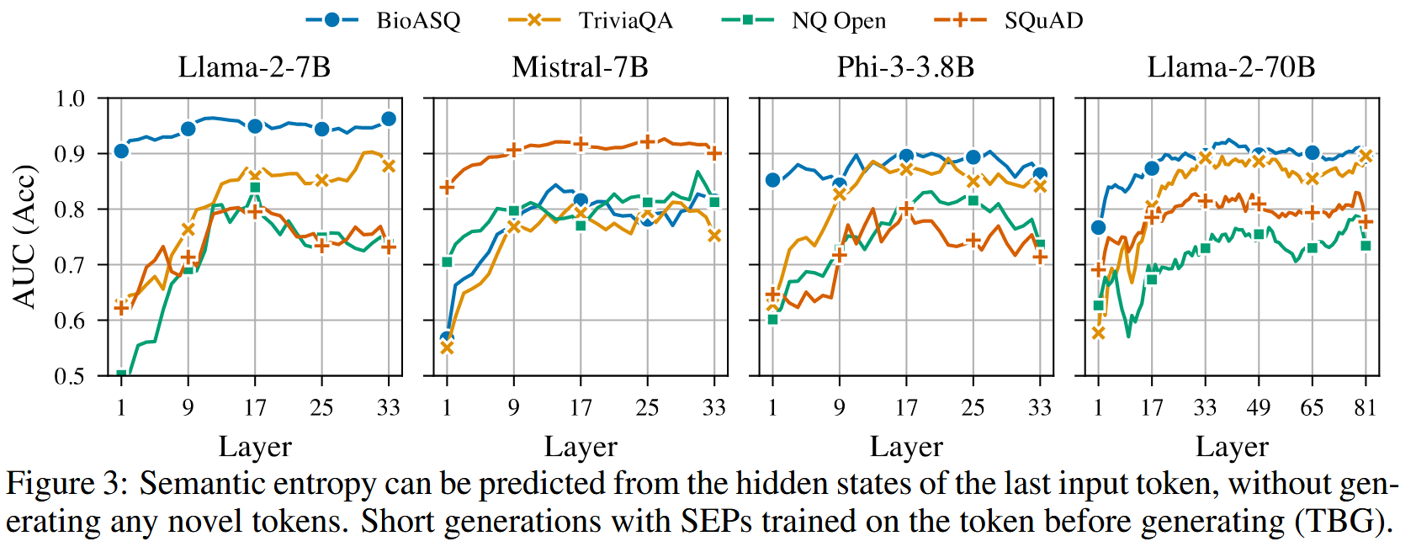
Semantic Entropy Probe
Predicting Semantic Entropy without Generation

Slide 13
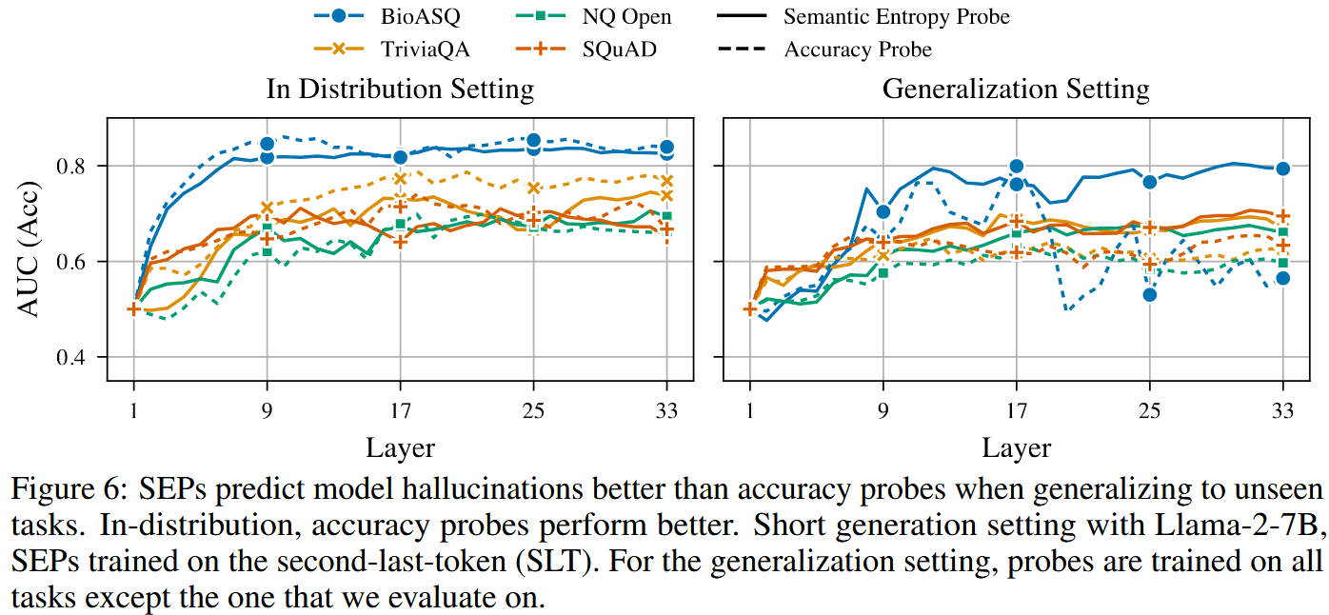
Semantic Entropy Probe
Predicting Hallucination on Unseen Task
Notes:
Why not just use the Accuracy as training labels?
Genera

Slide 14
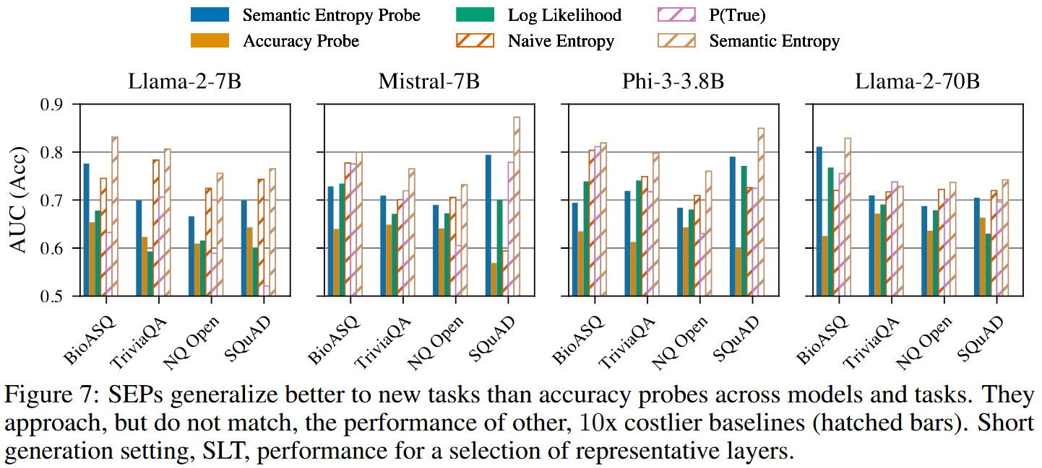
Semantic Entropy Probe
Predicting QA correctness

Slide 15
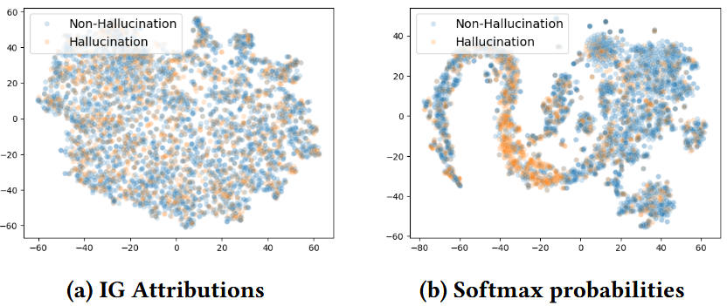
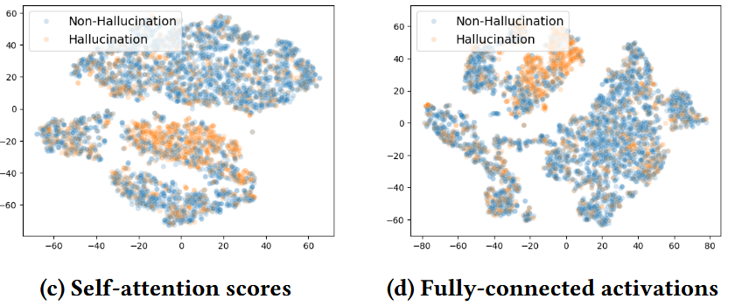
Accuracy probes
Accuracy probes
Softmax probabilities.
Feature attributions.
Self-attention.
Hidden Activations.

Slide 16
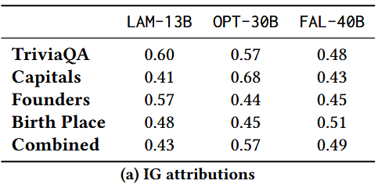
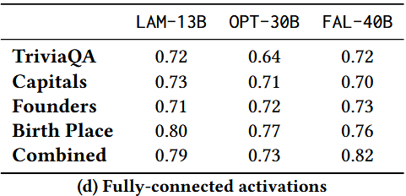
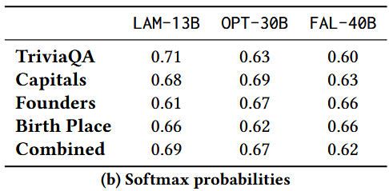
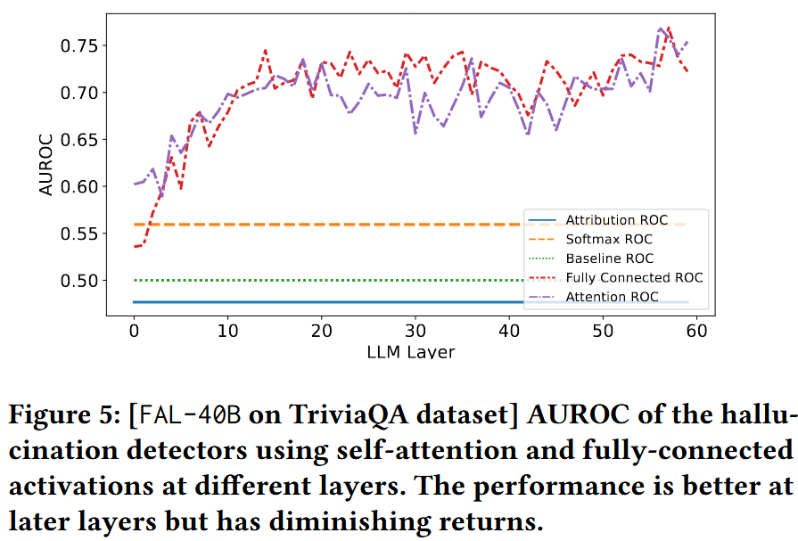
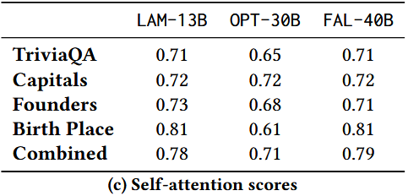

Slide 17
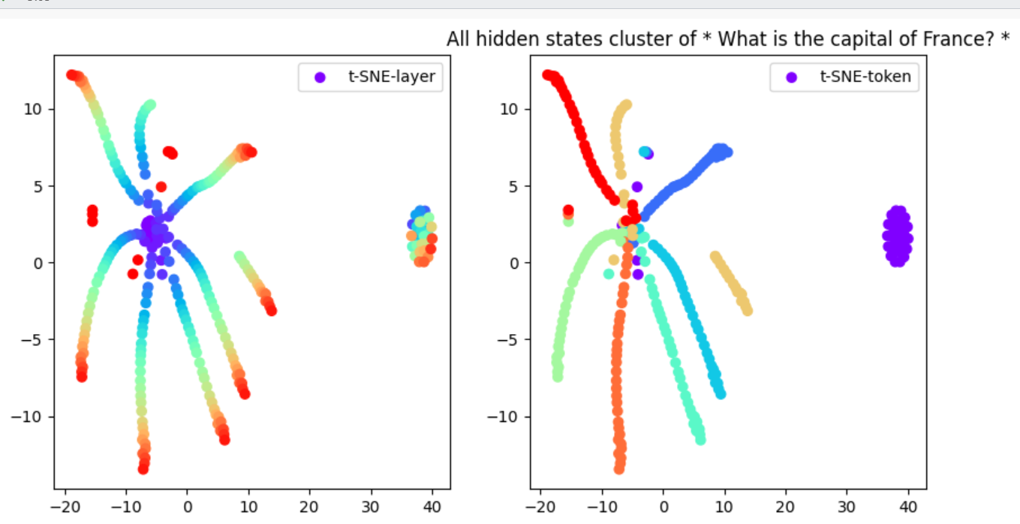
Distance as Uncertainty Score
Distance-based Metrics
Pair-wise distance
L2 and Cosine
Layer-wise distance
L2 and Cosine
Linear Assignment distance
L2 and Cosine
All of the above are round
0.5 AUROC

Slide 18
Reference
Semantic Uncertainty: Linguistic Invariances for Uncertainty Estimation in Natural Language Generation, University of Oxford, ICLR 2023
Semantic Entropy Probes: Robust and Cheap Hallucination Detection in LLMs, University of Oxford, ICML 2024 FM-Wild Workshop
On Early Detection of Hallucinations in Factual Question Answering, Amazon, KDD 2024
The Geometry of Truth: Emergent Linear Structure in Large Language Model Representations of True/False Datasets, COLM 2024, Northeastern University and MIT
Know Your Limits: A Survey of Abstention in Large Language Models, UW
Siren's Song in the AI Ocean: A Survey on Hallucination in Large Language Models
Internal Consistency and Self-Feedback in Large Language Models: A Survey

