Slide 1

SESSION 02
WORKSHOP FEBRUARY 2026 BY DR CORONA-LOPEZ
ARTIFICIAL NEURAL
NETWORKS
FACULTY OF SCIENCE AND ENGINEERING
UNIVERSITY OF MANCHESTER

Slide 2
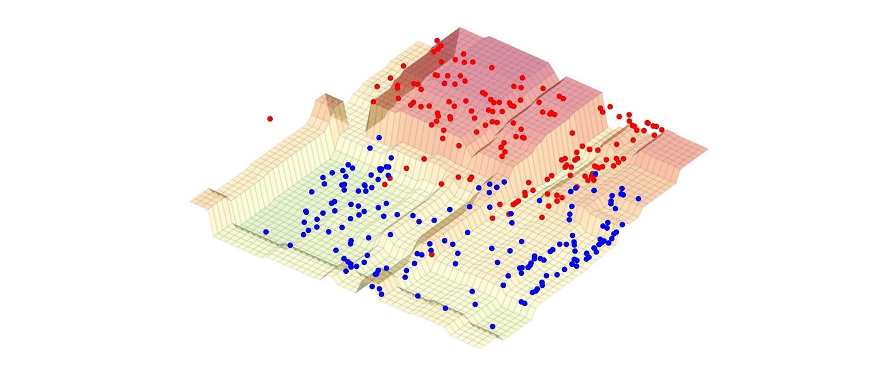
BY DR CORONA-LOPEZ
FEBRUARY 2026
AGENDA
anatomy of a neuron: linear classification and manual forward pass.
learning via gradient descent: binary cross-entropy and the pytorch standard recipe.
the non-linear wall: why lines fail (the circles dataset).
multi-layer perceptrons (mlps): combining neurons
and non-linear activations.
visualizing probability fields: solving the non-linear problem.
01

Slide 3
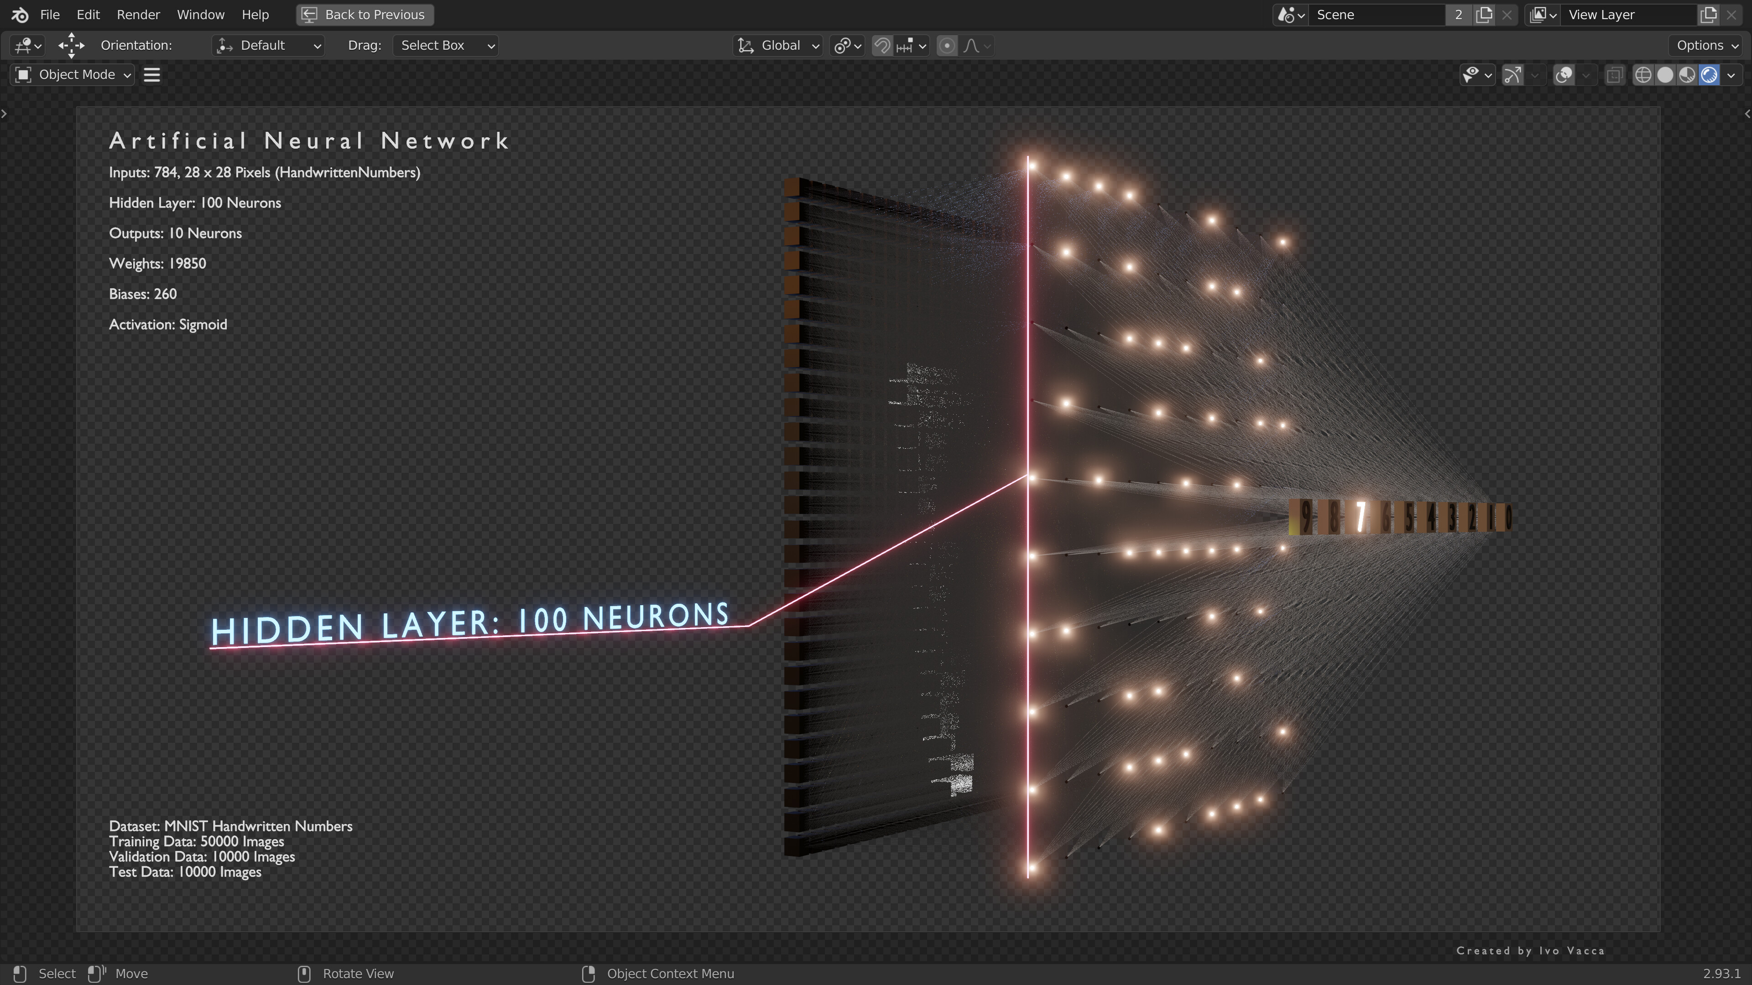
neural networks are computational models inspired by the human brain's neural structure. they consist of interconnected neurons organized in layers that transform input data into meaningful outputs. each neuron performs weighted calculations on its inputs and applies an activation function to introduce non-linearity.
02

Slide 4
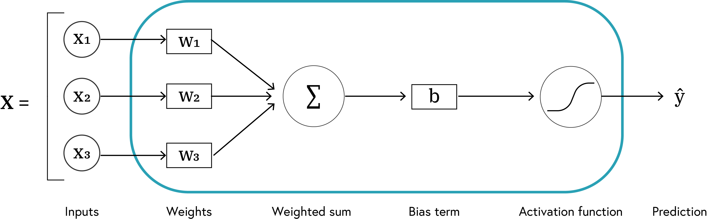

BY DR CORONA-LOPEZ
FEBRUARY 2026
NEURON
basic computational units of neural networks
each neuron:
receives inputs
applies weights and bias
processes through activation function
produces output
$$\hat{y}=f\left(W⋅X+b\right)$$
03

Slide 5
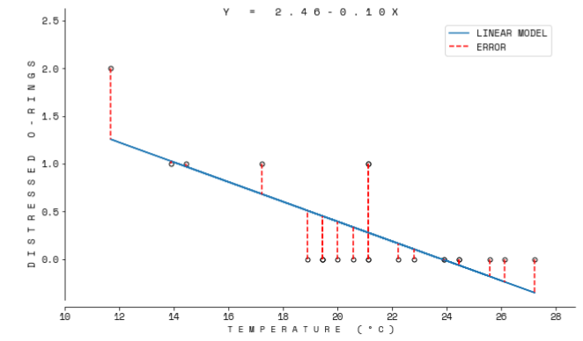

BY DR CORONA-LOPEZ
FEBRUARY 2026
TRAINING
BASICS
forward pass: feed data through network to get predictions
loss calculation: measure error between predictions and targets
backward pass: compute gradients to adjust parameters
parameter update: improve model using gradient descent
$$\hat{y}=\underset{x}{argmin}{||W x - b||_{2}}$$
04

Slide 6
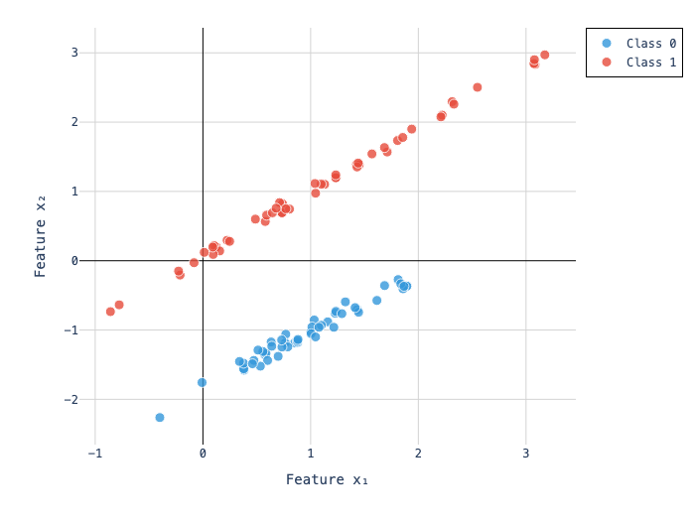
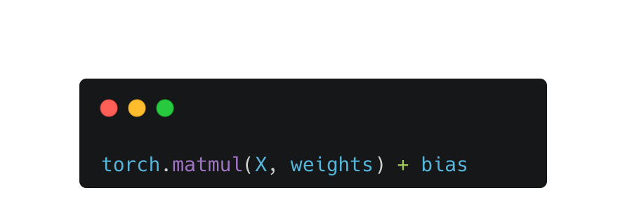
BY DR CORONA-LOPEZ
FEBRUARY 2026
FORWARD PASS
forward pass formula:
$$Z = XW^{T} + b = \text{Logits} →A = σ\left(Z\right)=y →\text{Probabilities}$$
05

Slide 7
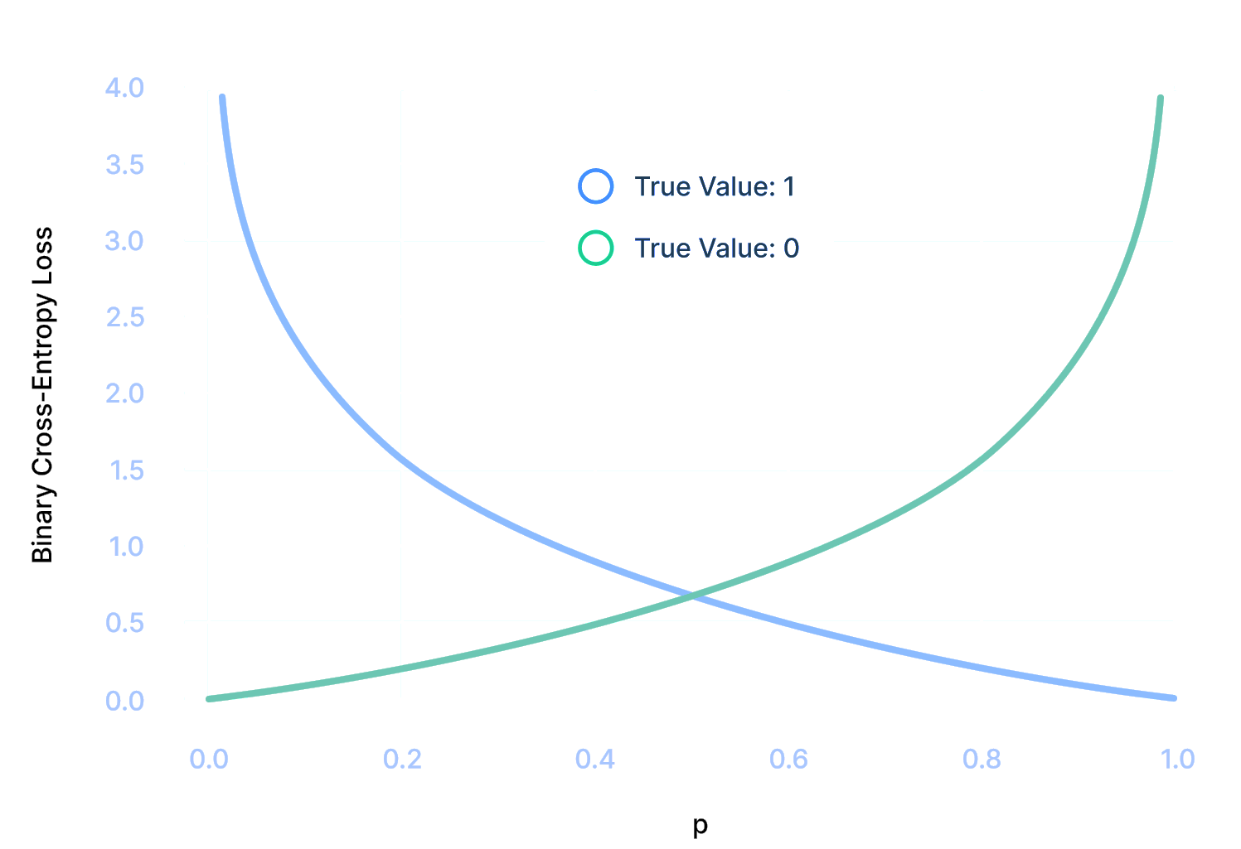
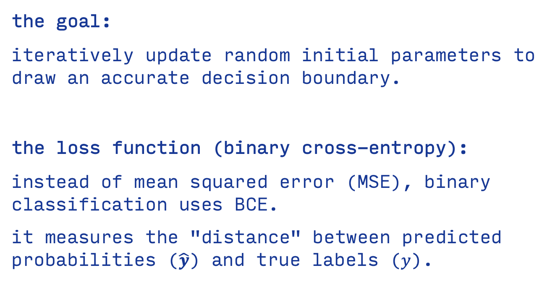
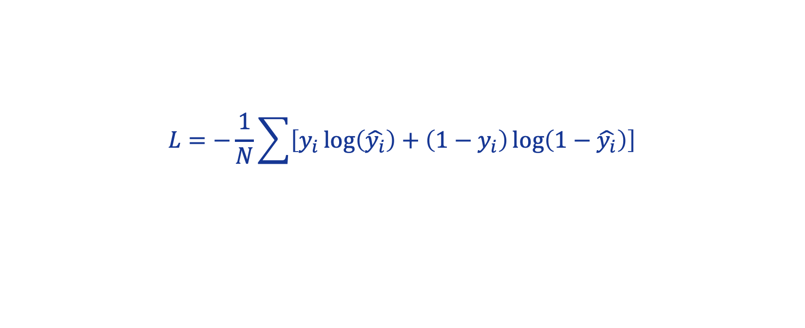
BY DR CORONA-LOPEZ
FEBRUARY 2026
LOSS FUNCTION
the goal:
iteratively update random initial parameters to draw an accurate decision boundary.
the loss function (binary cross-entropy):
instead of mean squared error (MSE), binary classification uses BCE.
it measures the "distance" between predicted probabilities ($\hat{y}$) and true labels ($y$).
$$L=−\frac{1}{N}\sum{\left[y_{i}\log\left(\hat{y_{i}}\right)+\left(1−y_{i}\right)\log\left(1−\hat{y_{i}}\right)\right]}$$
06

Slide 8
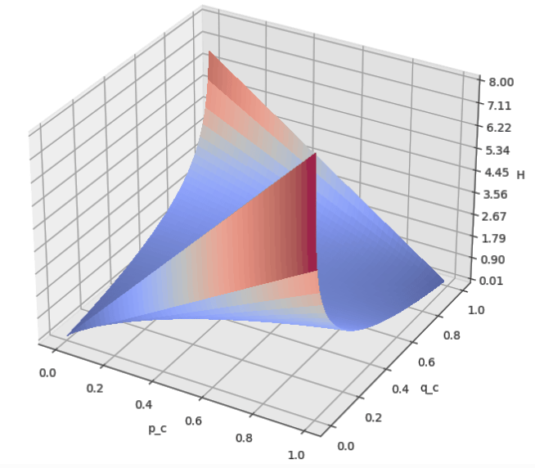
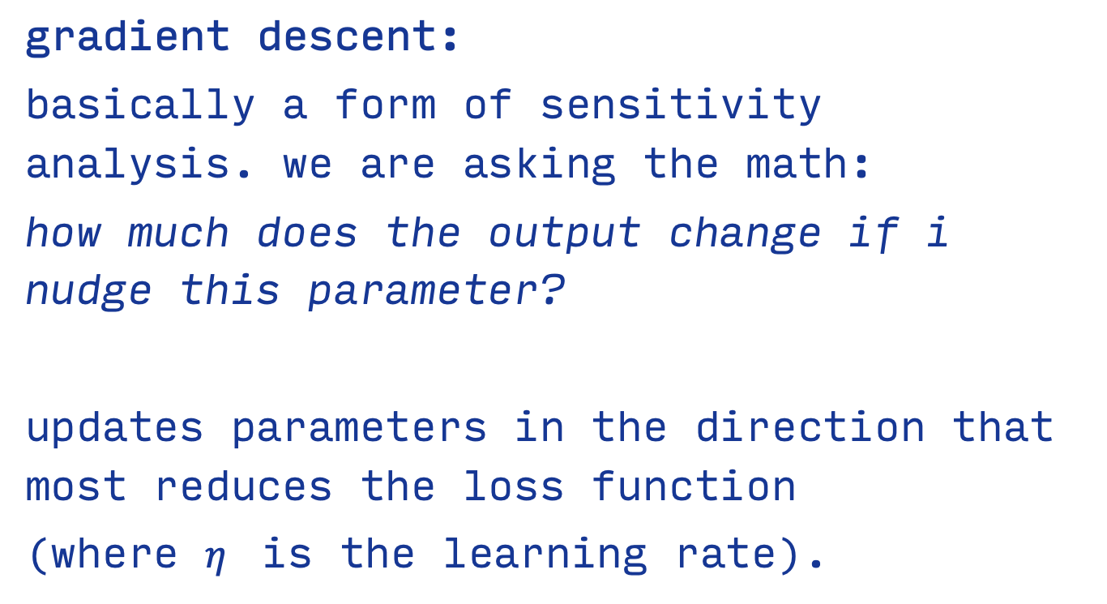


BY DR CORONA-LOPEZ
FEBRUARY 2026
LEARNING
ALGORITHM
gradient descent:
basically a form of sensitivity analysis. we are asking the math:
how much does the output change if i nudge this parameter?
updates parameters in the direction that most reduces the loss function
(where $η$ is the learning rate).
$$b_{new}=b_{old}−η\frac{∂L}{∂b}$$
$$w_{new}=w_{old}−η\frac{∂L}{∂w}$$
07

Slide 9
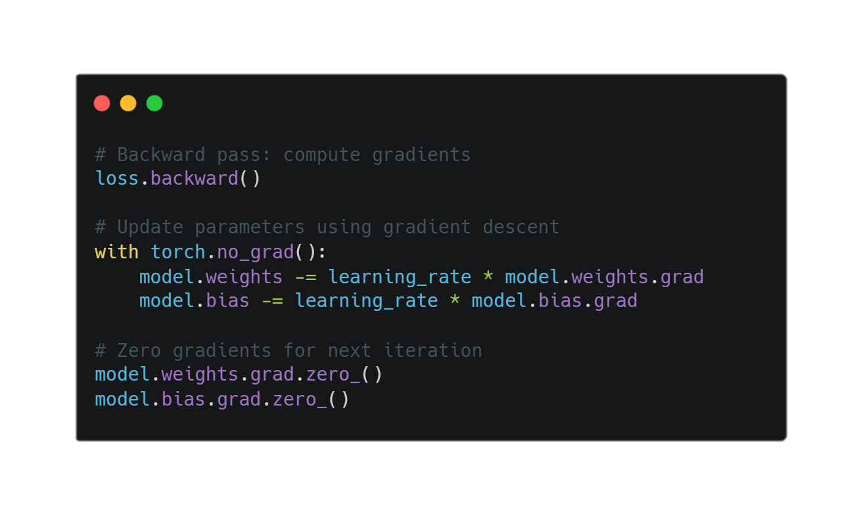
BY DR CORONA-LOPEZ
FEBRUARY 2026
LEARNING
ALGORITHM
gradient descent:
basically a form of sensitivity analysis. we are asking the math:
how much does the output change if i nudge this parameter?
updates parameters in the direction that most reduces the loss function
(where $η$ is the learning rate).
$$b_{new}=b_{old}−η\frac{∂L}{∂b}$$
$$w_{new}=w_{old}−η\frac{∂L}{∂w}$$
08

Slide 10
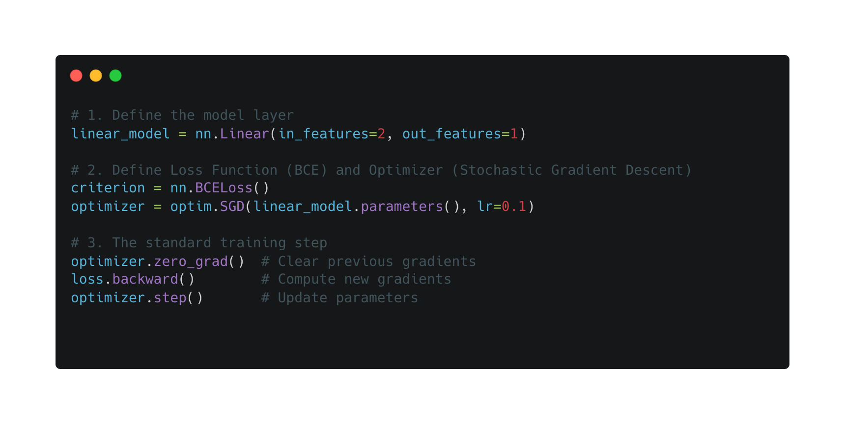
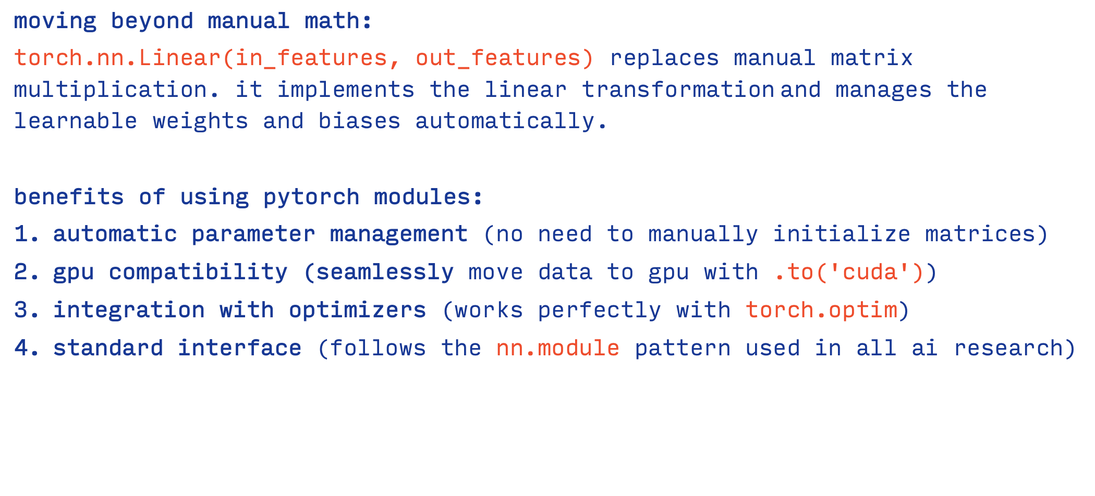
BY DR CORONA-LOPEZ
FEBRUARY 2026
PYTORCH RECIPE
moving beyond manual math:
torch.nn.Linear(in_features, out_features) replaces manual matrix multiplication. it implements the linear transformation and manages the learnable weights and biases automatically.
benefits of using pytorch modules:
automatic parameter management (no need to manually initialize matrices)
gpu compatibility (seamlessly move data to gpu with .to('cuda'))
integration with optimizers (works perfectly with torch.optim)
standard interface (follows the nn.module pattern used in all ai research)
09

Slide 11
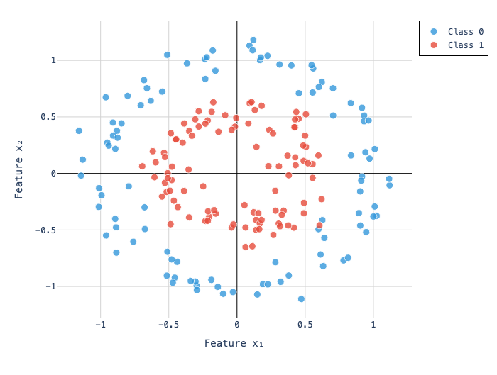
BY DR CORONA-LOPEZ
FEBRUARY 2026
NON-LINEAR
WALL
the limitation of linear models: a single neuron (or standard logistic regression) can only ever draw a single, straight hyperplane to separate data.
the circles problem: what happens when our data represents a complex, non-linear relationship?
example: a core system state (inner circle) surrounded by an failure state (outer ring).
the result: if we train our previous linear model on this dataset, it completely fails. it tries to draw a straight line through a circle, resulting in approximately 50% accuracy (no better than a random coin flip).
10

Slide 12
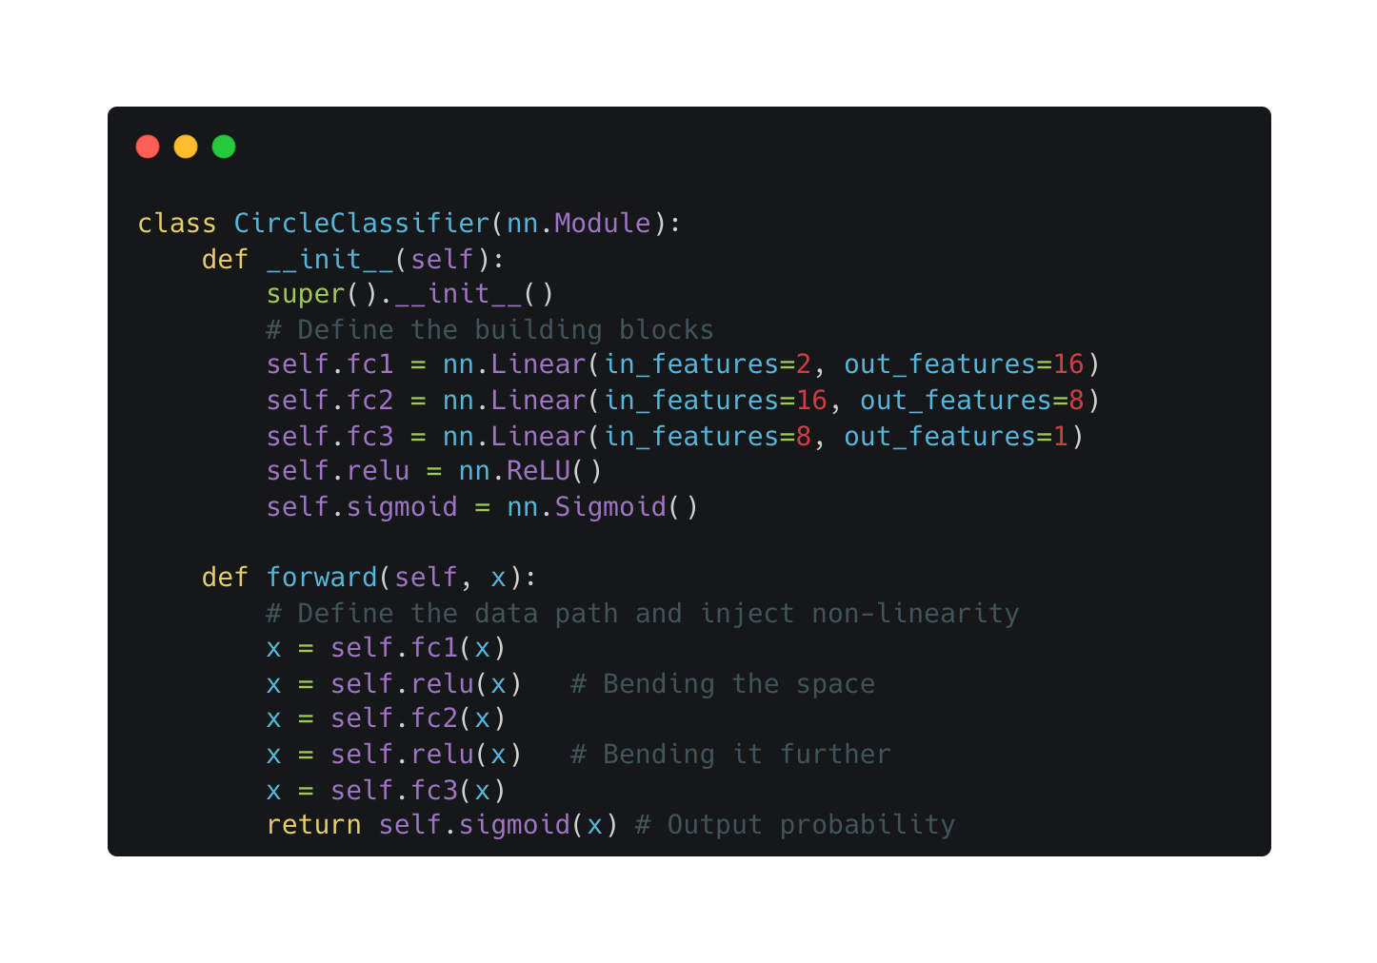
BY DR CORONA-LOPEZ
FEBRUARY 2026
OOP
PYTORCH
nn.Module pattern: we build neural networks by creating a class that inherits from torch.nn.Module.
two essential methods:
__init__(self): this is where we define the architectural building blocks (our layers).
forward(self, x): this is where we define the "flow" of data. we explicitly apply our relu activation functions between the linear layers here.
notice how we don't apply relu after the final layer. we use sigmoid there because we specifically want our final output to be a probability between 0 and 1.
11

Slide 13
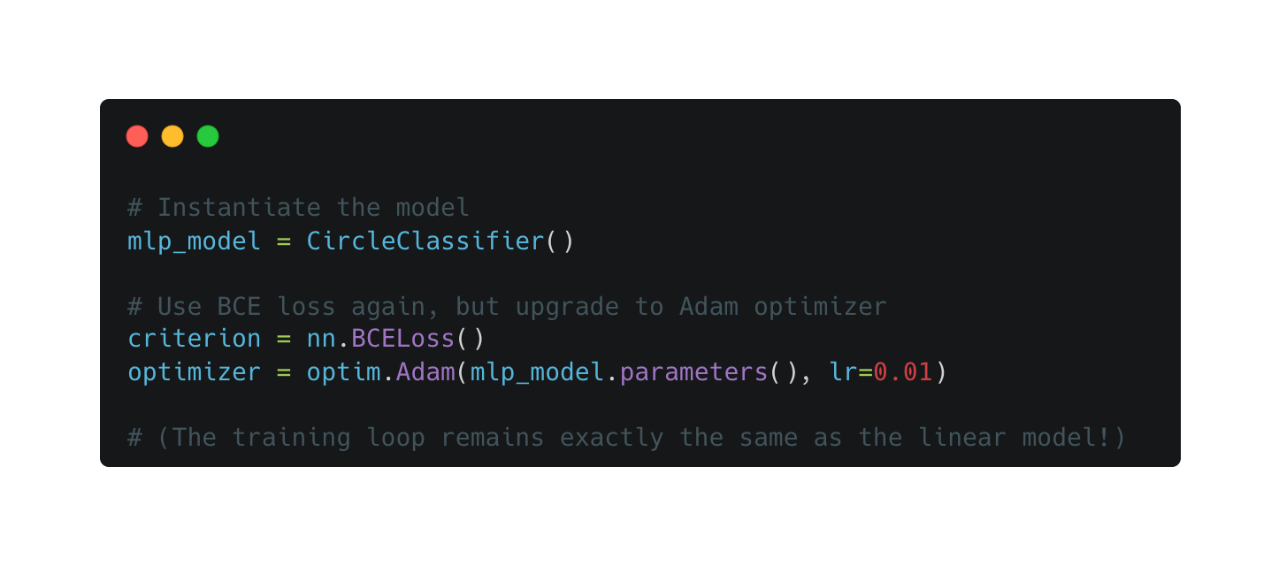
BY DR CORONA-LOPEZ
FEBRUARY 2026
TRAINING
upgrading the optimizer:
while stochastic gradient descent (sgd) works fine for single-neuron linear models, deep networks with hidden layers often require more sophisticated navigation of the loss landscape.
adam (optim.Adam):
adam dynamically adjusts the learning rate for each individual parameter. it's the industry-standard default for training deep neural networks.
the results:
by combining our mlp architecture with the adam optimizer, the model successfully learns the complex circular decision boundary.
12

Slide 14
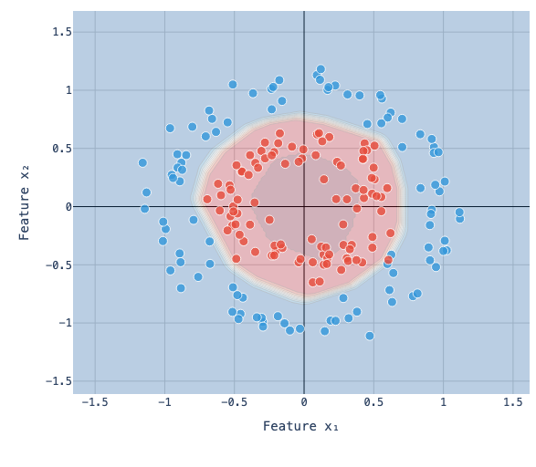
BY DR CORONA-LOPEZ
FEBRUARY 2026
DECISION BOUNDARY
because we used hidden layers and relu activations, our model is no longer drawing a rigid 1d line across our 2d data.
the probability field: the model has learned a continuous, non-linear probability field.
deep blue areas: the model is highly confident the data belongs to the inner circle
deep red areas: the model is highly confident the data belongs to the outer ring
the "coastline" (white/light colors): this is the actual decision boundary where the model crosses the 50% probability threshold.
13

