Slide 1
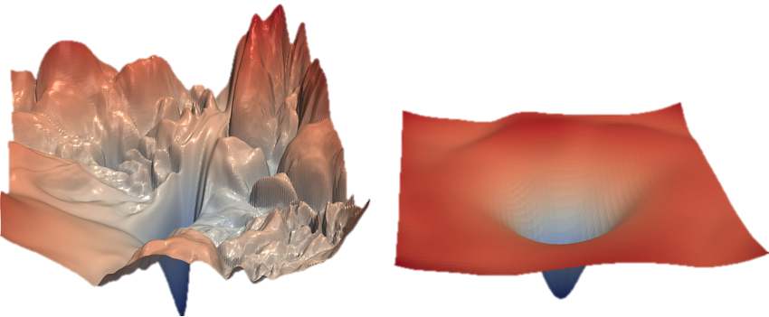
SESSION 03
WORKSHOP FEBRUARY 2026 BY DR CORONA-LOPEZ
TRAINING NEURAL NETWORKS
FACULTY OF SCIENCE AND ENGINEERING
UNIVERSITY OF MANCHESTER

Slide 2
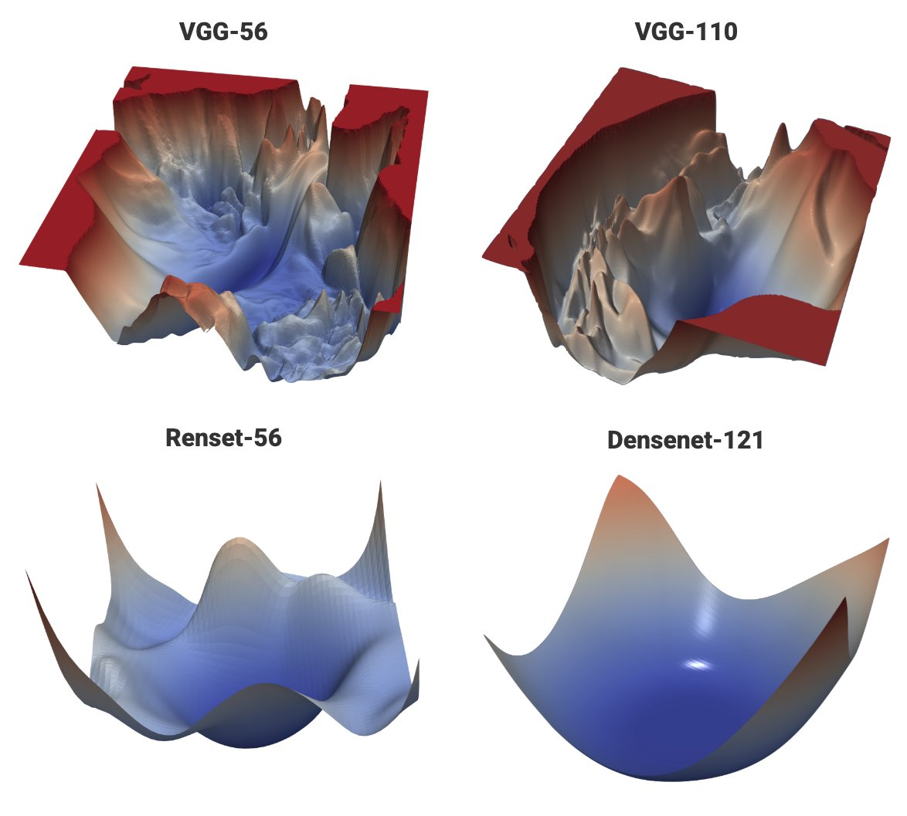
BY DR CORONA-LOPEZ
FEBRUARY 2026
AGENDA
the pytorch workflow: adapting the standard loop for unsupervised learning.
case study: heart and lung sounds (hls-cmds) dataset.
audio preprocessing: dimensionality reduction.
autoencoder architecture: encoders, decoders.
training & validation: overfitting/underfitting.
anomaly detection: reconstruction error as a diagnostic tool.
01

Slide 3
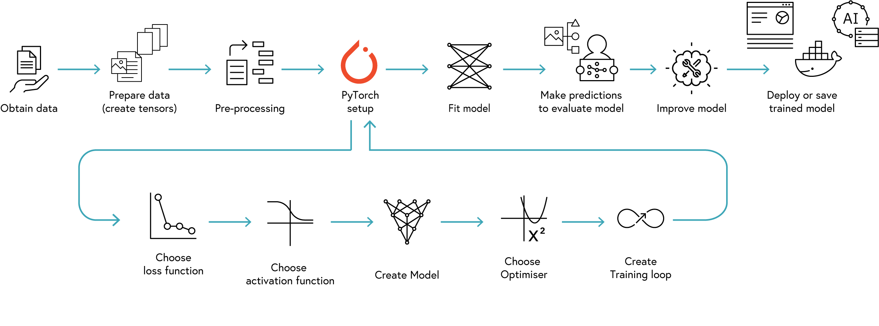
BY DR CORONA-LOPEZ
FEBRUARY 2026
WORKFLOW
02

Slide 4
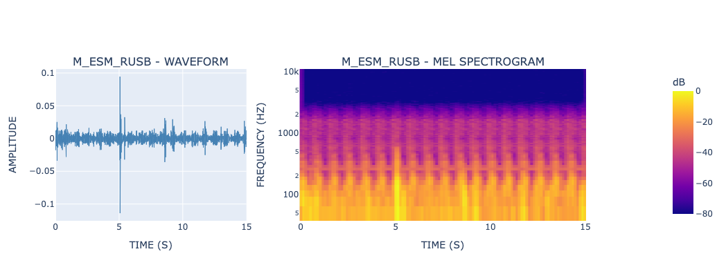
BY DR CORONA-LOPEZ
FEBRUARY 2026
CASE STUDY
the dataset: heart and lung sounds from a clinical manikin digital stethoscope (HLS-CMDS).
total of 535 audio recordings of patient cardiac and respiratory cycles.
the data classes:
normal: healthy heart and lung sounds.
abnormal: pathological sounds including murmurs, crackles, wheezing, and atrial fibrillation.
the real-world challenge: in a clinical setting, we have access to massive amounts of "healthy" baseline data.
however, abnormal data is rare, highly varied, and hard to collect for every possible disease.
03

Slide 5
BY DR CORONA-LOPEZ
FEBRUARY 2026
AUDIO PREPROCESSING
the problem with raw audio:
high dimensionality: a mere 15 seconds of audio at 22khz equals over 330,000 data points.
temporal redundancy: adjacent samples are highly correlated, leading to inefficient learning.
noise sensitivity: background clinical noise affects every single sample.
the solution: MFCCs (mel frequency cepstral coefficients).
MFCCs compress the audio into a highly meaningful, compact 2d feature matrix (a spectrogram).
the mel scale: the human ear does not perceive sound linearly; we are much more sensitive to changes in lower frequencies than higher ones. MFFCs mathematically warp the data to mimic human hearing.
04

Slide 6
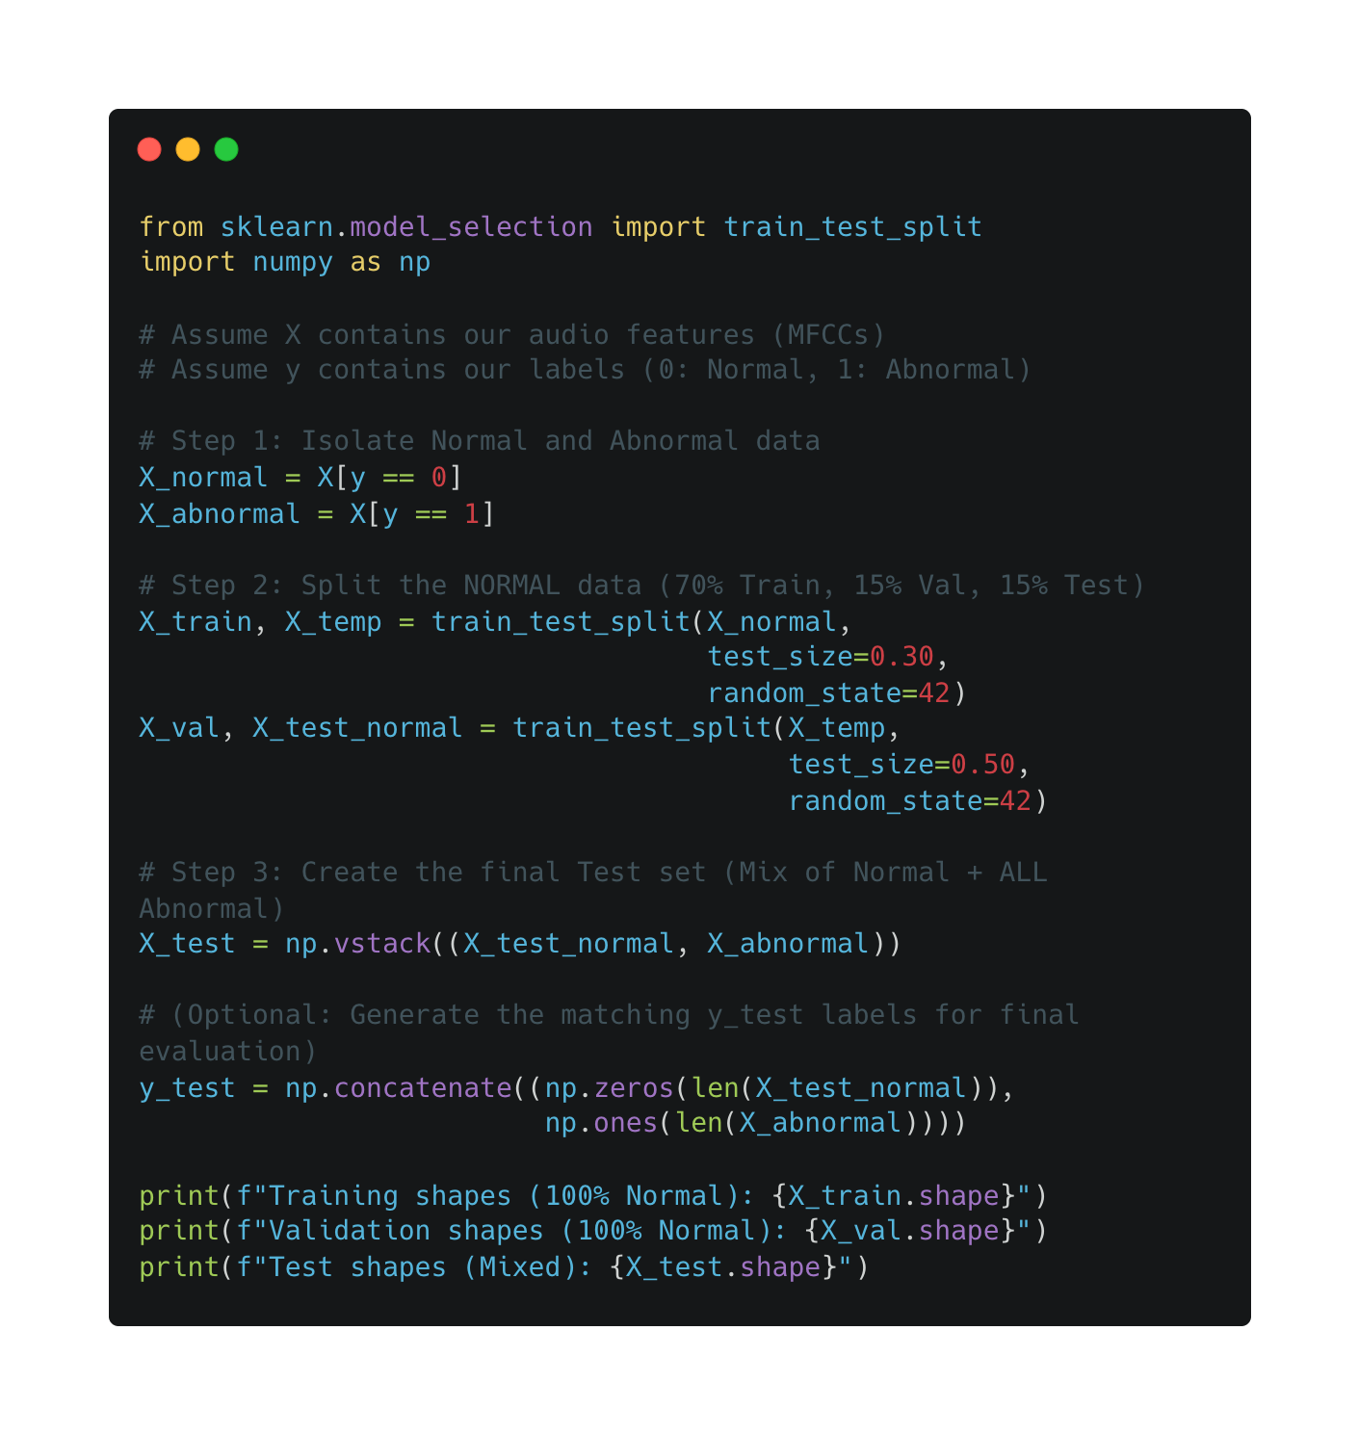
BY DR CORONA-LOPEZ
FEBRUARY 2026
DATA SPLIT
approach to splitting: in standard supervised learning, our train and test sets contain all classes. for unsupervised anomaly detection, our splitting strategy must reflect our goal of establishing a "healthy baseline.”
training set: 100% normal sounds.
used exclusively to teach the autoencoder how to compress and reconstruct a healthy heartbeat.
2. validation set: 100% normal sounds.
used to monitor the model during training and prevent it from overfitting.
3. test set: mixed normal & abnormal sounds.
a completely independent set of recordings containing real-world diseases. used at the very end to evaluate if our anomaly threshold actually works.
05

Slide 7
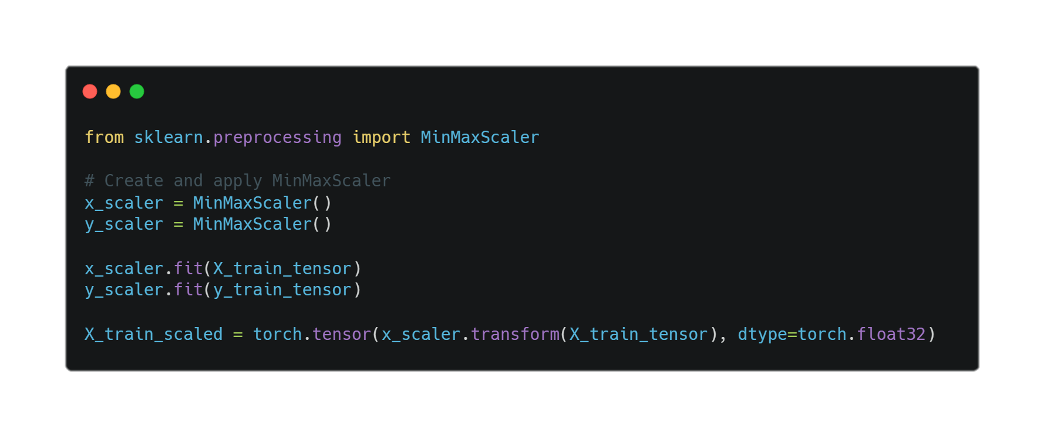

BY DR CORONA-LOPEZ
FEBRUARY 2026
NORMALISATION
why normalise?
faster convergence
numerical stability
equal feature contribution
better generalization
min-max scaling:
$$X_{norm}=\left(X−X_{min}\right)/\left(X_{max}−X_{min}\right)$$
06

Slide 8
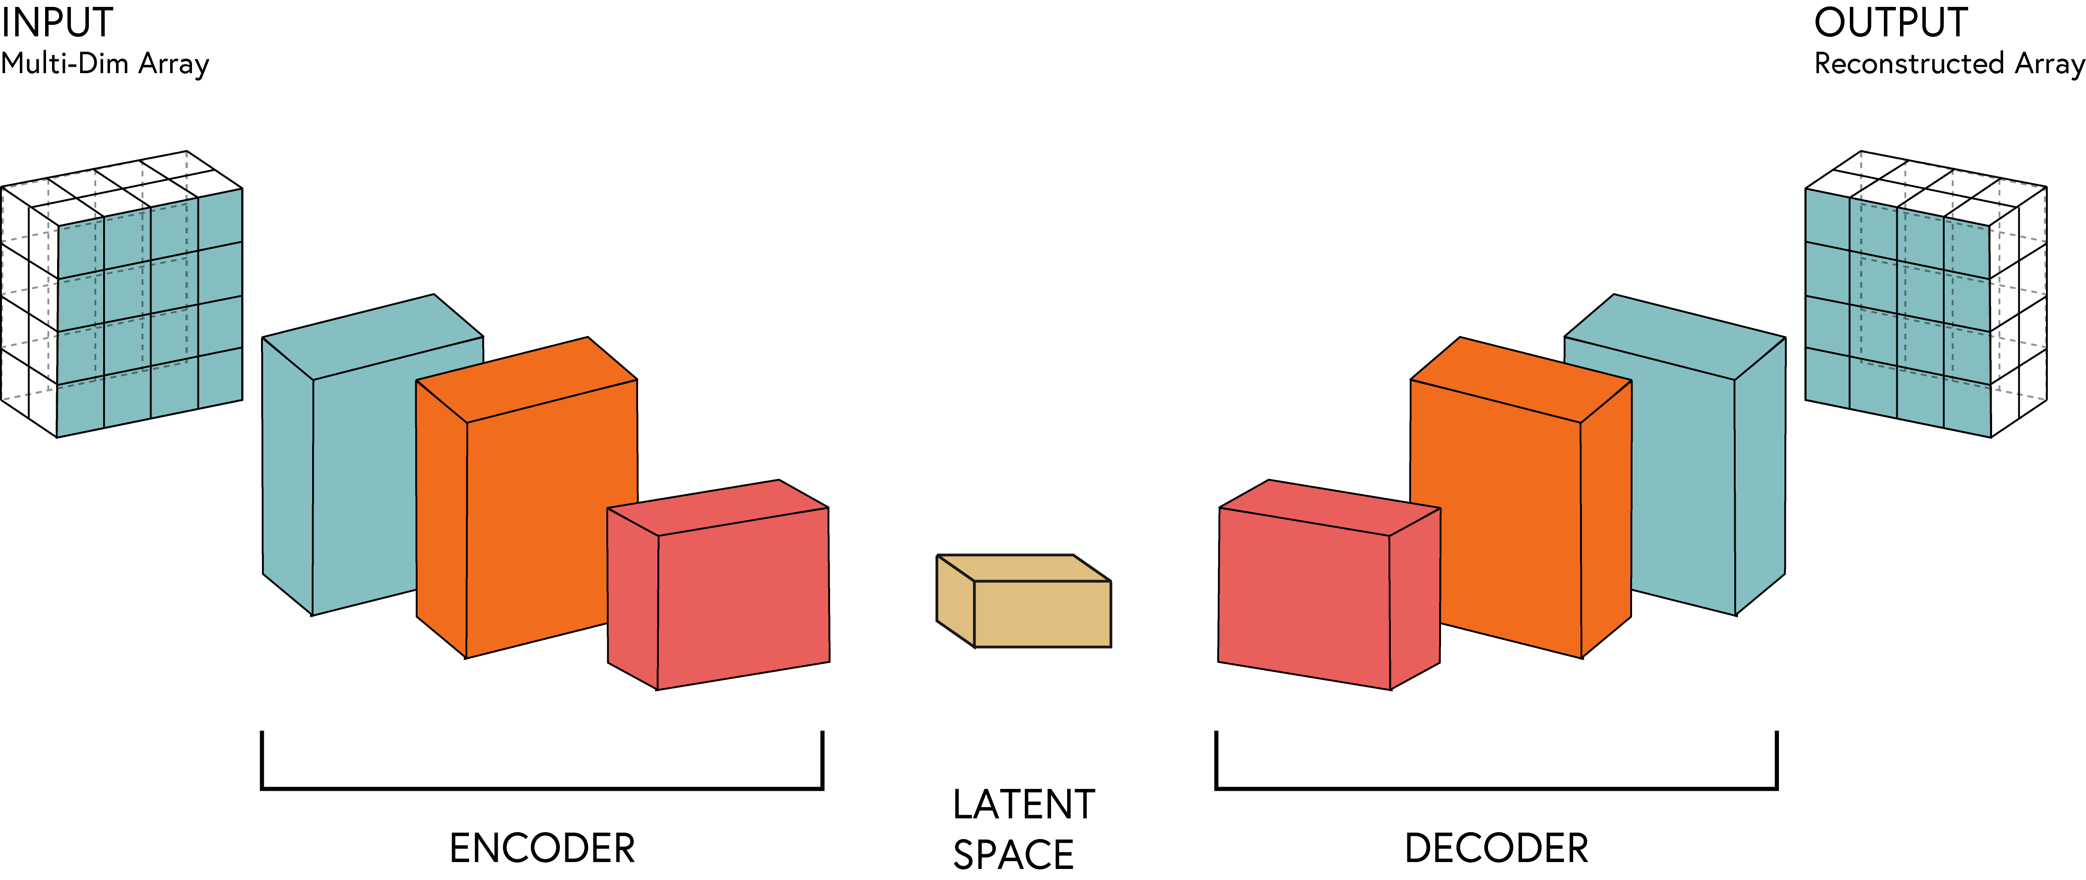
BY DR CORONA-LOPEZ
FEBRUARY 2026
AUTOENCODER
the encoder: a series of progressively smaller linear layers that squash the high-dimensional input data (our mfccs) down into a smaller representation.
the bottleneck (latent space): the most restricted, severely compressed point in the network. this forces the model to discard background noise and learn only the absolute most critical "rules" of a healthy heartbeat.
the decoder: a series of progressively larger layers that take the bottleneck data and attempt to reconstruct the original input exactly as it was.
07

Slide 9
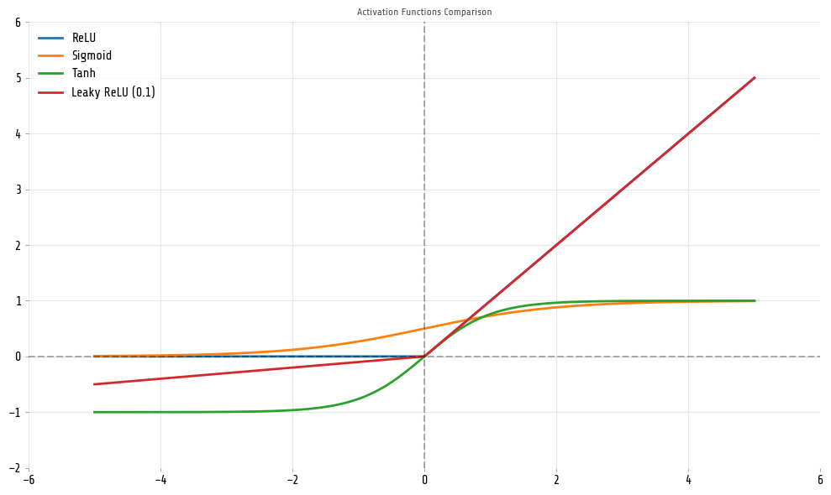
BY DR CORONA-LOPEZ
FEBRUARY 2026
ACTIVATION FUNCTIONS
purpose:
transform linear input to non-linear output
enable networks to learn complex patterns and relationships
key properties:
differentiable
non-linear
computationally efficient
08

Slide 10
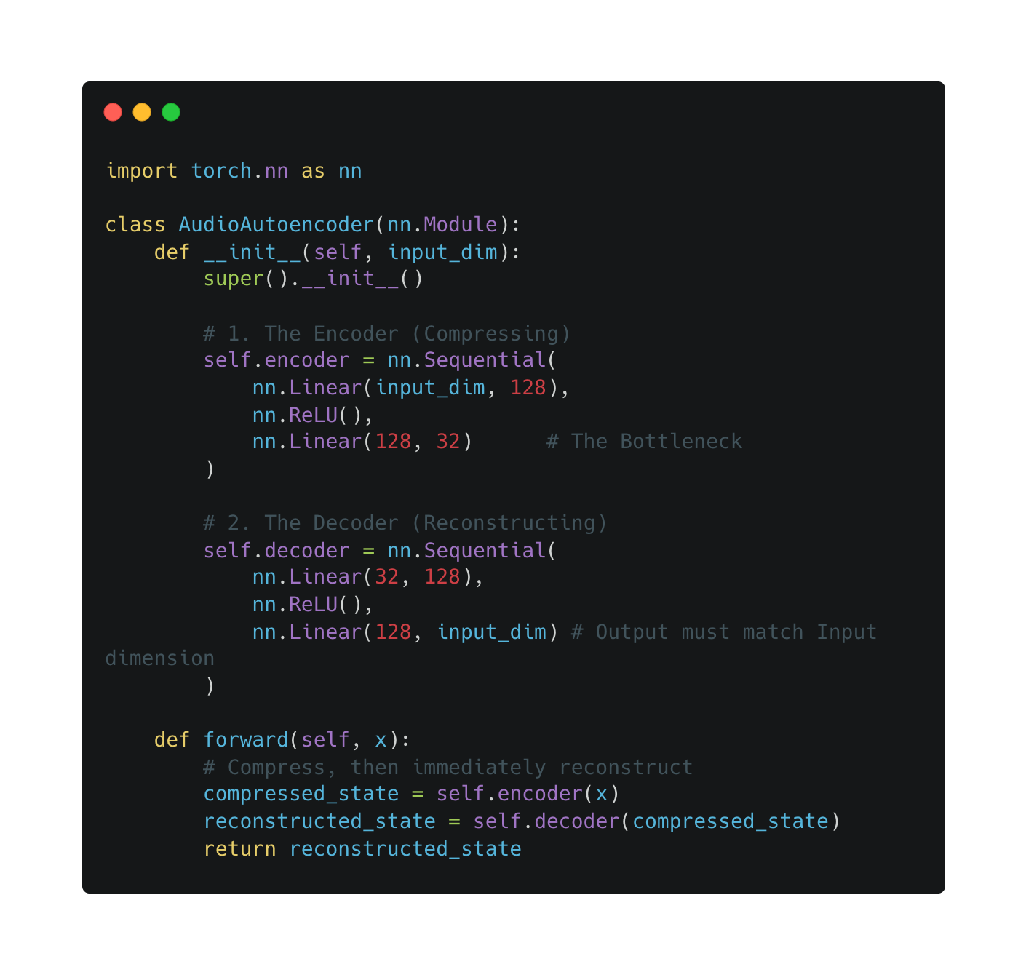
BY DR CORONA-LOPEZ
FEBRUARY 2026
NETWORK BUILDING
using nn.Sequential: to keep our code clean, we can group our layers together using pytorch's nn.Sequential container.
this saves us from having to manually pass the data through every single layer and activation function in the forward pass.
symmetry: notice how the decoder is generally a perfect mirror image of the encoder. if we compress from 128 down to 32, we reconstruct from 32 back up to 128.
09

Slide 11
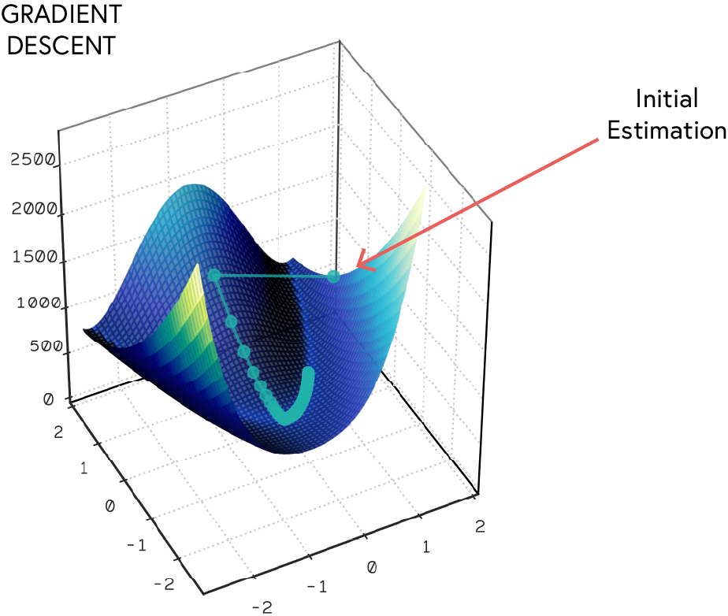
BY DR CORONA-LOPEZ
FEBRUARY 2026
OPTIMISER
& LOSS
the target is the input: in unsupervised learning with autoencoders, we don't have y labels. our target is simply our input x.
the loss function (MSE) nn.MSELoss: it calculates the mathematical difference between the original audio features and the reconstructed audio features.
high MSE = poor reconstruction (the network failed to compress/decompress accurately).
low MSE = good reconstruction (the network successfully learned the healthy patterns).
the optimizer (adam): we use the adam optimizer (optim.Adam). because the loss landscape of autoencoders can be complex.
10

Slide 12
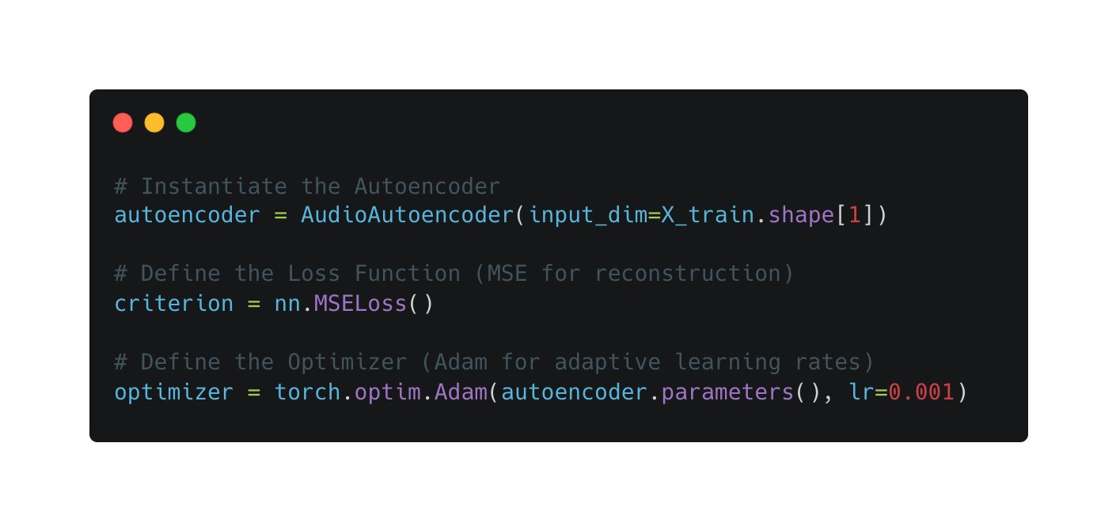
BY DR CORONA-LOPEZ
FEBRUARY 2026
OPTIMISER
& LOSS
the target is the input: in unsupervised learning with autoencoders, we don't have y labels. our target is simply our input x.
the loss function (MSE) nn.MSELoss: it calculates the mathematical difference between the original audio features and the reconstructed audio features.
high MSE = poor reconstruction (the network failed to compress/decompress accurately).
low MSE = good reconstruction (the network successfully learned the healthy patterns).
the optimizer (adam): we use the adam optimizer (optim.Adam). because the loss landscape of autoencoders can be complex.
11

Slide 13
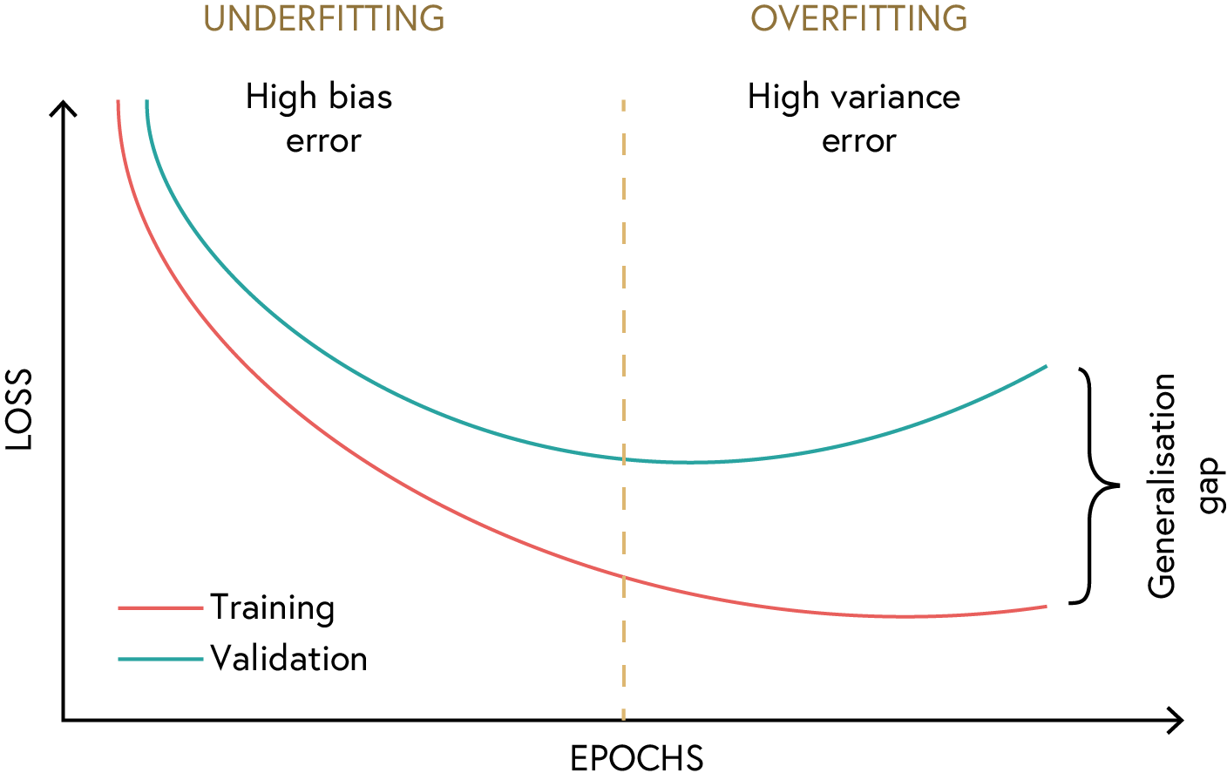
BY DR CORONA-LOPEZ
FEBRUARY 2026
OVER/UNDER-FITTING
underfitting: the model is too simple or hasn't trained long enough to learn the patterns of a normal heartbeat (both training and validation loss are high).
overfitting: the model memorizes the exact audio files in the training set, but fails to generalize to new, unseen normal sounds.
a solution - early stopping: we monitor the validation loss at every epoch. we stop training the moment the validation loss stops improving, ensuring our model generalizes perfectly to new patients.
12

Slide 14
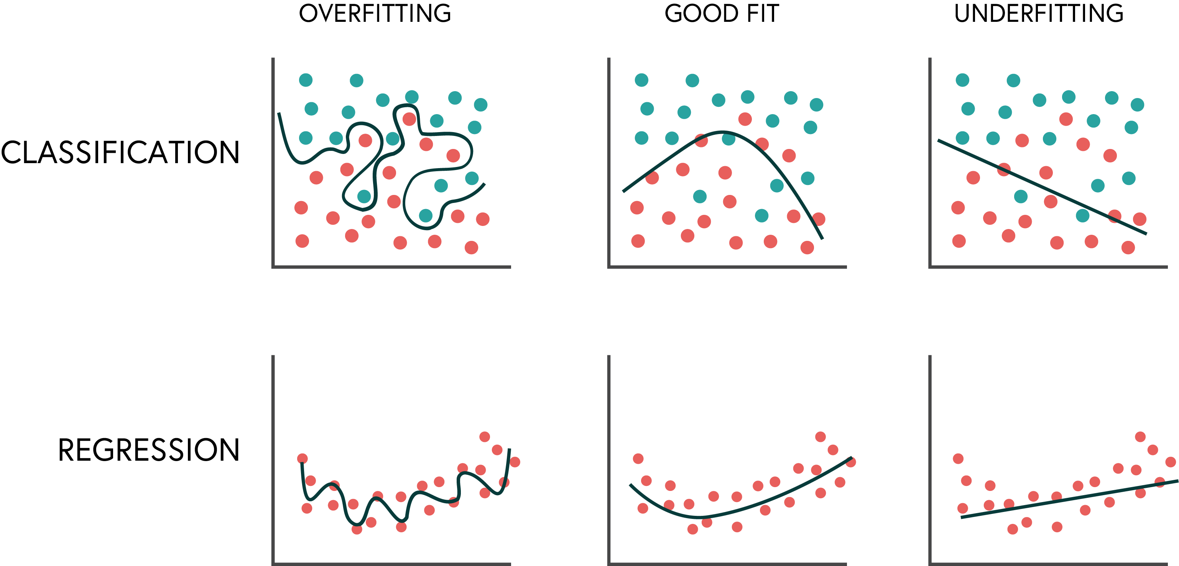
BY DR CORONA-LOPEZ
FEBRUARY 2026
OVER/UNDER-FITTING
13

Slide 15
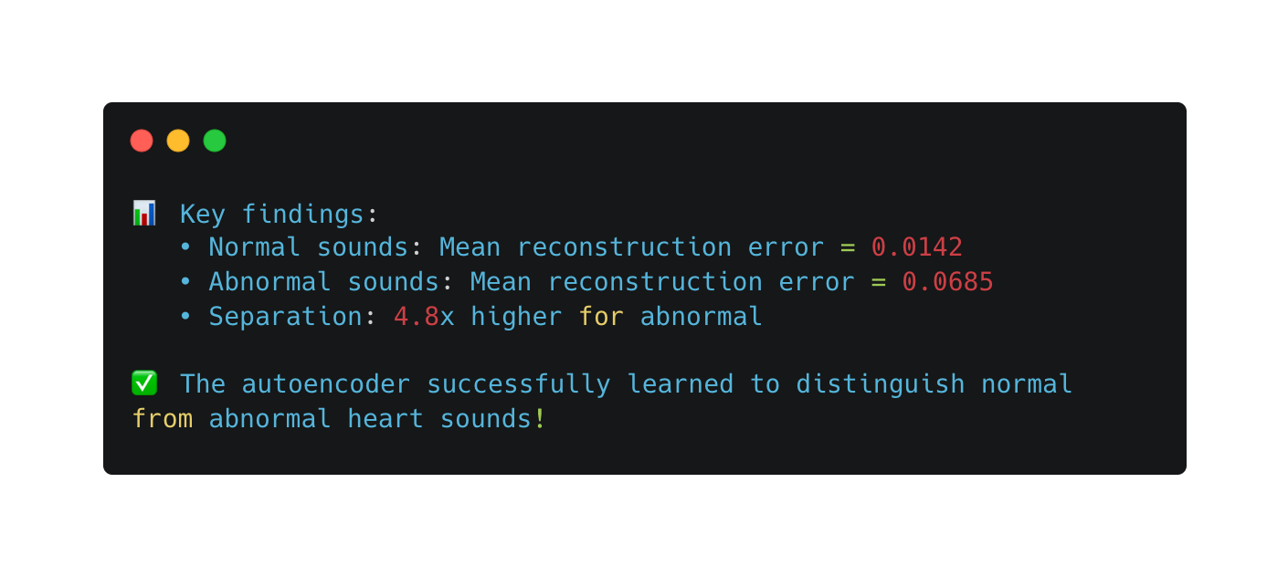
BY DR CORONA-LOPEZ
FEBRUARY 2026
EVALUATION
we now take our isolated test set and pass it through the trained autoencoder.
the results:
normal sounds: the model recognizes the patterns, compresses them, and reconstructs them easily
abnormal sounds: the model's bottleneck destroys the unknown diseased patterns, resulting in a failed reconstruction.
setting the threshold: by establishing a cut-off threshold on the reconstruction error, we successfully identify medical anomalies without ever giving the network labeled diseased data!
14

