Slide 1
SIDEFLIX
ORAL DEFENSE
Outline
Business
Data
Results
Production
A data pipeline to select independent films to feature each week
Matis Douay
Jérémy Caillaud
Rayan Faher Bonne
Data Engineering & Cloud Infrastructure · Albert School · 6 November 2026 · group 6
Notes:
Introduce the group and the central idea: fictional Sideflix, a single business decision, and a real pipeline executed end to end. Outline business, data/architecture, results/reliability, operations/costs and the live demo.

Slide 2
OUTLINE
01
BUSINESS
02
DATA
03
RESULTS
04
PRODUCTION
01
02
Sideflix, its model and the decision to support
Five real sources and the pipeline architecture
03
04
Quality, lineage, ranking and incidents
Operations, security, costs, team and demo
Notes:
Four parts: business and decision; data and architecture; results and reliability; operations, security, costs, team and choices; then the live demo.

Slide 3
01
THE BUSINESS
Outline
Business
Data
Results
Production
01
Sideflix, its model and the decision to support
Notes:
Part one: why Sideflix exists and which decision the pipeline supports.

Slide 4
NETFLIX IS REAL; SIDEFLIX IS OUR FICTIONAL PLATFORM
Outline
Business
Data
Results
Production
NETFLIX
SIDEFLIX
The real reference
Global streaming platform. Its public weekly Top 10 provides external context, never Sideflix viewing data.
Our case study
Independent streaming: films, series, shorts, documentaries and reports.
10,000 subscribers · 100 titles
€7.99 per month · 6 employees
Demo catalogue: six independently produced films
WHIPLASH
MOONLIGHT
FRANCES HA
ROOM
SICARIO
GET OUT
Notes:
Sideflix is fictional, inspired by real Netflix. We do not claim rights to these films: the six independently produced works were chosen because they can be reliably identified in the five real datasets. The numerical assumptions belong to our scenario. The grading matrix explicitly allows a fictional company; Framework step 1 asks for a real-world enterprise, so Netflix is our real-world reference.

Slide 5
≈ €80k
Outline
Business
Data
Results
Production
MONTHLY SUBSCRIPTIONS, A POSSIBLE SALE TO NETFLIX
monthly revenue: 10,000 subscribers × €7.99, about €0.96m per year (assumptions)
CUSTOMERS
SIZE AND OPERATIONS
STAKEHOLDERS
POSSIBLE EXIT
Film fans subscribing to an ad-free niche catalogue of 100 titles
6 employees; featured titles reviewed each week
Subscribers, catalogue manager, independent producers, management
Sale to Netflix: a scenario, not a second use case
Notes:
Revenue is only the arithmetic of explicit scenario assumptions. For a niche platform, weekly featured titles influence subscriber viewing; this is the decision supported by the pipeline. A possible sale to Netflix is an exit scenario, not a second use case.

Slide 6
WHICH TITLES SHOULD WE FEATURE THIS WEEK?
Outline
Business
Data
Results
Production
CATALOGUE MANAGER
CONCEPT | DEFINITION
Grain | Title × UTC day of session start
Valid sessions | Distinct session_id after exclusions
Minutes watched | Sum of watched seconds / 60
Exclusions | Invalid rows quarantined; bad device fails tests; duplicates removed
Ranking | 7-day window, real context displayed alongside
Acceptance test | 1 November: 13 sessions, 177.4 min, matches independent calculation
Selects the titles featured each week.
Daily computation at 06:00 Paris, ready by 07:00: a current 7-day window and issues detected before the decision.
GOLD OUTPUTS
GOLD_CONTENT_DAILY · title per day
GOLD_EDITORIAL_WEEKLY · ranking
Notes:
One decision and one user. Daily computation keeps the seven-day window current before the weekly decision. Explicit exclusions are visible in quarantine. The acceptance test compares Gold against an independent calculation from the input files.

Slide 7
THE DATA
Outline
Business
Data
Results
Production
02
Five real sources and the pipeline architecture
Notes:
Part two: where the data comes from and how it moves through the pipeline.

Slide 8
FIVE REAL DATASETS, PLUS SIMULATED SESSIONS
IMDB
WIKIDATA
MOVIELENS
WIKIMEDIA
NETFLIX TOP 10
SIDEFLIX SESSIONS (SIMULATED)
Outline
Business
Data
Results
Production
Title, type, year, runtime of the 6 works
Snapshot 4 Nov 2026 · file, COPY
Identity (QID), IMDb and Wikipedia links
Response 4 Nov 2026 · API, VARIANT
74 ratings, mean and count per title
Ratings from 1996–2018 · file, COPY
Daily Wikipedia page views, 42 observations
26 Oct–1 Nov 2026 · API, VARIANT
Weekly ranks; only Sicario matched (9 Mar 2025)
Jul 2021–Nov 2026 · file, COPY
32 JSON rows: 30 valid, 1 duplicate, 1 negative duration
30 Oct–1 Nov 2026 · files, COPY
The six-title catalogue lives in Sideflix's on-premises PostgreSQL database and loads by watermark and MERGE. A manifest records each file's URL, SHA-256 checksum and terms of use.
Notes:
The five datasets are authentic, with separate periods: historical MovieLens ratings, historical Netflix Top 10 and one recent week of Wikipedia views. Sideflix sessions are simulated and excluded from the five real datasets. Always label them as simulated. Join by identifiers (IMDb tconst and Wikidata QID), not by title. Netflix Top 10 has no identifier: its single match, Sicario, uses the exact title and was confirmed manually as Netflix title 80046311.

Slide 9
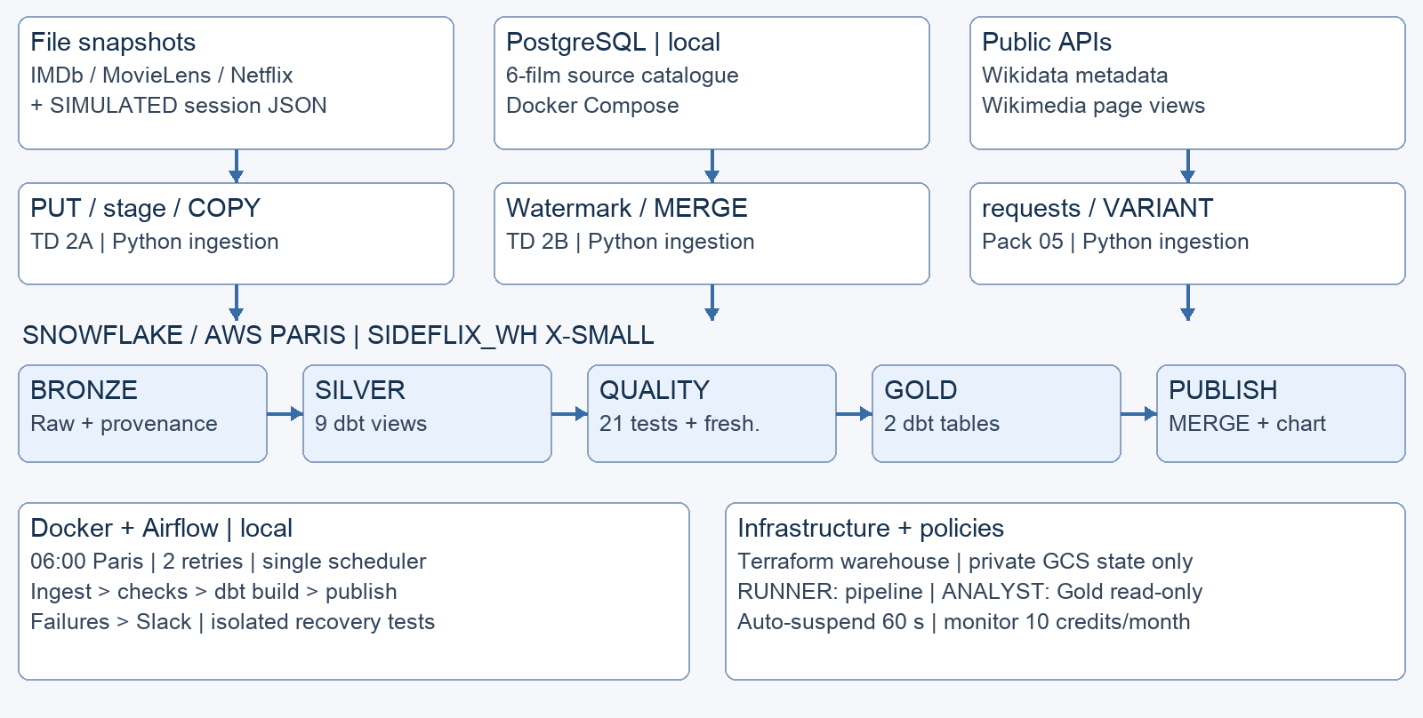

THREE INGESTION METHODS, ONE MEDALLION WAREHOUSE
Outline
Business
Data
Results
Production
LOCAL
PostgreSQL, Docker, Airflow 3.3: daily at 06:00 Paris, 2 retries
IN THE CLOUD
Snowflake (AWS Paris): Bronze, Silver, Gold; GCS only for Terraform state
QUALITY GATE
Publish only after checks and dbt build pass; Slack alert on final failure
Notes:
Every component uses a course method: TD 2B watermark/MERGE for PostgreSQL catalogue, TD 2A stage/COPY INTO for files, pack API requests/VARIANT, dbt Silver/Gold, TD 4.2 DockerOperator/Compose, and Terraform warehouse. Airflow is the only scheduler. Publication follows successful checks and dbt build. Manual steps: Snowflake account, RSA keys, Slack webhook and state bucket.

Slide 10
THE RESULTS
Outline
Business
Data
Results
Production
03
Quality, lineage, ranking and incident recovery
Notes:
Part three: what the pipeline produces, how quality is checked, and what happens when it fails.

Slide 11
SILVER CLEANS; TESTS BLOCK FAILURES BEFORE GOLD
SAFE TYPING
QUARANTINE
DEDUPLICATION
NO DOUBLE COUNTING
Outline
Business
Data
Results
Production
33/33
TRY_TO_* and FLATTEN for JSON, retaining batch metadata
Invalid row retained with its reason (S31: −60 seconds)
dbt build: 11 models, 21 tests, 1 log operation
2/2
source freshness checks
ROW_NUMBER and QUALIFY, deterministic order: duplicate S4 becomes one session
Context aggregated before joins; missing = NULL, never 0
32 = 30+1+1
raw = valid + quarantined + duplicate
Lineage: dbt docs (source, ref) · evidence: evidence/04_dbt_and_quality
Notes:
dbt build runs models and tests in dependency order, skipping downstream nodes after a failed test. Tests cover unique/non-null keys, session-content relationships, accepted devices, duration bounds, external-source grain, completeness of five datasets, reconciliation 32 = 30 + 1 + 1, and Silver-to-Gold equality.

Slide 12
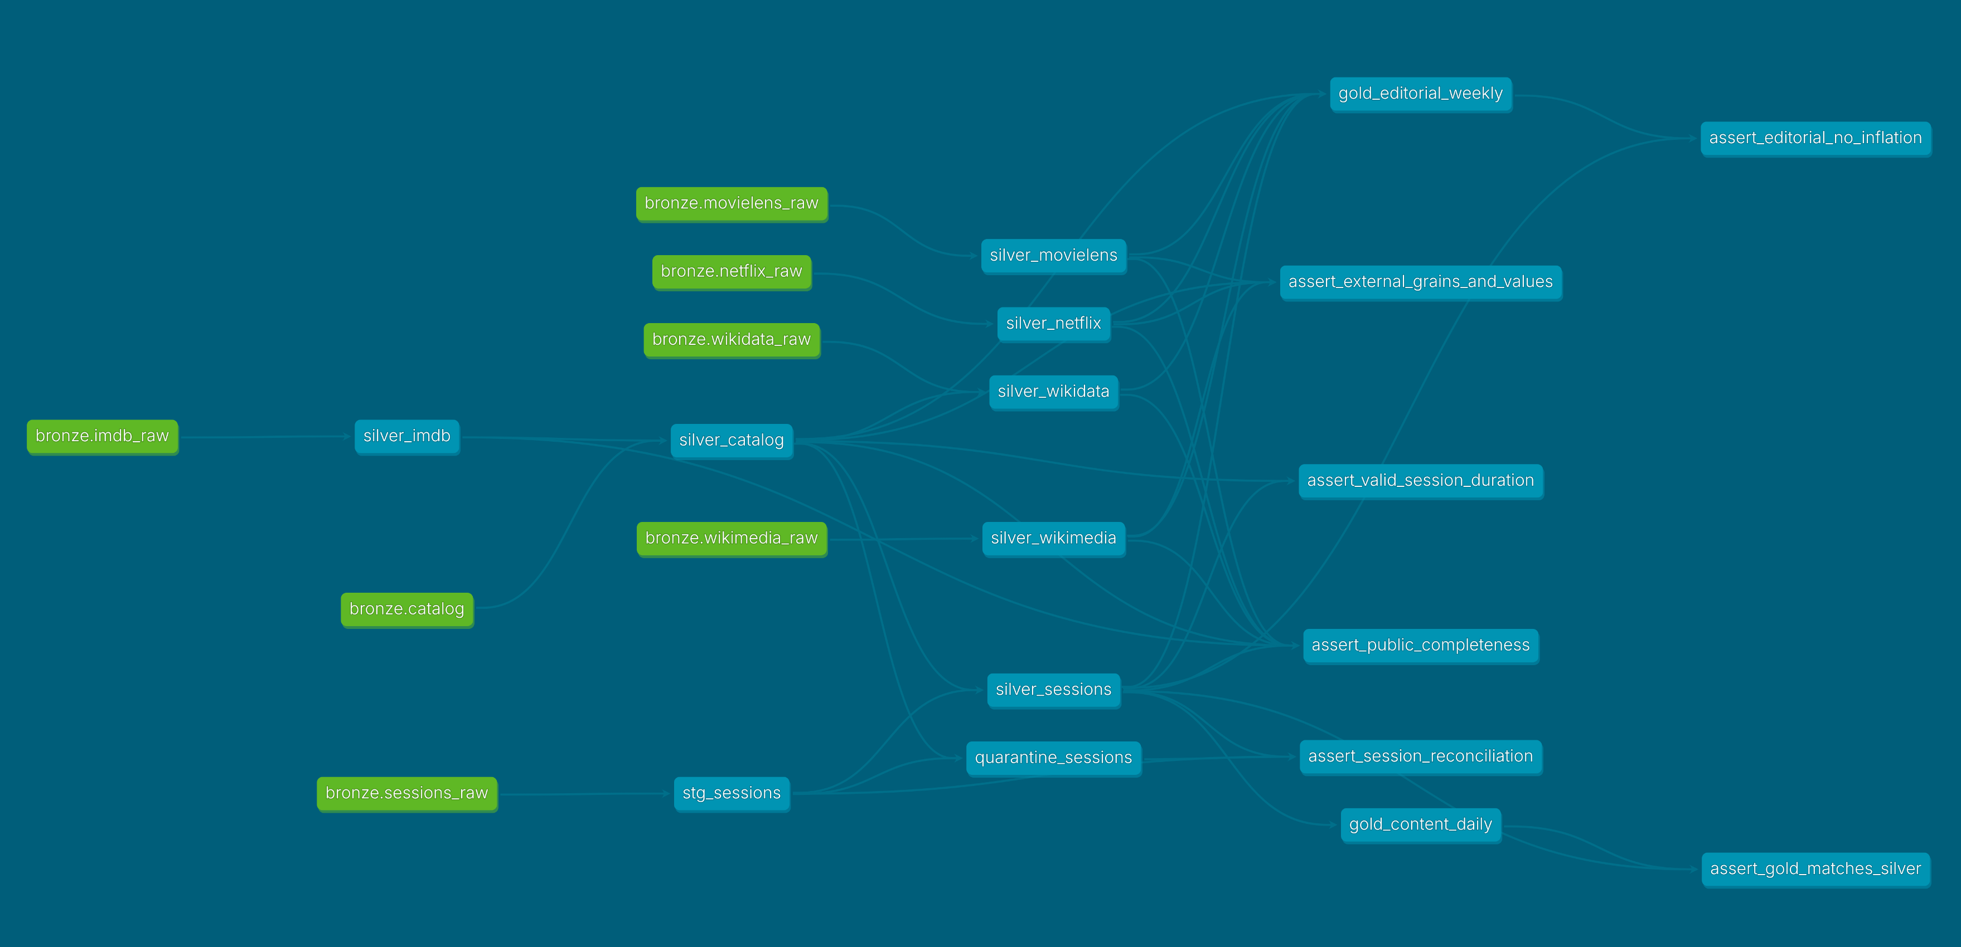

FROM RAW SOURCE TO RANKING, EVERY LINK IS TRACED
READ THE GRAPH
Outline
Business
Data
Results
Production
Green: Bronze sources declared in dbt.
Blue: 9 Silver views, 2 Gold tables and singular tests.
Generated by dbt docs. Open docs/dbt/index.html for model descriptions, columns, tests and lineage.
Notes:
The lineage was generated by dbt docs generate under the limited pipeline role. Read Bronze raw sources, cleaned Silver views, two Gold tables and protecting tests, including assert_gold_matches_silver and assert_public_completeness. Open docs/dbt/index.html for the packaged dbt documentation; show docs/dbt_lineage.png as an image fallback and dbt/sideflix_dbt/ for versioned source/model/test definitions.

Slide 13
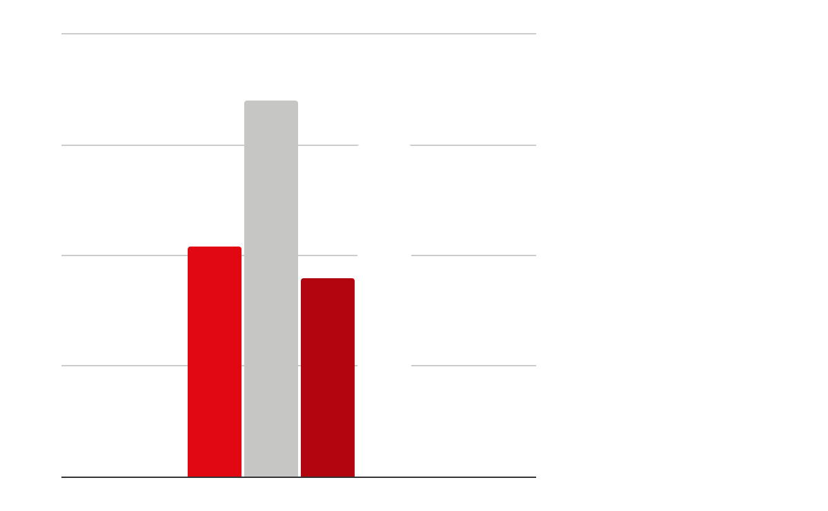
WHIPLASH LEADS THE RANKING AS OF 1 NOVEMBER
Outline
Business
Data
Results
Production
Minutes watched on Sideflix (simulated sessions, 30 Oct–1 Nov 2026)
REAL CONTEXT, ALONGSIDE THE RANK
Whiplash: 38 MovieLens ratings, mean 4.04 (2015–2018); 15,551 Wikipedia views (26 Oct–1 Nov 2026)
Sicario: Netflix Top 10 rank 5, week of 9 Mar 2025
No composite score: external context does not affect the rank.
INDEPENDENT RECALCULATION
14 title/day rows match the expected result; 1 November: 13 sessions and 177.4 minutes.
Source: SIDEFLIX.GOLD.GOLD_EDITORIAL_WEEKLY · simulated Sideflix sessions
Notes:
Ranking uses only Sideflix viewing metrics, clearly marked simulated. Real sources provide their own dated context: historical MovieLens ratings, recent Wikipedia views, historical Netflix Top 10 and one confirmed match (Sicario). Figures were compared with an independent calculation from files and API responses.

Slide 14
TWO INJECTED FAILURES, TWO VERIFIED RECOVERIES
Outline
Business
Data
Results
Production
 | 9.1 · INVALID DATA | 9.2 · CRASH AFTER WRITE
Failure | device "invalid" injected into an isolated copy of the session batch | publication is written, then the job crashes before confirming success (TD 4.2)
Detection | accepted_values fails after 3 attempts (28 pass, 1 error, 4 skipped); Slack alert received | attempt 1 fails in Airflow
Impact avoided | Gold and publication unchanged in before/after comparisons | still one row for 1 November: 13 sessions, 177.4 minutes
Recovery | remove only the test batch; corrective run 33/33, unchanged figures | automatic retry, attempt 2 succeeds
Safeguard | dbt build skips downstream nodes after a failed test | MERGE by date; an INSERT would duplicate the row
Also checked: a day without sessions fails the check, publishes nothing and alerts Slack · missing-file procedure documented (9.3)
Evidence: evidence/06_incidents (report, checks and task logs)
Notes:
Both incidents were actually executed in Airflow; incident options are disabled in normal runs. Incident 9.1 proves that invalid data cannot reach Gold or publication and that Slack notification is received. Incident 9.2 follows TD 4.2: a crash after the write triggers a retry; MERGE avoids counting the day twice. The report records cause, detection, avoided impact, recovery and prevention for both incidents. Show the failed and recovered task logs and before/after checks; do not claim the failures occurred accidentally in production.

Slide 15
IN
PRODUCTION
Outline
Business
Data
Results
Production
04
Operations, security, costs, team, choices and demo
Notes:
Final part: daily operation with least privilege and controlled costs, followed by choices, limitations and the demo.

Slide 16
ONE DAILY RUN, WITH LEAST PRIVILEGE
AIRFLOW AND DOCKER
ACCESS
SECRETS
Outline
Business
Data
Results
Production
01
sideflix_daily DAG: ingest, check, dbt build, publish
06:00 Paris, one run at a time, 2 retries, no catchup
Full run about 1 min 30: ready well before 07:00
Replay of the same date: 0 new rows, one publication
02
Analyst: reads Gold only; Bronze, Silver and writes denied
Pipeline: service user, limited role, no admin rights
11 of 11 access checks passed
03
RSA key mounted read-only; .env, Slack webhook and Terraform state excluded from Git
Evidence: evidence/05_orchestration and evidence/07_security_and_costs
Notes:
Docker runs the pipeline, scheduled only by Airflow as in TD 4.2. The evidenced service-user run used SIDEFLIX_PIPELINE with SIDEFLIX_RUNNER: 94 queries, no errors, no administrator role. The analyst can read Gold but not Bronze or Silver, and cannot write. Keep .env, private keys and webhook URLs out of the presentation.

Slide 17
ABOUT 1.5 CREDITS PER MONTH, UNDER A CAP OF 10
1.44
≈ 1.5
10
Outline
Business
Data
Results
Production
credits actually consumed (3–4 November), mainly development and tests
credits/month: 30 runs × 131 s warehouse time × 1.35 credits/hour
credits/month monitor: alerts at 50% and 80%, warehouse suspended at 100%
Warehouse | X-Small, auto-suspend after 60 s, auto-resume on demand
Storage | 0.48 MB active and 25 MB time travel: negligible volume
Performance | Filtered Gold query: 248 ms, 3 KB read, 3 of 5 partitions scanned
Terraform | Warehouse declared in code, no-change plan, private and locked GCS state
Shutdown | Pause DAG, docker compose down, suspend warehouse; targeted cleanup after the oral
Trial credits do not mean zero cost · no euro conversion without the account's actual price
Notes:
Actual credits come from ACCOUNT_USAGE.WAREHOUSE_METERING_HISTORY. Projection uses the observed limited-role run: 71 seconds of queries plus 60 seconds before auto-suspend, once per day, at the Snowflake X-Small Gen2 rate. A 10-credit monitor provides room for development and demonstrations. GCS stores only Terraform state; no GCS cost is invented. The red bars compare each value with the 10-credit cap.

Slide 18
EACH MEMBER OWNS PART OF THE PIPELINE
MATIS DOUAY
JÉRÉMY CAILLAUD
RAYAN FAHER BONNE
Outline
Business
Data
Results
Production
Five real sources collected and manifest maintained
Bronze v2 and ingestion of the five sources
dbt Silver and Gold, 21 tests
Incidents 9.1 and 9.2
Snowflake account and foundation
Terraform and shared GCS state
Docker and Airflow runs, Slack alert
Limited roles, costs and budget
Owns consumption layer: Snowsight reporting from Gold
Ranking table and chart (captured by Matis)
Read-only analyst role
Recalculation query during the demo
Each member presents their own part; the live demo runs on the prepared demonstration machine.
Contribution details: Git history and evidence/README.md
Notes:
The course checklist asks each member to own part of the pipeline. Each member presents their assigned part. Rayan owns the consumption layer and presents Gold reporting under the read-only analyst role. Matis executed and captured the final Snowsight worksheet; distinguish assigned ownership/presentation from work actually executed.

Slide 19
SIMPLE CHOICES, SIZED TO THE NEED
Outline
Business
Data
Results
Production
WAREHOUSE
SNOWFLAKE
Chosen over BigQuery: SQL and VARIANT for JSON, course account, auto-suspending warehouse
CADENCE
DAILY BATCH
Weekly decision and small volume: no need for Kafka, CDC, Snowpipe or Iceberg
METHOD
DBT + AIRFLOW
Versioned and tested rules, runs replayable by date
LIMITS
EXPLICIT
3 days of simulated sessions · dated sources, one Netflix match · AWS data, GCS state only · Snowflake trial account
Notes:
Kafka, CDC, Snowpipe and Iceberg are known alternatives, but a daily batch is enough for this small weekly decision. State the limits: simulated sessions, external sources with different periods, and GCS Terraform state while Snowflake data and compute run on AWS. Continue with the live demo.

Slide 20
DEMO
Outline
Business
Data
Results
Production
LIVE: run sideflix_daily for 1 November; show 4 green tasks and one publication (13 sessions, 177.4 min). Verify analyst allowed/denied access; show dbt lineage and documentation.
Notes:
A few minutes before the demo, unpause sideflix_daily: Airflow first starts the scheduled run for the previous day, which fails by design (no simulated sessions) and sends one Slack alert. Once it has failed, open Airflow at localhost:8080 and trigger sideflix_daily with {"date":"2026-11-01"}, a fresh run ID and no incident option. Show all four tasks succeed. While the run is executing, open governance/10_verify_access.sql in Snowsight: set SIDEFLIX_ANALYST, disable secondary roles, show CURRENT_ROLE and a permitted Gold SELECT, then an expected denied Bronze SELECT and zero-row Gold INSERT separately. Expected denials demonstrate policy enforcement. Open docs/dbt/index.html: trace one Bronze source to Gold in the lineage graph and show the model and test documentation; keep docs/dbt_lineage.png as the image fallback. Finish under SIDEFLIX_RUNNER by checking one publication for 1 November: 13 sessions and 177.4 minutes. Rayan presents the Gold reporting. Then run the incidents live: 9.2 with {"date":"2026-11-01","incident":"crash_after_write"} (automatic retry, still one row), and, if time allows, 9.1 with "incident":"bad_device" followed by the prepared cleanup and a normal run (see docs/live_demo_runbook.md); otherwise show 9.1 from the recorded evidence. The video is fallback evidence and does not replace the required live run.

Slide 21
THANK YOU!
Outline
Business
Data
Results
Production
Questions?
Matis Douay · Jérémy Caillaud · Rayan Faher Bonne
Repository: github.com/CLDprog/SideFlix-Project
dbt documentation: docs/dbt/index.html
Notes:
Thank the audience and invite questions. Repository: https://github.com/CLDprog/SideFlix-Project. It contains README, architecture, dbt source/model documentation and execution evidence indexed in evidence/README.md. The private repository requires the professor to be invited.

