Slide 1

Project Release Plan
College Length Estimator Web Edition 01/25/2017
Team members:
Tyler Schmidt – Product Owner
Aiden McClelland – SCRUM Master
James Huang
Jinying Wu
Luc Harvey

Slide 2
Project Release Plan
College Length Estimator Web Edition
A web application that gives the user an estimate on how long it would take to complete a set number of courses under ideal conditions.

Slide 3
Project Release Plan – User Stories
College Length Estimator Web Edition
Sprint 1 User Stories:
- Establish Basic Functionality: As a student, I want to:
Add a course and be able to keep track of it so I can change it later.
Add prerequisites so that I know which courses I can take in a current term.
Add concurrent courses so that I know which classes to take all together.
Specify if a course can be taken in the summer/another term so that I can have more options to consider for taking the course.
Add a limit on the number of units per term so that I do not have too many courses in one term.
- Implement a Friendly Interface: As a student, I want this process to be easy to do on multiple devices.

Slide 4
Project Release Plan – User Stories
College Length Estimator Web Edition
Sprint 2 User Stories:
- Integrate Processing Logic: As a student, I want to have these courses organized nicely in terms so that I do not have to arrange them myself.
- Provide Results: As a student, I want to export my final result as a text file so that I can save it and access it anywhere anytime.

Slide 5
Project Release Plan – User Stories
College Length Estimator Web Edition
Sprint 3 User Stories:
- Eliminate Tediousness: As a student, I want an extension that can help me autofill my UCSC courses into a list so that I do not have to type all of them manually.
- Welcome Other Convenience Tools: As a developer, I want to be able to add extensions so that I can add courses from a college not currently known.

Slide 6
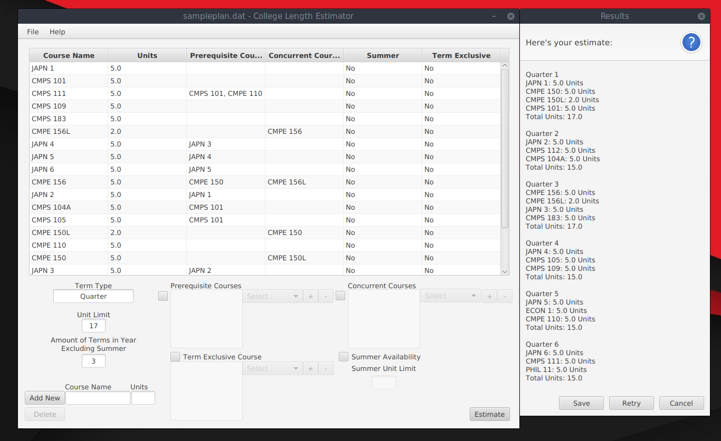
Project Release Plan – Architecture
College Length Estimator Web Edition

Slide 7
Project Release Plan – Challenges/Risks
College Length Estimator Web Edition
Challenge/Risk 1: Prerequisites and Concurrent Course Processing (Graph Theory Galore!)
Challenge/Risk 2: Majority of team unfamiliar with web programming.
Challenge/Risk 3: Parsing course information from UCSC website (It’s inconsistent per department.)

Slide 8
Project Release Plan – Technologies
College Length Estimator Web Edition
Technologies to be used:
- Languages: HTML5, PHP, CSS (Provided by Bootstrap), JavaScript/jQuery (Maybe)
- Web Framework: CakePHP
- Development Environments: Currently Atom Editor, NetBeans

