Slide 1
Lightweight DETR
朱顺尧
2025.3.14

Slide 2

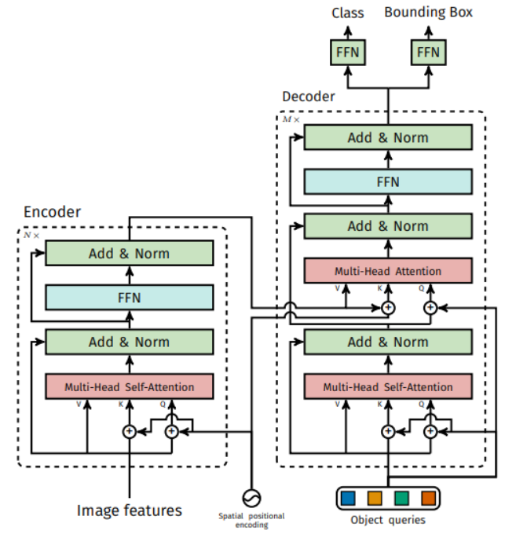
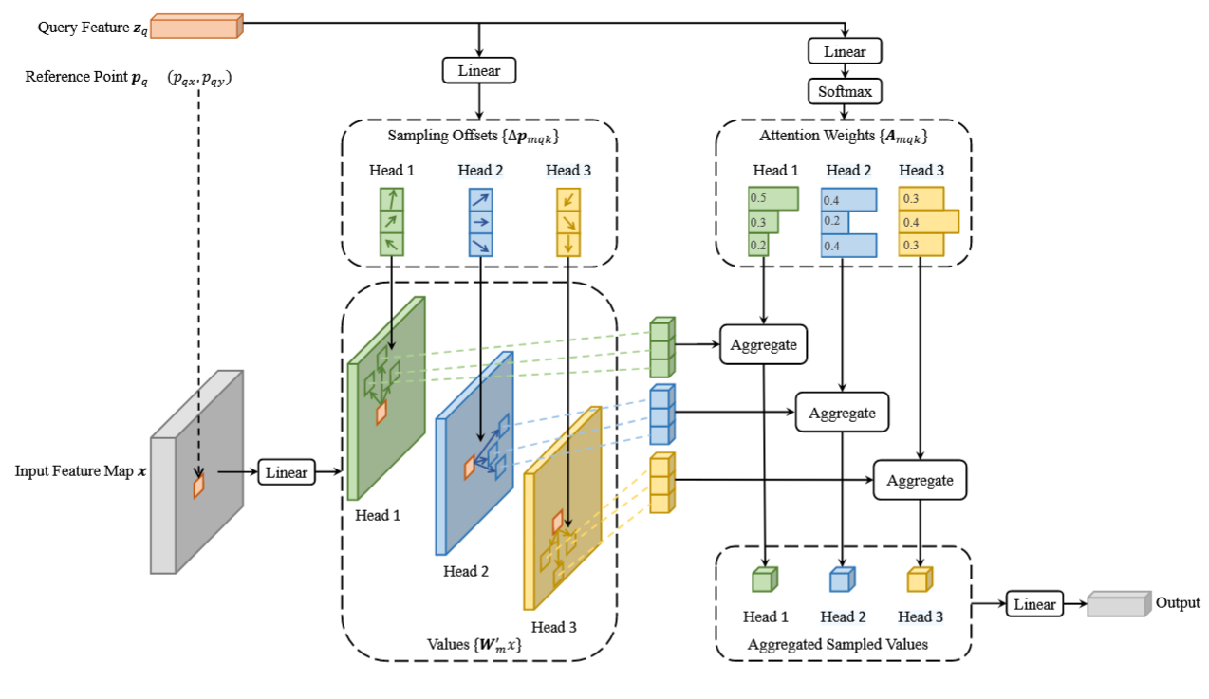
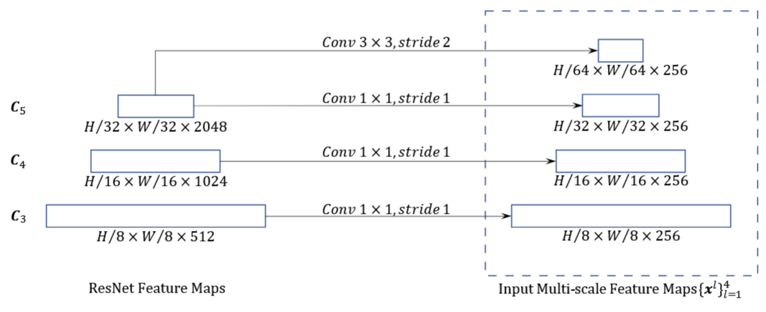
DETR
Multi-scale feature map
O ∝(HW)²d
Deformable attn：Sparse key
O_{Deformable} ∝ Nq(HW) d

Slide 3


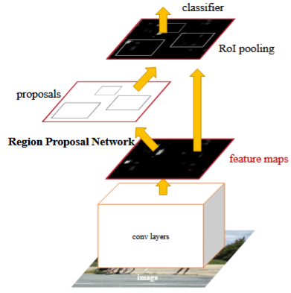
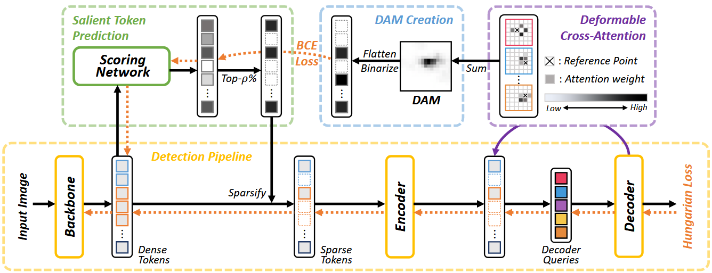

Slide 4


Slide 5
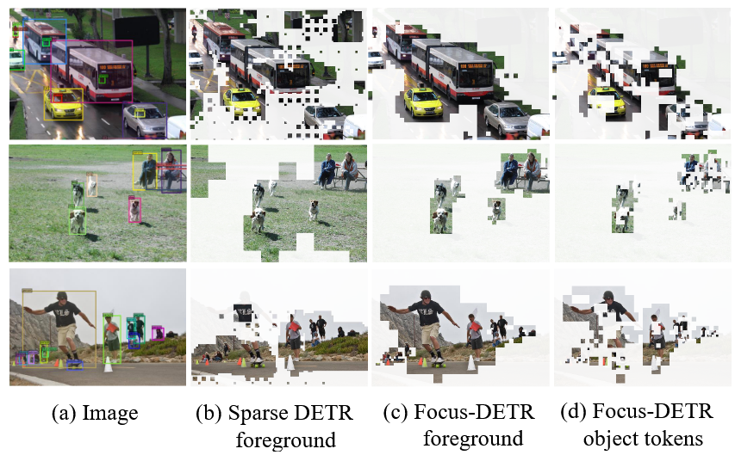
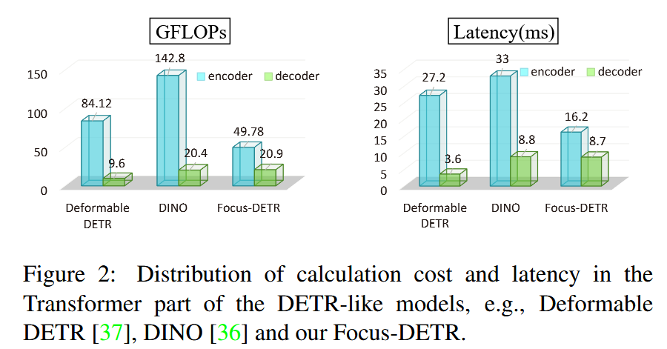
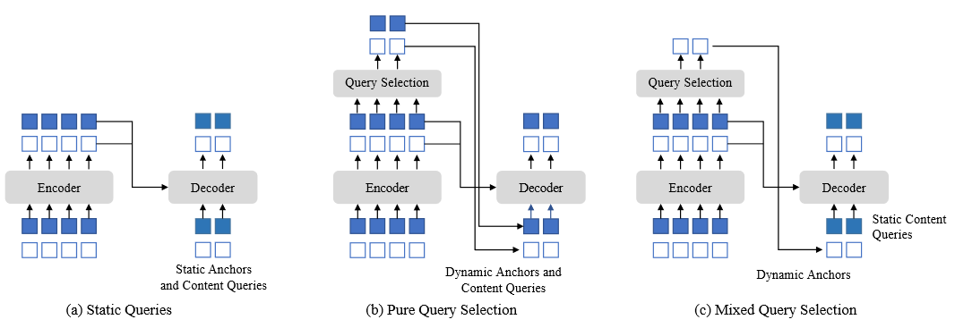
Motivation&Observation
Sparse DETR relies heavily on DAM
DAM use predicted pseudo GT to supervise training
Weak correlation between DAM and the retained foreground tokens while using learnable query

Slide 6
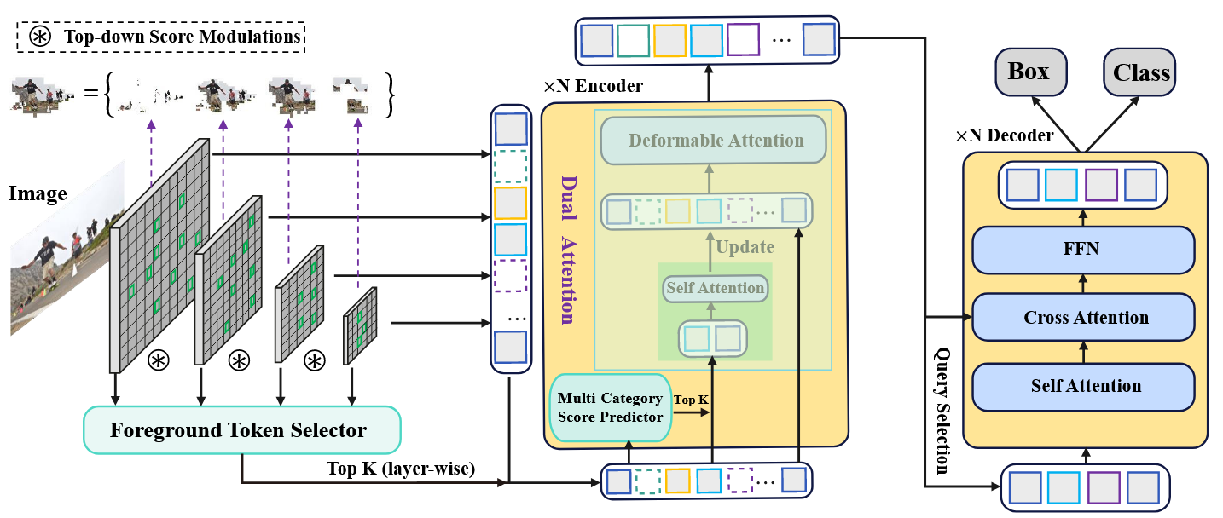
Method
Foreground Token Selector Multi-Category Score Predictor Dual Attention

Slide 7
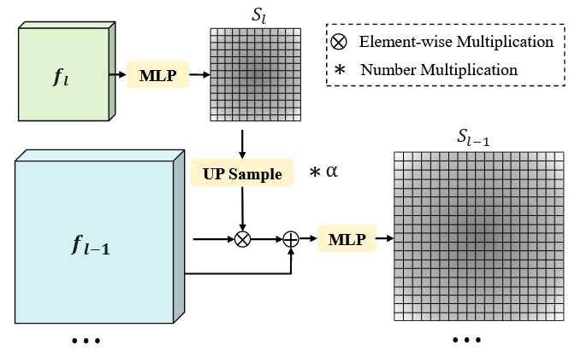



Method
Foreground Token Selector

Slide 8
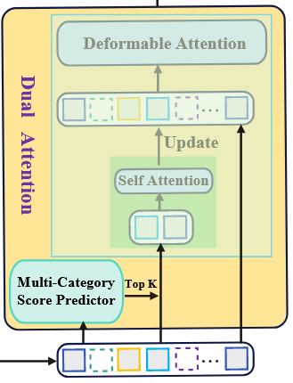

Method
Multi-Category Score Predictor
foreground
score
class
score

Slide 9
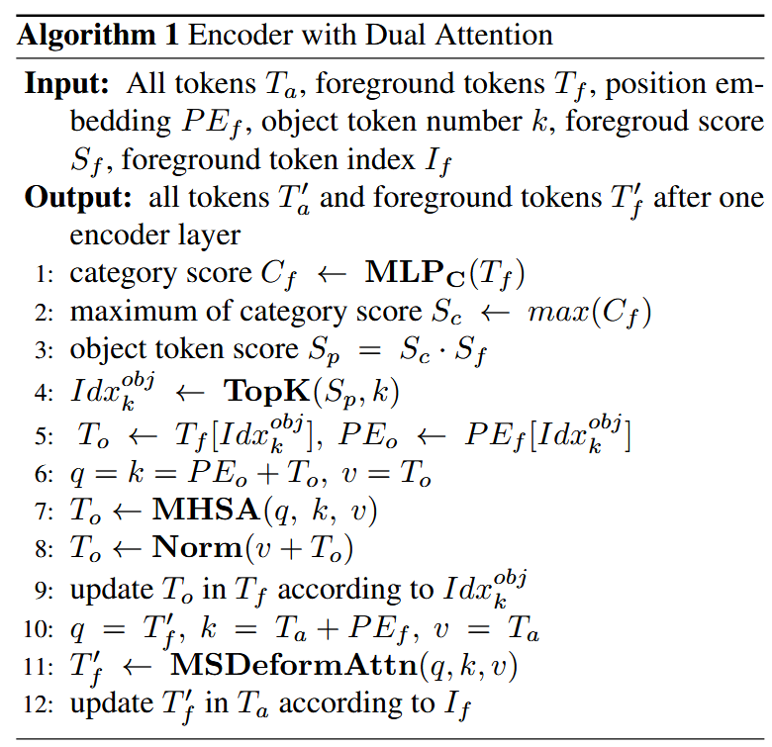
Method
Dual Attention topk=300

Slide 10
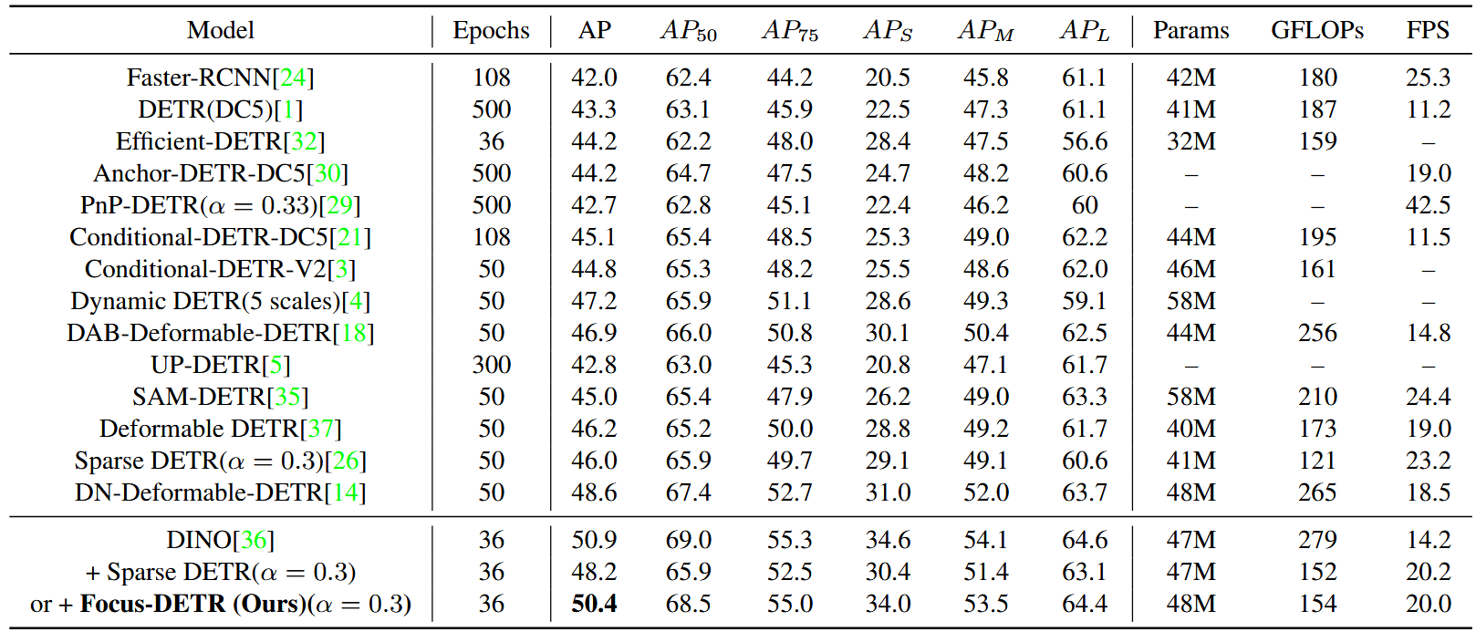
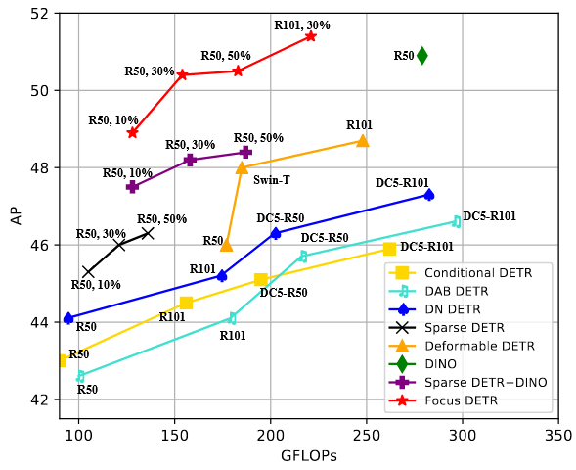
Results

Slide 11


Ablation

Slide 12
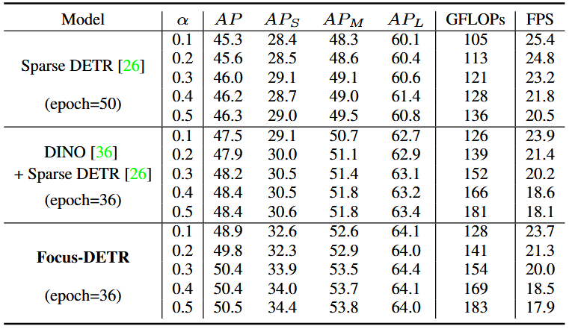
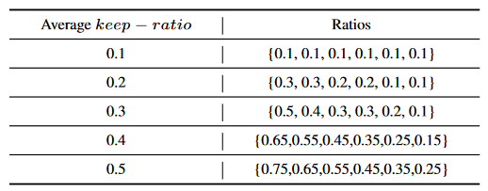
Ablation

Slide 13
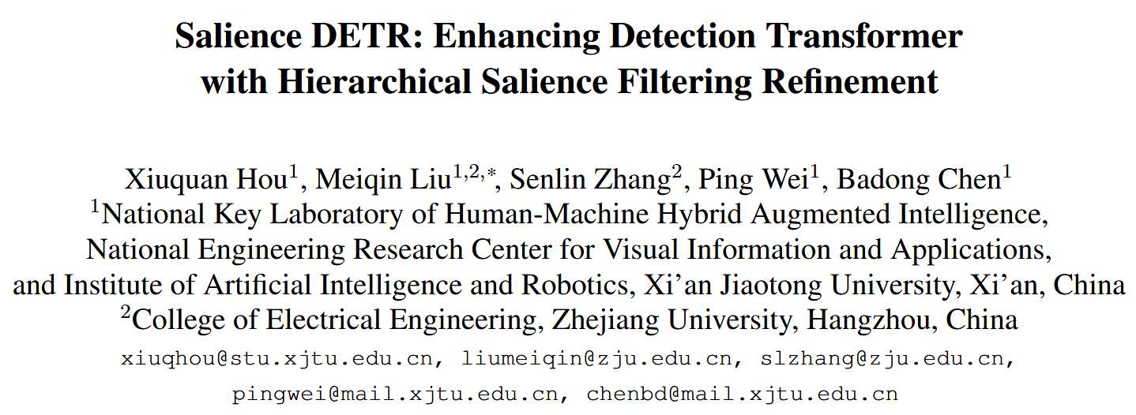

Slide 14
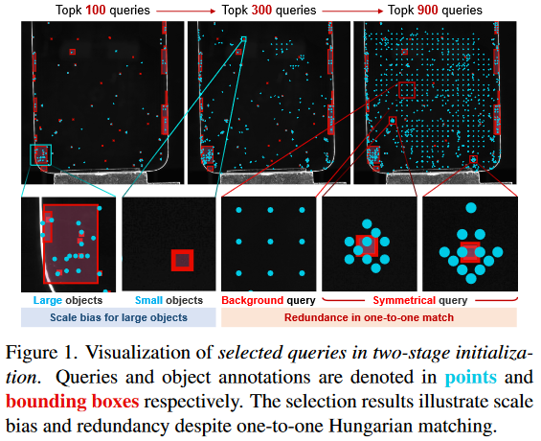

Motivation&Observation
Encoding Redundancy：background
Selection Redundancy：query do not match one-to-one with GT

Slide 15

Method

Slide 16
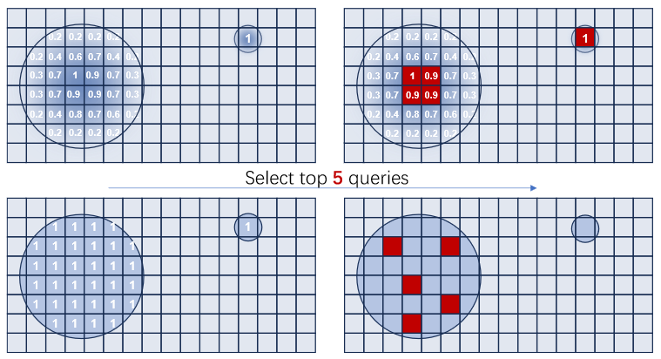


Method
Salience Supervision

Slide 17
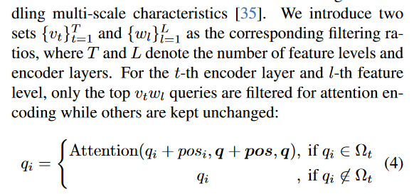

Method
Hierarchical Filtering
0.4 0.8 1.0 1.0
Dual attention

Slide 18
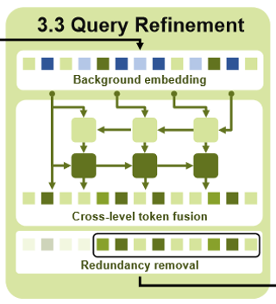


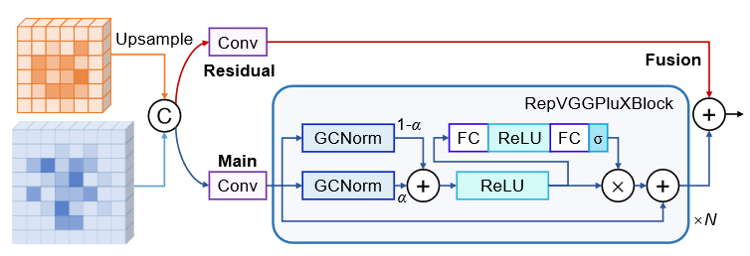


Method
Query Refinement (semantic misalignment)
Background embedding
Cross-level token fusion
Redundancy removal

Slide 19
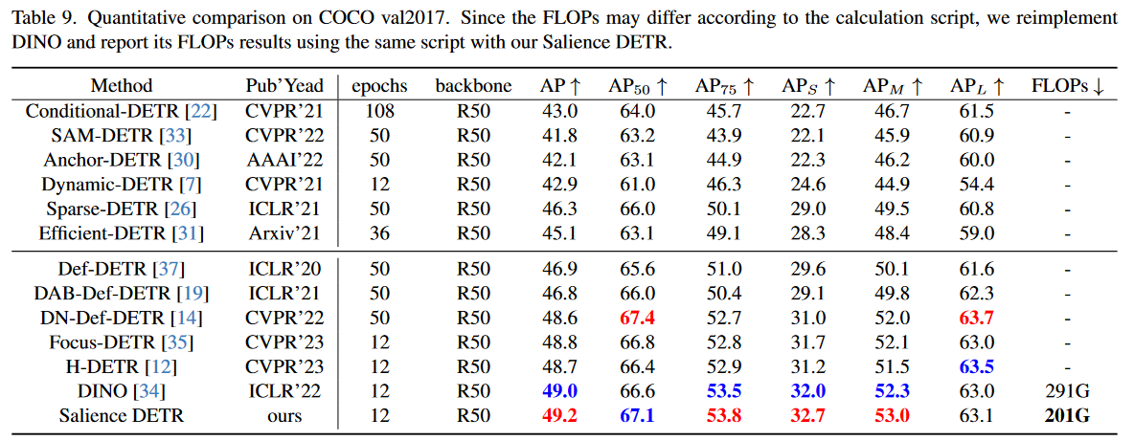
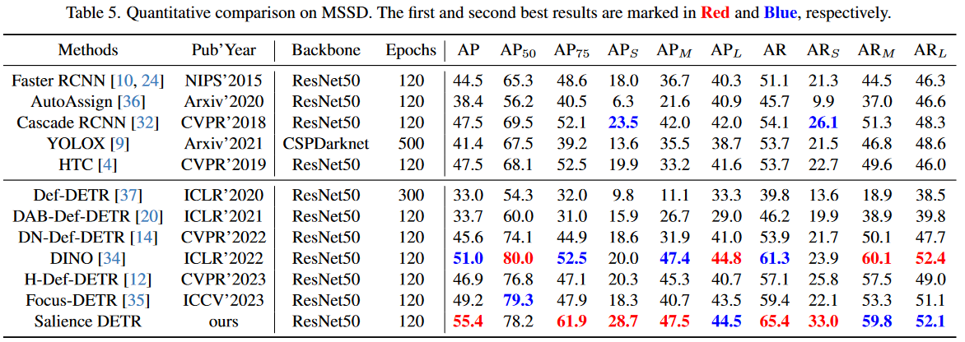
Results

Slide 20
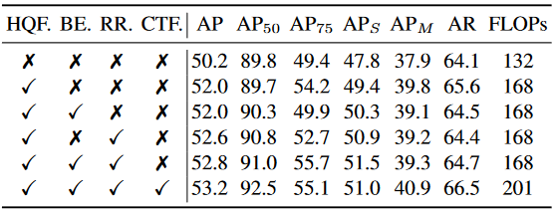
Ablation

Slide 21

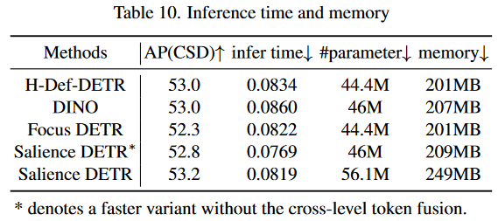
Ablation

