Slide 1
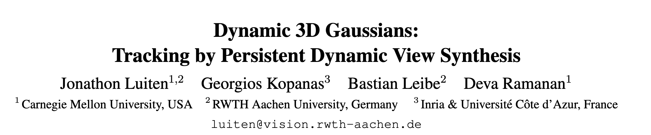

Slide 2
Task & Setting
Dynamic Novel-View Synthesis：
Given a set of images from different timesteps and different cameras (It,c),
along with each camera's respective intrinsic (Kc) and extrinsic (Et,c) matrices,
reconstructs the dynamic 3D scene (S) observed by these cameras
in a temporally persistent manner.
对于3D重建多了时间维度(物体运动)

Slide 3
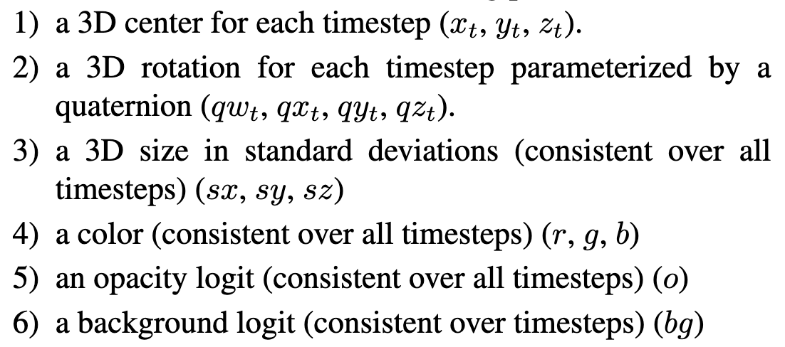
Background
traditional 3D gaussians
Dynamic 3D gaussians
1）3D center （ x, y, z）
2）3D rotation (w, x, y, z)
3）3D scaling （sx, sy, sz）
4）color （r, g, b）
5）opacity （o）
通过渲染到2D图像进行回归监督学习

Slide 4




Render
1. GS influences：
2. 2D均值计算
3. 2D协方差计算
4. 渲染公式

Slide 5
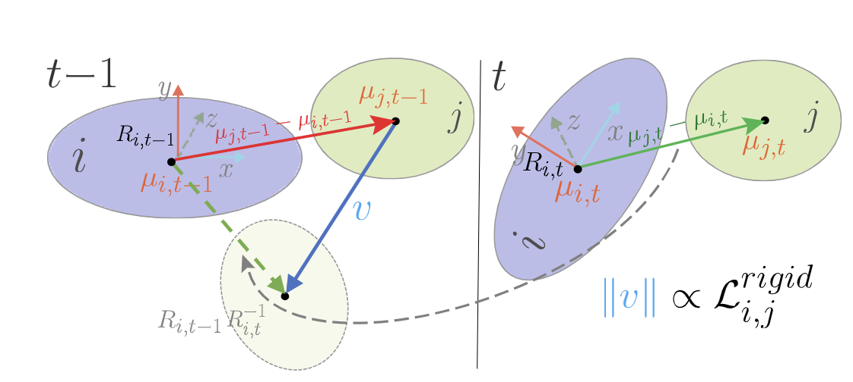




method：Physically-Based Priors
旋转约束
等距约束
刚体约束
0
t-1
t
lterative training

Slide 6
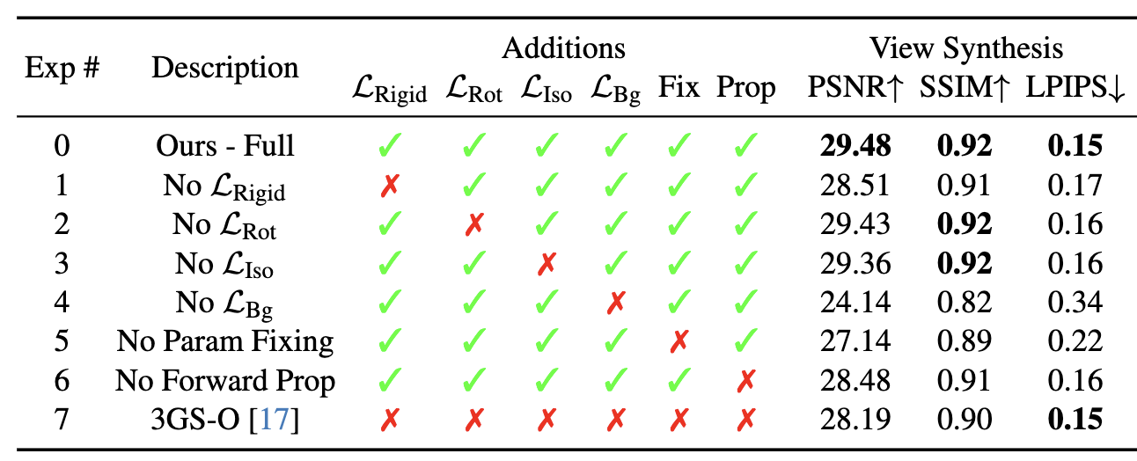
results
forward prop：时间步长初始化
would completely fail to reconstruct new objects entering the scene

Slide 7
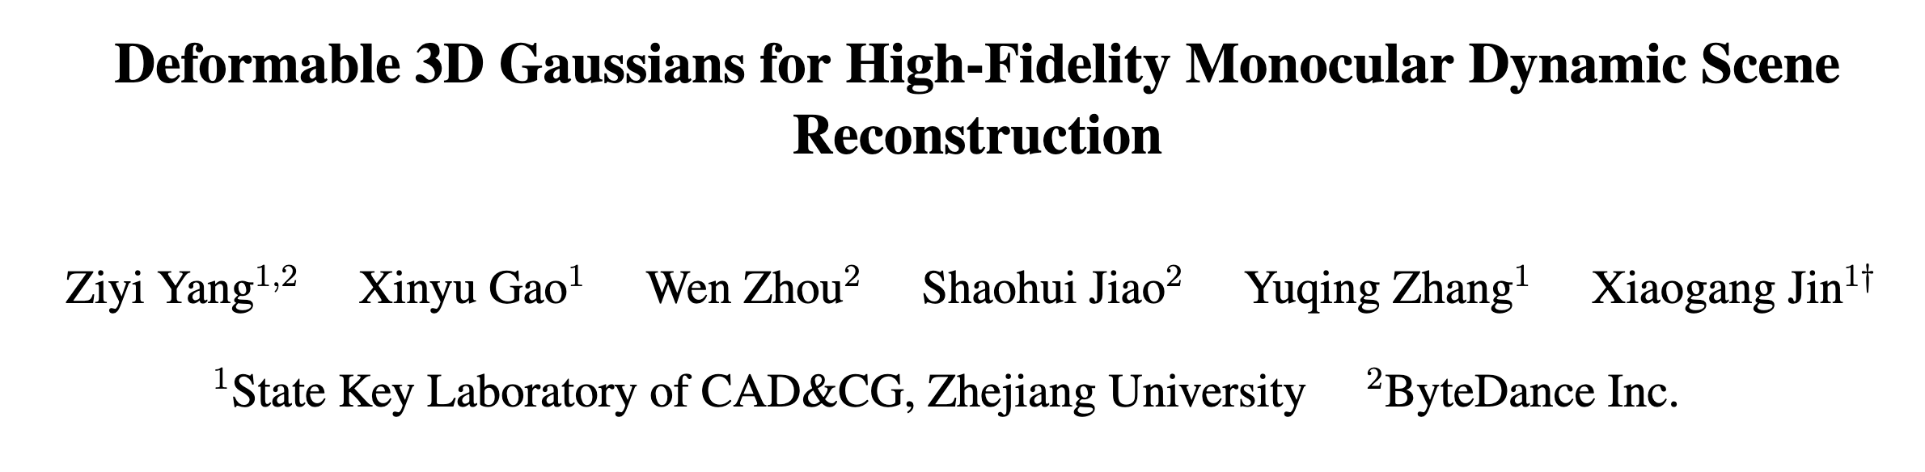

Slide 8
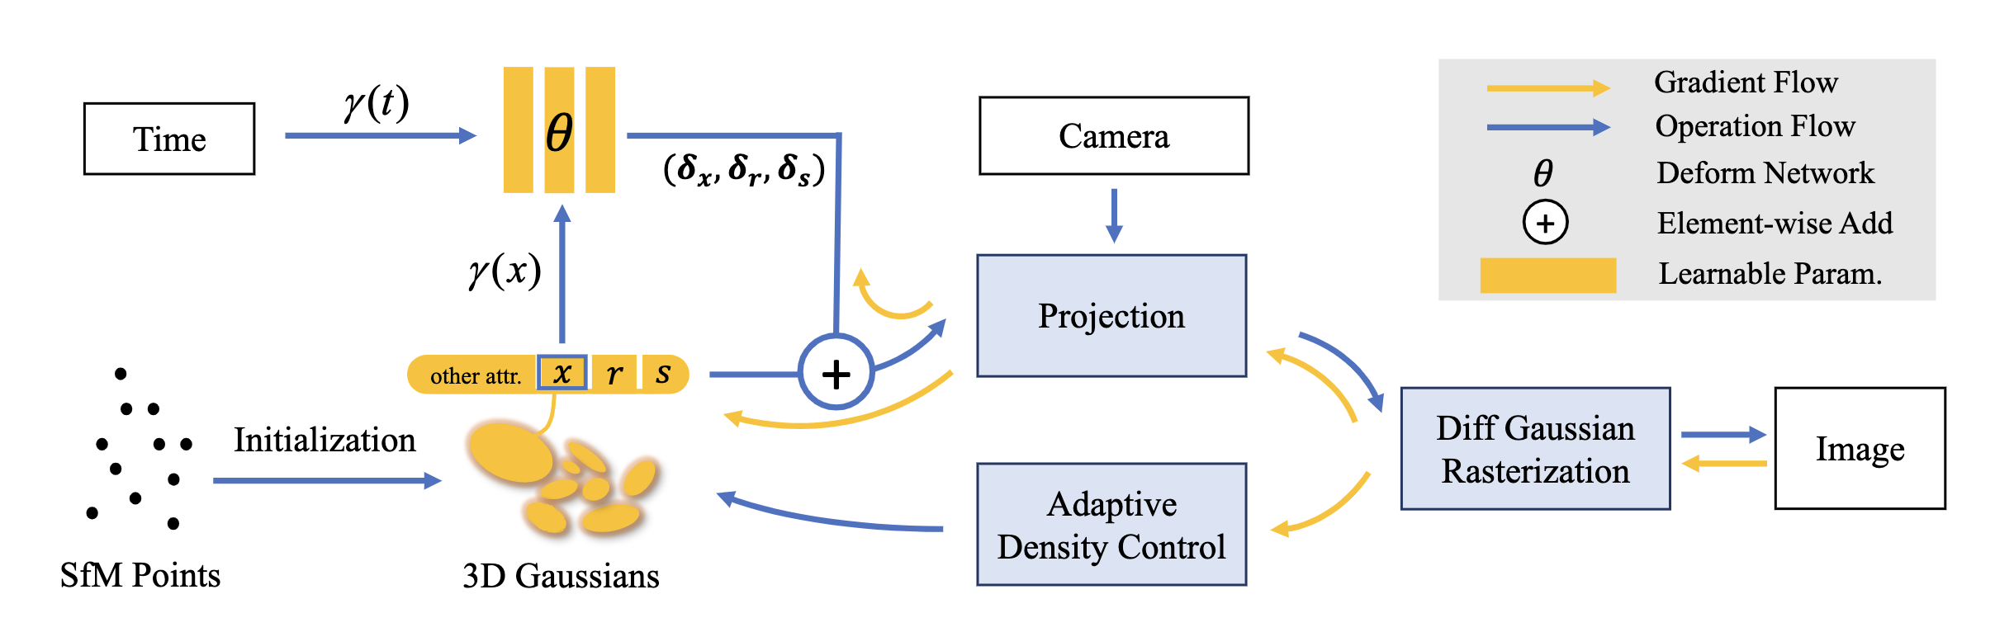
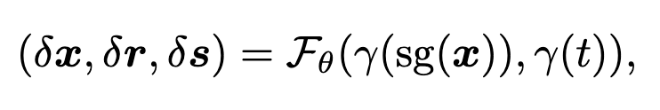

method

Slide 9
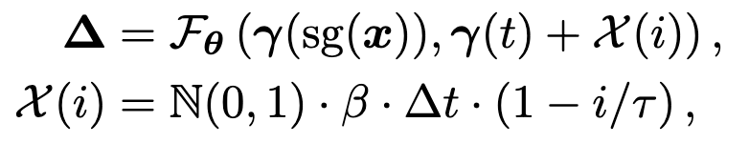
method
Annealing Smooth Training
噪声注入，增加鲁棒性

Slide 10
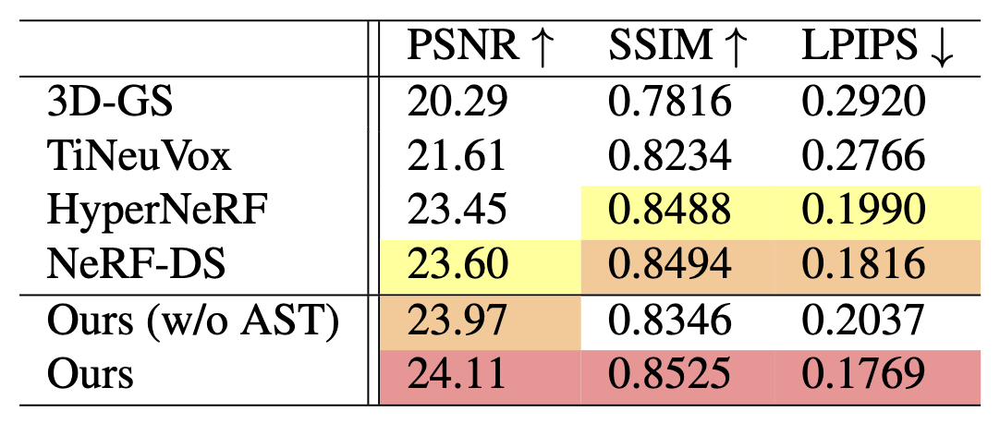
result

