Slide 1

Welcome
Please set up an account at www.pythonanywhere.com
We will be using the text www.automatetheboringstuff.com
Python Basics

Slide 2
Step 1: Cloning the Repository for the series
Go to https://github.com/CLEPyLadies/beginners_sessions_2020
Using the green code drop down, copy the link to your clipboard.
In Python Anywhere open the BASH console
Type:
git clone {Paste the line of code you just copied to your clipboard}
Hit return. You should have a new file folder in your FILES section of python anywhere.

Slide 3
OPEN A PYTHON CONSOLE

Slide 4
Basic Vocabulary
>>> 2 + 2
4
>>> 2
2
Expression
Values
Operators
Evaluate

Slide 5
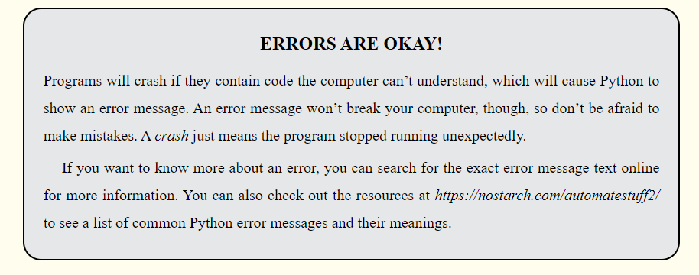
Mistakes are How WE Learn

Slide 6
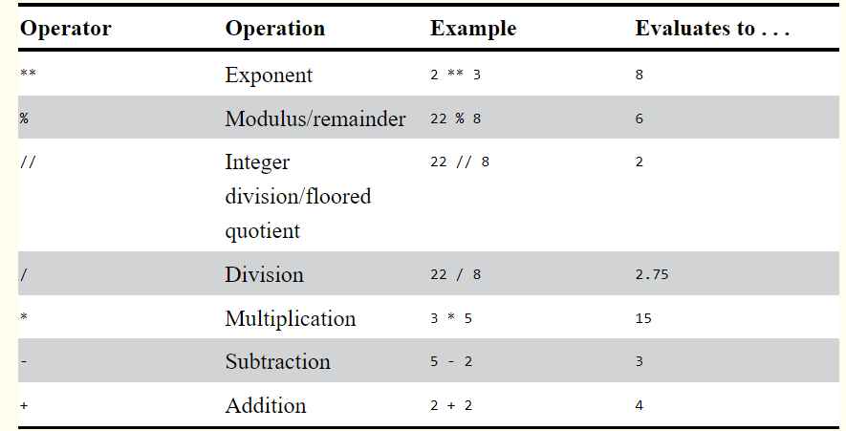
Math Operators

Slide 7
Try These Expressions
ORDER OF OPERATIONS (PRECEDENCE)
1. Exponent **
2. multiply *
3. integer division //
4. division /
5. modulo (remainder) %
6. addition + and subtraction -
2 + 3 * 6
(2 + 3) * 6
346445 * 678493
2 ** 8
23 / 3
23 // 3
23 % 3
(5 – 1) * ((7 + 1) / (3 – 1))

Slide 8
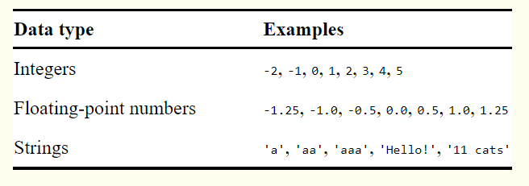
Data TYPES
Integers (int)
Floating-Point (float)
Strings (str)

Slide 9
String Concatenation and Replication
‘Alice’ + ‘Bob’
‘Alice’ * 5
‘Alice’ + 42
‘Alice’ + ‘42’
‘Alice’ * ‘Bob’
‘Alice’ * 5.0

Slide 10
Variables
Vocabulary
Assignment Statement
Assignment Operator
Verb: To assign
SPAM = 42

Slide 11
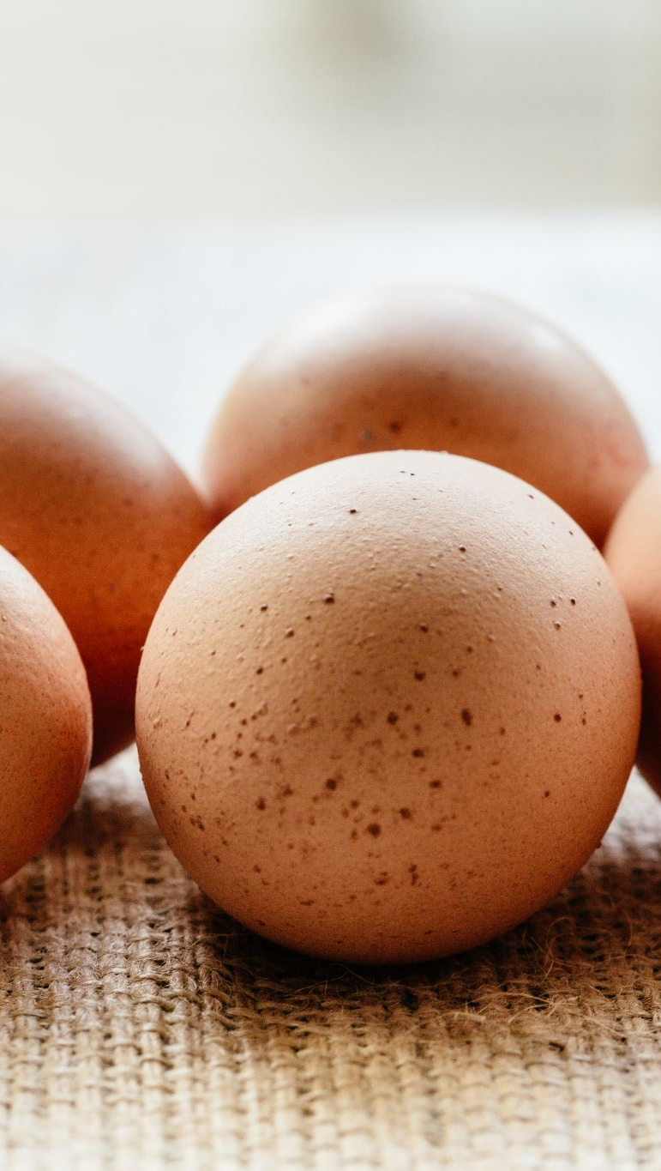
Try This
spam = 40
spam
eggs = 2
eggs
spam + eggs
spam * eggs
spam + eggs + spam
spam = spam + eggs
spam

Slide 12
Initializing, Overwriting, and Variable Names
Initialize
spam = ‘Hello’
spam
Overwrite
spam = ‘Goodbye’
spam

Slide 13
Putting it ALL together: Your FIRST PROGRAM
# This program says hello and asks for my name.
print(‘Hello World!’)
print(‘What is your name?’)
my_name = input()
print(‘It is good to meet you, ’ + my_name)
print(‘The length of your name is:’)
print(len(my_name))
print(‘What is your age?’)
my_age = input()
Print(‘you will be ’ + str(int(my_age) +1) + ‘ in one year’)

