Slide 1

Welcome
Please set up an account at www.pythonanywhere.com
We will be using the text www.automatetheboringstuff.com
Python Basics

Slide 2

Python Fundamentals Workshop
Objectives:
Learn fundamental concepts in a comprehensive and unified way that build upon each other week by week.
Push the limits of your technical experience.
Set yourself up to go deeper into Python or other computer languages and topics.
Learn in a welcoming setting where you can share your experiences with others judgement free.

Slide 3

Python Basics
Objectives:
Learn the basics of python and computer programming in general
Learn vocabulary and theoretical concepts
Build your first program

Slide 4
Step 1: Cloning the Repository for the series
Go to https://github.com/CLEPyLadies/beginners_sessions_2020
Using the green code drop down, copy the link to your clipboard.
In Python Anywhere open the BASH console
Type:
git clone {Paste the line of code you just copied to your clipboard}
Hit return. You should have a new file folder in your FILES section of python anywhere.

Slide 5
OPEN A PYTHON CONSOLE

Slide 6
Basic Vocabulary
>>> 2 + 2
4
>>> 2
2
Expression
Values
Operators
Evaluate

Slide 7
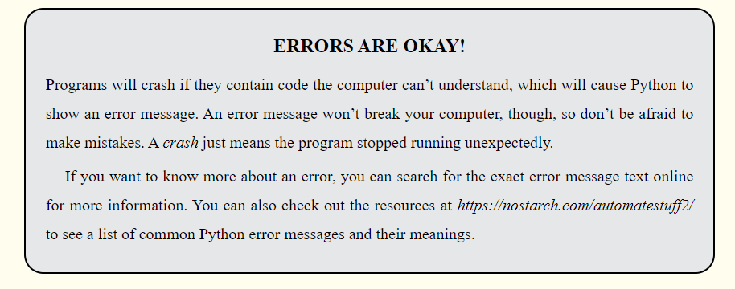
Mistakes are How WE Learn

Slide 8
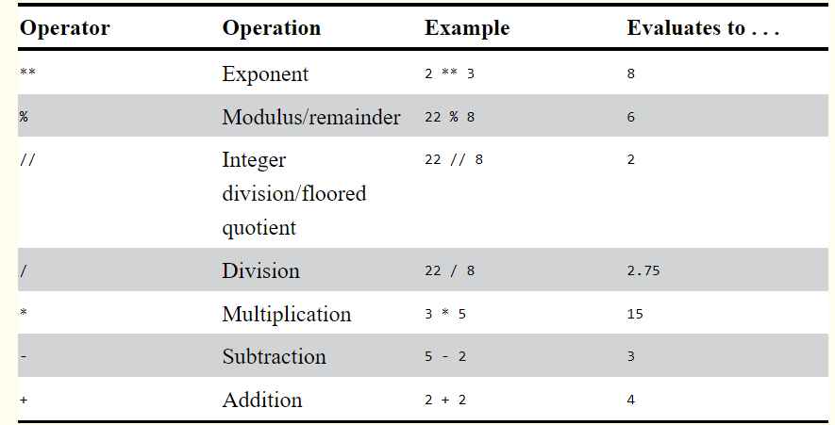
Math Operators

Slide 9
Try These Expressions
ORDER OF OPERATIONS (PRECEDENCE)
1. Exponent **
2. multiply *
3. integer division //
4. division /
5. modulo (remainder) %
6. addition + and subtraction -
2 + 3 * 6
(2 + 3) * 6
346445 * 678493
2 ** 8
23 / 3
23 // 3
23 % 3
(5 – 1) * ((7 + 1) / (3 – 1))

Slide 10
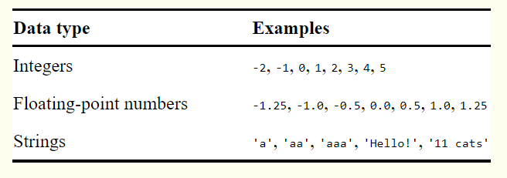
Data TYPES
Integers (int)
Floating-Point (float)
Strings (str)

Slide 11
String Concatenation and Replication
‘Alice’ + ‘Bob’
‘Alice’ * 5
‘Alice’ + 42
‘Alice’ + ‘42’
‘Alice’ * ‘Bob’
‘Alice’ * 5.0

Slide 12
Variables
Vocabulary
Assignment Statement
Assignment Operator
Verb: To assign
SPAM = 42

Slide 13
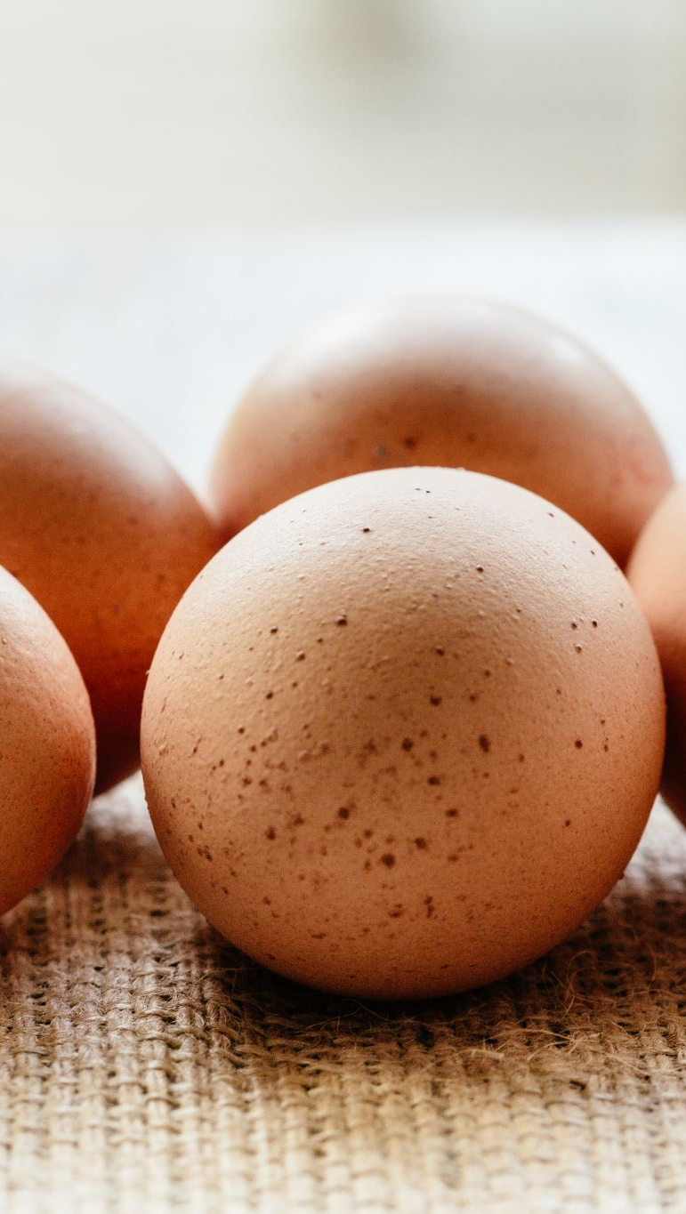
Try This
spam
spam = 40
spam
eggs = 2
eggs
spam + eggs
spam * eggs
spam + eggs + spam
spam = spam + eggs
spam

Slide 14
Initializing, Overwriting, and Variable Names
Initialize
spam = ‘Hello’
spam
Overwrite
spam = ‘Goodbye’
spam

Slide 15
Putting it ALL together: Your FIRST PROGRAM
# This program says hello and asks for my name.
print(‘Hello World!’)
print(‘What is your name?’)
my_name = input()
print(‘It is good to meet you, ’ + my_name)
print(‘The length of your name is:’)
print(len(my_name))
print(‘What is your age?’)
my_age = input()
Print(‘you will be ’ + str(int(my_age) +1) + ‘ in one year’)

Slide 16

Wrap UP and Next Steps
Homework: Read Chapter 2 of Automate the Boring Stuff
(Its okay if you don’t understand it all – we’ll talk the concept next time, but it is a long chapter and we will be moving fast, so it is helpful to familiarize yourself with the material)
How do you feel after this week?

