Slide 1
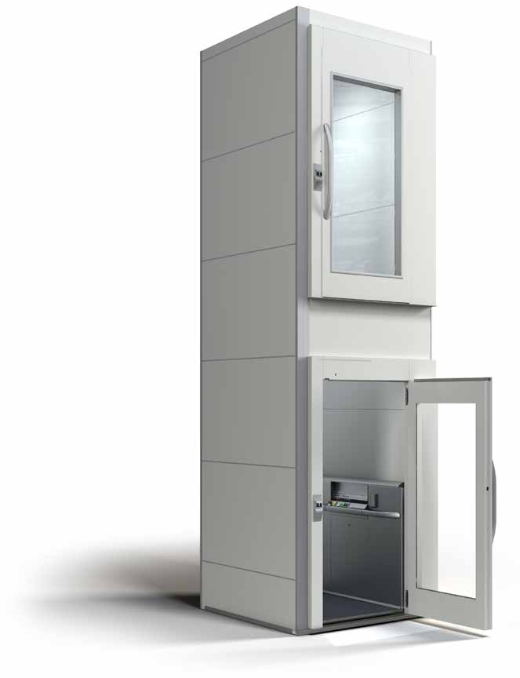
A GLOBAL MARKET
Global presence
Cibes Lift Group sells lifts in more than 50 countries, via direct sales subsidaries in selected countries or via our network of 200 distributors.
Headquarters and production
Sales companies/subsidiaries
Cibes representation
Cibes Approved Dealer Showroom

