Slide 1
New RTL TCM Flows: SDC Lint and Constraints Demotion using Rqual
Notes:
Purpose: Introduce shift-left constraints using Rqual + TCM; outcomes: early issue detection, mapped SDCs, demotion methodology.

Slide 2
AGENDA
Overview and Benefits
RTL TCM FLOWS
Introduction to Rqual
Overview of Rqual
RTL TCM Adoption Plan
SDC lint and constraints demotion flows
Notes:
Agenda: motivation → flow → parameters → checks → inputs/outputs → demotion → artifacts.

Slide 3
Rqual (RTL static verification)
Improved RTL Quality
Consolidate disparate checks into a standardized location
Unified verification for all IPs
Reduced Verification Time
Shift left structural verification into defined stages for consistency
Easy to setup for new users
Ensure all checks standardize on a unified reporting mechanism for easy data analysis
Comprehensive check visualization which allows intuitive user optimization of runtime performance

Slide 4
Implementing a Shift-Left Strategy for Constraints Validation
Why Change?
Benefits
Current flow waits for full-chip feedback at gate-level
New Approach
Validate constraints early at RTL stage
Feedback comes late → costly fixes and schedule delays
Validation happens after netlist generation instead of early RTL stage
Perform SDC lint checks, same-domain false path checks, no-marker checks
Faster turnaround
Early detection → fewer late surprises
Significant time savings vs current flow
Improved design quality and smoother integration
Use Rqual for RTL static verification
Unified reporting for lint and constraint checks
Easy setup for new tiles/IPs
Tools and Automation

Slide 5
RTL TCM FLOWS

Slide 6
Why Do We Need It?
Early Constraints Validation (Shift-Left)
Catches issues **BEFORE** synthesis and P&R
Prevents costly re-spins in later stages
Easier and faster fixes at RTL level
Constraint Quality Assurance
Ensures clocks properly defined
Verifies timing exceptions are valid
Confirms generated clocks correctness
Design Methodology Compliance
Enforces AMD's TCM standards
Consistent practices across blocks
Quality metrics tracking
Missing Marker c ells on FP and MCP exceptions
Marker Cell Check
Confirms generated clock derivations
Wrong number of cycles on MCPs

Slide 7
RTL TCM FLOWS
IP-Block TCM Lint & Demotion
Block->Tile TCM Lint & Promotion : WIP
Tile->SOC TCM Lint & Promotion
IP Clock XML/SDC/Tunable SDCs/Tcl
SOC File List (RTL)
Tile file-list (RTL)
TCM Constraints Promotion
IP File-list (RTL)
TCM Lint Check
html/reports
-logs/mapped sdc
TCM Constraints Promotion
TCM Constraints Demotion
Demoted Block Constraints
Promoted SOC Constraints
Tile Promoted Constraints
TCM Equivalence check
TCM Lint check
TCM LINT Check

Slide 8
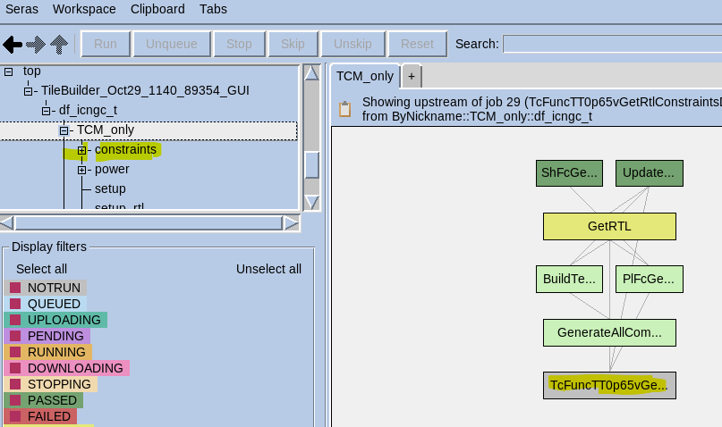
TCM RTL LINT CHECK
TileBuilder Console
No Marker checks:
rpts/Tc*/fp_verification/
rpts/Tc*/mcp_verification/
SDC LINT CHECKS:
rpts/Tc*/setup/
LINT/ SDC check
XML
Convert xml to SDC
Input SDC
No marker check reports
Same Domain FP
Multi cycle MCP
TCM Constraints Check
TCM mapped constraints
SDC lint checks
-rpts/Tc*/setup/*mapped.sdc
Constraints Lint refers to the verification of the contents of an SDC (Synopsys Design Constraints) file to flag situations where the specified constraints are either incorrect or incomplete. If not addressed, these issues could result in silicon failure.
This flow reads the RTL (Register Transfer Level) synthesizable file list and input constraints.
It then verifies various aspects such as clock constraints, case analysis, IO constraints, generated clocks, and timing exceptions. It generates System Verilog Assertions for all exception-failing paths, and generated clock failures.
These generated assertions can be used for further verification in functional simulation.

Slide 9
Step 1: Constraint Mapping
└─> Map SDC constraints
└─> Result: Check mapping success
↓
Step 2: Database Creation
└─> Build TCM design database
└─> Extract structural hierarchy
↓
Step 3: Clock Setup Verification
└─> Verify clock definitions
└─> Check clock relationships
└─> Result: Check warnings identified
↓
Step 4: Generated Clock Verification
└─> Formal verification of clocks
└─> Result: pass rate
↓
Step 5: Report Generation & Metrics
└─> HTML reports, CSV metrics, TCM validation
Technical Flow (RTL Constraint Check)

Slide 10
TCM OUTPUT (s)
Directory | File Name | File Type | Summary
ROOT | README | Documentation | Flow documentation describing verification and generation procedures for TCM constraint checking
ROOT | ft_stats.rpt | Summary Report | Consolidated runtime summary and verification metrics across all constraint checking phases
ROOT | ft_stats.html | Summary Report | Interactive HTML dashboard for browsing all verification results in web browser
ROOT | ft_stats.csv | Summary Report | Machine-readable CSV format of runtime and verification statistics for automated tracking
ROOT | setup_issues.rpt | Issue Report | Comprehensive listing of RTL issues SDC parsing warnings and constraint setup problems
ROOT | tcm_constraints_check.json | Compliance Report | TCM validation status with pass/fail metrics for timing exceptions and methodology compliance
ROOT | tunesource_sourced_file_list | Log | Log of all tune files sourced during verification run
ROOT | generate_all | Executable | Master executable script to run all constraint generation steps
ROOT | generate_summary | Executable | Script to compile final summary report from all verification runs
ROOT | verify_all | Executable | Master executable script to run all verification steps including mapping and exception checking
ROOT | ogmatic-Static_Timing.Constraint.csv.gz | Database Export | Compressed database export of all timing constraints for OGMATIC metrics tracking
ROOT | ogmatic-Static_Timing.Constraint_Validation_Violations.csv.gz | Database Export | Comprehensive database of all constraint validation violations
ROOT | ogmatic-Static_Timing.Constraint_Validation_Violations_Waiver.csv.gz | Database Export | Database of waived violations with justification metadata
ROOT | ogmatic-TileBuilder.Jobstats.csv.gz | Database Export | Job execution statistics including runtime and resource utilization
ROOT | ogmatic-TileBuilder.Jobstats_Features.csv.gz | Database Export | Feature-level execution metrics for TileBuilder performance analysis
ft_stats_issues | clock_warnings.csv | Issue Report | Comprehensive listing of all clock-related warnings from setup verification

Slide 11
CONTD…
Directory | File Name | File Type | Summary
setup | Syn.Constraints.all.mapped.sdc | Constraint File | Complete set of RTL constraints successfully mapped to design
setup | design.fdb | Database | TCM design database containing RTL elaboration and structural hierarchy
setup | analysis.fdb | Database | TCM analysis database with timing paths and constraint relationships
setup | design.rdb | Database | RTL database in RDB format for TCM processing
setup | files.f | File List | File list for RTL elaboration and design database creation
setup | generated_clock_verification.sdc | Constraint File | SDC file containing all generated clock definitions for verification
setup | glitch_verification.sdc | Constraint File | SDC constraints for glitch analysis if enabled
setup | design_setup_issues.html | Issue Report | HTML report of clock setup issues with interactive browsing
setup | lint_summary.rpt | Lint Report | SDC syntax and semantic lint checking results with violation details
setup | setup_issues.csv | Issue Report | CSV format of all setup issues for database import and tracking
setup | map_sdc.log | Log | Detailed log from SDC constraint mapping phase
setup | map_sdc_and_check_setup | Executable | Executable to perform constraint mapping and clock setup verification
setup | setup.log | Log | Detailed log from clock setup verification phase
setup | write_db.log | Log | Log from TCM design database creation phase
setup | write_db_mem.log | Log | Memory usage log during database creation
setup | modules.rpt.gz | Hierarchy Report | Compressed report of all design modules and hierarchy
setup | rmodules.rpt.gz | Hierarchy Report | Compressed report of refined module information post-elaboration
setup | waive.sdc | Constraint File | Symbolic link to SDC waiver file for suppressing known benign issues
setup | remove_databases | Executable | Script to clean up design and analysis databases for fresh runs
setup | write_rdb | Executable | Script to write RTL database in RDB format
setup | write_setup_db_and_do_setup | Executable | Script to create setup database and run clock verification
setup | write_verification_db | Executable | Script to create verification database for exception checking
setup | tcm_data.csv | Compliance Report | TCM-specific data metrics for constraint methodology compliance tracking
setup | run_status.log | Log | Execution status log for setup verification run
setup | report_setup_issues.log | Log | Log from setup issue reporting phase
setup | map_mem.log | Log | Memory usage log during constraint mapping phase
setup | setup_mem.log | Log | Memory usage log during setup verification phase
setup | lite_mem.log | Log | Memory usage log during lite verification mode
setup | rpts.tar.gz | Report Archive | Compressed archive of all setup verification reports

Slide 12
CONTD…
Directory | File Name | File Type | Summary
setup/rpts | clk065_insts.rpt | Text | Clock instances at 0.65V operating voltage corner
setup/rpts | clock_crossings.rpt | Text | Clock domain crossing analysis identifying all CDC paths and asynchronous boundaries
setup/rpts | clock_definitions.rpt | Text | Complete definitions of all primary clocks generated clocks and virtual clocks
setup/rpts | clock_propagation.rpt | Text | Clock propagation paths through the clock network showing distribution structure
setup/rpts | clock_to_data_pins.rpt | Text | Pins receiving both clock and data signals with timing path information
setup/rpts | clocks.rpt | Text | Overall clock summary report with statistics and relationships
setup/rpts | constant_propagation.rpt | Text | Constant value propagation through design identifying static signals
setup/rpts | endpoints.rpt | Text | All timing endpoints including register inputs and output ports
setup/rpts | legal_values.rpt | Text | Legal signal values and value constraints for design signals
setup/rpts | mapping.rpt | Text | SDC constraint mapping results showing successful mappings and failures
setup/rpts | metastable_endpoints.rpt | Text | Endpoints at risk for metastability and CDC synchronizer analysis
setup/rpts | ports.rpt | Text | Complete port definitions including input output and inout ports
setup/rpts | static_nets.rpt | Text | Nets with constant values including tie-high and tie-low connections
setup/rpts | unconstrained_paths.rpt | Text | Timing paths without constraints identifying missing constraint coverage
setup/rpts | waived_endpoints.rpt | Text | Timing endpoints with applied waivers and justification documentation
setup/rpts | waived_messages.rpt | Text | Suppressed warning and error messages with waiver reasons
setup/rpts | waived_start_end_pair.rpt | Text | Start-to-end path pairs with timing waivers applied

Slide 13
CONTD…
Directory | File Name | File Type | Summary
fp_verification | fp_verification_summary.html | Summary Report | HTML summary of false path verification results with pass/fail statistics
fp_verification | passing_and_failing_exceptions_fp.csv | Metrics Report | CSV summary of passing and failing false path exceptions
fp_verification | pass.sdc | Constraint File | False paths that successfully passed formal or assertion-based verification
fp_verification | fail.sdc | Constraint File | False paths that failed verification requiring debug and correction
fp_verification | no_paths.sdc | Constraint File | False path constraints where no matching timing paths exist in design
fp_verification | unknown.sdc | Constraint File | False paths with indeterminate verification status
fp_verification | assertions.out.gz | Formal Results | Compressed assertion results from formal verification engine
fp_verification | verify_fp | Executable | Executable script to run false path verification flow
fp_verification | run_confirm.log | Log | Detailed log from false path confirmation phase
fp_verification | run_confirm_mem.log | Log | Memory usage log during false path confirmation
fp_verification | confirm_mem.log | Log | Memory tracking log for confirmation phase resource monitoring
fp_verification | generate_html | Executable | Script to generate HTML summary for false path verification
fp_verification | generate_html.log | Log | Log from HTML report generation phase

Slide 14
CONTD…
Directory | File Name | File Type | Summary
mcp_verification | mcp_verification_summary.html | Summary Report | HTML summary of multicycle path verification with pass/fail statistics
mcp_verification | passing_and_failing_exceptions_mcp.csv | Metrics Report | CSV summary of passing and failing MCP exceptions
mcp_verification | passing_and_failing_exceptions_mcp.modified.csv | Metrics Report | Modified MCP exception CSV with additional analysis data
mcp_verification | pass.sdc | Constraint File | Multicycle paths that successfully passed formal verification
mcp_verification | fail.sdc | Constraint File | Multicycle paths that failed verification requiring correction
mcp_verification | no_paths.sdc | Constraint File | MCP constraints where no matching timing paths exist
mcp_verification | unknown.sdc | Constraint File | Multicycle paths with indeterminate verification status
mcp_verification | assertions.out.gz | Formal Results | Compressed assertion results from MCP formal verification
mcp_verification | verify_mcp | Executable | Executable script to run multicycle path verification flow
mcp_verification | run_confirm.log | Log | Detailed log from MCP confirmation phase
mcp_verification | run_confirm_mem.log | Log | Memory usage log during MCP confirmation
mcp_verification | confirm_mem.log | Log | Memory tracking log for MCP confirmation phase
mcp_verification | generate_html | Executable | Script to generate HTML summary for MCP verification
mcp_verification | generate_html.log | Log | Log from MCP HTML report generation phase

Slide 15
RTL TCM DEMOTION
XML
In override.params:
TCM_BLOCK_LIST = <block1> <block2>
In override.controls
TCM_RTL_DEMO_CHECK = 1
<:
run_constraints_check( {tool=>"tcm", mode => "demote",type=>"tile",sdc_corner =>
(split /:/, "$FCNL_CONSTGEN_MODES_CORNERS")[1],sdc_mode => "$OPTIMIZATION_MODE",stage_name=> "GetRtl"});
:>
TCM_BLOCK_LIST
Convert xml to SDC
Get SDC
TCM Demotion
TCM Lint
Demoted constraints
Mapped constraints/Logs/Reports
Generated SDC(s)
- rpts/<TARGET_NAME>/constraints_demotion/<block_name>.sdc
If No xml and No GetSDC provided, The flow will pick SDC from SYN_CONSTRAINTS_ORDER param in the order and those files will pick from tune/FxSynthesize folder

Slide 16
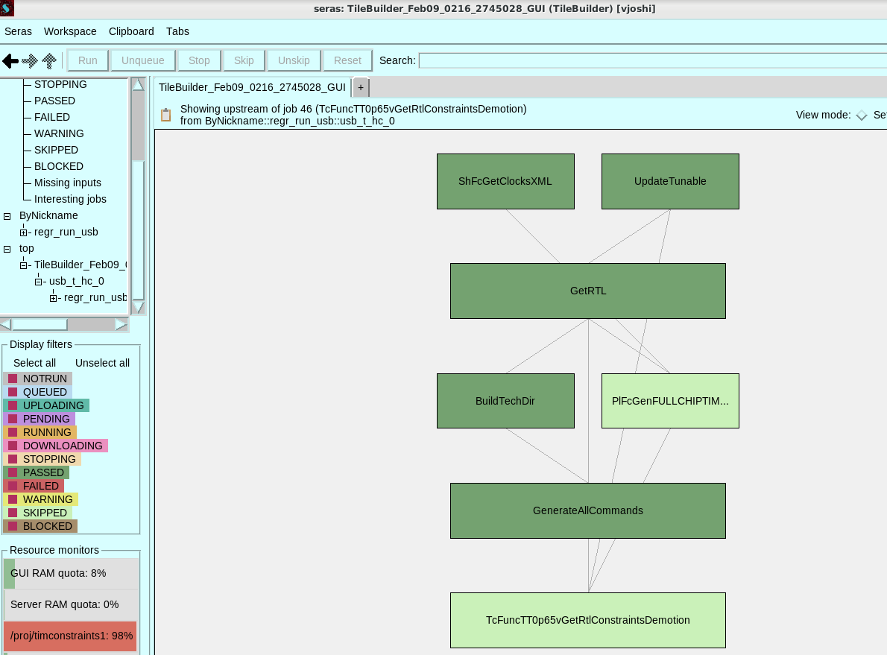
TCM RTL DEMOTION
An established methodology exists for propagating design constraints from the IP level to the block level.
In a top‑down IP design flow, top‑level design constraints are systematically decomposed and propagated to the block level, thereby enabling the derivation of consistent and implementation‑ready block‑level constraints from the top‑level requirements. Flow demotes constraints from IP to block.
Run Dir: /proj/timconstraints1/vjoshi/Rqual/USB/main/pd/tiles/usb_t_hc_0_regr_run_usb_TileBuilder_Jan13_1100_44218_GUI

Slide 17
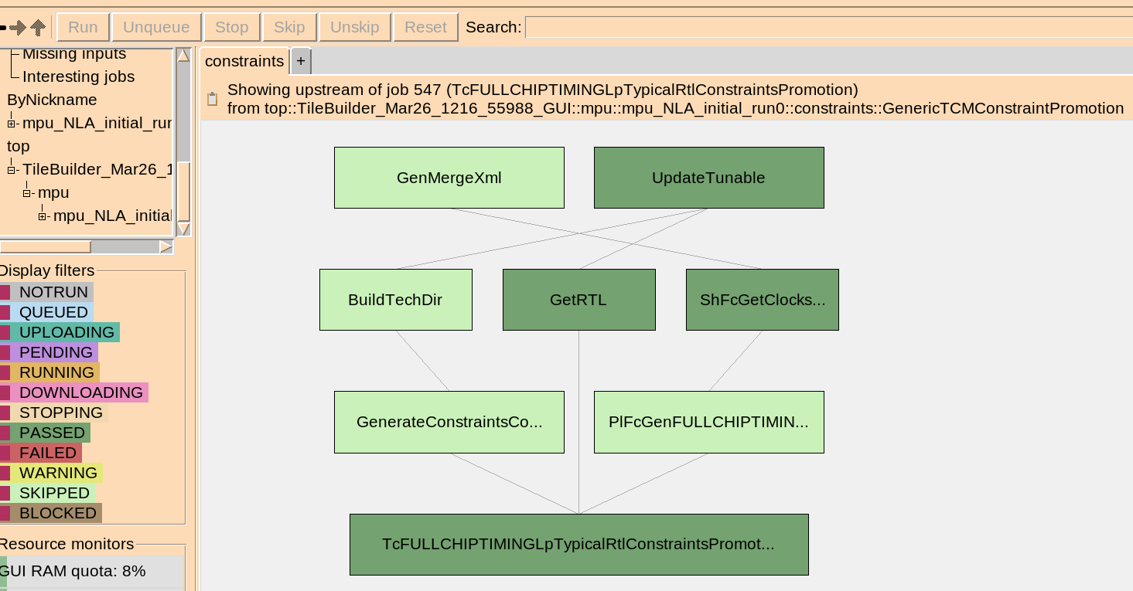
RTL TCM Tile->SOC Promotion
Pre-requisites
SOC Synthesizable file-list
XML (IP Xml(s))
Eg (For GetRTL)
RTL_TAG =
SYN_VF_FILE = /proj/timgatecdc1/vjoshi/TCM/Medusa/TB/main/pd/tiles/mpu_mpu_NLA_initial_run0_TileBuilder_Mar26_1216_55988_GUI/data/GetRTL_org_Feb6/GetRTL.vf
USE_DROP2CAD = 0
DROP_TO_CAD_FOR_GPU = 0
Run Dir:/proj/timgatecdc1/vjoshi/TCM/Medusa/TB/main/pd/tiles/mpu_mpu_NLA_initial_run0_TileBuilder_Mar26_1216_55988_GUI

Slide 18
Q&A

