Slide 1
GENIE AGENT
KEY STATS
Analyze Mode
4
Entry Points
Complete Flow Guide
4
Pipeline Waves
From run instruction to analysis report — CDC/RDC · Lint · SpgDFT · Auto-Fixer Loop\
Azman/Warren
5
Max Fixer Rounds
AI-powered static check analysis framework for RTL design verification
0
Waivers Added
1 / 12

Slide 2
THE CHALLENGE
Why Analyze Mode?
🔍 Hundreds of Violations
✅ THE SOLUTION
Static checks produce CDC/RDC, Lint and SpgDFT violations — manually reviewing them is slow and error-prone.
→ Automated parallel agent analysis
→ Intelligent violation filtering (DFT/RSMU excluded)
→ RTL-level root cause explanation per violation
→ Auto-apply fixes — constraint & RTL
→ Round-to-round fix memory (no repeated mistakes)
→ HTML report emailed per check type
→ ZERO waivers — all fixes in RTL or constraints
⚠️ Tool Noise vs Real Bugs
DFT/RSMU false positives buried with real RTL issues — engineers waste time on irrelevant violations.
🔄 Repeat Re-runs
Fix one violation, re-run, repeat — no memory of what was tried before across rounds.
2 / 12

Slide 3
ENTRY POINTS
4 Ways to Trigger Analysis
A
Run + Analyze
B
Analyze Only
--analyze
--analyze-only
Run static check AND analyze when it completes. Monitor runs in background — main session stays free.
Skip re-running — analyze an already-completed run. Emits SKIP_MONITORING=true to jump straight to agents.
C
Run + Auto-Fix Loop
D
Fix Existing Results
--analyze-fixer
--analyze-fixer-only
Run check → analyze → auto-apply all fixes → rerun. Loop repeats up to 5 rounds or until CLEAN.
Start the fixer loop from an already-completed run. No re-run needed — picks up where analysis left off.
3 / 12

Slide 4
PIPELINE OVERVIEW
The 4-Wave Analysis Pipeline
WAVE 1
GATE
WAVE 2
WAVE 2.5
WAVE 3
Extractor & Precondition
Skip Logic Gate
RTL Analyzer Agents
Fix Consolidator
Report Compiler + Email
5 agents in parallel CDC Precondition · CDC Extractor · Lint Extractor SpgDFT Precondition · SpgDFT Extractor
If focus_violations == 0 for a check type → skip its RTL analyzers → mark as CLEAN in report
Parallel agents — one per violation/file CDC · RDC · Lint · SpgDFT · Library Finder Reads RTL, traces tech cells, formulates fix
Deduplicates fixes across parallel agents Resolves instance-name vs module-name confusion Verifies tech-cell traces
3 compilers in parallel → 3 HTML files 3 separate emails (CDC/RDC · Lint · SpgDFT) File-based storage — survives context interruption
▶
▶
▶
▶
📁 All intermediate results written to disk as JSON → Survives context interruption → Fully auditable → Resumable
4 / 12

Slide 5
WAVE 1
Extractor & Precondition Agents
CDC/RDC Precondition
CDC/RDC Extractor
Lint Extractor
haiku
sonnet
sonnet
Reads cdc_report.rpt & rdc_report.rpt → Inferred clocks/resets → Unresolved modules → Blackbox modules → Reads constraint file
Reads CDC Section 3 & RDC Section 5 → ERROR violations only → Filters DFT/RSMU → 2-3 per bucket → All types covered
Reads leda_waiver.log → Error violations only → Filters rsmu/dft → Up to 10 focus → Groups by RTL file
SpgDFT Precondition
SpgDFT Extractor
haiku
sonnet
Reads moresimple.rpt (blackbox only) → BlackboxModule entries → Module names → needs_library?
Reads spec file (not rpt) → Pre-computed filter → Summary table → Unfiltered Error Details section
All 5 agents run in PARALLEL → Results written to data/<tag>_precondition_*.json & data/<tag>_extractor_*.json
5 / 12

Slide 6
SKIP LOGIC GATE
Intelligent Agent Skipping
After Wave 1 completes, Claude evaluates each check before spawning RTL analyzers. This prevents wasted compute on checks that are already clean.
CDC
focus_violations == 0
→
✓ CDC CLEAN
→
Skip CDC RTL Analyzers
RDC
focus_violations == 0
→
✓ RDC CLEAN
→
Skip RDC RTL Analyzers
Lint
focus_violations == 0
→
✓ Lint CLEAN
→
Skip Lint RTL Analyzers
SpgDFT
focus_violations == 0
→
✓ SpgDFT CLEAN
→
Skip SpgDFT RTL Analyzers
Library
unresolved == 0 & blackbox == 0
→
✓ No missing libs
→
Skip Library Finder
⚠ Precondition agents are NEVER skipped — even a 'zero inferred' result belongs in the report
6 / 12

Slide 7
WAVE 2
RTL Analyzer Agents
CDC/RDC RTL Analyzer
haiku
Lint RTL Analyzer
sonnet
SpgDFT RTL Analyzer
sonnet
→ Checks LEARNING.md first
→ Finds RTL file via grep
→ Understands clock domains
→ Traces to leaf tech cell
→ Checks constraint file
→ WHY statement formulation
→ Risk: HIGH / MEDIUM / LOW
→ Fix: rtl_fix / constraint / investigate
→ ZERO waivers
→ Checks lint/LEARNING.md
→ One agent per RTL FILE (not per violation)
→ Reads full RTL file
→ Checks waiver file (context)
→ Analyzes ALL violations in file
→ Fix types:
rtl_fix — real bug
tie_off — DFT/debug port
investigate — needs context
→ Checks spgdft/LEARNING.md
→ Identifies violation type:
async not disabled → PIN_CON
clock uncontrolled → SGDC
undriven port → tie-off
→ Reads project.params
→ Fix: rtl_fix / tie_off
SPGDFT_PIN_CONSTRAINT
sgdc_constraint / filter
Also: Library Finder (haiku) — runs in parallel if unresolved or blackbox modules exist
7 / 12

Slide 8
WAVE 2.5
Fix Consolidator
WHY NEEDED
WHAT IT DOES
RTL analyzers run in PARALLEL — can cause:
✓ Reads ALL RTL analyzer JSON outputs for its check type
✓ Detects and removes duplicate fix suggestions
✓ Resolves instance name → correct module name
✓ Verifies tech-cell traces reach leaf cell level
✓ Writes single unified, deduplicated fix set
⚡ Duplicate Fixes
Agents 2 & 4 both suggest registering the same tech cell
🔀 Instance vs Module Name
Agent uses instance name from violation path instead of the module name required by the CDC tool
SPAWN WHEN
CDC CDC focus > 0 → _consolidated_cdc.json
RDC RDC focus > 0 → _consolidated_rdc.json
🔍 Shallow Tech-Cell Trace
Lint Lint focus > 0 → _consolidated_lint.json
Agent stopped at UMCSYNC wrapper instead of tracing to the leaf cell (e.g. SYNC3 → two_dff)
SpgDFT SpgDFT focus > 0 → _consolidated_spgdft.json
8 / 12

Slide 9
ANALYZE-FIXER MODE
Auto-Fix Loop — Up to 5 Rounds
PER-ROUND FLOW
TERMINATION STATES
0
Build fix_history — read all previous fix attempts
✅ CLEAN
focus_violations == 0
1
Run full analysis pipeline (Waves 1 → 2.5)
⚠ STALLED
No new fixes applied this round
2
Fix Implementor — apply constraints & RTL fixes
🔴 MAX ROUNDS
Round >= 5
2b
Deep-Dive Agents — resolve 'investigate' items
WHAT GETS AUTO-APPLIED
3
Compile round report → HTML
CDC/RDC constraint → project.0in_ctrl.v.tcl
4
Send round email
CDC/RDC rtl_fix → insert synchronizer in src/rtl/
Lint rtl_fix / tie_off → src/rtl/
5
Check termination → loop or stop
SpgDFT constraint → project.params
SpgDFT rtl_fix → path as-is (stable)
9 / 12

Slide 10
RELIABILITY
Agent Forgetting Prevention
As agents process large RTL files, critical rules can be displaced from context. Two layers defend against this.
🛡 Layer 1
🔄 Layer 2
CRITICAL_RULES.md — Prevention
Output Validation + Retry — Recovery
config/analyze_agents/shared/CRITICAL_RULES.md (≤25 lines)
Orchestrator reads it at startup → stores as CRITICAL_RULES_BLOCK
Prepended at TOP of every sub-agent prompt (before detailed instructions)
Rules covered:
• p4 edit ONLY for src/meta/tools/ — NEVER for src/rtl/
• CDC/RDC & Lint RTL paths must resolve to src/rtl/
• SPG_DFT RTL uses path as-is (publish_rtl/ stable)
• Output JSON MUST be written to disk with Write tool
• ZERO waivers — all fixes in RTL or constraints only
• Fix Implementors run SEQUENTIALLY for full_static_check
After every sub-agent, orchestrator checks for required JSON:
ls data/<tag>_<expected_output>.json
EXISTS → proceed to next step
MISSING → re-invoke agent with '⚠️ RETRY: Write the output JSON'
Still missing after retry → log 'STEP FAILED' in report, continue best-effort
Each agent MD ends with a SELF-CHECK block:
→ Did you write your output JSON?
→ Did you avoid p4 edit on RTL files?
→ Did you avoid writing to publish_rtl/?
10 / 12

Slide 11
ARCHITECTURE
File-Based Storage & Fix History
INTERMEDIATE FILE NAMING
FIX HISTORY — Round-to-Round Memory
data/<tag>_precondition_cdc.json
← CDC/RDC Precondition Agent
data/<tag>_precondition_spgdft.json
← SpgDFT Precondition Agent
data/<tag>_extractor_cdc.json
← CDC/RDC Violation Extractor
data/<tag>_extractor_lint.json
← Lint Violation Extractor
data/<tag>_extractor_spgdft.json
← SpgDFT Violation Extractor
data/<tag>_rtl_cdc_<N>.json
← CDC RTL Analyzer (per violation)
data/<tag>_rtl_lint_<N>.json
← Lint RTL Analyzer (per RTL file)
data/<tag>_consolidated_cdc.json
← Fix Consolidator — CDC
data/<tag>_fix_applied_cdc.json
← Fix Implementor output — CDC
data/<tag>_deepdive_<N>.json
← Deep-Dive Agent output
Round 1: fix_history = {} Round 2: fix_history = { "cfg_out[3:0]": [ {round:1, fix_type:"rtl_fix", status:"applied"} ] } Round 3+: if same signal appears → different approach if 2+ failures → always "investigate"
WHY FILE-BASED STORAGE?
✓ Survives context interruption — findings not lost
✓ No context bloat — compiler reads only what it needs
✓ Resumable — partial analyses can be continued
✓ Auditable — each agent's raw output inspectable
✓ Parallel-safe — each agent writes its own file
11 / 12

Slide 12
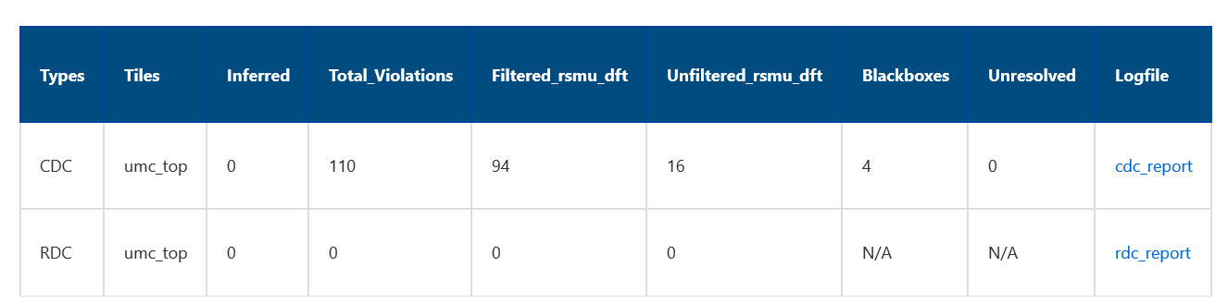
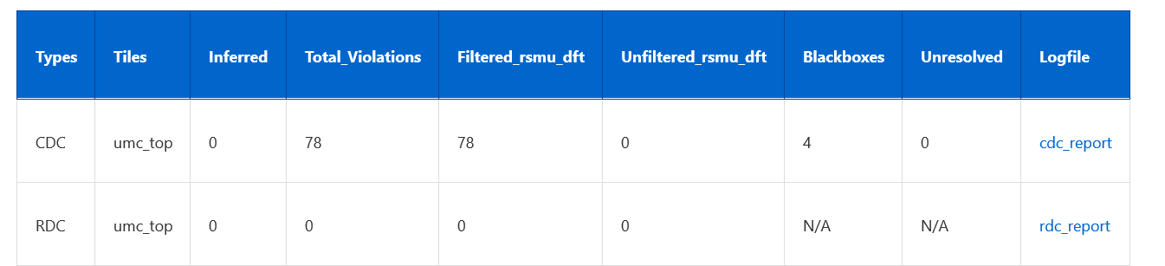
Before vs After: CDC Analyze-Fixer (Round 1 — Zero Manual Edits)
BEFORE · CDC: 110 total | 16 focus violations | NEEDS ACTION
AFTER · CDC: 78 total | 0 unresolved | CLEAN

Slide 13
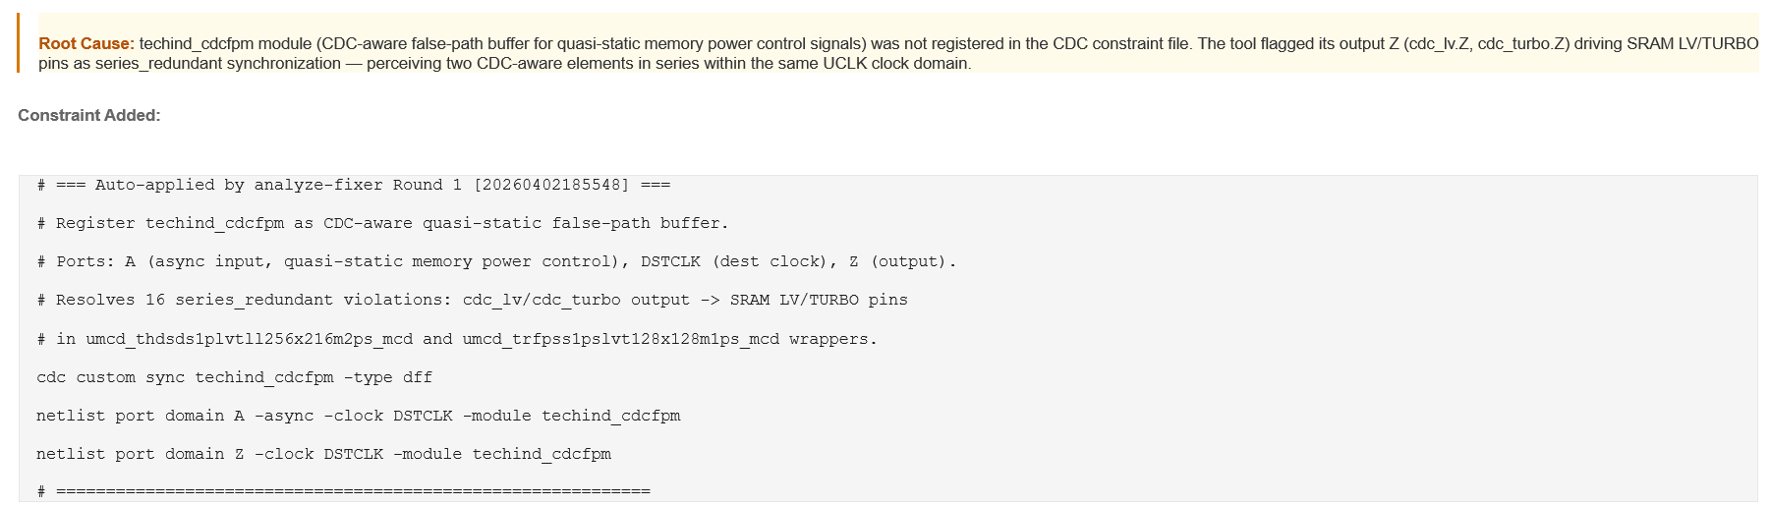
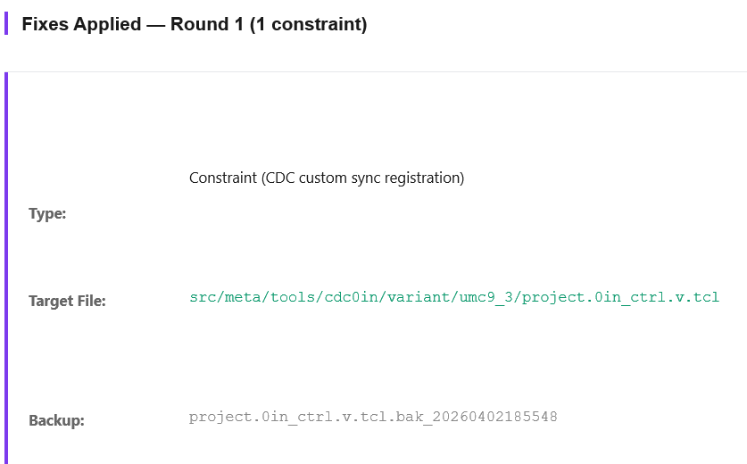
AI Root Cause Analysis & Auto-Generated CDC Constraint
Root Cause identified → constraint auto-written to TCL:
Fix Applied — Round 1 (1 constraint, original backed up):

Slide 14
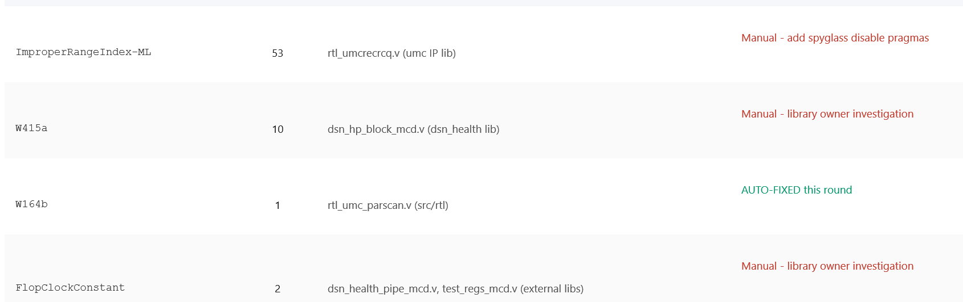
Lint Analysis — Violation Summary (1 Auto-Fixed · 3 Manual)
AI classifies each violation: AUTO-FIX (RTL edit applied inline) or MANUAL (action routed to owner)

Slide 15
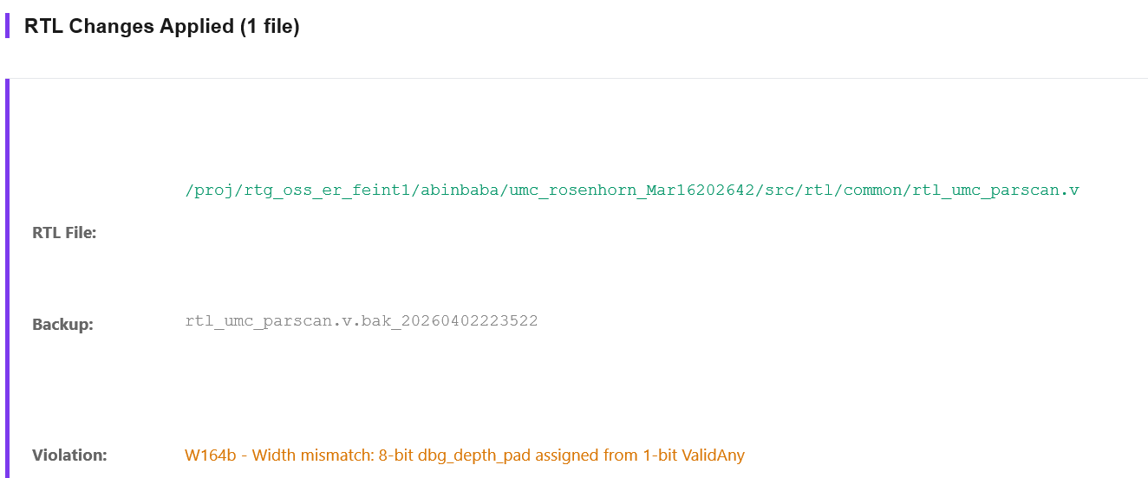
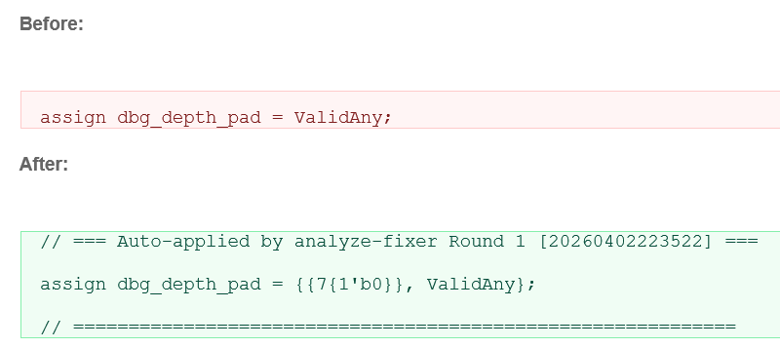
W164b Width Mismatch — RTL Auto-Fixed (Zero Manual Edits)
RTL file modified by analyze-fixer:
Before → After (auto-applied Round 1):

Slide 16
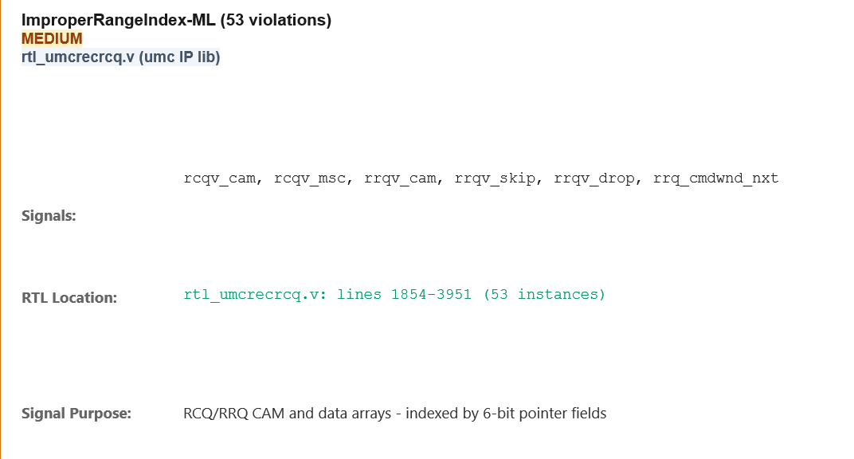
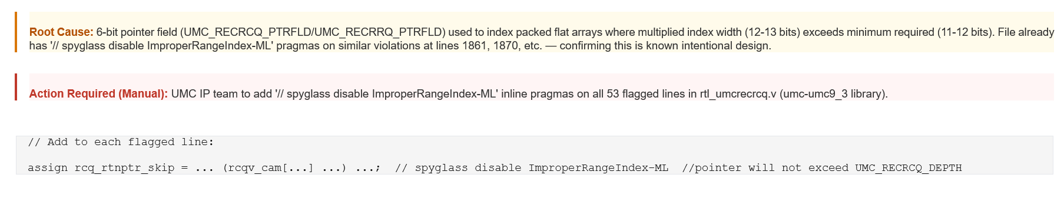
ImproperRangeIndex-ML | 53 Violations | Manual Action Required
Violation detail (rtl_umcrecrcq.v — umc IP lib, MEDIUM severity):
Root Cause & Recommended Action:

Slide 17
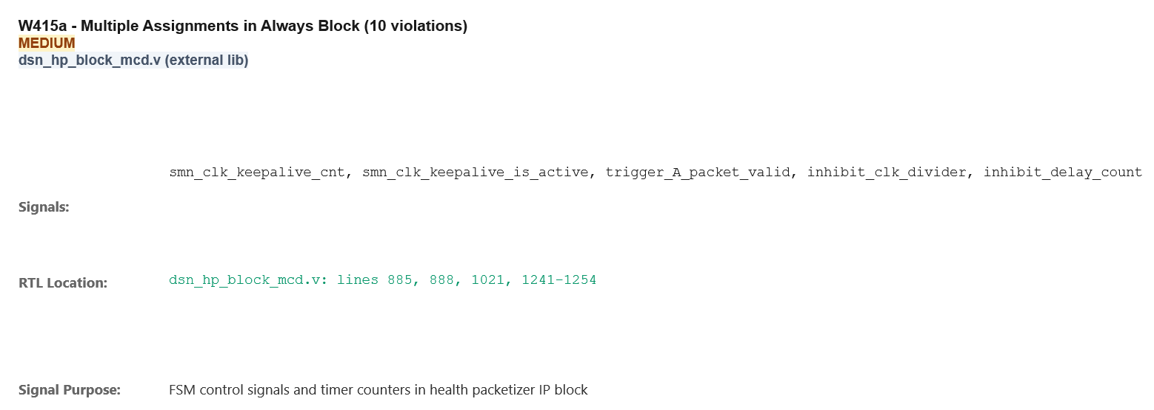
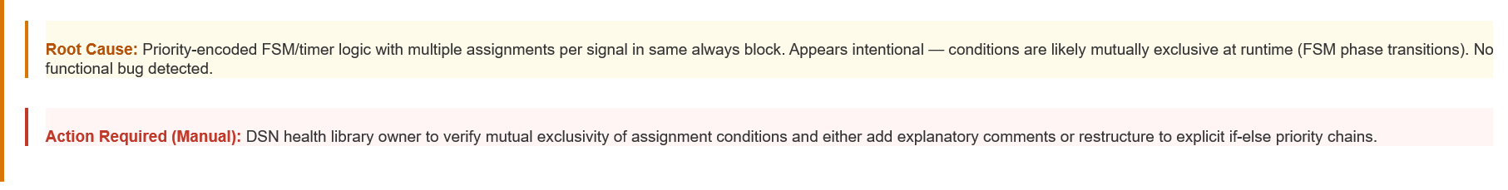
W415a | Multiple Assignments in Always Block | 10 Violations | Manual
Violation detail (dsn_hp_block_mcd.v — external lib, MEDIUM severity):
Root Cause & Recommended Action:

Slide 18
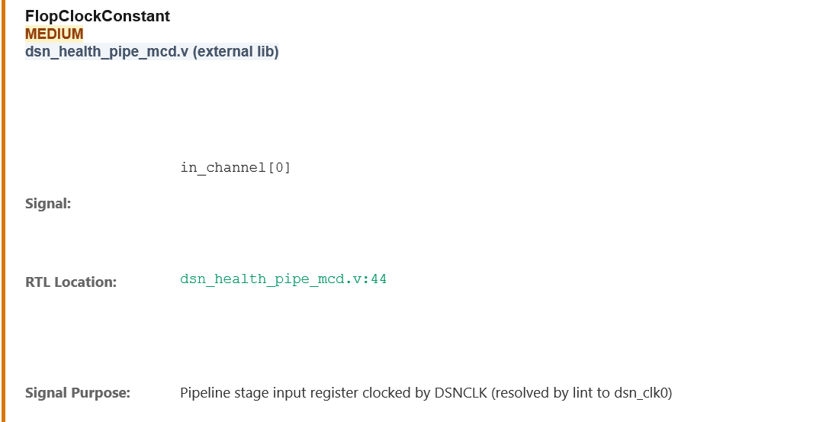
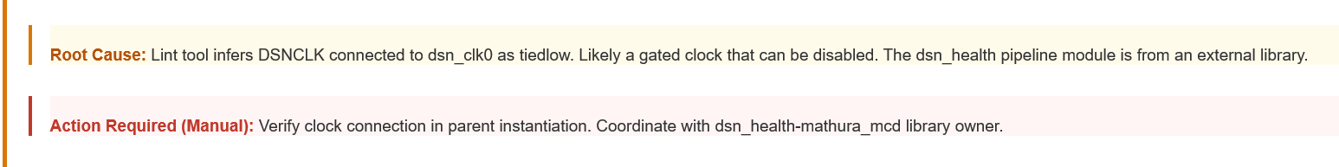
FlopClockConstant | Gated Clock Inference | 2 Violations | Manual
Violation detail (dsn_health_pipe_mcd.v — external lib, MEDIUM severity):
Root Cause & Recommended Action:

Slide 19
VIOLATION HANDLING
How the AI Decides What to Fix
Every violation is classified into one of three actions — zero waivers, zero manual guesswork.
⚡ Violation Detected
▼
🤖 AI Agent reads RTL + context → determines root cause + fix type
▼
AUTO-FIX
AUTO-FIX
INVESTIGATE
constraint
rtl_fix
investigate
Add CDC sync constraint to project.0in_ctrl.v.tcl Auto-written, backed up
Real bug — correct driver missing. Exact RTL line auto-inserted in src/rtl/
Parent context needed or fix cannot be safely determined from this file
rtl_fix
tie_off
AI specifies exactly what to look at and why — not vague 'investigate further'
Insert synchronizer in RTL Auto-applied to src/rtl/
Legacy port — assign to 0 Auto-inserted after signal declaration
Applied automatically by Fix Implementor Agent
Applied automatically by Fix Implementor Agent
Flagged in report for human action
AMD Corporate — Genie AI Agent | Violation Handling

Slide 20
CDC / RDC
Fix Types — Zero Waivers, Zero Guesswork
Every CDC/RDC violation resolved by constraint, RTL fix, or targeted investigation.
constraint
AUTO-FIX
Signal is safe to cross — already gated, static config, or single-cycle. Agent writes exact TCL constraint.
→ Appended to project.0in_ctrl.v.tcl (original backed up)
netlist cdc_sync umccmd/cfg_enable netlist clock clk_main -period 2.0
rtl_fix
AUTO-FIX
Missing synchronizer in RTL — signal crosses domains without any sync cell. Agent inserts the fix inline.
→ Applied to src/rtl/<ip>/<module>.sv
// insert after: always @(posedge clk_dst) assign sync_q = sync_ff1; assign sync_ff1 = async_in;
investigate
MANUAL
Root cause unclear from this file alone — parent hierarchy or external context needed. Agent specifies exactly what to check.
→ Flagged in HTML report — engineer must review
"Check parent module umcdat_top instantiation of umcdat_core — verify cfg_enable is gated before being passed to this module"
⚠ NO WAIVERS — every violation resolved with constraint or RTL fix. Investigate provides specific next steps.
AMD Corporate — Genie AI Agent | CDC/RDC Fix Types

Slide 21
LINT
Fix Types — Zero Waivers, Zero Guesswork
Every Lint violation resolved by RTL edit, tie-off, or targeted investigation — waivers are NOT an option.
rtl_fix
AUTO-FIX
Real designer bug — signal SHOULD be driven but connection is missing. Agent inserts exact RTL line.
→ Applied directly to src/rtl/ file
// After signal declaration in <module>.sv: assign cfg_out = cfg_reg[3:0];
tie_off
AUTO-FIX
Legacy port kept for backward compatibility — not connected by design. Agent assigns to 0 or constant.
→ Applied directly to src/rtl/ file
// After declaration of Tdr_data_out: assign Tdr_data_out = 8'b0;
investigate
MANUAL
Signal is driven by parent module — correct driver cannot be determined from this RTL file alone.
→ Flagged in HTML report — engineer must review
"Check parent module instantiation of this block for connection of port debug_obs — parent likely drives it from a mux or config register"
⚠ NO WAIVERS — waivers hide real bugs. Lint goal is zero violations via actual code changes only.
AMD Corporate — Genie AI Agent | Lint Fix Types

Slide 22
SPG DFT
Fix Types — Design-for-Test Violations
5 fix types — async signals, clock controllability, TDR ports, real bugs, and intentional filters.
SPGDFT_PIN_CONSTRAINT
AUTO-FIX
# project.params → SPGDFT_PIN_CONSTRAINT umcdat_core/cfg_rst_n:1
→ Written to src/meta/tools/spgdft/variant/<ip>/project.params
Async set/reset has no test-mode disable path. SpyGlass cannot verify it stays inactive during scan.
sgdc_constraint
MANUAL
# In <ip>.sgdc: testclock clk_div2 -divide_by 2 -master_clock clk_main
→ Engineer verifies test-clock relationship, then adds SGDC
Clock generated internally (divided/muxed) — not reachable by test clock. Needs SGDC or TestMode port.
rtl_fix
AUTO-FIX
assign dft_observe_out = scan_chain_q[7:0];
→ Applied to src/rtl/<ip>/<module>.sv
Real designer bug — functional signal should be connected but is missing. Same as Lint rtl_fix.
tie_off
AUTO-FIX
assign Tdr_status = 16'b0; assign Tdr_umcdat_ctrl = 32'b0;
→ Applied to src/rtl/ — DFT tools override during synthesis
TDR/scan/BIST placeholder port — DFT tools will connect during scan insertion. Tie off for pre-DFT sim.
filter
MANUAL
# project.params → SPGDFT_BLACKBOX or waiver entry <module_name>
→ Engineer confirms intent, then adds to SpgDFT params
Intentional — module is blackboxed, feature config- disabled, or stub for future DFT insertion.
⚠ filter is used ONLY for blackboxed or config-disabled features — not as a shortcut to hide violations.
AMD Corporate — Genie AI Agent | SpgDFT Fix Types

Slide 23
SUMMARY
Genie Agent Analyze Mode
CHECK TYPES
CDC / RDC
4 Entry Points
Run+Analyze · Analyze-Only · Fixer · Fixer-Only
Clock/Reset Domain Crossing Constraint & synchronizer RTL fixes
4-Wave Pipeline
Extract → Skip → Analyze → Consolidate → Compile
Parallel Agents
Up to N agents running simultaneously per check
Lint
RTL code quality violations RTL fix or tie-off per file
File-Based
JSON on disk — resumable, auditable, no context loss
Auto-Fix Loop
Up to 5 rounds — CLEAN / STALLED / MAX ROUNDS
SpgDFT
ZERO Waivers
All violations fixed in RTL or constraints only
Design-for-Test violations Constraint or pin control fixes
Reliability
CRITICAL_RULES.md + output validation + retry logic
AMD Corporate — Genie AI Agent | Analyze Mode v1.4 | 2026
12 / 12

