Slide 1
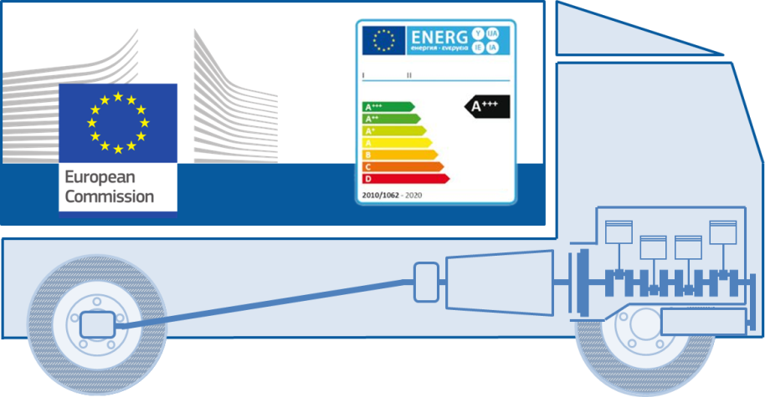
VECTO Engine Short documentation and user manual
App Version 1.4
10.08.2017

Slide 2
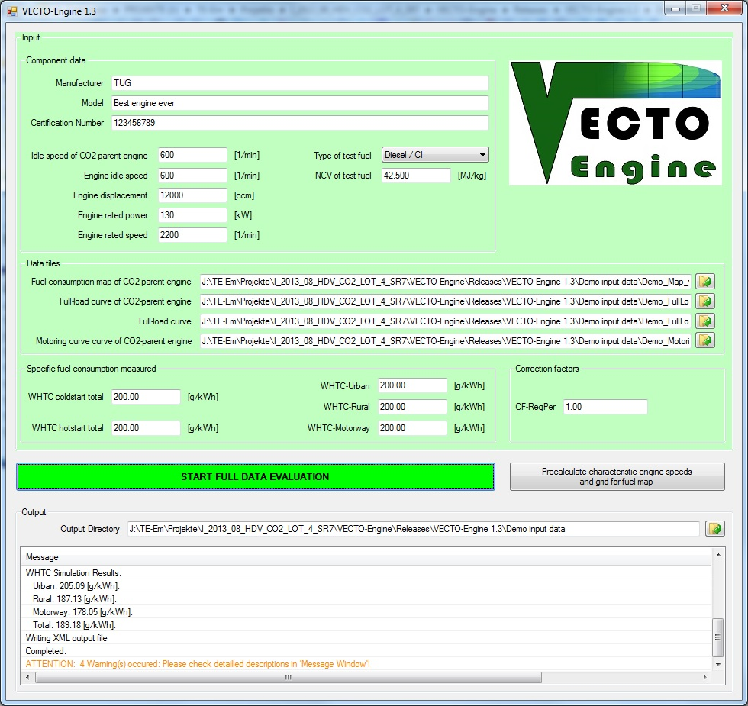
VECTO Engine – GUI
Step 1
Input all component data
Step 2
Load all required input files via separate open file buttons (for file format please see demo files)
Step 3
Input measured specific FC values and correction factor
Step 4
Define directory where output files are stored
Step 5
Press „Start“ button for full evaluation
(OR press other button to precalculate grid for fuel map from CO2-parent full-load curve)
„Message“ window will display
errors (red), warnings (orange),
informations and results

Slide 3
VECTO Engine – Input files
VECTO Engine needs 4 separate input files (determined according to the current version of the technical annex):
Fuel consumption map of CO2-parent engine
Full-load curve of CO2-parent engine
Full-load curve of engine to be certified
Motoring curve of CO2-parent engine
Input file formats
For file formats please refer to the technical annex or supplied demo files!
Demo data supplied
Two different full-load curves for two power ratings of one engine CO2-family supplied
Child: full-load of lower power rating
Parent: full-load of highest power rating

Slide 4
VECTO Engine – Output files
VECTO Engine produces one XML output file:
File name is created based on GUI input data accodring to the following scheme: “OutPath” + “Manufacturer” + "_" + Model + "_" + “Certification Number” + ".xml"

Slide 5
VECTO Engine – Operations performed (p1/4)
1. Reading of input files and automatic check of input data
1.1 Check of requirements for input data according to the definitions in paragraph 6.1 of the technical annex
1.2 Check of requirements for recorded FCMC data according to the definitions in paragraph 4.3.5.2 and subpoint (1) of paragraph 4.3.5.5 of the technical annex
2. Calculation of characteristic engine speeds from full load curves of parent engine and actual engine for certification according to the definitions in paragraph 4.3.5.2.1 of the technical annex
3. Processing of fuel consumption (FC) map
3.1 FC values at n_{idle} are copied to engine speed (n_{idle} – 100 min⁻¹) in the map
3.2 FC values at n_{95h} are copied to engine speed (n_{95h} + 500 min⁻¹) in the map
3.3 Extrapolation of FC values at all engine speed setpoints to a torque value of (1.1 times T_{max_overall}) by using least squares linear regression based on the 3 measured FC points with the highest torque values at each engine speed setpoint in the map
3.4 Adding of FC = 0 for interpolated motoring torque values at all engine speed setpoints in the map
3.5 Adding of FC = 0 for minimum of interpolated motoring torque values from subpoint (3.4) minus 100 Nm at all engine speed setpoints in the map

Slide 6
VECTO Engine – Operations performed (p2/4)
4. Simulation of FC and cycle work over WHTC and respective subparts for actual engine for certification
4.1. WHTC reference points are denormalized using the full load curve input in originally recorded resolution
4.2. FC is calculated for WHTC denormalized reference values for engine speed and torque from subpoint 4.1
4.3. FC is calculated with engine inertia set to 0
4.4. FC is calculated with standard PT1-function (as in main vehicle simulation) for engine torque response active
4.5. FC for all motoring points is set to 0
4.6. FC for all non-motoring engine operation points is calculated from FC map by Delaunay interpolation method (as in main vehicle simulation)
4.7. Cycle work and FC are calculated according to equations defined in paragraphs 5.1 and 5.2 of the technical annex
4.8. Simulated specific FC values are calculated analogous to equations defined in paragraphs 5.3.1 and 5.3.2 of the technical annex for measured values

Slide 7
VECTO Engine – Operations performed (p3/4)
5. Calculation of WHTC correction factors
5.1. Measured values from input to pre-processing tool and simulated values from point (4) are used in accordance with the equations in points (5.2) to (5.4)
5.2. CF_{Urban} = SFC_{meas,Urban} / SFC_{simu,Urban}
5.3. CF_{Rural} = SFC_{meas,Rural} / SFC_{simu,Rural}
5.4. CF_{MW} = SFC_{meas,MW} / SFC_{simu,MW}
5.5. In case that the calculated value for a correction factor is lower than 1, the respective correction factor is set to 1
6. Calculation of cold-hot emission balancing factor
6.1. This factor is calculated in accordance with the equation in point (6.2)
6.2. BF_{cold-hot} = 1 + 0.1 x (SFC_{meas,cold} – SFC_{meas,hot}) / SFC_{meas,hot}
6.3. In case that the calculated value for this factor is lower than 1, the factor is set to 1

Slide 8
VECTO Engine – Operations performed (p4/4)
7. Correction of FC values in FC map to standard NCV
7.1. This correction is performed in accordance with the equation in point (7.2)
7.2. FC_{corrected} = FC_{measured,map} x NCV_{meas} / NVC_{std}
7.3. FC_{measured,map} shall be the FC value in the FC map input data processed in accordance with point (3)
7.4. NCV_{meas} and NVC_{std} shall be defined in accordance with paragraph 5.3.3.1 of the technical annex
7.5. In the case that reference fuel of the type B7 (Diesel / CI) in accordance with paragraph 3.2 of the technical annex was used during testing, the correction in accordance with points (7.1) to (7.4) is not performed.
8. Converting of engine full load and motoring torque values of the actual engine for certification to a logging frequency of the engine speed of 8 min⁻¹ if the average engine speed stepwidth is smaller than 6 min⁻¹
9.1. The conversion is performed by arithmetical averaging over intervals of ±4 min⁻¹ of the given setpoint for the output data based on the full load curve input in originally recorded resolution

Slide 9
Contact data
Please be aware that from now on all questions, user support and bug reports need to be handled via the CITnet service of the EU-COM.
Also future updates of the tool will be released only via this platform (https://webgate.ec.europa.eu/CITnet/confluence/display/VECTO/vecto-engine+releases).
If you do not already have an account for this service please contact jrc-vecto@ec.europa.eu.

