Slide 1





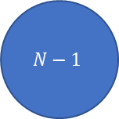


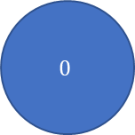


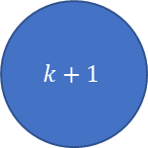

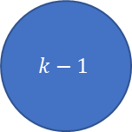



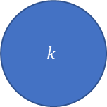



$$β$$
$$(k−2)β$$
$$(k−1)β$$
$$kβ$$
($N−2)β$
($N−1)β$
$$0$$
$$1$$
…
$$k−1$$
$$k$$
$$k+1$$
…
$$N−1$$
$$N$$
$$γ$$
$$2γ$$
$$(k−1)γ$$
$$kγ$$
($k+1)γ$
($k+2)γ$
($N−1)γ$
N$γ$

Slide 2
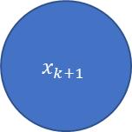

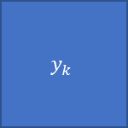
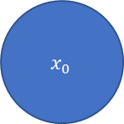
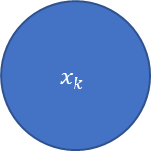
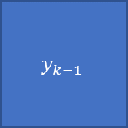
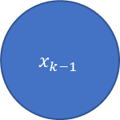
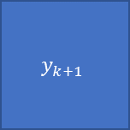
Time evolution
$$x_{0}$$
…
$$x_{k−1}$$
$$x_{k}$$
$$x_{k+1}$$
State evolution
$$y_{0}$$
$$y_{k−1}$$
$$y_{k}$$
$$y_{k+1}$$
Observations

