Slide 1
What is metadata and why is it important?
CLOSER, University College London
2023
Notes:
Most of you will know, or have an idea about, what metadata is after completing the Understanding Metadata module on the Learning Hub.
This presentation is going to build on the Learning Hub, by explaining what metadata is and why it’s important in more detail.

Slide 2
Outline
Objectives
Metadata in everyday life
“Sam1”
What is metadata?
Why is metadata important?
The benefits of metadata
Use cases
Summary
Notes:
This presentation will cover…

Slide 3
Intended learning outcomes
By the end of this session, you should be able to:
Define metadata and structured metadata
Explain why metadata is important
Describe the benefits of creating and using metadata

Slide 4


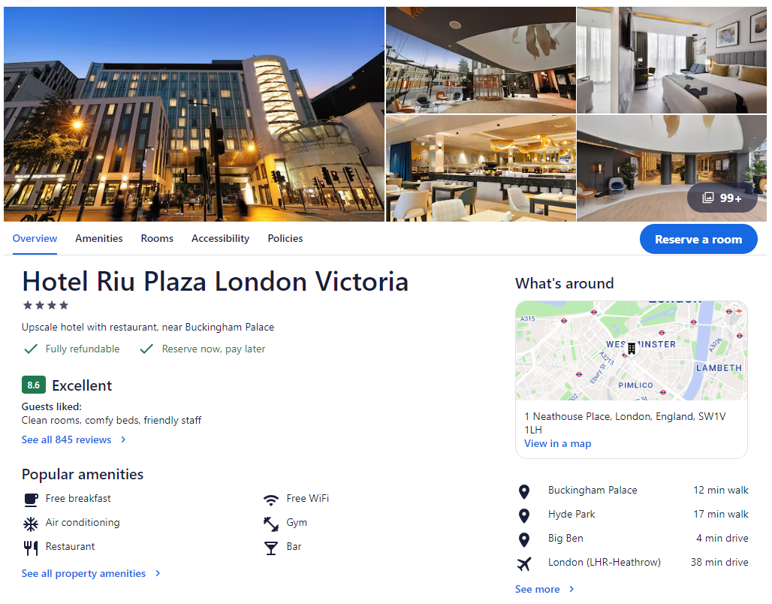
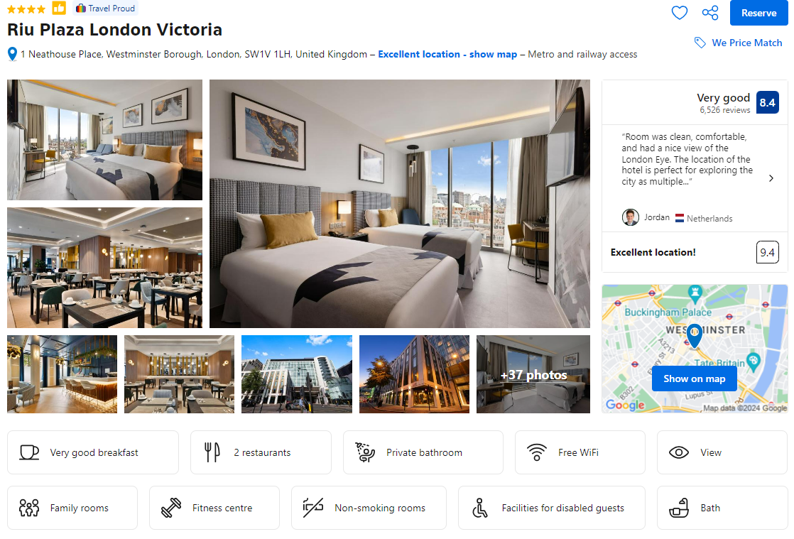
Metadata in everyday life
Metadata is not exclusive to the research/data context
Notes:
Before we get into the details, let’s zoom out and think about examples of metadata that we come across in our everyday lives, because it’s not only useful in the research/data context.
Everything you see on the slide are examples of metadata (travel comparison sites, description of a show on Netflix, a library), so we use it all the time without realising.

Slide 5
A dataset
Person | Sam1 | Sam2 | Sam3 | Sam4 | Sam5
1 | 6 | 170 | 165 |  | 140
2 | 7 | 200 |  | 250 | 180
3 | 18 | 250 | 270 |  | 370
4 | 5 | 125 |  | 190 | 100
5 | 6 | 115 | 140 |  | 275
6 | 5 | 180 | 170 | 190 | 300
Notes:
So now we’ve had a look at examples of metadata in everyday life, let’s have a look at metadata in the context of research data.
On the slide is an example of a dataset with some columns and headings.
The first thing you might be asking yourself is, what does “Sam1” mean?
Dr Judy Benign from NYU also wanted to know the answer to this question, so let’s watch a video to find out how she got on.

Slide 6
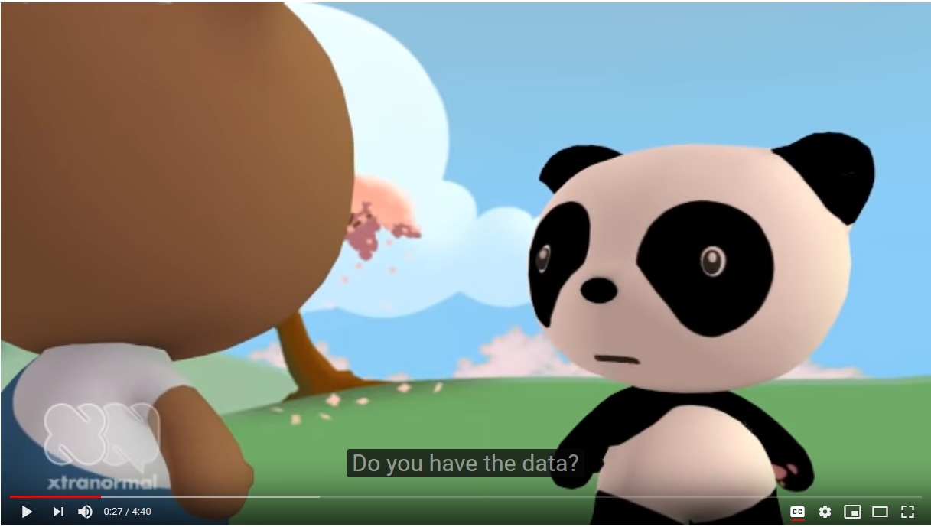

Common issues in (meta)data management
Notes:
This scenario might be familiar to you in some way or another - maybe not to this extent - but it highlights some of the key issues in data and metadata management.

Slide 7
Sam1 video reflection
What are some of the key (meta)data management issues that the Sam1 video demonstrates?

Slide 8
Key (meta)data management issues from Sam1 video
Storage
Variable labels
Submitting to an archive
Sharing with your future self

Slide 9
Metadata is…
Opinions vary, but everyone agrees that metadata has some relationship to data
Data measures, metadata describes
Data about data (or things, or objects)
Structured information that describes, explains, locates, or otherwise makes it easier to retrieve, use, or manage an information resource
Information that enables us to make sense of data (e.g., documents, images, datasets), concepts (e.g., controlled vocabularies, classification schemes), real-world entities (e.g., people, organisations, places), and processes (e.g., data collections, archiving, computation)
Notes:
So we can see from the video that metadata is crucial for helping us to understand and use data, but let’s have a look at a formal definition.
As we saw in the What is data presentation, there is some disagreement about what exactly metadata is, but one thing everyone agrees on is that metadata has a relationship to data.
Most commonly, it is described as data about data.
http://www.niso.org/publications/press/UnderstandingMetadata.pdf

Slide 10
Metadata is data? Discuss!
Can you think of any examples of when metadata could be used as data/data could be used as metadata?
Metadata can be used as data
E.g., the funder of a study is metadata, but that can be used as data if it is used as a data point (studies funded by different research councils)
Most (if not all) data can be used as metadata
E.g., frequencies, mean, min and max
Notes:
Sometimes, data can be metadata and data, it depends on its usage – you can have the same data but a different perspective – discuss in breakout groups (then show examples on slide).

Slide 11
Structured metadata…
Tells a computer what something is, how it relates to other things (“objects”), and what to do with it
Standardises the content and structure to make it easier for computers to extract information from the metadata
This information can be provided to researchers to help them discover and access data
Primary purpose: for computers to deliver the content to audiences (e.g., on a website)
Notes:
So that’s metadata, but how can we define structured metadata?
Structured metadata categorises things (or objects) so that computers can understand the meaning of the text - it tells the computer what something is, how it relates to other objects, and what to do with it.
It is machine-readable, unlike textual metadata like a PDF or journal article.

Slide 12
Advanced metadata needs structure
Textual “documentation” vs. structured metadata
Same content, but structured metadata is based on a schema
A schema is a formal technique for organizing metadata
Elements
Attributes
Machine-actionable metadata must be structured
Structured metadata is needed to support reuse
Notes:
Advanced metadata needs structure.
Structured metadata contains the same content as textual metadata, but it is based on a schema.
Schema describes all the pieces of metadata in a structured way.

Slide 13
Structured metadata example
https://mah0001.github.io/schema-guide/chapter03.html#what-structure

Slide 14
Roles of (structured) metadata
Metadata supports three main uses:
Discovery - it helps people to find relevant resources.
Understandability and context - it helps to convey the meaning of resources.
Use and action - it describes the limits of reasonable use or what actions can be taken.

Slide 15
Why is metadata important?
Metadata is the core component of Research Data Management
It may be required by...
Institutes (in your working contract or project agreements)
Funding agencies (to ensure reusability and meet FAIR requirements)
Journals (as a condition for publishing)
Supervisors (data citation as a way of enhancing researcher reputation)
Projects (needed for cooperation across agencies/organisations)
For your future self
Understand your data in the future
Share your data in a meaningful way
Notes:
So far, we’ve described what metadata - in particular, structured metadata - is. But why is it important?
There are several external reasons why we might be required to document metadata…
But also, as we’ve previously touched upon, metadata is helpful for your future self, to help you understand your own data later down the line, and be able to share your data in a meaningful way with others.

Slide 16
Exercise: what information is needed to understand and use this data?
 | n622 | n545 | n1171 | N2REGION | N1112 | N1261
1 | 2 | 4 | 6 | -2 | 1 | 1
2 | 1 | 4 | -1 | 1 | 1 | 1
3 | 1 | 4 | 2 | 1 | 1 | 1
4 | 1 | 4 | 4 | 10 | 1 | 1
5 | 1 | 4 | 4 | 4 | 1 | 1
6 | 2 | 4 | 2 | 1 | 2 | 1
7 | 2 | 4 | 6 | 2 | 1 | -1
8 | 2 | 5 | 2 | 4 | 1 | 1
9 | 1 | 5 | 4 | 1 | 1 | 1
10 | 1 | 5 | 4 | 1 | 1 | 1
11 | 2 | 5 | 3 | 2 | -1 | -1
12 | 2 | 4 | -1 | 1 | -1 | -1
13 | 1 | 4 | 3 | 1 | 1 | 1
14 | 2 | 4 | 2 | 4 | 1 | 1
15 | 2 | 4 | -1 | 7 | 1 | 1
16 | 2 | 4 | 1 | 7 | 1 | 1
17 | 2 | 4 | 3 | 2 | -1 | 1
18 | 2 | 4 | 6 | 2 | 1 | 1
19 | 2 | 4 | 6 | 10 | 1 | 1
Notes:
We’ve discussed some of the benefits of metadata, but let’s have a look at more of a contextualised example.
On the slide is a screenshot of a dataset. With the people on your table, please take a couple of minutes to discuss what information you would need in order to be able to understand and use this data.
Study: National Child Development Study
Sweep: Age 7 Survey (1965)
Data File: NCDS1 Parental Questionnaire (1965) Dataset

Slide 17
Exercise: examples of information we would need
What is the study about?
When was the data collected?
 | n622 | n545 | n1171 | N2REGION | N1112 | N1261
1 | 2 | 4 | 6 | -2 | 1 | 1
2 | 1 | 4 | -1 | 1 | 1 | 1
3 | 1 | 4 | 2 | 1 | 1 | 1
4 | 1 | 4 | 4 | 10 | 1 | 1
5 | 1 | 4 | 4 | 4 | 1 | 1
6 | 2 | 4 | 2 | 1 | 2 | 1
7 | 2 | 4 | 6 | 2 | 1 | -1
8 | 2 | 5 | 2 | 4 | 1 | 1
9 | 1 | 5 | 4 | 1 | 1 | 1
10 | 1 | 5 | 4 | 1 | 1 | 1
11 | 2 | 5 | 3 | 2 | -1 | -1
12 | 2 | 4 | -1 | 1 | -1 | -1
13 | 1 | 4 | 3 | 1 | 1 | 1
14 | 2 | 4 | 2 | 4 | 1 | 1
15 | 2 | 4 | -1 | 7 | 1 | 1
16 | 2 | 4 | 1 | 7 | 1 | 1
17 | 2 | 4 | 3 | 2 | -1 | 1
18 | 2 | 4 | 6 | 2 | 1 | 1
19 | 2 | 4 | 6 | 10 | 1 | 1
What were the response options?
What was the intent/concept of the question?
What are the categories?
How was the data collected?
What was the data capture? (the question)
What are the variables?
Who is the data about?
What type are the data?
What was the previous question?
What are the missing values?
Who created it?
Where was the data collected?
Notes:
Here are just some of the questions we would need to answer in order to be able to understand and use the data.
We’d need some high-level information such as the who/what/when/where/how of the data collection, and more fine-grained information such as the response options and the number of missing values.
In addition to this, we’d also like to have metadata which provides additional context. For example, if the data was collected via surveys, it might be helpful to know what question was asked, or what the previous or subsequent questions were.
This kind of information provides useful context for interpreting the data. For example, if the respondents were asked about life satisfaction, there might have been a question that follows asking specifically about work satisfaction, which means the respondent doesn’t confuse general life satisfaction with work satisfaction.
This is helpful as it gives you a better idea of how the respondents might have answered the questions, therefore improving your understanding and quality of the research.
This example shows us how metadata is necessary to understand someone else’s data, but it’s also good to consider how this information might be useful for your future self when working on your own data, so you don’t end up in a Sam1 situation!
Capturing this information (or metadata) in a structured, standardised way means that the data is available for re-use, and it also makes it machine-actionable to make data management easier and more efficient, and the data more discoverable.

Slide 18
Benefits of metadata
Discovery and reuse
More consistent production and dissemination of data
More comparable, more understandable, and more FAIR
Assess and ensure data quality
Proof of transparent and valid conduct
More accurate and high-quality research
Organisational efficiency
Reuse of metadata assets
Better design, implementation, and execution of processes
Increased automation
Improved communication within a project
Notes:
Metadata is hugely important to be able to effectively use data, because it contains crucial information which is necessary to exploit the full potential of datasets for research.
On the slide, there are just a few of the benefits of using structured metadata.

Slide 19
Benefits of metadata for you

Slide 20
Uses of metadata
Notes:
S:\IOECLOSER_Share\USP\Presentations\Training\training workshop\Malawi_final\Day 1\2. Metadata\2.1 Understanding_Metadata.pptx (slides 14-16).

Slide 21
Summary
Metadata is information that describes data (but metadata can also be data!)
Structured metadata is based on a schema
It standardises the content and structure to make it easier for computers to extract information from the metadata
Metadata is important for several external factors, and for your future self
Metadata allows us to use data effectively, because it contains the important information needed to exploit the full potential of data

