Slide 1


Introducing Question and Instrument Structures
DDI Alliance Training Library
Version 1.0
DDI Alliance, DDI Training Working Group
This work is licensed under Creative Commons Attribution 4.0 International License.

Slide 2
Contents
DDI-Lifecycle and the Instrument
DDI Question Item
Response Domain Types
Question Types
Reuse of a Question
The Question in the Instrument
DDI Control Constructs/Question Flow

Slide 3
DDI-Lifecycle and the Instrument
DDI-L allows you to develop and maintain instrument components separately (i.e., individual questions and response options)
This allows for reuse of components within or between instrument
Control construct components allows you to add instrument related details and define the instrument flow

Slide 4
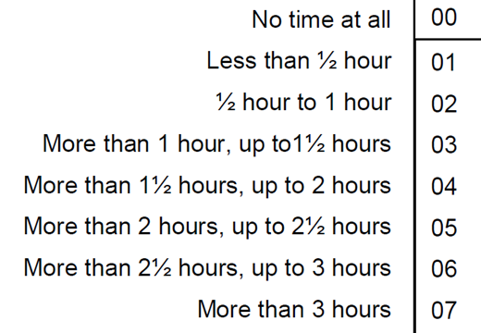

DDI Question Item – the Reusable Parts of the Question
Question Item
Response Domain
Question Text
On an average weekday, how much time, in total, do you spend watching television?
Code List – valid codes
Missing Values Representations
Notes:
A question item is reusable as a whole and is also made up of reusable parts, the question text and the response domain.

Slide 5
Response Domain Types
Code list:
Has codes with a set of related categories
Managed representations:
Scale - For scales. Can have multiple label anchor-points
Numeric - Specifies the numeric format and range
Text - Specifies format and text range
DateTime - Specifies date time according to ISO specifications
Notes:
There are different types of response domains, not only code lists.
Both the CodeList and the Managed representations are reusable formats. This allows you to use the same codelist or scale for example in many different questions.

Slide 6
Question Types
QuestionItem:
Contains the reusable part of an individual question like the question text and the response domain.
QuestionGrid:
Cube-like structure for entering questions from forms or question batteries.
QuestionBlock:
Used in testing where an object (Stimulus Material) is provided, and a set of questions are asked regarding the object.
Notes:
There are different types of questions, not only question items.

Slide 7
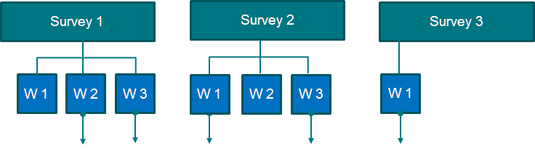
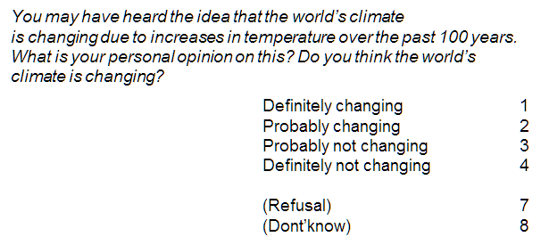
Reuse of a Question
in a different waves/rounds/sweeps of a survey and across surveys
Surveys
Waves (W)
Notes:
Some surveys put lots of effort into question developments like discussions with experts, cognitive interviewing, validation tests, piloting in various countries etc.
Similar questions can advantageously be reused within rounds, waves or sweeps of the same survey, or between surveys.
How can questions be structured in DDI to make them as reusable as possible?

Slide 8
Reuse of a Scale Representation
A managed scale representation can for example be reused by reference by many different question items within one survey.
Q1, V3
Q2, V1
Q3, V4
People in general should care more about the environment
Climate change is caused by human activity alone
There is nothing I can do to prevent global temperature rise
R1, v1
Strongly agree Strongly disagree
0 1 2 3 4 5 6 7 8 9 10

Slide 9
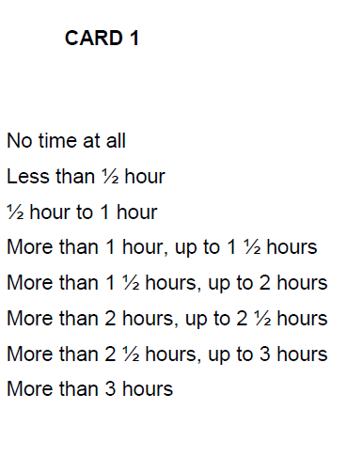
DDI Question Construct – the Question in the Instrument
Question Item
Instructions
CARD 1
Please use this card to answer
Universe
ALL RESPONDENTS
On an average weekday, how much time, in total, do you spend watching television?
External aid

Slide 10
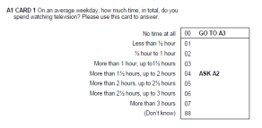
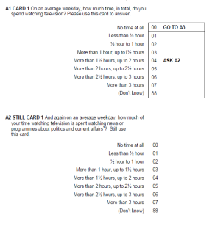
DDI Control Construct – Components for Describing Instrument Flow
Question Construct
Sequence
Statement Item
Here are some questions about media use
Flow logic: If then else/loop etc.
If A1 = 1 – 7; 88
Tutorial: ' What can DDI do for you? An Introduction to the DDI' EDDI 2019

Slide 11
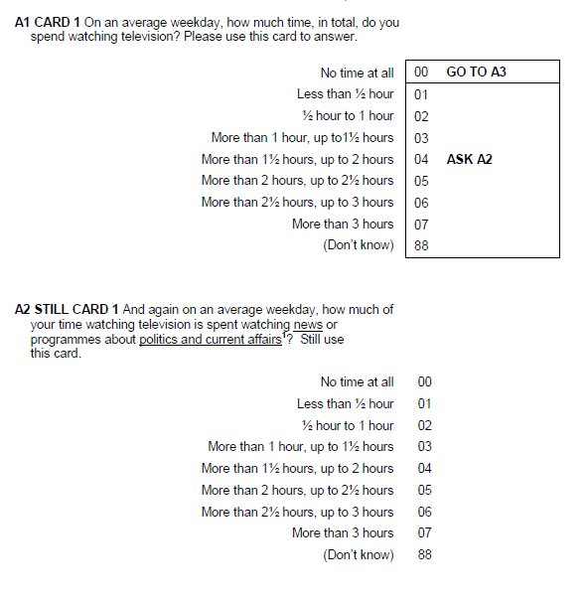
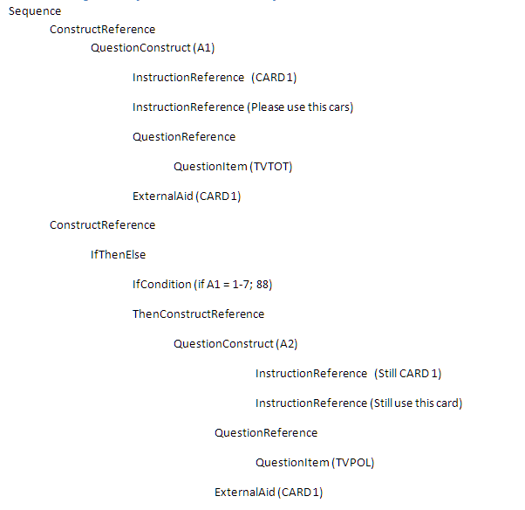
Instrument Control – Question Sequence and Flow

Slide 12
Control Construct Types
Statement Item:
A statement in the instrument
Question Construct:
The question as in the instrument
If Then Else:
Specifies the control logic of the instrument
Loop:
Describes an action which loops until a limiting condition is met.
Repeat Until/Repeat While:
Repeats until/while a specific condition is met

Slide 13
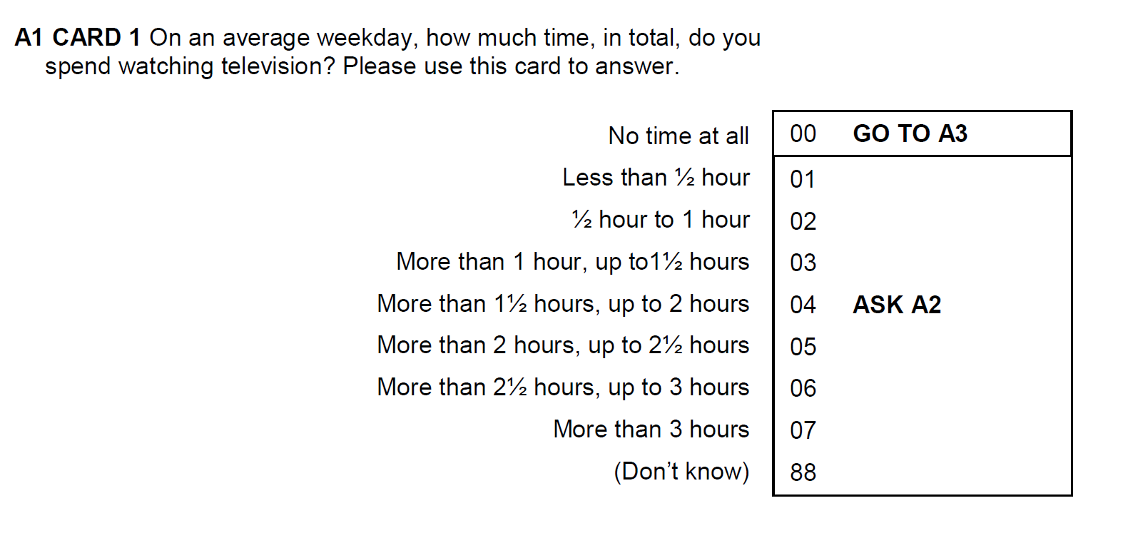
A Question in an Instrument – and in DDI-L
Number/name in instrument
Instructions
instrument flow
Question text
Response domain
Code list
Missing values list
Categories
Code values
Notes:
A question as in the instrument is composed of a set of components that usefully can be maintained separately.
The basics of a question is the QuestionItem in DDI that contains the more reusable parts of a question like the QuestionText and the ResponseDomain.
Instructions and instrument flow logic are less reusable components belonging on the level of the instrument.
Response options, here a code list, can usefully be split into valid and missing values code lists, which allows them to be maintained and reused separately.
A CodeList consists of codes with a value and a category reference. Categories can be reused in many different response domains, as well as for variables.
A CodeList is one of several types of response domains in DDI. Others are ScaleDomain, NumericDomain, TextDomain, DateTime etc.

Slide 14
Attributions
Tutorial: ' What can DDI do for you? An Introduction to the DDI' EDDI 2019

Slide 15
Credits: DDI Training Working Group
Florio Orocio Arguillas
Alina Danciu
Adrian Dusa
Jane Fry
Martine Gagnon
Dan Gillman
Arofan Gregory
Taras Günther
Lea Sztuk Haahr
Chifundo Kanjala
Kaia Kulla
Kathryn Lavender
Amber Leahey
Marta Limmert
Jared Lyle
Alexandre Mairot
Lucie Marie
Hayley Mills
Laura Molloy
Hilde Orten
Anja Perry
Knut Wenzig

