Slide 1



How to use this kit
Duplicate the slide you need
Edit only the marked parts
Read the notes for what to change
Mission, Ground Rules, and Thank You are ready to use as is.
Leadership-Link | Eileen Habelow, PhD
Notes:
This is the Leadership-Link deck kit, reusable across Leadership-Link and Leadership-Link On-Demand (LLOD) decks. To build a deck: copy the slide whose layout fits your beat into your working deck, then change only the parts marked with guillemets, the angle marks that look like this. Slides that hold standard content are ready to use unchanged. Delete this instruction slide from any deck you deliver.

Slide 2

«Program name»
«Subtitle»
Leadership-Link | Eileen Habelow, PhD
Notes:
COVER (customize). Replace the program name and subtitle. Leave the logo, lime rule, and footer. Dark title slide that opens the deck.

Slide 3
OUR MISSION
We help teams of experts become expert teams.
Leadership-Link | Eileen Habelow, PhD
Notes:
MISSION (ready to use). Standard Leadership-Link mission, stated large. Confirm the exact current wording before an external delivery; otherwise use unchanged.

Slide 4



Ground Rules
Be present phones down, fully here
Participate the room is the content
Confidentiality what's shared here stays here
Respect the room one voice at a time, assume good intent
Leadership-Link | Eileen Habelow, PhD
Notes:
GROUND RULES (ready to use). Standard workshop ground rules. Adjust per engagement only if a client needs different ones.

Slide 5
THE BIG IDEA
«State the one Big Idea for this workshop»
Leadership-Link | Eileen Habelow, PhD
Notes:
BIG IDEA (customize). One idea, one bold line, its own slide. Use the program's approved Big Idea; do not invent a framework claim.

Slide 6
Overview
«Item 1»
1
«Item 2»
2
«Item 3»
3
«Item 4»
4
Leadership-Link | Eileen Habelow, PhD
Notes:
OVERVIEW / AGENDA (customize). Retitle if you like and list the program's sections, modules, or moves. Add or remove numbered rows to match the real count.

Slide 7
«01»
«Section title»
Leadership-Link | Eileen Habelow, PhD
Notes:
SECTION DIVIDER (customize). Change the big number and the section title. Duplicate this slide once per section or module.

Slide 8
«LABEL»
«Headline»
«Key point»
«Anchor»
«Support line»
Leadership-Link | Eileen Habelow, PhD
Notes:
CONTENT (customize). The workhorse slide: one idea, a few words, one visual. Replace the marked parts and keep the slide lean; put the full narration in these notes.

Slide 9

«Practice title»
«What to do» «Instructions: one or two lines»
«Visual»
Leadership-Link | Eileen Habelow, PhD
Notes:
PRACTICE / EXERCISE (customize). Use for a partner or table exercise. Put the timing and the debrief prompts in these notes.

Slide 10
My Commitment
Leave with a real plan. Pick one real «situation» coming up soon. Apply what you learned, and commit to the specific behavior you'll use.
The situation: ________________ What I'll do differently: ________________
Leadership-Link | Eileen Habelow, PhD
Notes:
ACTION COMMITMENT (mostly ready). Adjust the one marked word to fit the program (conversation, handoff, decision, and so on). Otherwise ready to use.

Slide 11
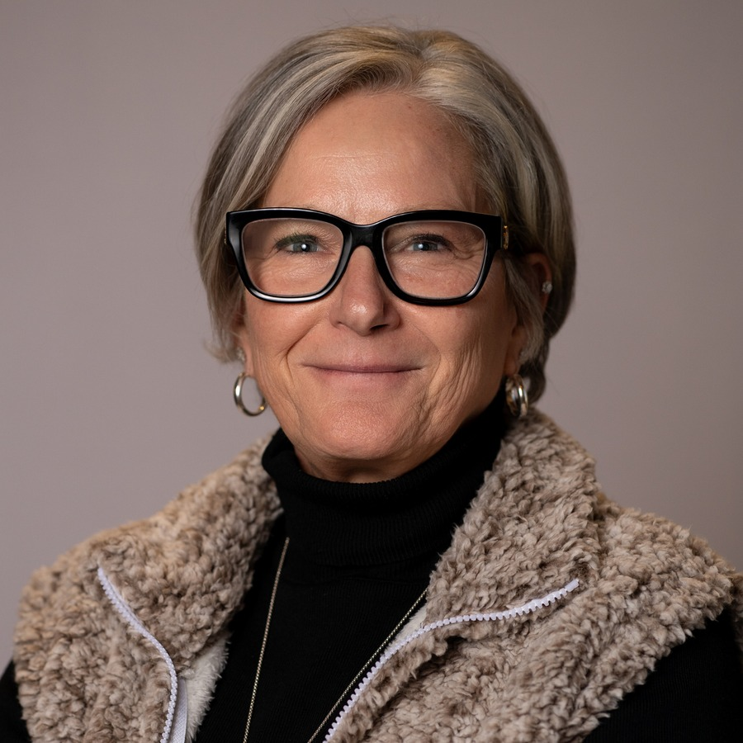

Thank you.
Eileen Habelow, PhD Leadership-Link eileen@leadershiplink.com leadershiplink.com
Connect on LinkedIn
Leadership-Link | Eileen Habelow, PhD
Notes:
THANK YOU / CONTACT (ready to use). Eileen's contact block and LinkedIn QR. Use unchanged. For an LLOD (Leadership-Link On-Demand) piece, keep the same contact treatment.

